Slide 1

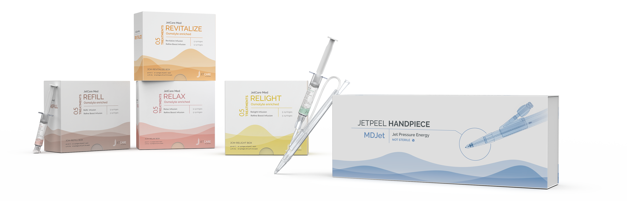
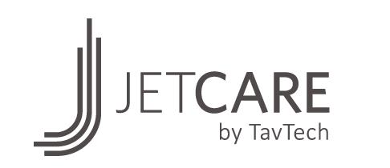
JetCare Med by TavTech
Osmolyte-enriched for Invigorating Collagen and Elastin
Re-ignite your clinic results

Slide 2

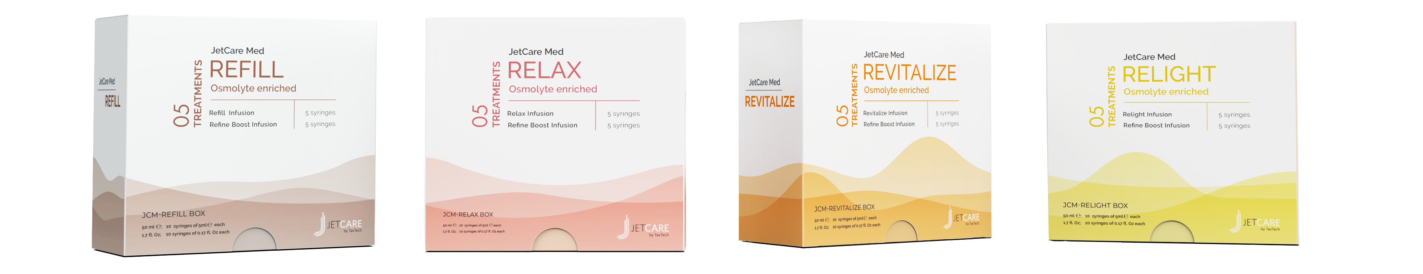
Introducing JetCare Med
by TavTech
JetCare Med is an advanced line of JetPeel treatment infusions, specially developed by TavTech for use in physician clinics
The clinically-proven line includes 4 infusions and 1 booster infusion to target key skin concerns
Based on an advanced blend of osmolytes, working in synergy to invigorate collagen and elastin
Each infusion product is enriched with additional unique ingredients, specifically formulated to deliver the desired outstanding results

Slide 3

Clinically Proven for Outstanding Results
A clinical study of JetCare Med and JetPeel treatment was conducted at
JS Hamilton labs in Poland
The subject pool included women and men, all skin types (dry, oily, normal, combination), and both sensitive and non-sensitive skin
Skin testing was carried out on day 0 (before 1st treatment), day 8 (after the 3rd treatment), day 28 (4 weeks after 1st treatment), and day 56 (8 weeks after 1st treatment)
    26%
    12%
On day 56, results showed:
    16%
improvement
in skin density
improvement
in skin firmness
improvement
in skin elasticity

Slide 4
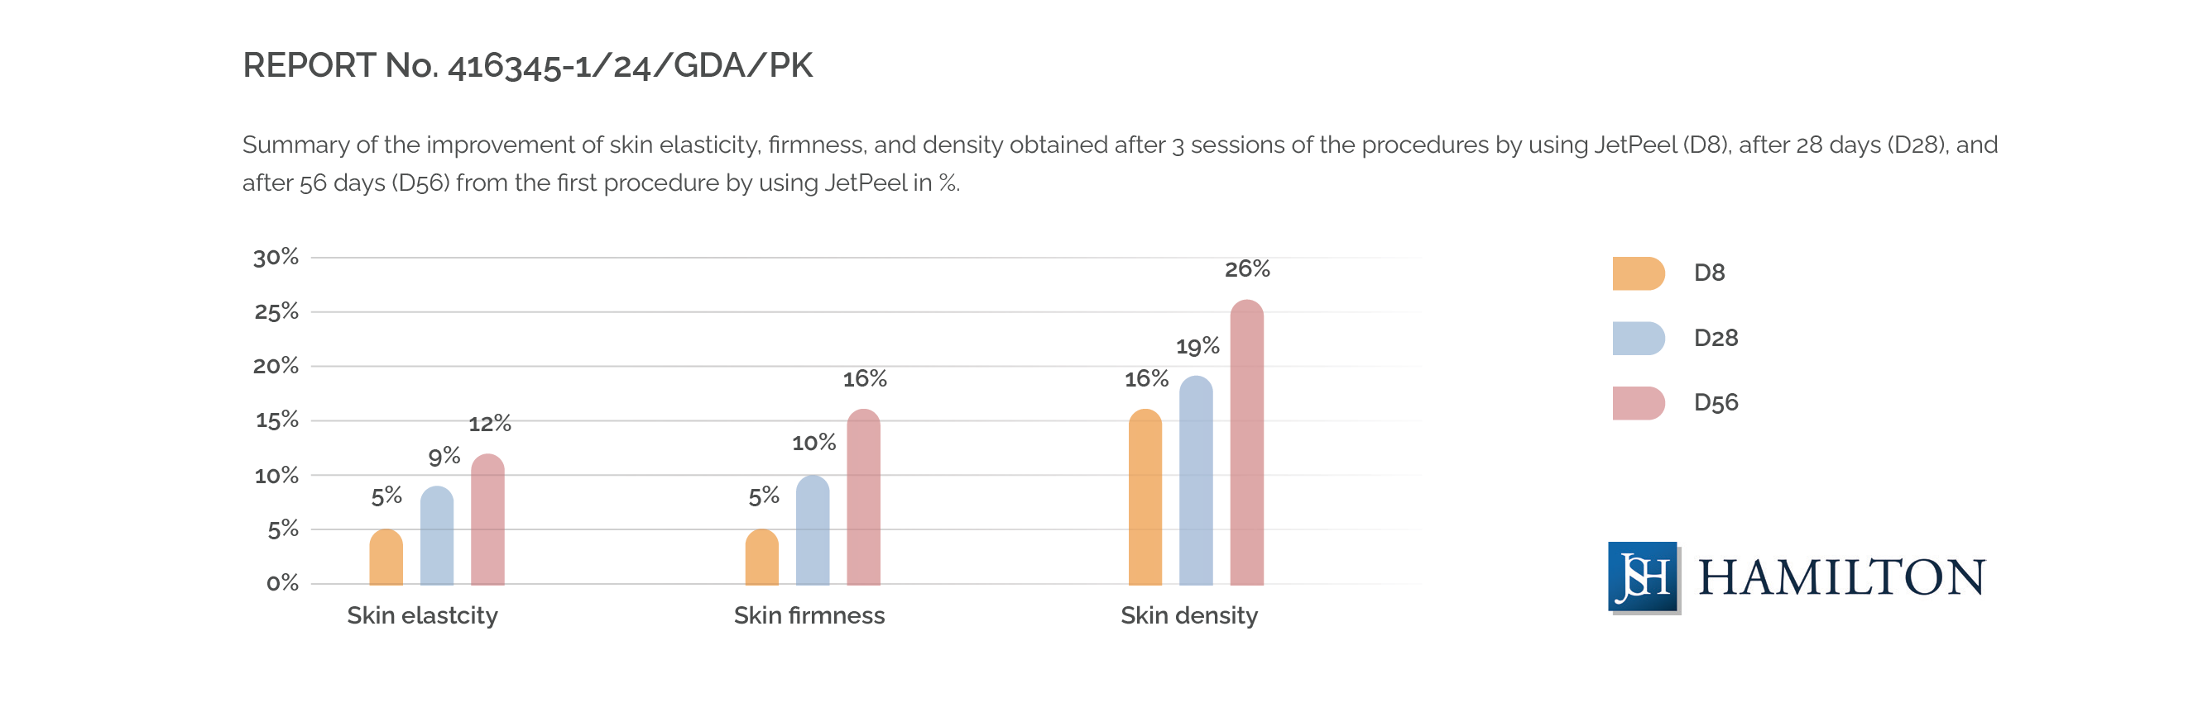
Summary of the improvements in skin elasticity, firmness and density obtained after 3 JetPeel sessions on D8 (eight days after 1st treatment), D28 (28 days after 1st treatment) and D56 (56 days after 1st treatment)
JetCare Med products were well-tolerated by all skin types, demontrating safety and efficacy for sensitive skin. All results show statistical significance.

Slide 5
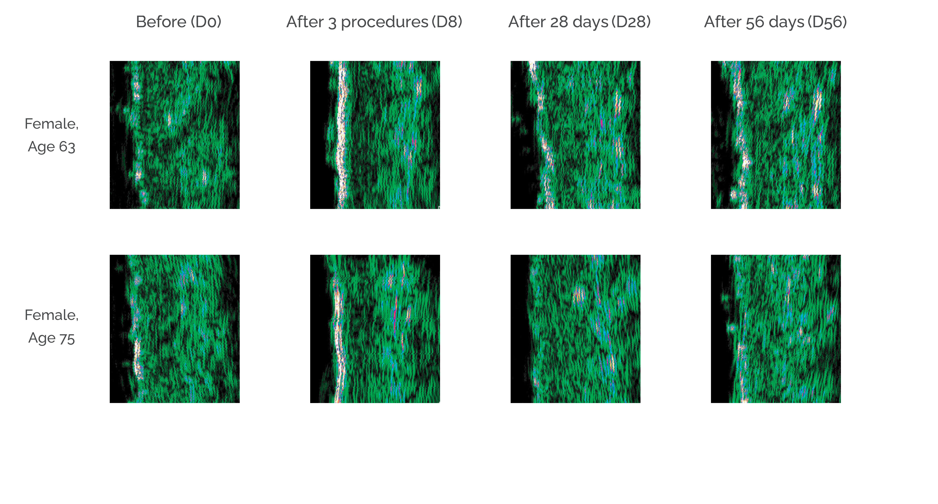

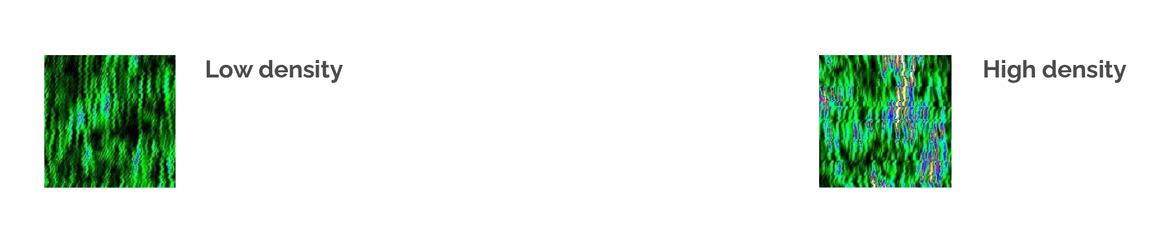
Skin Density Improvements
Measured with Dub® Skin Scanner manufactured by TPM Taberna Pro Medicum GmbH

Slide 6
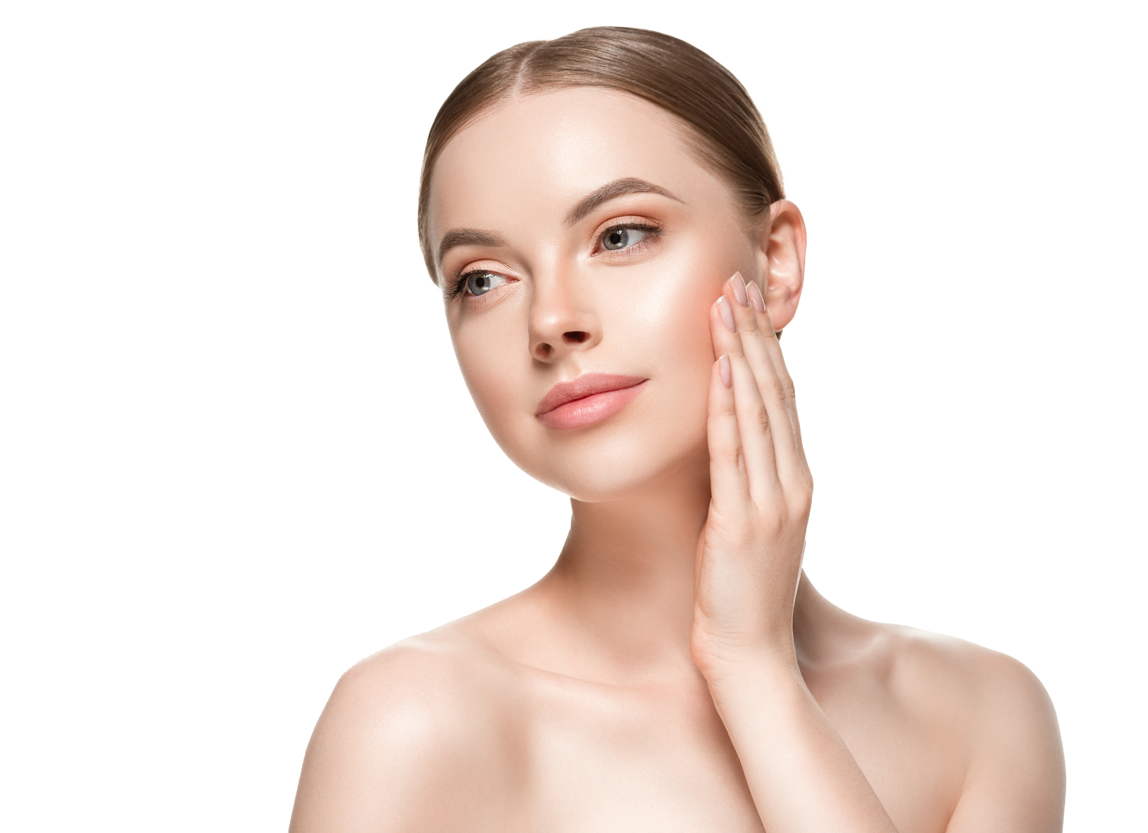
Cutting-Edge JetPeel for Clinic Success
Provide the JetCare Med treatment experience in your clinic, with:
  JetPro by TavTech: the world-leading aesthetic devices for jet pressure technology
  MDJet by TavTech handpiece: exclusively developed for use in JetCare Med treatments
  JetCare Med by TavTech infusions/boost infusion: delivered to the skin via the JetPro devices and MDJet handpiece, providing exceptional treatment results, enhancing patient satisfaction, and boosting your clinic performance

Slide 7
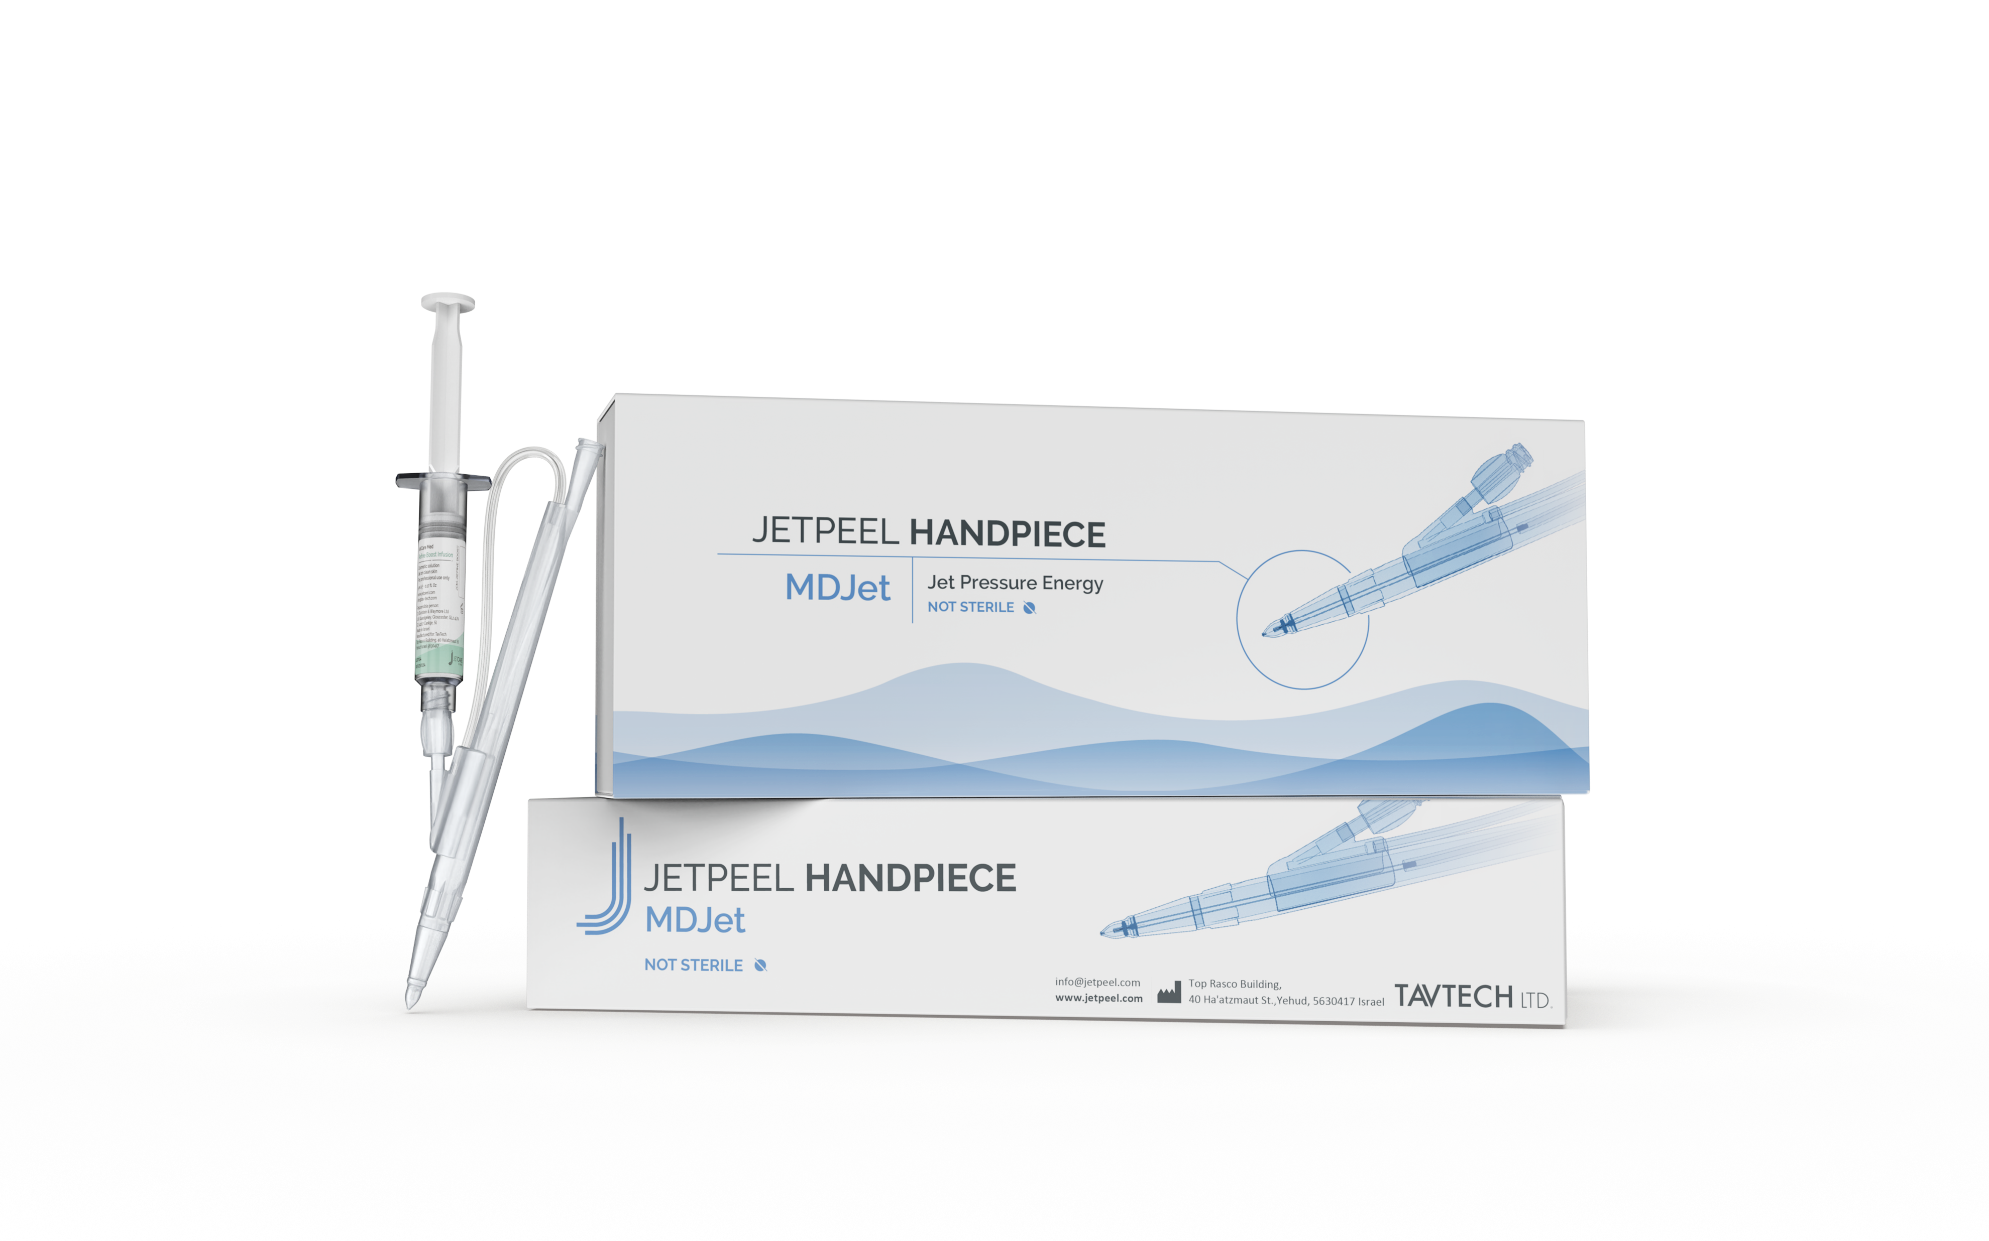
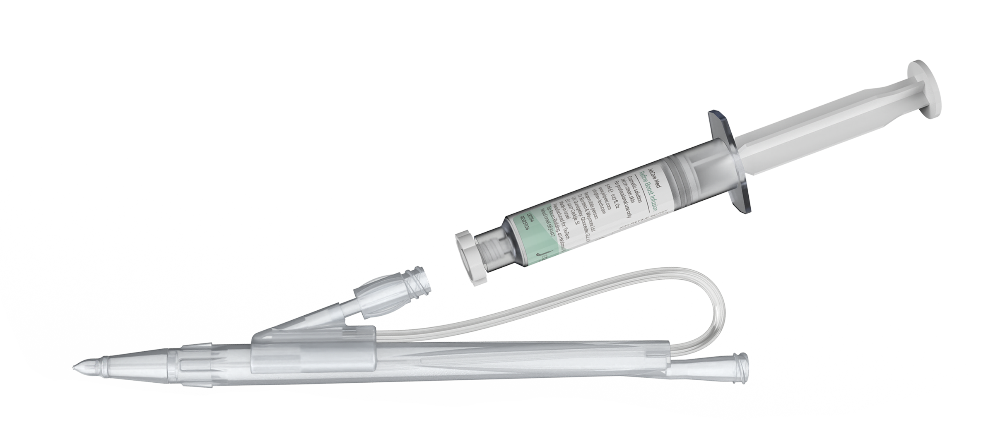
MDJet: The Exclusive Handpiece
JetPeel handpiece specially designed for JetCare Med treatments
Only handpiece that delivers the ultimate JetCare Med results
JetCare Med infusions come in pre-packed 5 ml syringes that directly screw onto the MDJet handpiece
Physicians can swap syringes quickly and easily, instead of using tubes and bottles as with other JetPeel treatments
Ensures a seamless, productive treatment flow

Slide 8
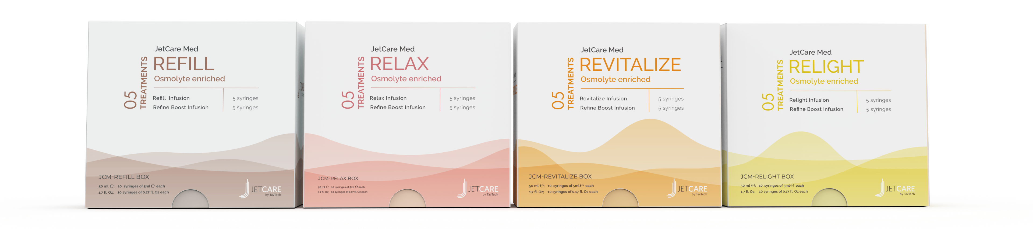
JetCare Med Formulation: Concentrated Power
JetCare Med infusions and boost infusion are uniquely formulated with a powerful cocktail of osmolytes
Osmolytes are organic molecules with lower molecular weights that protect peptides and improve protein stability
This leads to improved hydration and invigorated collagen and elastin for smooth, youthful looking results
JetCare Med formulas also contain propanediol, a 100% bio-based glycol alternative to enhance moisture and soothe the skin, and unique combinations of targeted ingredients to deliver the desired treatment results

Slide 9

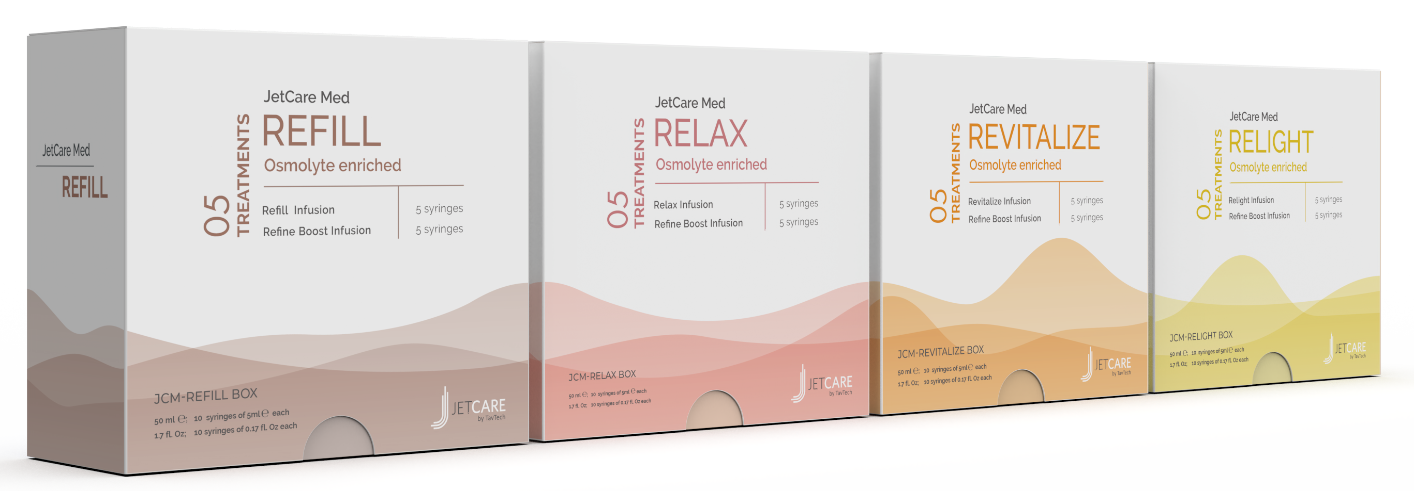
Osmolytes: The Synergy of Beautiful Skin
JetCare Med products contain over 5.5% osmolyte blend, based on three osmolytes working in synergy to invigorate collagen and elastin, and support powerful aesthetic results.
Betaine: Natural humectant that helps strengthen the skin barrier, maintain moisture balance, and support long-lasting skin hydration
Xylitol: A prebiotic moisturizer that enhances the skin’s microbiome profile, helping to fortify the skin barrier and supporting powerful hydration
Inositol: A glucose isomer that improves fibroblasts metabolism, helping to improve oxygenation, boost elasticity, and fight signs of fatigue

Slide 10
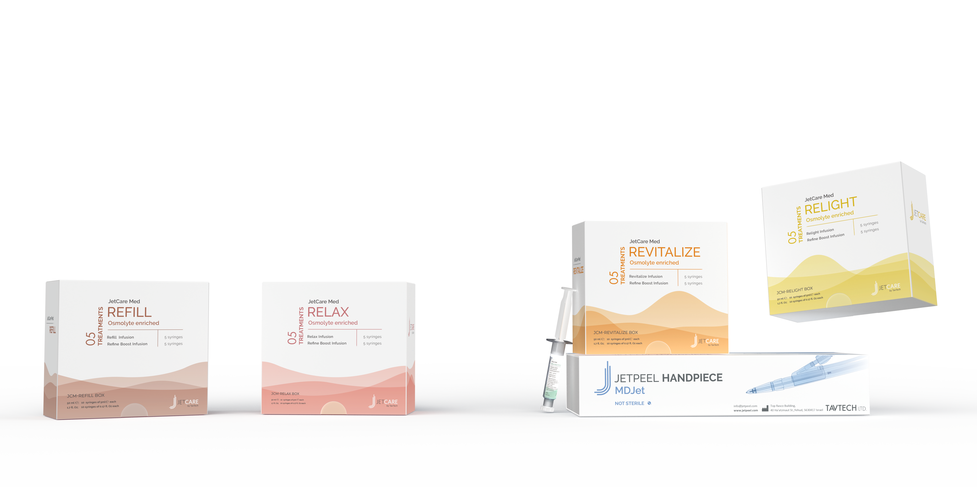
The JetCare Med Infusions
JetCare Med Refill Infusion for skin filling
JetCare Med Relax Infusion for muscle calming
JetCare Med Revitalize Infusion for anti-aging
JetCare Med Relight Infusion for lightening & brightening
JetCare Med Refine Boost Infusion for final lift & glow

Slide 11

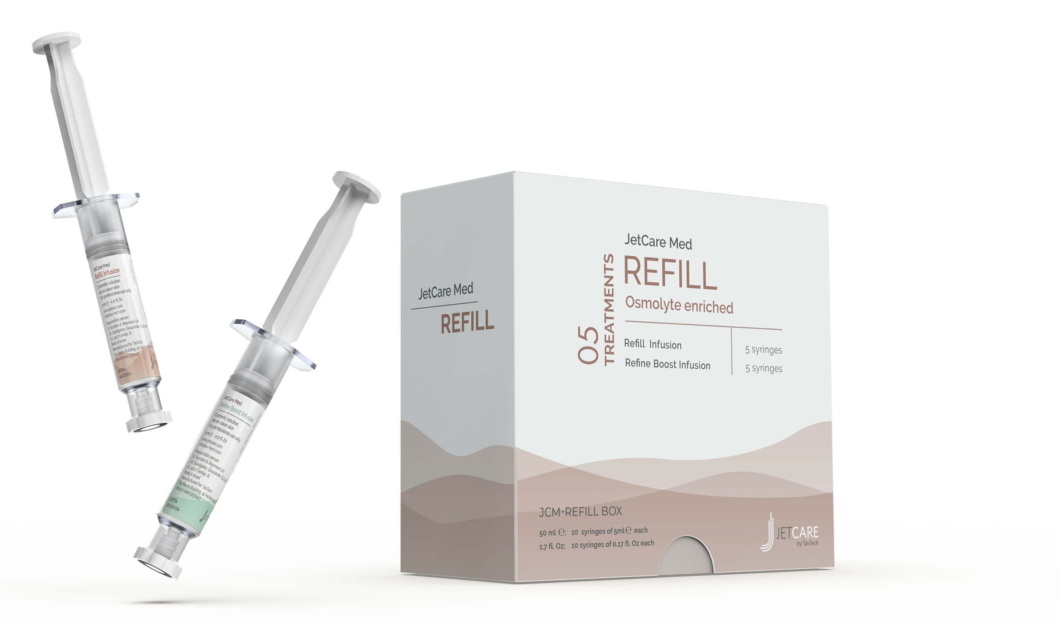
JetCare Med Refill: For skin filling
Smooths fine lines, soothes facial muscles, and invigorates the skin’s natural collagen, for firm, even, and youthful-looking skin.
Contains osmolytes, propanediol, and:
BioPeptide CL – 5%: Anti-wrinkle tripeptide of the collagen chain that helps to energize and invigorate collagen
Argireline® Amplified Peptide Solution C – 5%: Next generation multi-active peptide that helps slow the natural aging process
Feminage – 2%: Helps protect skin elasticity and maintain the integrity of the dermal-epidermal junction
PrimalHyal™ UltraFiller: Patented Hyaluronic Acid derivative enhances HA penetration in the skin, improving the appearance of fine lines
Primalhyal 3K™: Hyaluronic acid blend concentrated in 3 molecular weights, providing anti-aging effects at different levels of the skin
Argireline® is a trademark of Lipotec S.A. or its affiliates

Slide 12
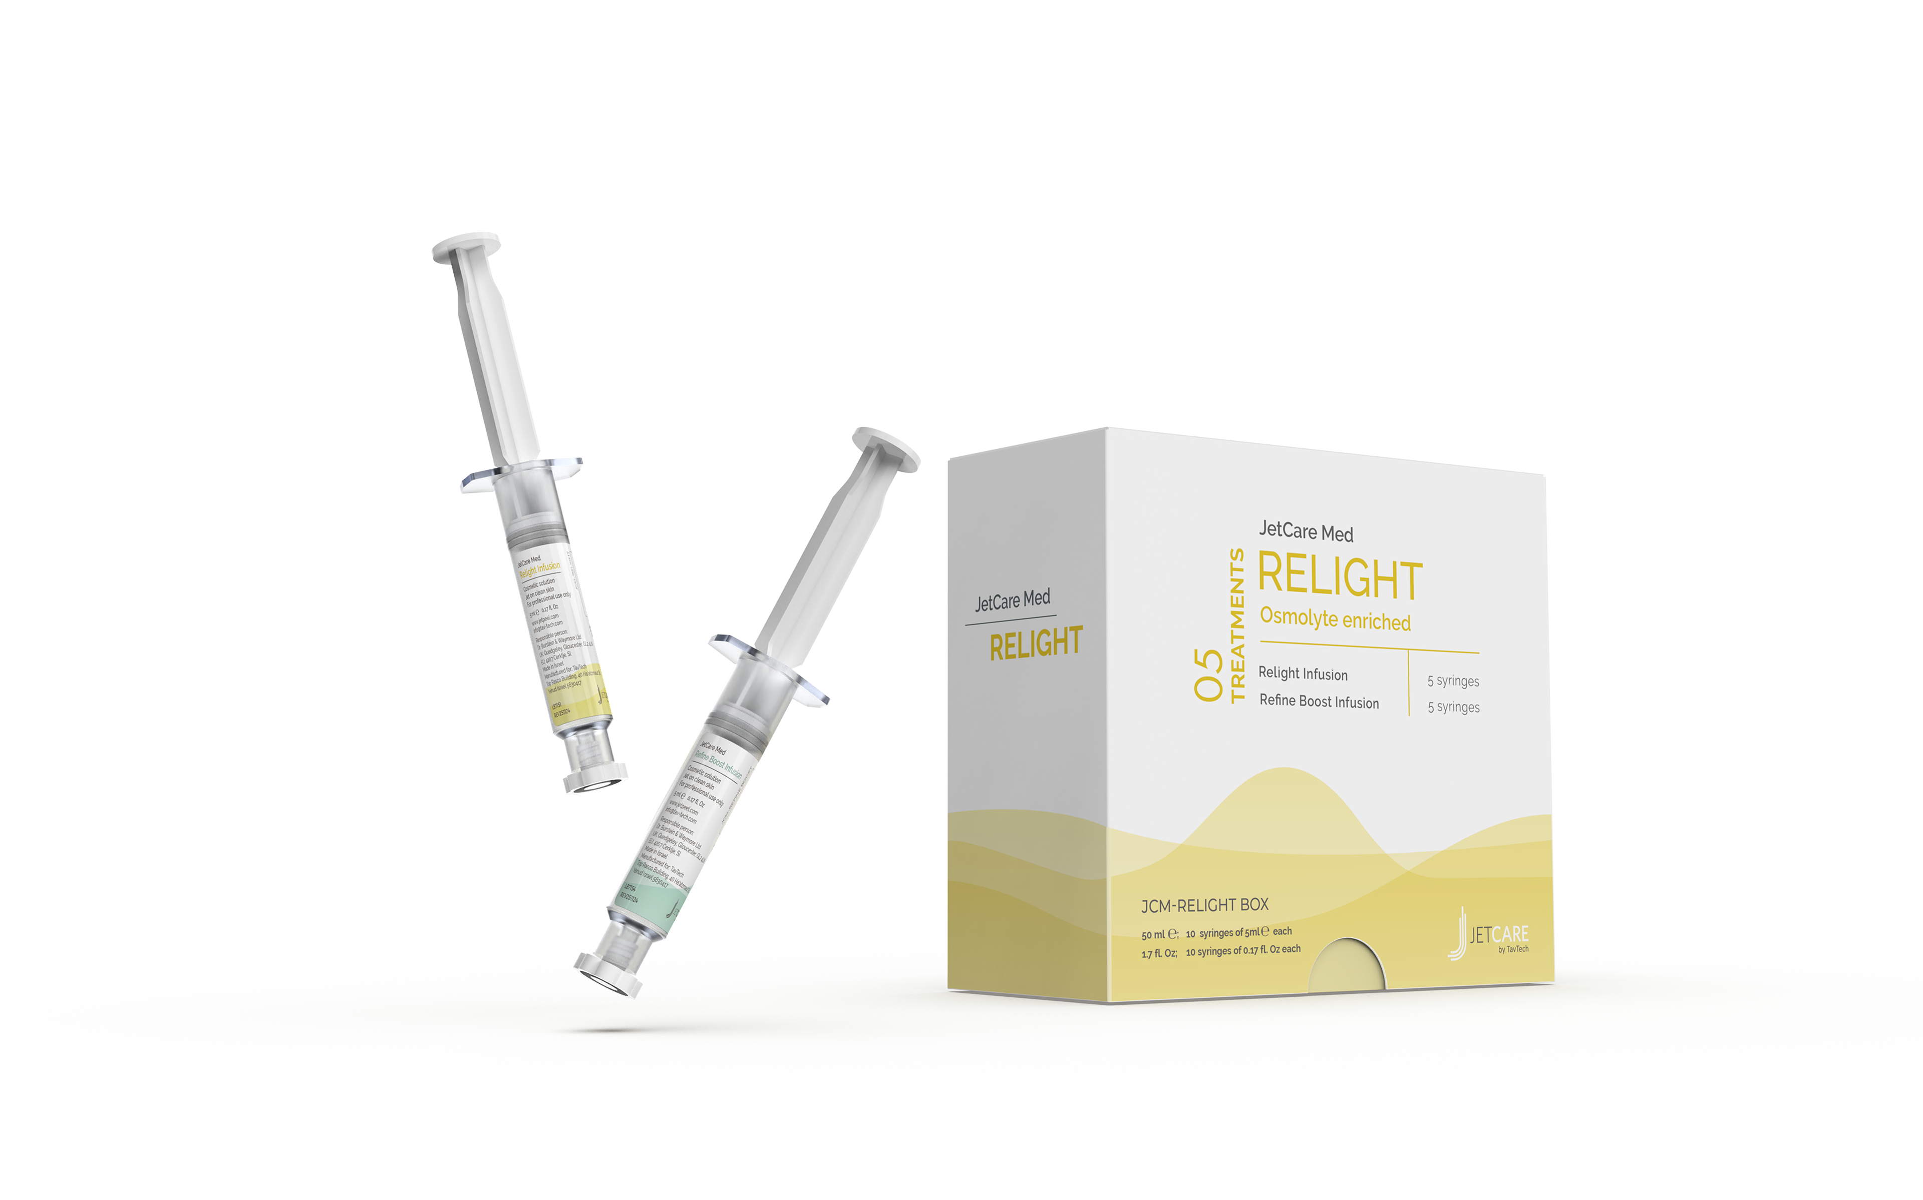

JetCare Med Relight: For skin lightening
Lightening infusion rich in vitamin C to help brighten the complexion and soothe and protect against the dulling effects of free radicals and UV damage.
Contains osmolytes, propanediol, and:
Ascorbyl Glucoside AA2G – 5%: Stable vitamin C derivative that lightens the skin, helping to fight free radicals, inhibit melanin synthesis, and enhance collagen production

Slide 13
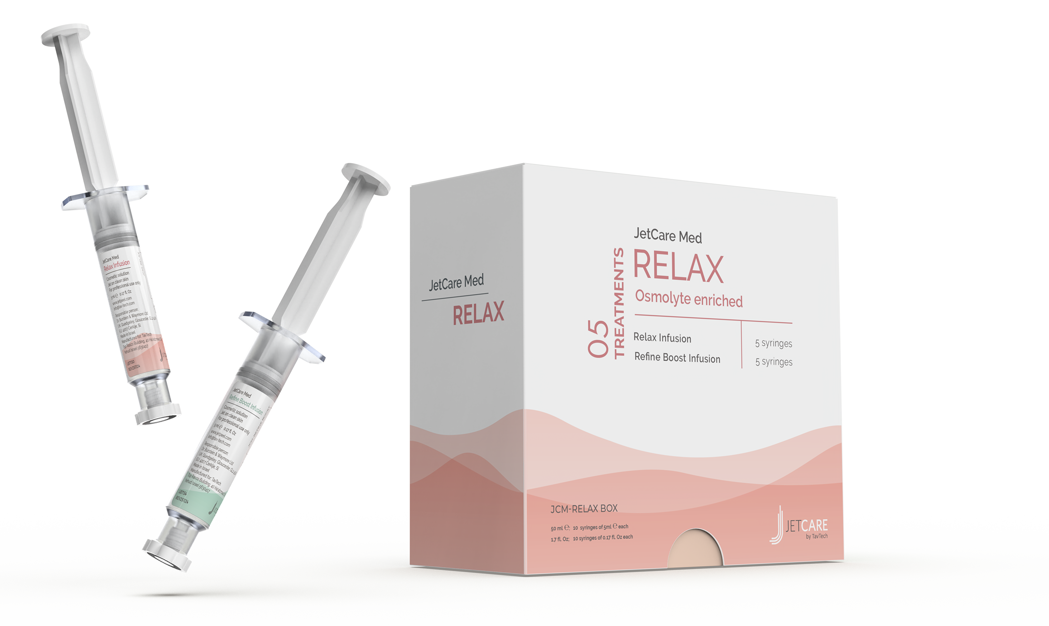
JetCare Med Relax: For muscle calming
Formulated to calm the muscles, helping to create a smooth, clear skin texture and appearance. Enriched with calming hydrating ingredients and age-defying peptides to restore the relaxed look of youth.
Contains osmolytes, propanediol, and:
Argireline® Amplified Peptide Solution C – 10%: Next generation multi-active peptide that helps slow the natural aging process
Neutrazen™ – 2.5%: Advanced neurocosmetic biomimetic lipopeptide, based on three amino acids that deliver vital calming and anti-inflammatory action
Allantoin: Comfrey root extract helps hydrate, exfoliate, and smooth the skin surface to restore the skin’s natural glow
Dipotassium Glycyrrhizate: Anti-inflammatory ingredient extracted from liquorice root that helps to regulate sebum, and soothe and calm the skin
Argireline® is a trademark of Lipotec S.A. or its affiliates

Slide 14

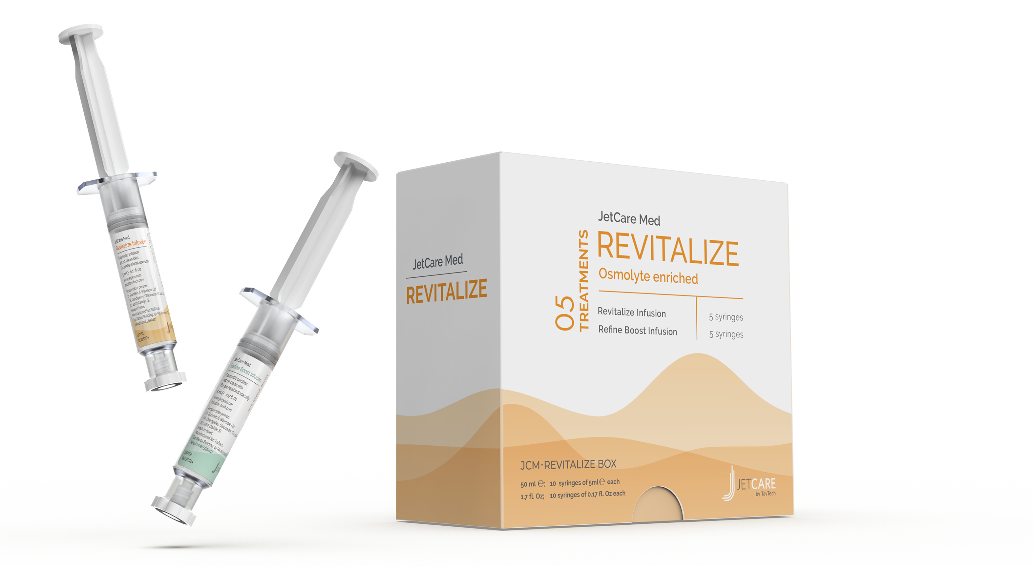
JetCare Med Revitalize: For anti-aging
Anti-aging treatment rich in peptides and specially formulated for mature, fragile skin.
With wrinkle-smoothing and regenerating ingredients that deliver a powerful rejuvenating sensation.
Contains osmolytes, propanediol, and:
Matrixil® 3000 – 10%: Powerful double-peptide blend for anti-wrinkle action, helping to boost tone and elasticity. Rich in martikines that promote effective skin repair and regeneration

Slide 15
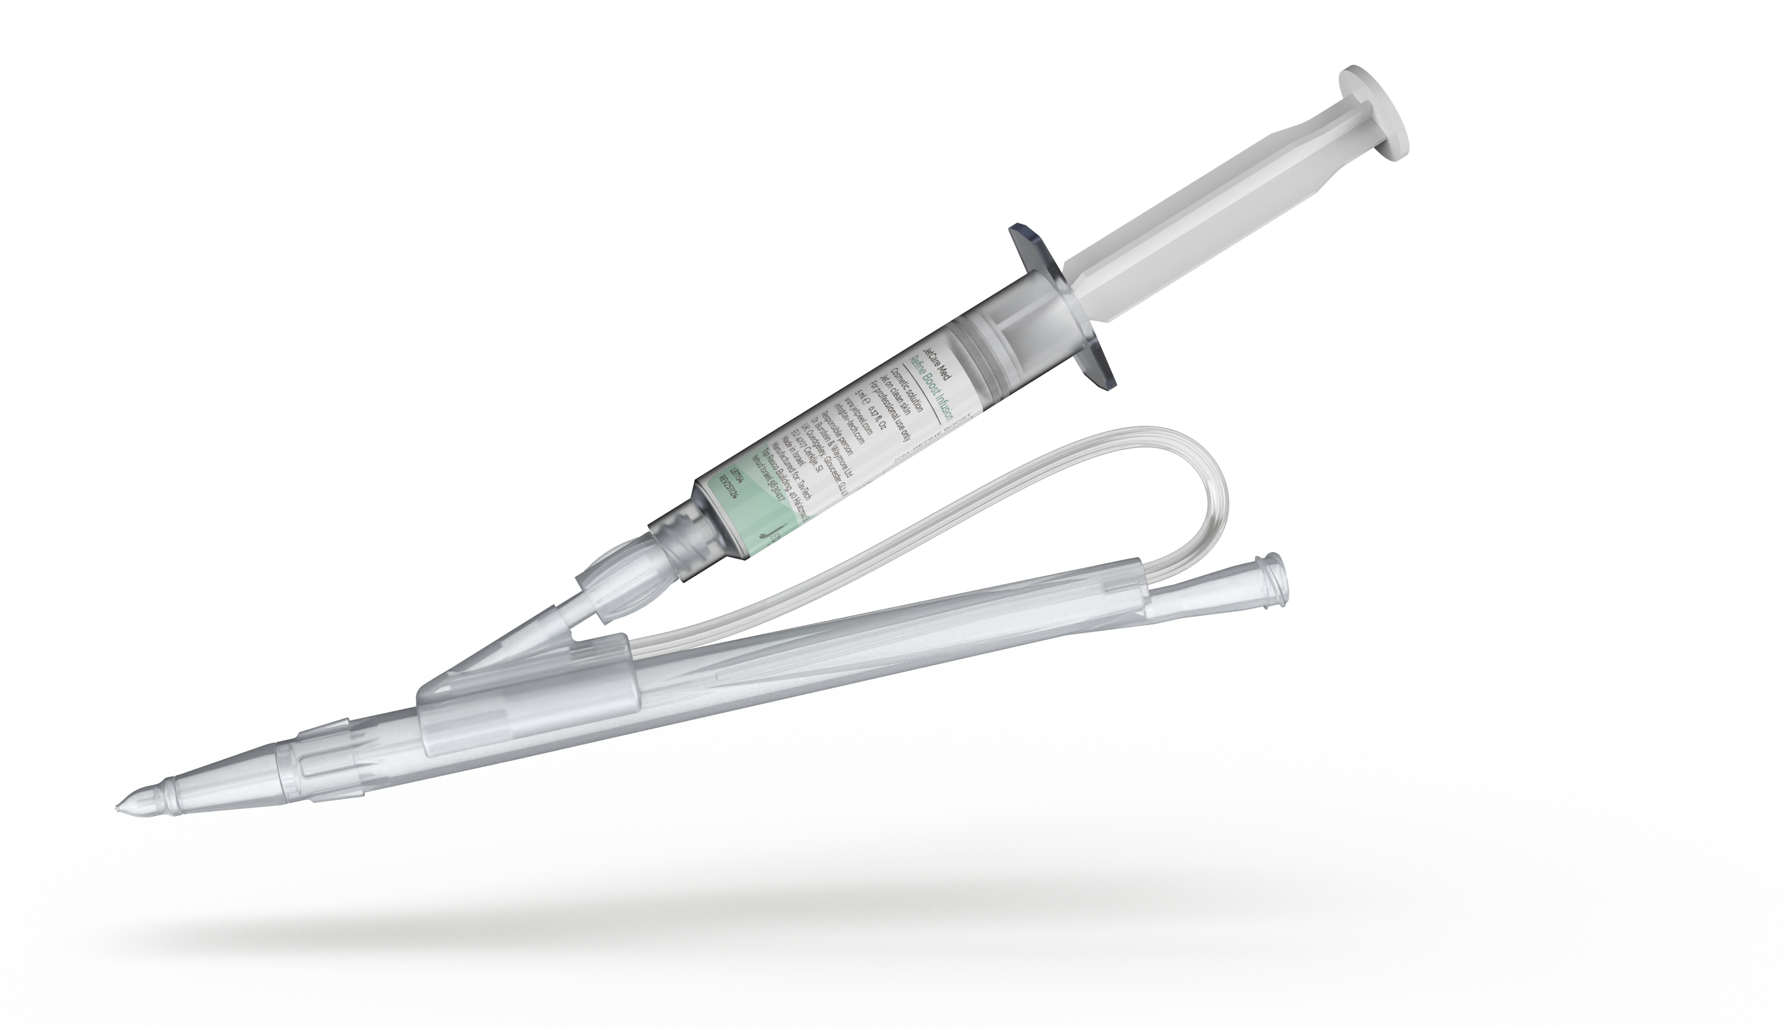
JetCare Med Boost Infusion: For final lift & glow
Formulated for the final step of JetCare Med treatment, based on a power blend of hydrating ingredients and vitamins to boost the radiance impact.
Contains osmolytes, propanediol, and:
Detoxi-Look ® – 3%: Based on Everlasting and Daisy flowers, rich in flavonoids, polyphenols, and saponins, that detoxifies the enzymatic system and regulates microcirculation
Keratoline C: Enzymatic protease-based exfoliant that helps to remove dead skin cells and promote cell renewal
D-Panthenol – 1.8%: Deeply nourishing vitamin B₅ helps to lock in moisture, protect and strengthen the skin’s natural barrier

Slide 16
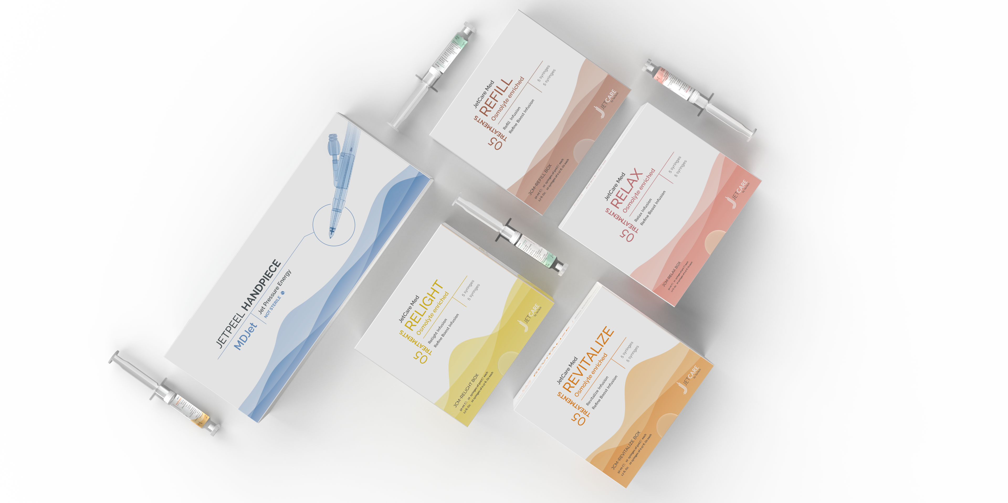
JetCare Med by TavTech
Osmolyte-enriched for Invigorating Collagen and Elastin
Re-ignite your clinic results
Thank you

