Slide 1
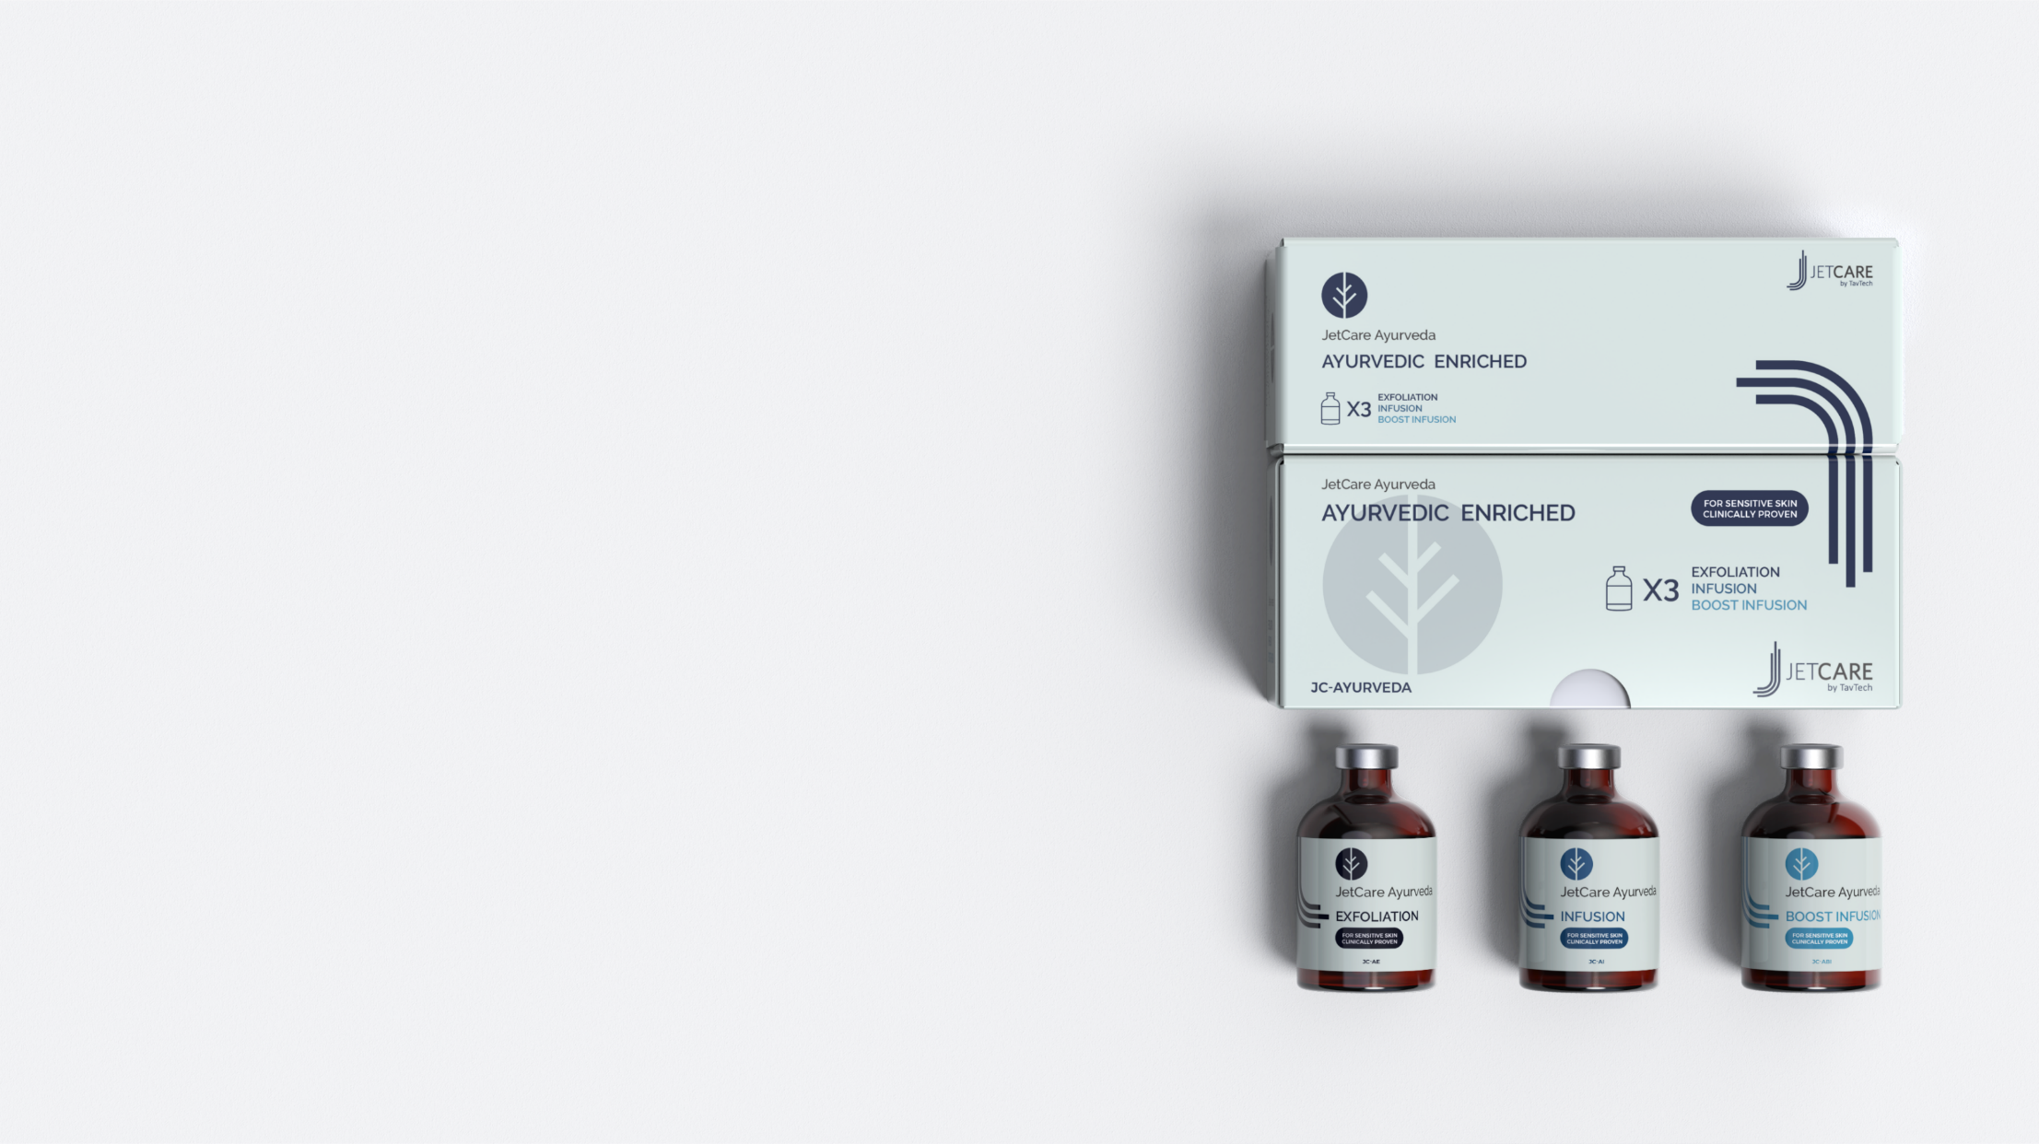

JetCare Ayurveda
For Sensitive Skin – Clinically Proven
Ancient Healing
Modern Science
The JetPeel Glow

Slide 2
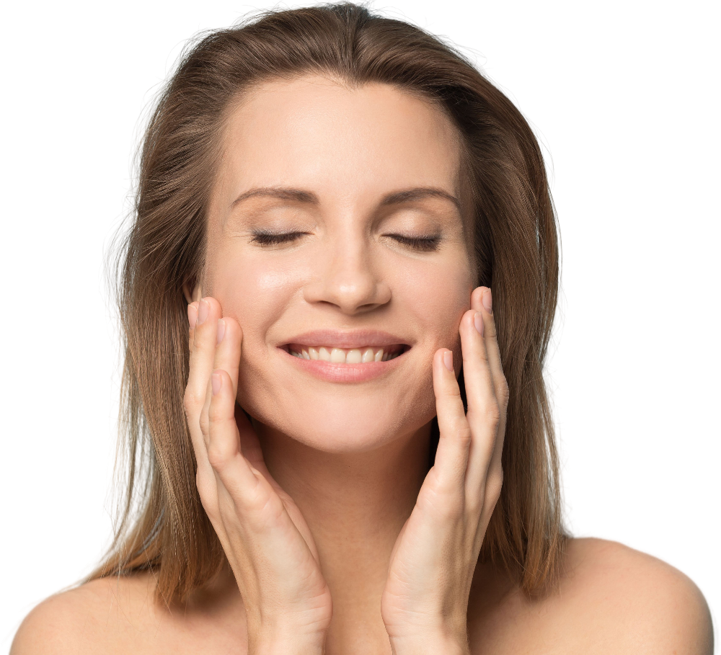
JetPeel technology + Ayurvedic tradition
JetPeel is the world leader in jet technology for aesthetic care. Treatments are non-invasive, non-ablative, non-contact, needle free and pain free, with no downtime or recovery, and instant visible results.
Using high-pressure jet streams applied to the skin, JetPeel enables the delivery of exclusive concentrated JetCare solutions for a wide range of skin concerns.
JetCare Ayurveda is a new line of JetCare solutions, based on known, effective ingredients from the ancient Indian medicinal and healing practice of Ayurveda, clinically proven for sensitive skin.

Slide 3

Ayurveda Explained: “The Science of Life”
Ayurveda is an ancient philosophy of holistic medicine, originating in India.
The key principle of Ayurveda is promoting balance, which helps restore and maintain natural health.
Ayurvedic medicine uses a selection of natural herbs and supplements to reduce inflammation and detoxify the body and skin.
Today, Ayurveda is the primary medical approach across India and recognized by WHO as an effective alternative treatment.

Slide 4
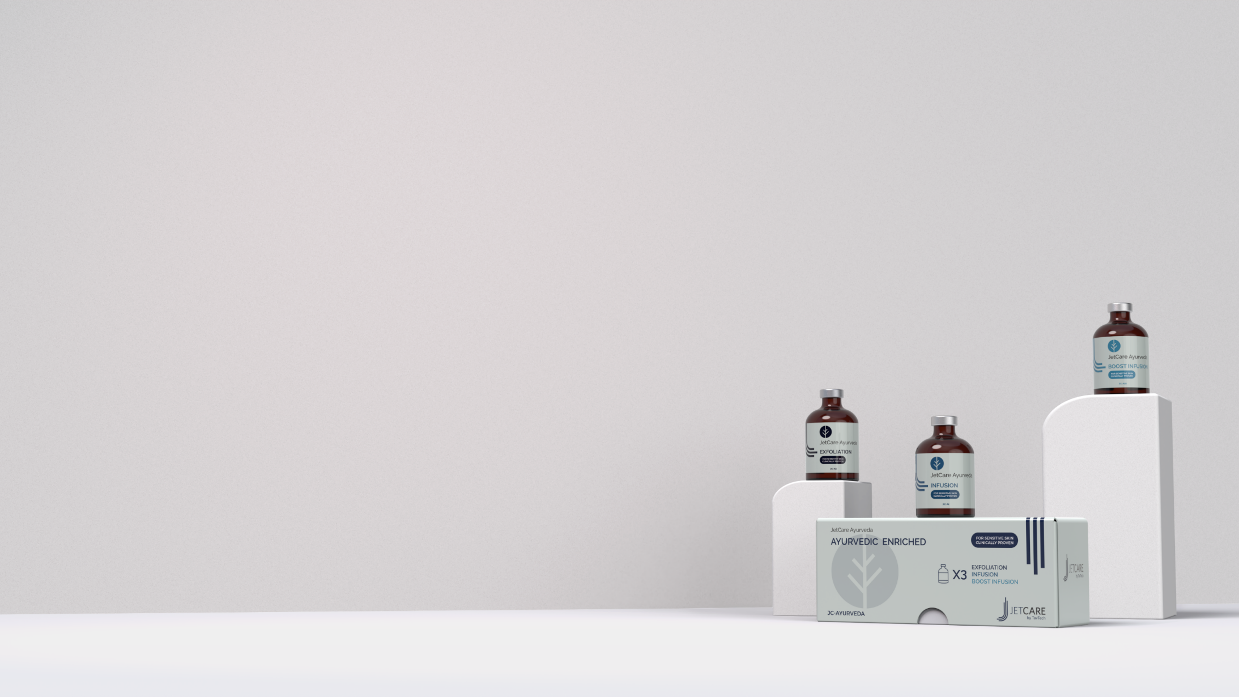
Ayurveda Powering JetCare
JetCare Ayurveda solutions are enriched with Ayurvedic ingredients that deliver the gentle healing and smoothing effects of Ayurvedic medicine, clinically proven for sensitive skin.
Exclusive Ayurvedic blend in all JetCare Ayurveda solutions:
Bacocalmine: Anti-stress herb fights free radicals and oxidation, and reduces inflammation.
Campo Vijaya Sara: Natural astringent, boosts blood flow and balances sebum production. Promotes a smoother, healthier appearance.
Campo Jyotismati: Helps to close pores and create a smooth, even tone. Regulates moisture balance and helps restore the skin’s natural elasticity.
Campo Susunishak: Excellent hydrating and moisture-balancing properties. Promotes skin tightening and toning.

Slide 5
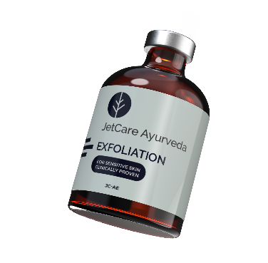
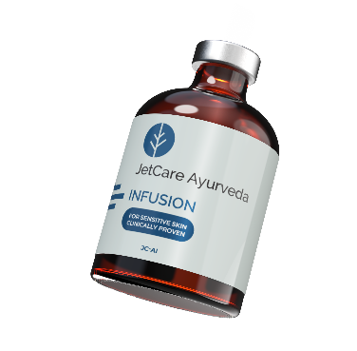
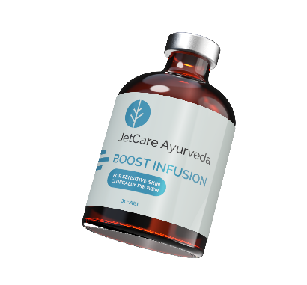
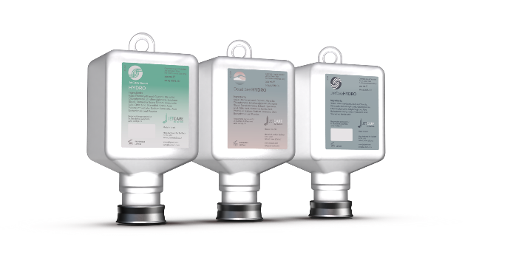
Introducing JetCare Ayurveda
STEP
1
STEP
2
STEP
3
STEP
4
LYMPHATIC MASSAGE
EXFOLIATION
INFUSION
BOOST INFUSION
Detoxifies and stimulates micro circulation. Performed with one of the JetCare hydro products: JetCare Hydro, JetCare Youth Dead Sea Hydro or JetCare Green Hydro
Cleanses, balances and preps the skin with Ayurvedic exfoliation
Penetrates the skin with Ayurvedic hydration and healing
Amplifies the balancing and smoothing Ayurvedic boost effect

Slide 6
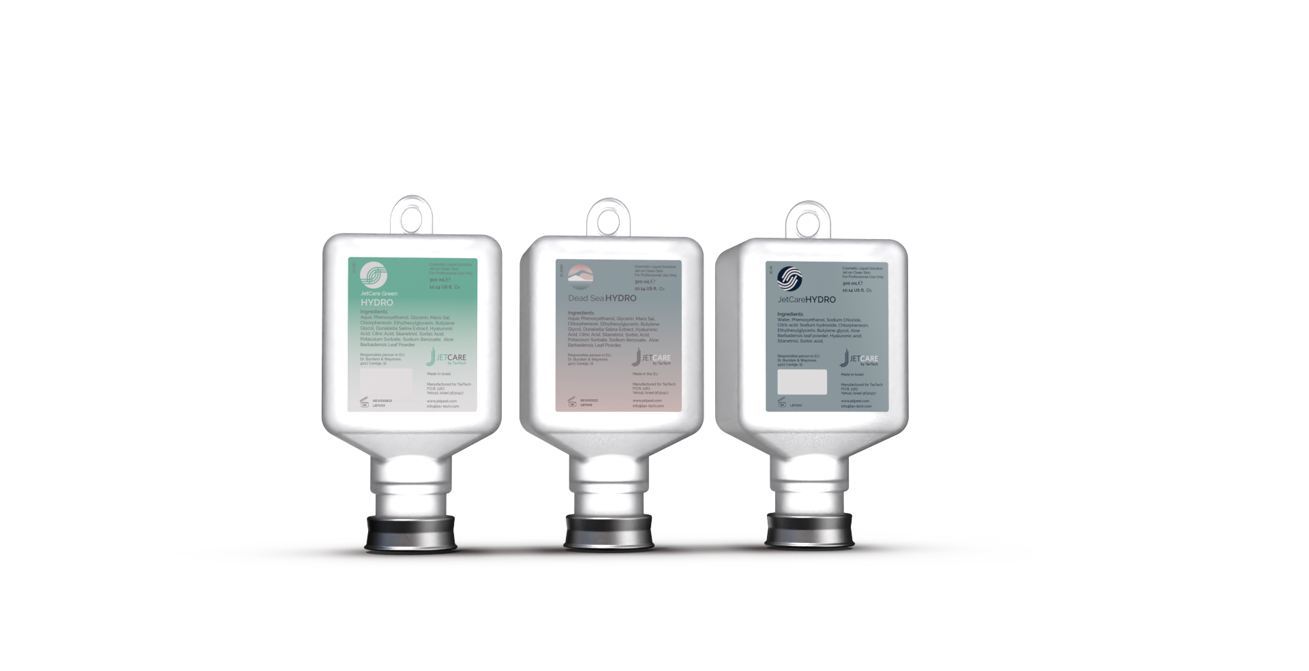
Lymphatic Massage
Every JetPeel treatment should begin with Hydro, a water-based solution for lymphatic massage to detoxify and to stimulate micro-circulation
JetCare offers several options for this stage:
  JetCare Hydro – enriched with Hyaluronic Acid and Aloe Vera
  JetCare Youth Dead Sea Hydro – enriched with Dead Sea mineral-rich salts for young skin
  JetCare Green Hydro - based on natural origin, eco-friendly ingredients
Notes:
If you have exfoliated with glycolic acid, wait 3-5 minutes (see also “Exfoliation Protocols”) and then repeat the same exfoliation with Jet Detox Water (same hand piece, movements and distance) to wash off the product and the debris at the same time. If you have exfoliated with mandelic acid, do not wash off the product and proceed directly to the infusion step.

Slide 7

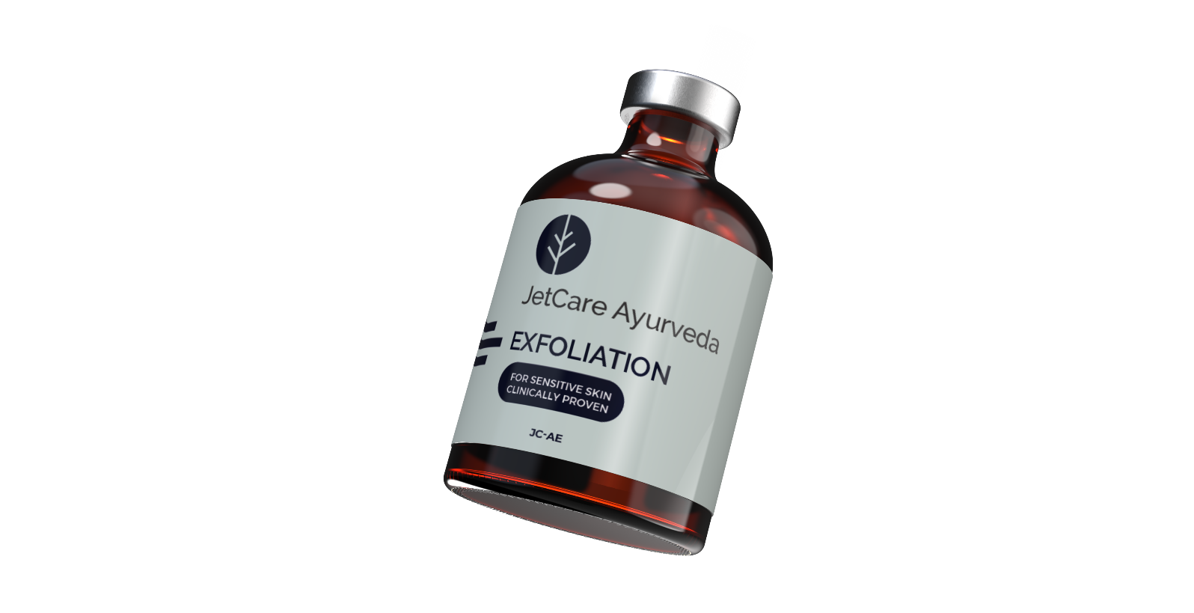
JetCare Ayurveda Exfoliation
After the lymphatic massage, the JetPeel exfoliation with the exclusive JetCare Ayurveda Exfoliation blend is a gentle exfoliation to refine the skin, restore balance, and prepare it for the following infusion stages.
Enriched with 5% Lactic Acid to enhance the exfoliating effects while remaining gentle enough for sensitive skin.
Notes:
If you have exfoliated with glycolic acid, wait 3-5 minutes (see also “Exfoliation Protocols”) and then repeat the same exfoliation with Jet Detox Water (same hand piece, movements and distance) to wash off the product and the debris at the same time. If you have exfoliated with mandelic acid, do not wash off the product and proceed directly to the infusion step.

Slide 8

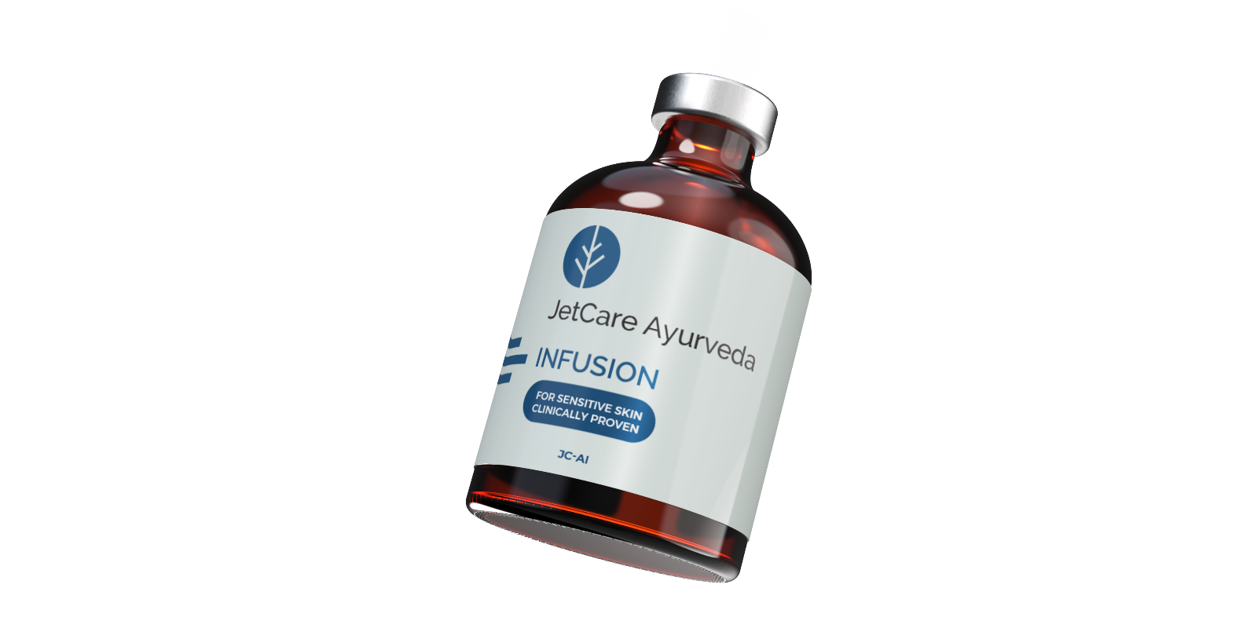
JetCare Ayurveda Infusion
The third stage of the JetPeel Ayurvedic-based treatment protocol is JetCare Ayurveda Infusion, formulated to hydrate the skin at the basilic layer with the natural power of JetCare’s exclusive Ayurvedic blend.
The Infusion solution is enriched with Primalhyal 3k, composed of 3 molecular sizes of Hyaluronic Acid that penetrate from the surface to the deeper levels of the skin, for a gentle infusion of Ayurvedic healing and smoothing effects.
Notes:
If you have exfoliated with glycolic acid, wait 3-5 minutes (see also “Exfoliation Protocols”) and then repeat the same exfoliation with Jet Detox Water (same hand piece, movements and distance) to wash off the product and the debris at the same time. If you have exfoliated with mandelic acid, do not wash off the product and proceed directly to the infusion step.

Slide 9

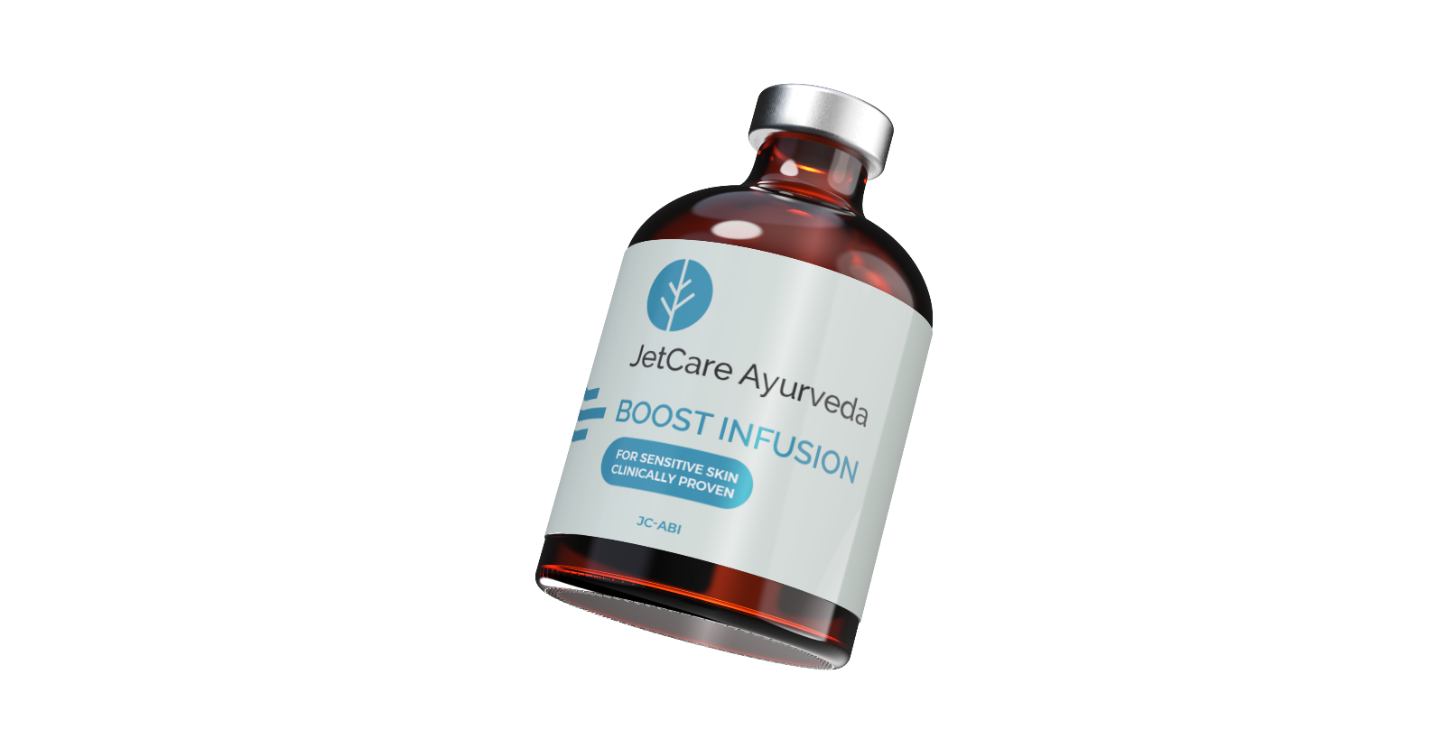
JetCare Ayurveda Boost Infusion
Formulated to enhance the JetPeel Ayurvedic treatment, the Boost Infusion is the 4th and final stage of the protocol. JetCare Ayurveda Boost Infusion is formulated to amplify the effects of the Exfoliation and Infusion treatments with the rich, gentle healing of Ayruvedic ingredients.
The Boost Infusion solution is enriched with 5% Pore Reductyl, a mushroom extract with strong astringent properties to close pores and leave skin even and smooth.
Notes:
If you have exfoliated with glycolic acid, wait 3-5 minutes (see also “Exfoliation Protocols”) and then repeat the same exfoliation with Jet Detox Water (same hand piece, movements and distance) to wash off the product and the debris at the same time. If you have exfoliated with mandelic acid, do not wash off the product and proceed directly to the infusion step.

Slide 10
The Benefits of JetCare Ayurveda
Made by TavTech, the developers of JetCare, who continue to update the JetPeel product collection to offer new, advanced treatment approaches.
Non-invasive, non-ablative and non-contact delivery of Ayurvedic effects deep into the skin – the best of traditional healing wisdom and safe, effective aesthetic technology.
JetPeel Ayurveda results: Reduces pores, balances sebum production, stimulates blood flow, hydrating and softening effects, leaves skin smooth, even and glowing.
Specially for sensitive skin: The gentle balancing Ayurvedic ingredients are clinically proven as safe and effective for sensitive skin.
Aestheticians can offer customers with sensitive skin an exclusive, advanced treatment, bringing the power of Ayurvedic healing and detoxification to their clinics.

Slide 11


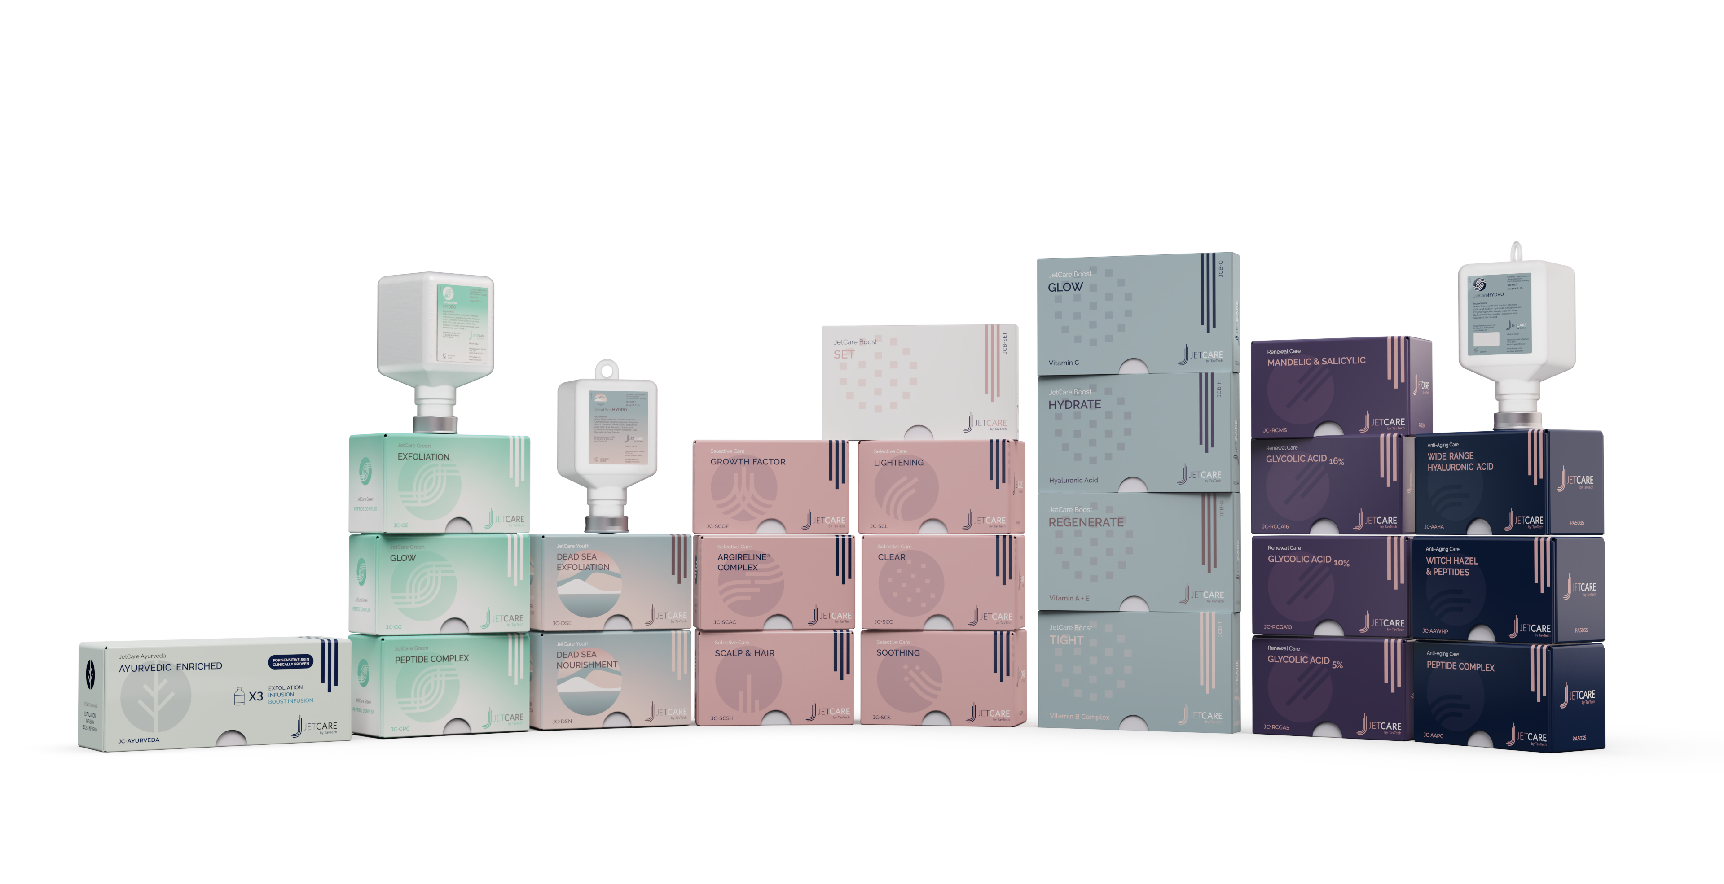

Where Sustainability Meets Beautiful Skin
JetCare by TavTech solutions, JetPeel’s range of world-renowned treatment formulas, was launched in 2021.
TavTech is continually expanding and updating the product collection to offer new, advanced treatment approaches.
Following the release of the JetCare, JetCare Youth for young skin, and JetCare Green for eco-concerned customers, JetPeel now offers JetCare Ayurveda for sensitive skin.
JetPeel customers with sensitive skin can experience the same power of JetPeel treatments, with the ancient healing and modern science of JetCare Ayurveda.

