Slide 1
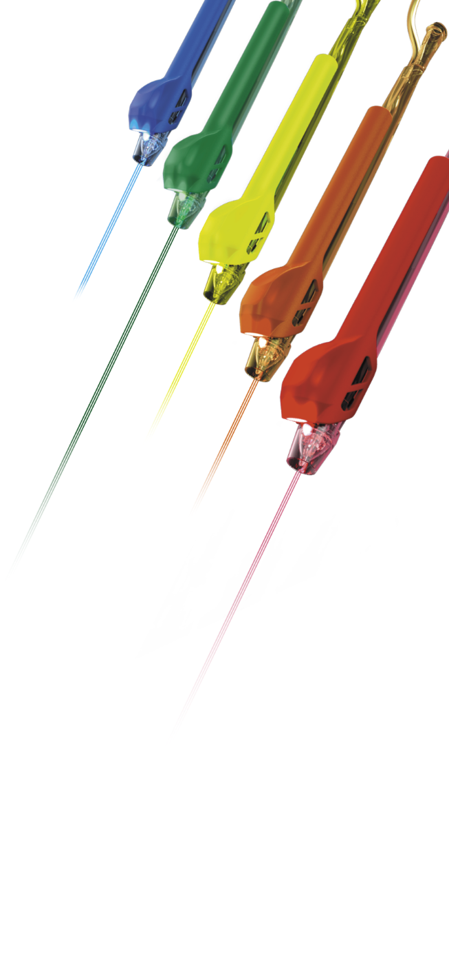
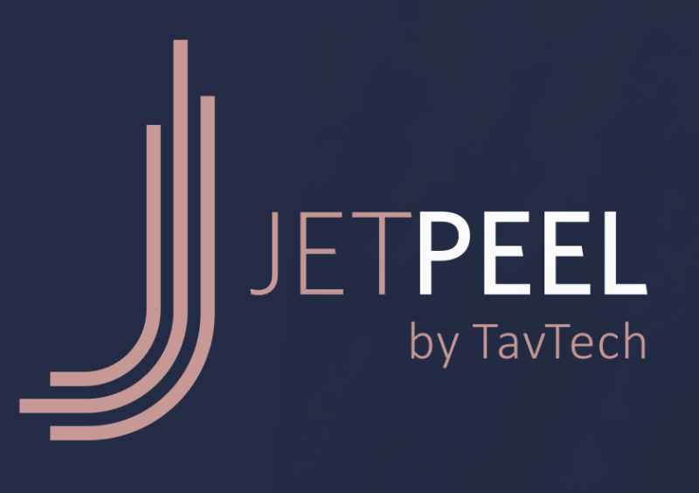

Expand your Clinic’s JetPeel LED Wavelength Spectrum for More Versatile Treatment Offerings

Slide 2


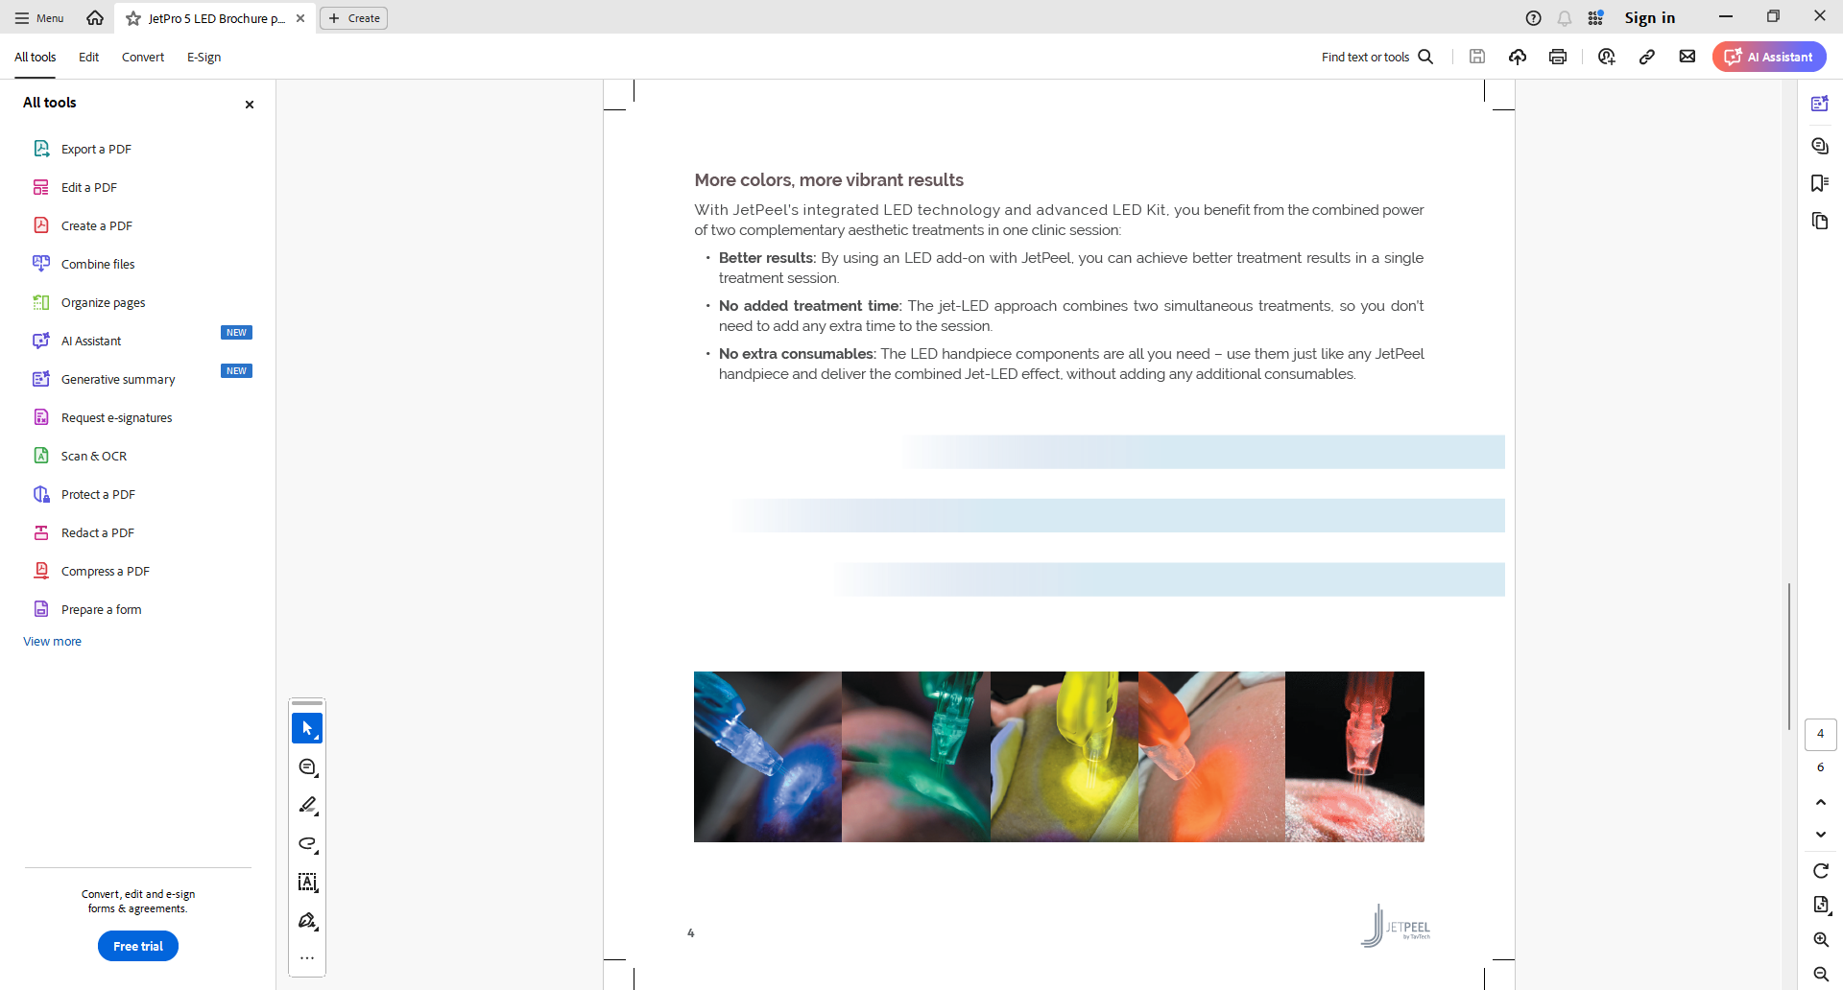
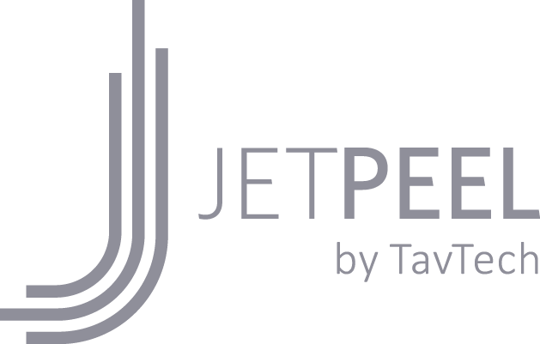
Enhance JetPeel results with simultaneous LED therapy
LED therapy is clinically proven to cause natural photo-biochemical reactions in the skin cells that can lead to rejuvenation and smoother, beautiful skin.
Different light wavelengths penetrate different levels of the skin, supporting various aesthetic benefits.
JetPeel’s JetPro Duo and JetPro ToGo devices combine Red and Blue light waves and jet pressure energy in a dual Jet-LED treatment to effectively treat a wide range of skin concerns.

Slide 3

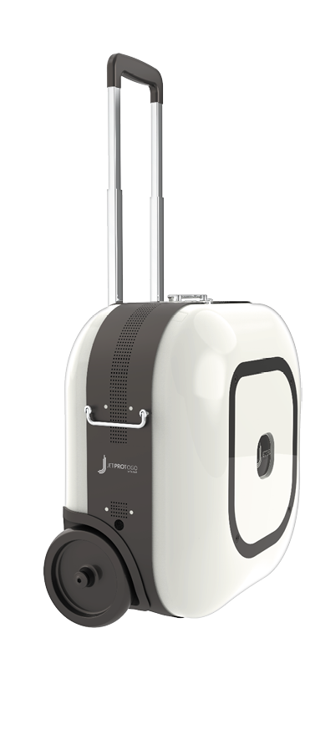
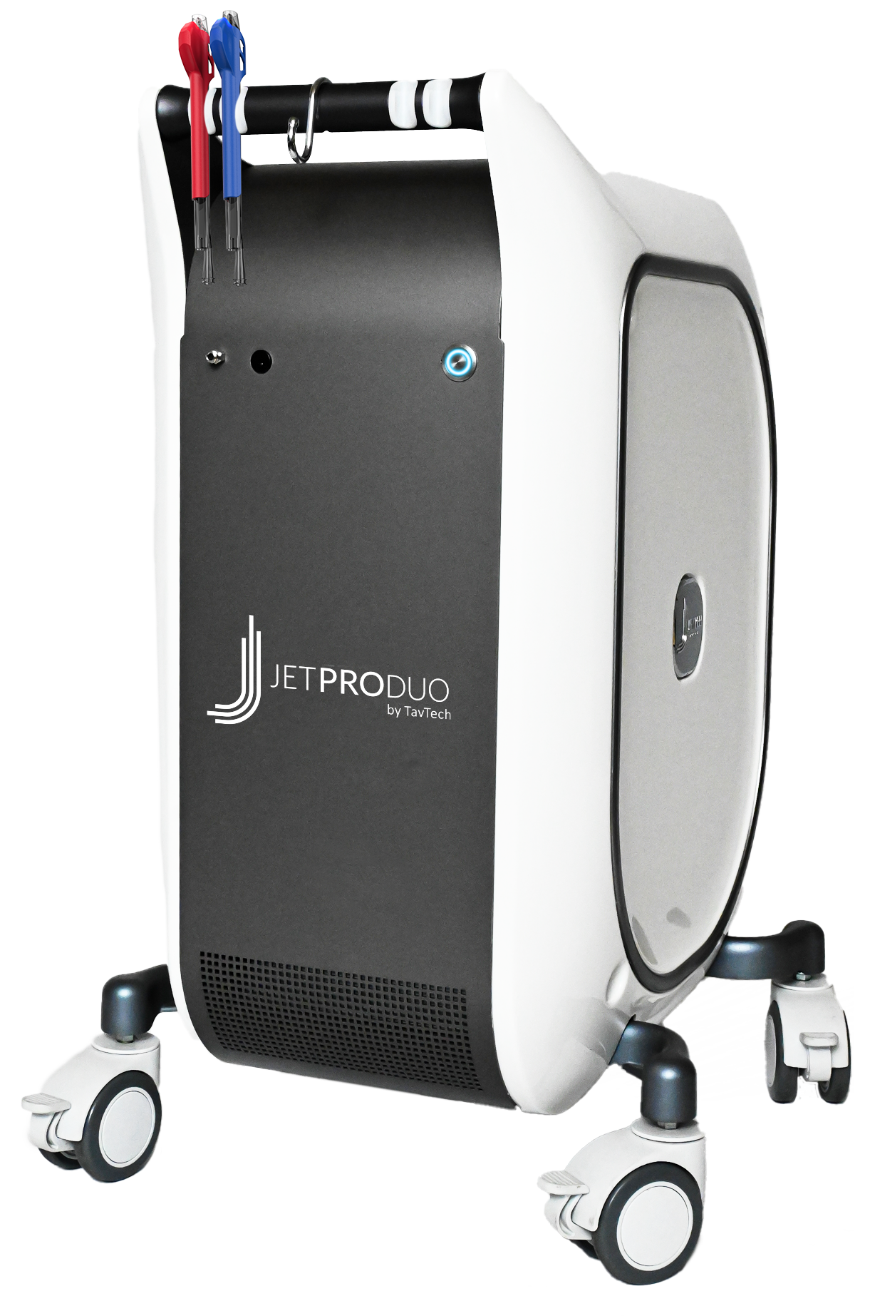
JetPro and JetPro ToGo by TavTech devices include Red and Blue LED components
COMES WITH JETPRO DUO AND JETPRO TOGO:
Red LED (620-630nm): Deepest penetration to the lower dermis, suitable for anti-aging treatments that target loss of tone and wrinkles. Also treats pigmentation and post-acne skin for enhanced vitality and glow.
Blue LED (460-470nm): Penetrates the uppermost epidermis to target bacteria that causes mild-moderate acne. Also ideal for couperose and sensitive skin, and to soothe and balance oily scalp.

Slide 4
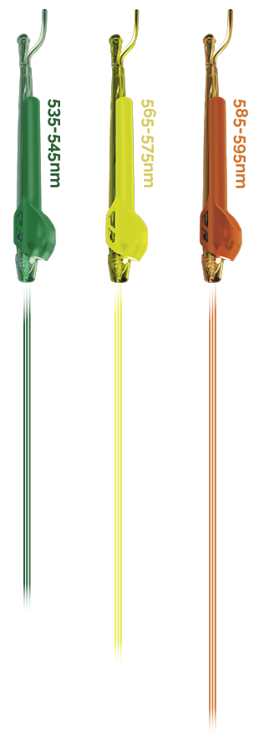
Advanced JetPeel LED Components Kit: Beyond Red and Blue
The advanced LED components kit by JetPeel is an accessory to the JetPro Duo and JetPro ToGo devices, supplied separately, featuring three additional LED colors: Green, Yellow-Green and Amber.
The advanced LED components kit enables clinicians to expand their treatment offering beyond the Red and Blue LED components already provided with the JetPro Duo and JetPro ToGo devices.

Slide 5
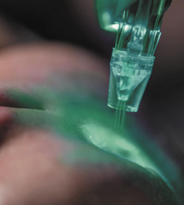
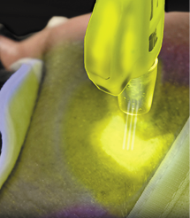
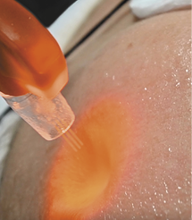
LED color: Different Effects at Different Skin Depths
SUPPLIED SEPARATELY IN THE ADVANCED LED COMPONENTS KIT:
Green LED (535-545nm): Penetrates the upper skin levels, where it targets melanin producing cells, ideal for treating pigmentation issues such as age spots, sun spots, and uneven complexion.
Yellow-Green LED (565-575nm): Penetrates to the intermediate skin layers, with soothing, anti-inflammatory properties to help treat skin redness and irritation, and sensitive, itchy scalp.
Amber LED (585-595nm): Deeper penetration with anti-inflammatory, anti-oxidative and protective effects, helping to reduce redness from sunburn and rosacea, and soothe other causes of skin inflammation.

Slide 6


JetPeel’s Multi-level approach to Aesthetic Care
Blue
460-470nm
Green
535-545nm
Yellow-Green
565-575nm
Amber
585-595nm
Red
620-630nm
Uppermost penetration (epidermis) Targets bacteria, mild-moderate acne Also used for couperose and sensitive skin, and for oily scalp JetCare Anti-Aging Care Peptide Complex, JetCare Anti-Aging Care Witch Hazel & Peptides, JetCare Selective Care Clear, JetCare Selective Care Soothing, JetCare Selective Care Lightening, JetCare Selective Care Growth Factor, JetCare Selective Care Scalp & Hair, and JetCare Ayurveda for Sensitive Skin.
Upper skin penetration Targets melanin producing cells Used for pigmentation conditions such as age-spots, sun-spots and uneven skin Helps even skin complexion Recommended for use with JetCare Anti-Aging Care Peptide Complex, JetCare Anti-Aging Care Witch Hazel & Peptides, JetCare Selective Care Lightening and JetCare Selective Care Growth Factor
Intermediate penetration
Soothing and anti-inflammatory properties
Used for skin redness, skin irritation, reactive skin and sensitive and itchy scalp
Recommended for use with JetCare Ayurveda for Sensitive Skin, JetCare Selective Care Soothing and JetCare Selective Care Scalp & Hair
Deeper skin penetration Reduces redness from inflammation, sunburn and rosacea Anti-oxidative, anti-inflammatory Protective effect against skin damage Recommended for use with JetCare Youth Dead Sea liquid solutions to maintain healthy young skin
Deepest penetration (lower dermis) For anti-aging, skin vitality and skin glow Also used for loss of tone and wrinkles, for post-acne and for lightening and pigmentation JetCare Anti-Aging Wide Range Hyaluronic Acid, JetCare Anti-Aging Care Peptide Complex, JetCare Anti-Aging Care Witch Hazel & Peptides, JetCare Selective Care Argireline® Complex, JetCare Selective Care Lightening, and JetCare Selective Care Growth Factor.

Slide 7

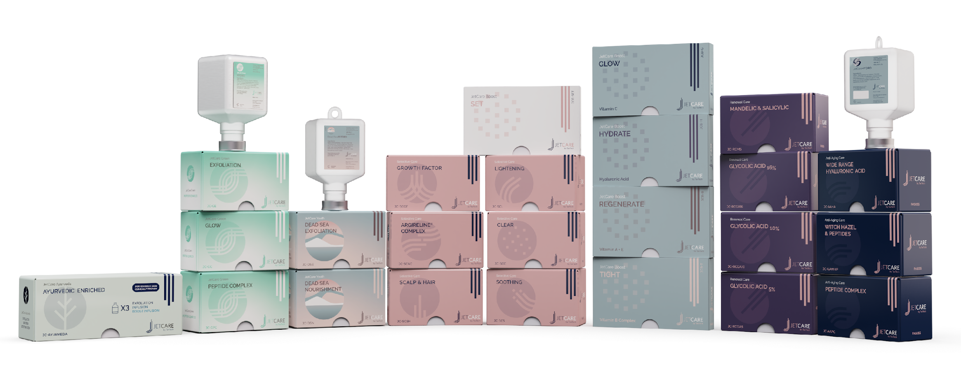
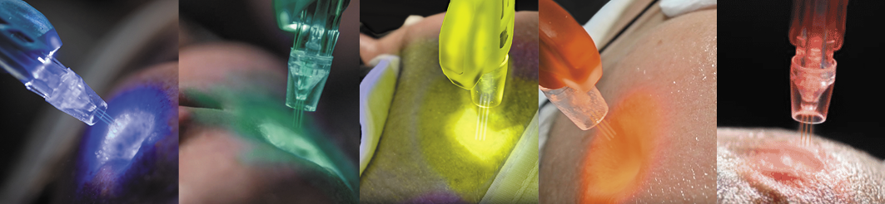
Combined Simultaneously with JetPeel Pressure-Energy and JetCare by TavTech Liquid Serums

Slide 8
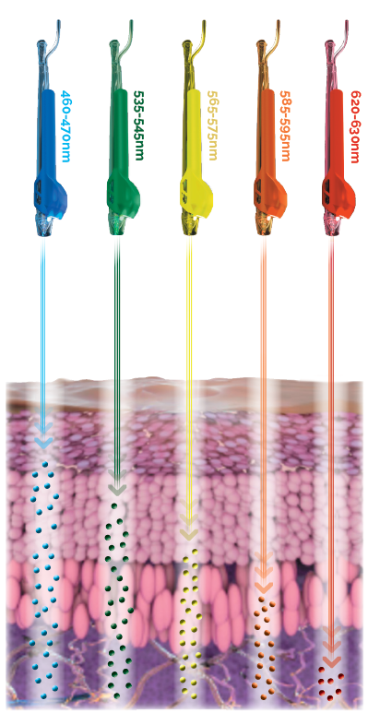
Why Jet-LED? The add-on impact
JetPro Duo and JetProToGo devices simultaneously combine two complementary aesthetic treatments in one clinic session:
Enhanced results: Give clients the clinically proven effects of LED therapy, together with jet pressure treatment to achieve better results.
No added treatment time: Two aesthetic treatment technologies are delivered simultaneously, without adding extra time to the session.
No extra consumables costs: Simply use the JetPeel handpiece with the LED components; no additional cost per treatment.
More colors available: The advanced LED components kit offers three additional LED colors as an accessory to the JetPro Duo and ToGo devices.

Slide 9
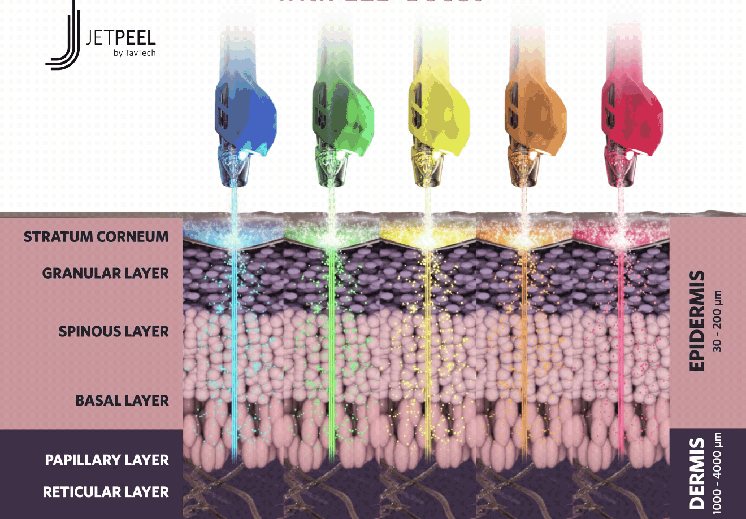
Lead your JetPeel Success with LED
THANK YOU

