Slide 1
JetPeel by TavTech
Publications Summary
2024

Slide 2
Indications
1. Anti-Aging
2. Hyperhidrosis
3. Melasma
4. Scalp & Hair

Slide 3
Table of Contents
1. Anti-Aging
Evaluation of Changes in Skin Biophysical Parameters and Appearance after Pneumatic Injections of Non-Cross-Linked HA in the Face
Short Review on Face Rejuvenation Procedures: Focus on Preoperative Antiseptic & Anesthetic Delivery by JetPeel
The Increase of Interfollicular Epidermal Stem Cells and Regulation of Aryl Hydrocarbon Receptor and its Repressors in the Skin through Hydroporation with Anti-Aging Cocktail
Epidermal & Histological Characteristics in Response to Hydroporation
Significant Improvement in Crows Feet after Treatment with JetPeel

Slide 4
Table of Contents
2. Hyperhidrosis
Painless & Effective Transdermal Botulinum Toxin A Delivery by JetPeel for Primary Hyperhidrosis
3. Melasma
The Effects of Hydroporation on Melasma with Anti-Aging Cocktail
Comparing Efficacy of JetPeel Assisted Tranexamic Acid and Vitamin C in Treating Melasma: A Split-Face Controlled Trial

Slide 5
Table of Contents
4. Scalp & Hair
Hair Loss Treatment using Erbium:YAG Fractional Laser with Hair Growth-promoting Solution Delivered by JetPeel
Transdermal Delivery of a New Hair Growth-promoting Solution in Patients with Hair Loss
A Novel Needleless Delivery System for Scalp Platelet-Rich Plasma
The Clinical Effect of JetPeel Assisted Topical Minoxidil in the Treatment of Androgenetic Alopecia: A Randomized Pilot Study
Appendix

Slide 6
1. Anti-Aging

Slide 7
Evaluation of Changes in Skin Biophysical Parameters and Appearance after Pneumatic Injections of Non-Cross-Linked HA in the Face
Hai-yan Cheng, Yu-xin Chen, Mei-fang Wang, Jun-ying Zhao, Lin-feng Li
Full Article Here
Twenty eight healthy female patients were treated with non-cross-linked HA into the face delivered by JetPeel for five consecutive weeks
Results:
  TEWL was significantly lower in week 4 than in baseline (18.47 vs. 22.03 g/h/m², p < 0.05)
  Skin texture was better in week 4 than in baseline (599 vs. 668, p < 0.05)
  Skin pores improved significantly at week 4 vs. baseline (934 vs. 1024, p < 0.05)
  Skin wrinkles improved at 3 month follow-up vs. baseline (29 vs. 36, p < 0.05)
Improvement in skin redness after 5 treatments
Before (a) and after (b) X 40 skin biopsy with hematoxylin-eosin stain

Slide 8
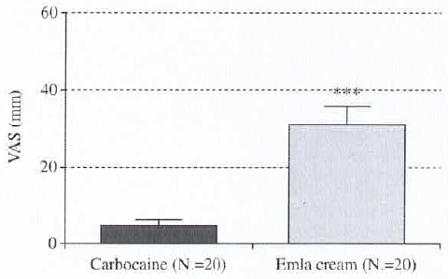
Short Review on Face Rejuvenation Procedures: Focus on Preoperative Antiseptic & Anesthetic Delivery by JetPeel
T. Iannitti, S. Capone, B. Palmiera
Full Article Here
The anesthetic power of JetPeel was tested on 40 adult volunteers by comparing Emla cream (n=20) to 3-carbocaine delivered by JetPeel together with chlorhexidine for sterilization and disinfection (n=20).
Results:
  The spontaneous pain sensation perceived by the patients in the JetPeel treated hemiface was significantly lower compared to the Emla cream treated hemiface (p < .0001)in a short time
  The results point to JetPeel as being a good non-invasive approach which induces local anesthesia
JetPeel carbocaine protocol vs. Emla cream. Degree of pain measured by means of Scott-Huskisson VAS (mean +/- SE, mm)

Slide 9
The Increase of Interfollicular Epidermal Stem Cells and Regulation of Aryl Hydrocarbon Receptor and its Repressors in the skin through Hydroporation with Anti-Aging Cocktail
Jung-Won Shin MD, PhD, Hye-Ryung Choi PhD, Seung-Hye Yang MS, Ji-Young Choi MD, Jung-Im Na MD PhD
Full Article Here
Skin samples from 6 volunteers were treated with JetPeel hydroporation using GHR formulation once a week for 8 weeks
Results:
  Markers for dermal matrix (procollagen type 1 and fibrillin-1) and basement membrane (type IV collagen and integrin α6) increased after treatment
  There was a significant increase of histone deacetylase 1-positive/p63-negative basal cells previously reported as interfollicular epidermal stem cells
  AhR decreased significantly while AhRR increased significantly indicating protection of the skin from the harmful environment

Slide 10
Epidermal & Histological Characteristics in Response to Hydroporation
Prof. Uwe Paasch MD, PhD, University of Liepzig
Full Article Here
Skin explants were subjected to JetPeel hydroporation for 10 s, 30 s, and 1 min.
Results:
  JetPeel hydroporation shows effective deposition of low molecular weight particles in a homogenous distribution up to a dermal depth of 1436 µm
Homogenous distribution in the skin up to depth of 1024 µm
Vacuole formation, removal of stratum corneum and circumscribed epidermal loss, localized separation of dermal fibre bundles
Complete loss of the epidermis, dermal vacuole formation, localized separation of dermal fibre bundles
Uniform vacuole formation, spreading of dermal fibres within the full depth of the dermis up to 1436 µm

Slide 11
Significant Improvement in Crow’s Feet after Treatment with JetPeel
Sang-Young Byun MD, Je-Byeong Chae MD, Jung-Im Na MD, Kyoung-Chan Park MD PhD
Full Article Here
Crow’s feet case study: 59 year old male was treated once a week for 12 weeks with JetPeel and GHR formulation on one side of face (“treated”) and with Jetpeel and normal saline on other side (“untreated”)
Results:
  Treated side shows significant improvement in crow’s feet
  Upper dermis: Significant collagen production, increased expressions of fibrillin, procollagen and tropelastin

Slide 12
2. Hyperhidrosis

Slide 13
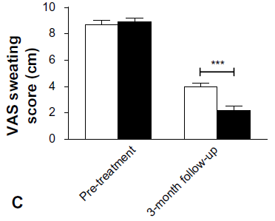
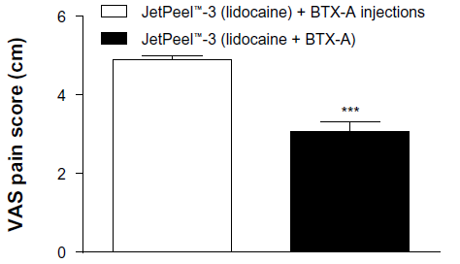
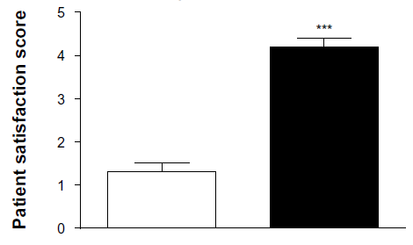
Painless & Effective Transdermal Botulinum Toxin A Delivery by JetPeel for Primary Hyperhidrosis
T. Iannitti, B. Palmieri, A. Aspiro, A. Di Cerbo
Full Article Here
20 patients with VAS sweating score > 8 cm were randomized to receive lidocaine 2% delivered by JetPeel followed by multiple injections of BTX-A, or with lidocaine 2% and BTX-A both delivered by JetPeel
Results:
  Both treatment modalities reduced sweating at 3 month follow up, while delivery of both lidocaine and BTX-A by JetPeel resulted in lower sweating than treatment with BTX-A injections
  Delivery of both lidocaine and BTX-A by JetPeel resulted in lower procedure related pain
  Patient satisfaction was higher in group receiving both lidocaine and BTX-A with JetPeel

Slide 14
3. Melasma

Slide 15
The Effects of Hydroporation on Melasma with Anti-Aging Cocktail
Je Byeong Chae MD, Seung Hye Yang MS, Sang Young Byun MD, Hye-Ryung Choi PhD, Jung-Won Shin MD, Kyoung-Chan Park MD Phd.
Full Article Here
6 volunteers with melasma were treated with JetPeel and a GHR formulation once a week for 8 weeks
Results:
  Pigmentation and erythema were relieved
  MI and EI decreased
  Histopathologic observations shows type IV collagen and procollagen increase in upper dermis
  There is an increase in p63-positive cells along the basement membrane
  Findings suggest that JetPeel hydroporation with GHR formulation induces anti-aging effects by reconstruction of extracellular matrix

Slide 16
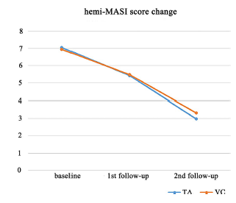
Comparing Efficacy of JetPeel Assisted Tranexamic Acid and Vitamin C in Treating Melasma: A Split-Face Controlled Trial
Huijuan Zhao MD, Mengna Li MD, Xiaofeng Zhang MD, Li Li MD, Yan Yan MD, Baoxi Wang MD
Full Article Here
Controlled trial with17 patients who were randomized to receive 8 weekly JetPeel split face treatments, one side with tranexamic acid (TA) and other side with Vitamin C (VC)
Results:
  A reduction in MASI was observed for TA and VC separately (p < 0.05)
  The difference between TA and VC was not statistically significant
  Both treatments were well tolerated

Slide 17
4. Scalp & Hair

Slide 18
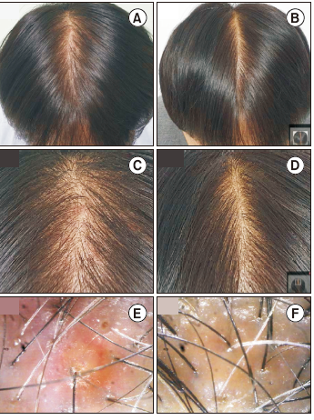
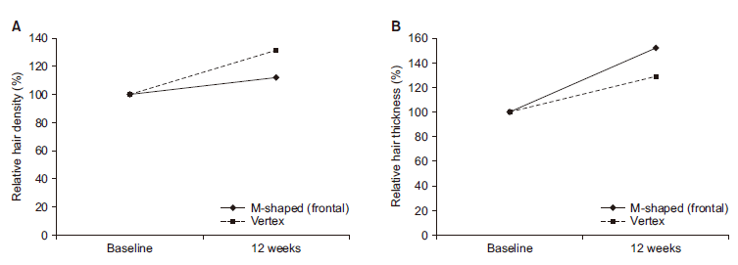
Hair Loss Treatment using Erbium:YAG Fractional Laser with Hair Growth-promoting Solution Delivered by JetPeel
Dong Hyun Ahn
Full Article Here
A case study showing a Laser – JetPeel combination treatment on a 48 year old male patient with frontal M-shaped, mid and vertex hair loss
JetPeel was used to apply a hair growth promoting agent immediately following each weekly Erbium:YAG fractional laser treatment over a 3 month period
Results:
  Hair density increased by 11-31% (depending on place)
  Hair thickness increased by 51-27% d(depending on place)

Slide 19
Transdermal Delivery of a New Hair Growth-promoting Solution in Patients with Hair Loss
Dong Hyun Ahn, Insoo Kang
Full Article Here
A retrospective case series including 6 Korean patients (5 male, 1 female) with alopecia who were treated once a week for 3 months with a hair growth-promoting solution delivered by JetPeel
Results:
  All patients demonstrated considerable improvement in both
  hair counts and hair thickness compared to baseline
  values at one week after final treatment session.
  No patient reported pain
  No side effects were reported

Slide 20
A Novel Needleless Delivery System for Scalp Platelet-Rich Plasma
Gary Linkov MD, Kumar Sukhdeo PhD, Elizabeth Grand MD
Full Article Here
Prospective evaluation of efficacy and usability of JetPeel for scalp PRP in patients with androgenic alopecia
5 female and 9 male patients with androgenic alopecia underwent 3 JetPeel sessions with PRP
Results:
  12 of the 14 patients showed improvements
  in overall hair restoration based on Jaeschke scale
  (average score 2.2)
  13 of the 14 patients said that they would
  recommend this treatment to others
  Pain was reported as 0%
Before and 6 months after 3 consecutive sessions with JetPeel delivered PRP

Slide 21
The Clinical Effect of JetPeel Assisted Topical Minoxidil in the Treatment of Androgenetic Alopecia: A Randomized Pilot Study
Lin Gong, Linlin Bao, Tian Tian, Yuanhong Li
Full Article Here
30 male patients with AGA were randomly divided into 3 groups of 10:
  Group 1: Treated with JetPeel delivering 5% minoxidil once a week plus topical self-application of 5% minoxidil twice daily
  Group 2: Only topical self-application of 5% minoxidil twice daily
  Group 3: no treatment
  The study lasted 3 months
Results:
  The increase in hair amount and hair diameter in Groups 1 and 2
  were statistically significant (p < 0.05), with no significant difference
  in Group 3
  The difference between Group 1 and Group 2, and Group 1 and Group 3
  after 2 and after 3 months were significant (p < 0.05)

Slide 22
Appendix

Slide 23
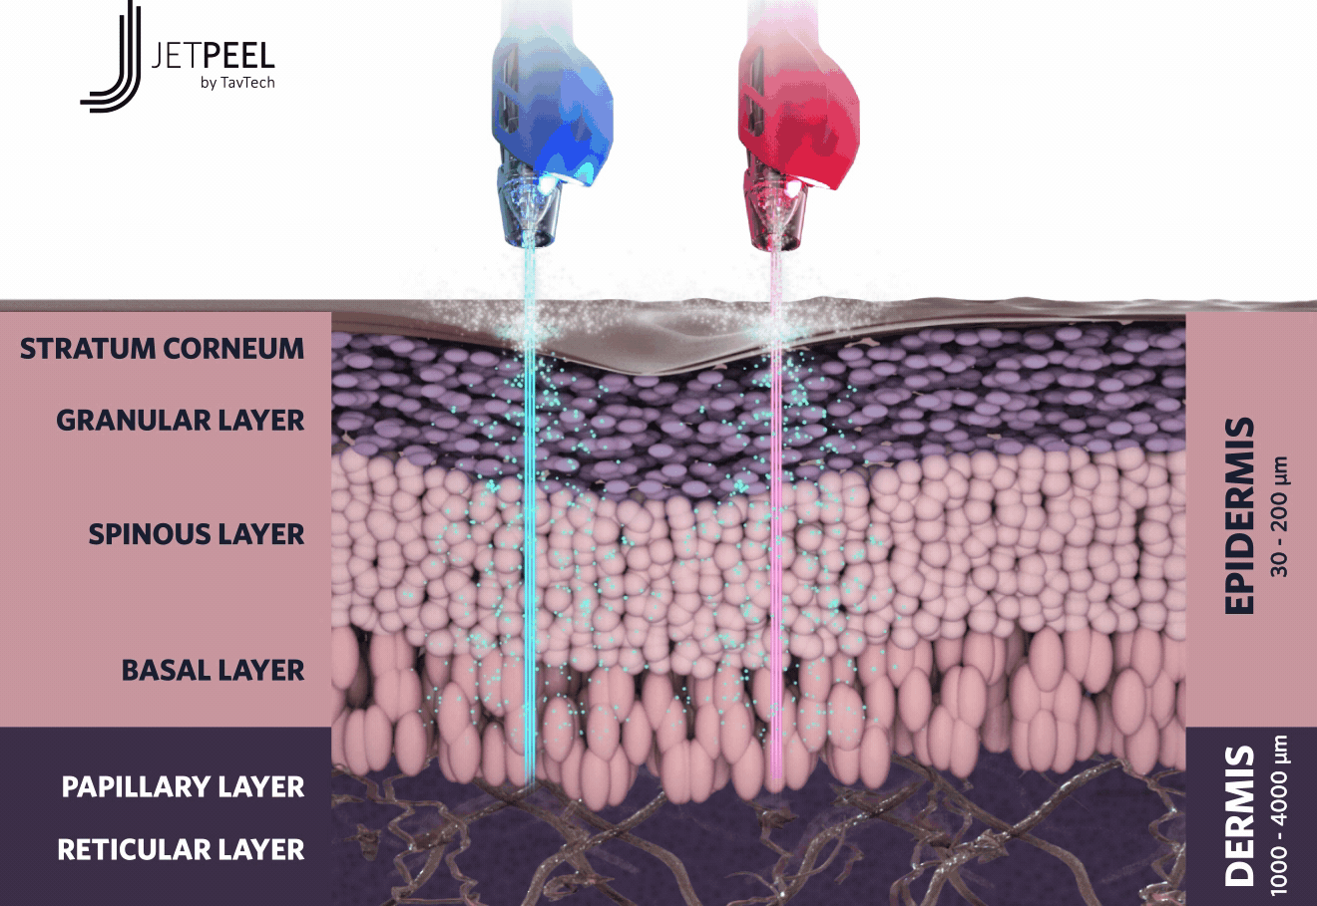
JetPeel by TavTech
Unique patented technology using jet pressure energy enabling aesthetic practitioners to perform rejuvenation treatments starting with a lymphatic massage to remove waste and toxins, followed by gentle exfoliation and effective infusion of skin-renewal and anti-aging solutions into the dermis. The treatment is pleasurable, non-invasive, safe, needle-free, pain-free and non-contact for aesthetic enhancement, with zero-downtime and immediate results.

Slide 24
Pressure-Energy: The power behind JetPeel
1
Pressurized air is generated at 95psi (6.5 bar)
High pressure is manipulated to accelerate liquid and form a misty jet with speed of 200 mt/sec
2
A concave region stretching the skin opens transdermal microchannels allowing the
enriched liquid to penetrate deeper and deliver nutrients and treatment solutions
3

Slide 25
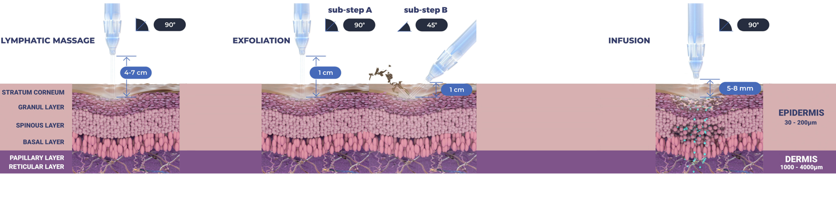
The Versatility of JetPeel
LYMPHATIC
MASSAGE
GENTLE
EXFOLIATION
EFFECTIVE
INFUSION
BOOSTER
INFUSION

Slide 26
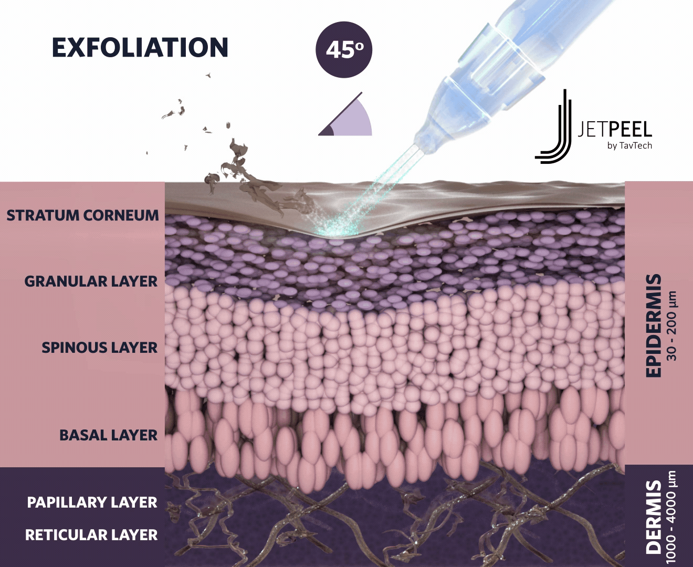
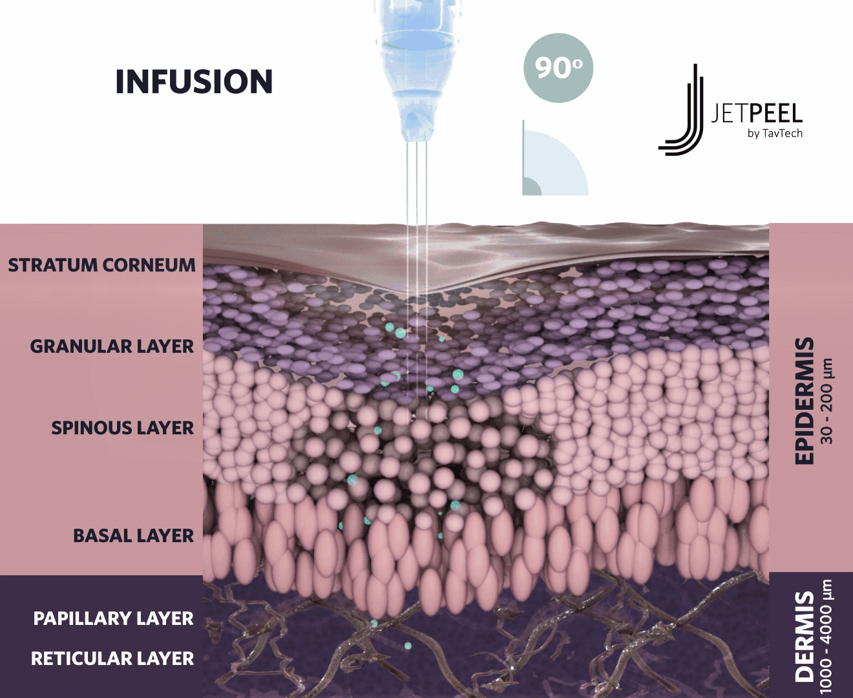
The Versatility of JetPeel

Slide 27
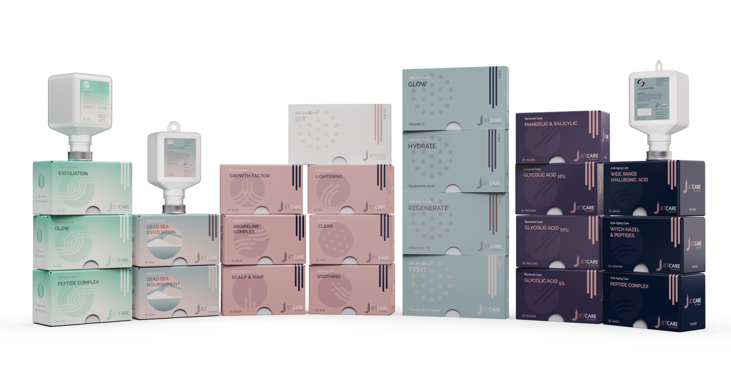
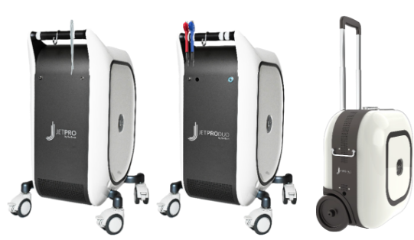
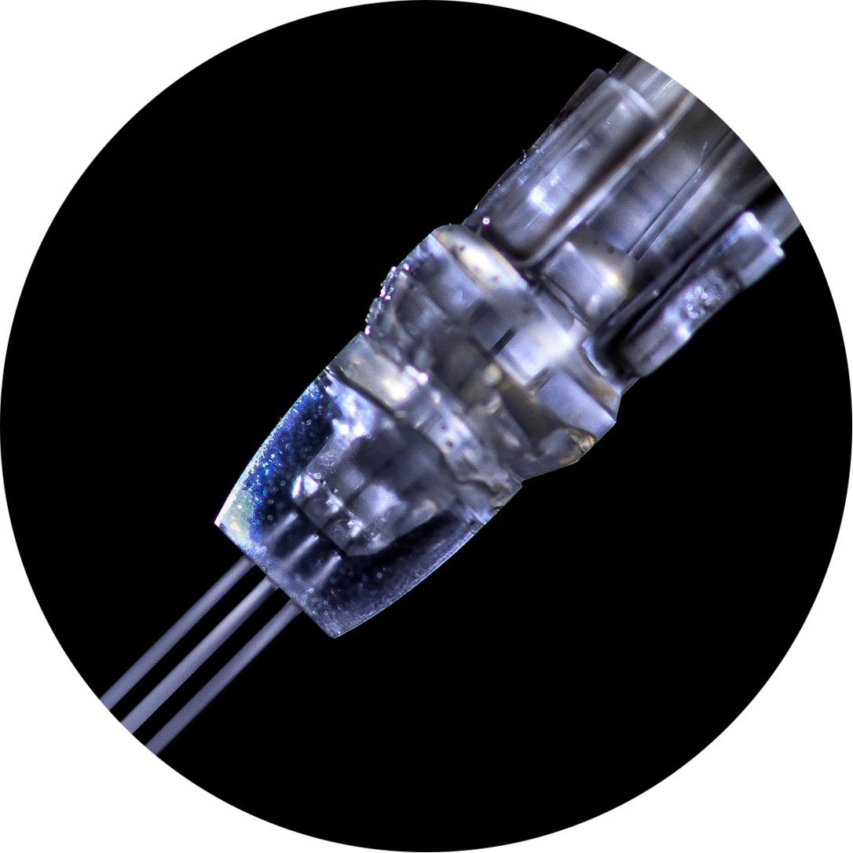
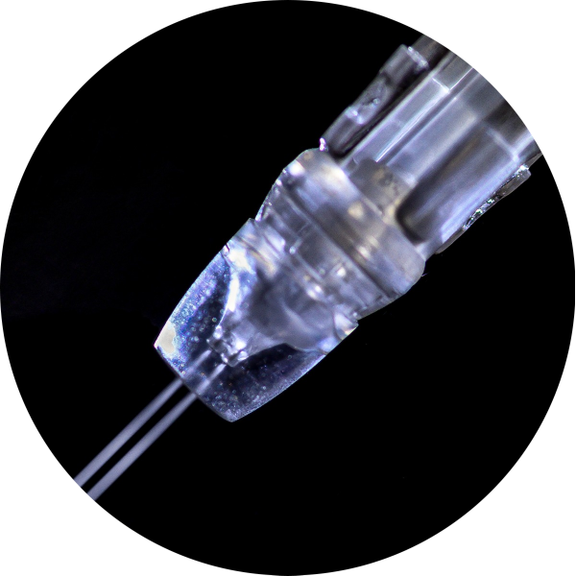
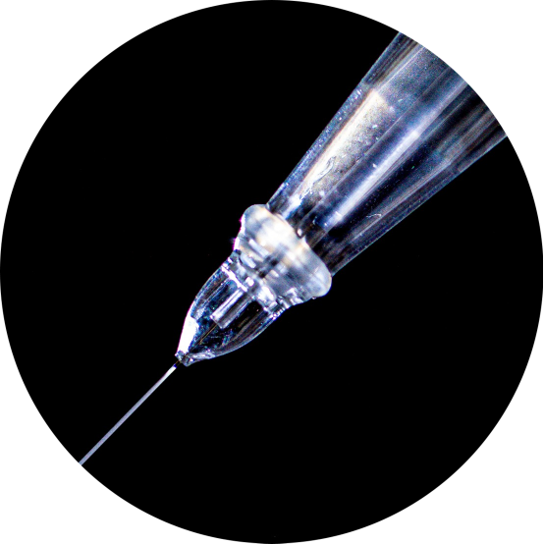
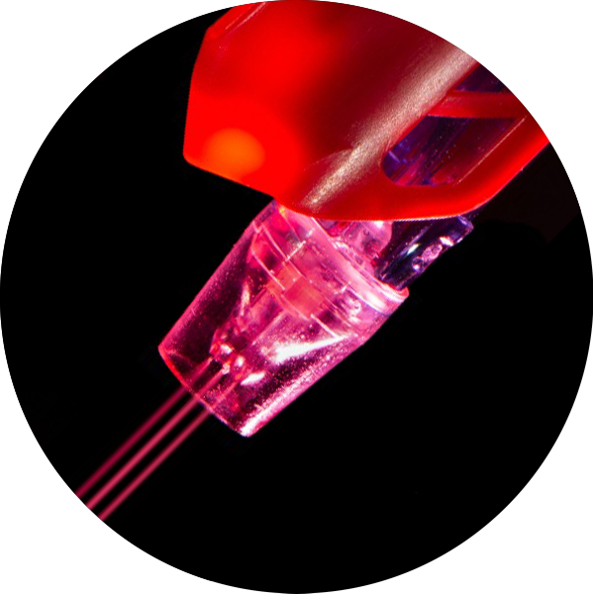
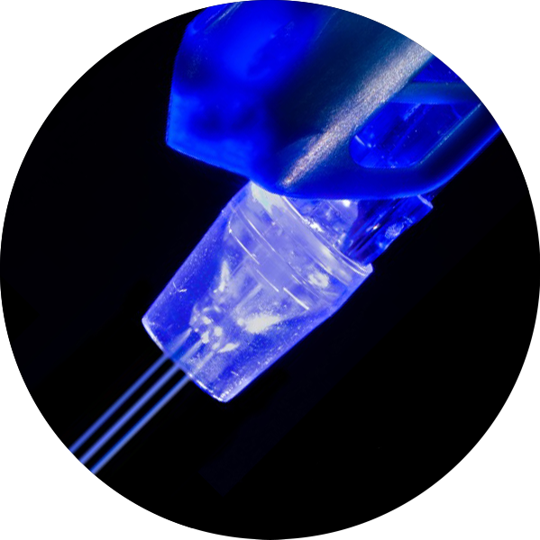
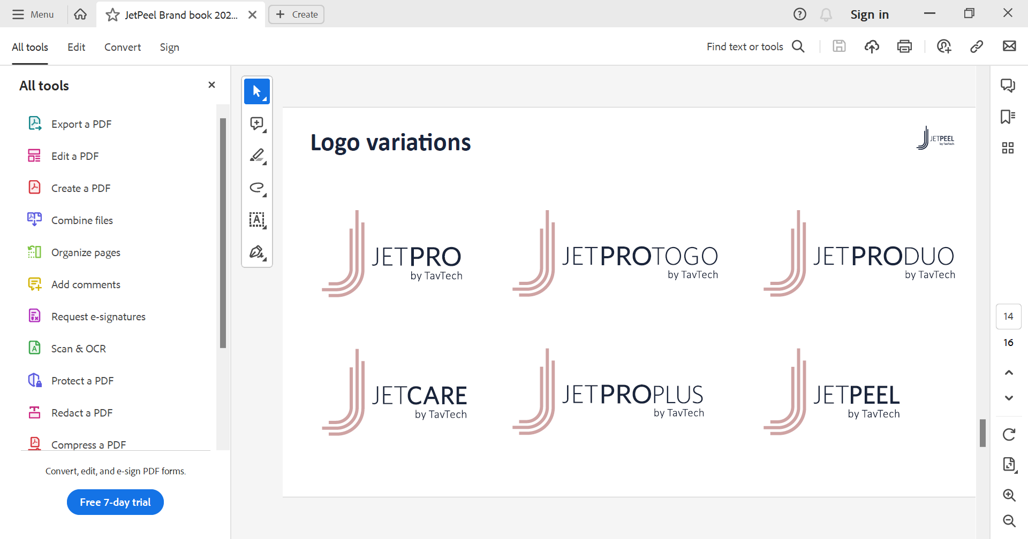
JetPeel by TavTech – the Perfect Trio
      The enduring JetPro devices
      The original patented JetPeel handpieces
      premium JetCare solutions
designed exclusively for use together to deliver outstanding results

Slide 28
Thank You

