Slide 1

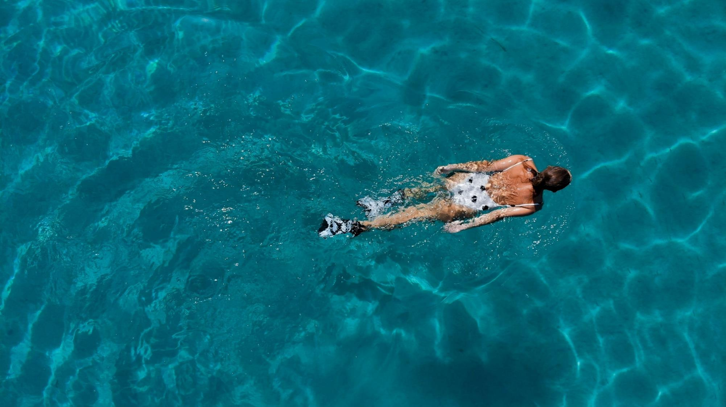
SUMMER IS COMING
The beach is waiting

Slide 2
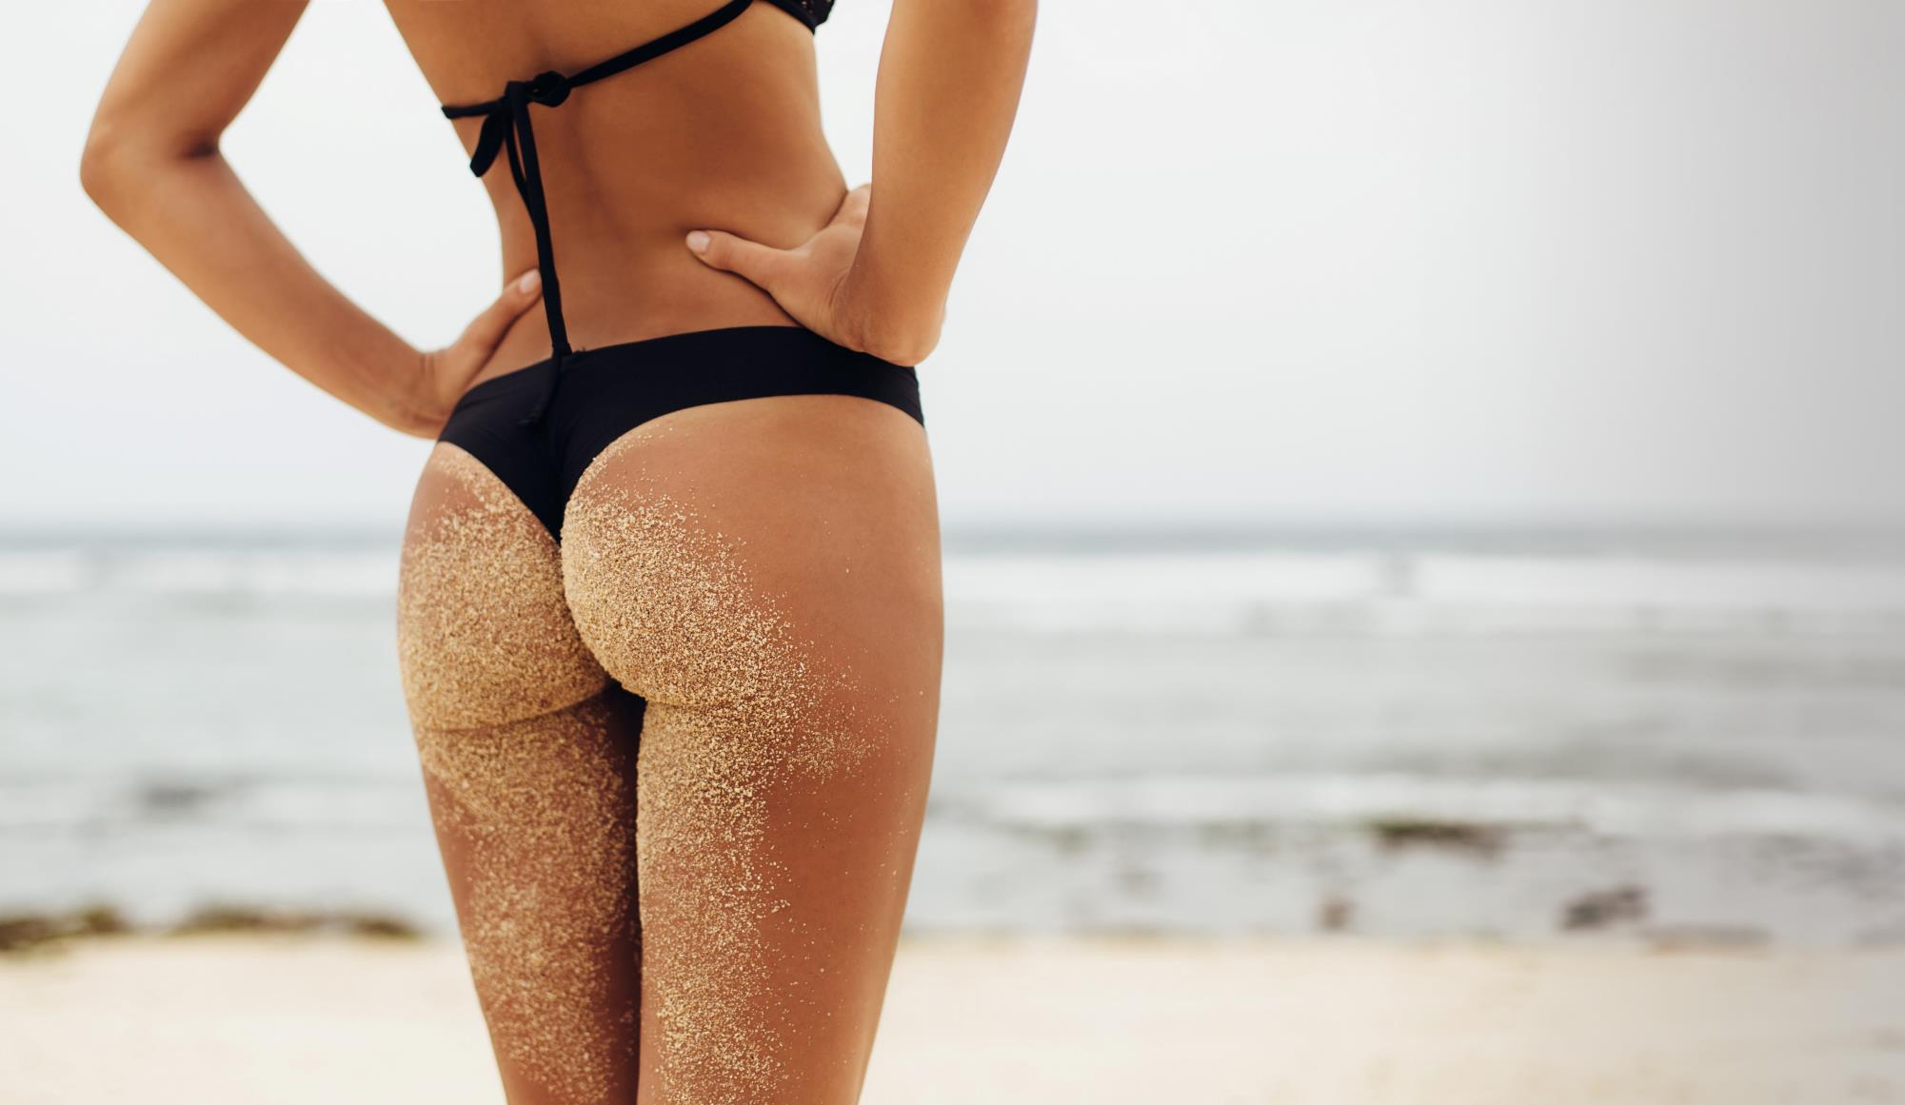
Skin is highly sensitive to damaging environmental factors like sun and sand

Slide 3
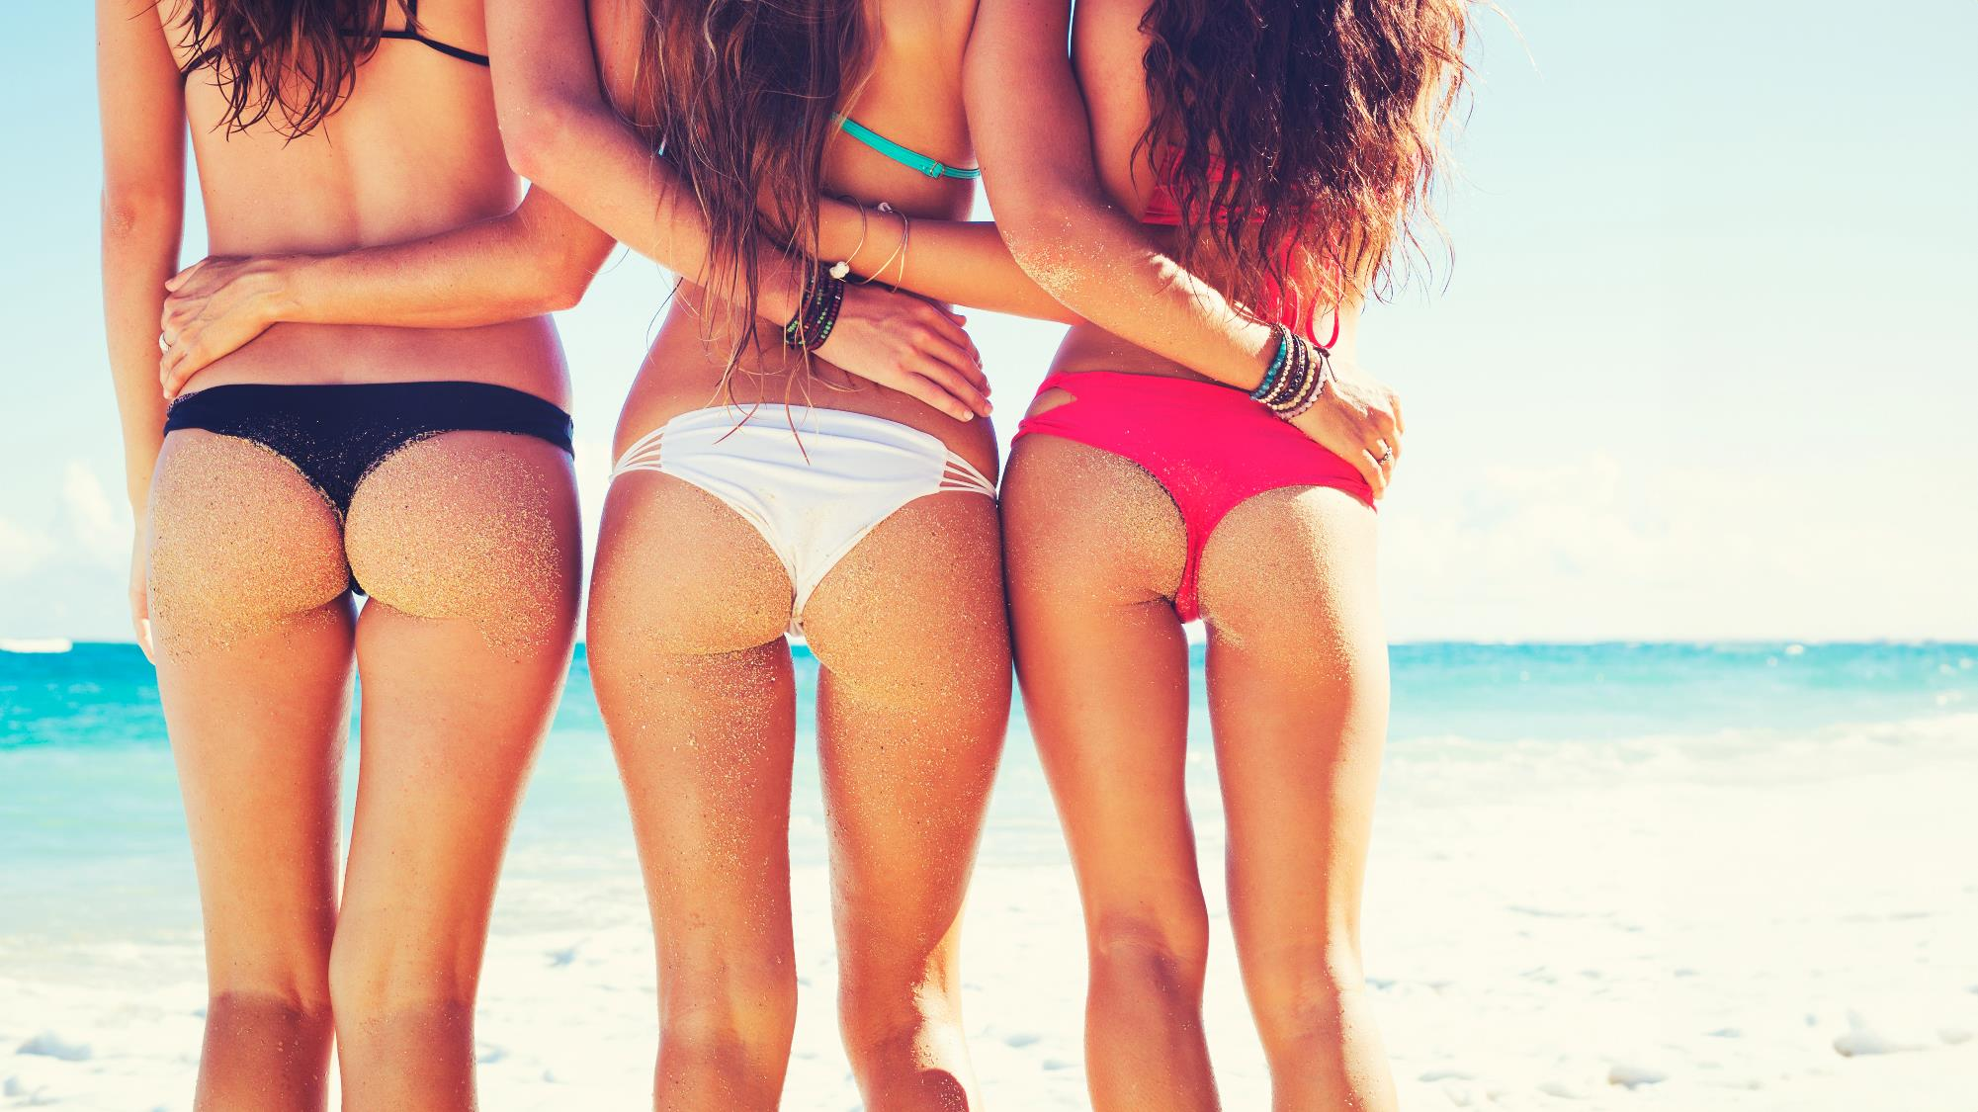
One of the most demanded aesthetic treatments in summer among young women is BUTTOCKS TREATMENT

Slide 4

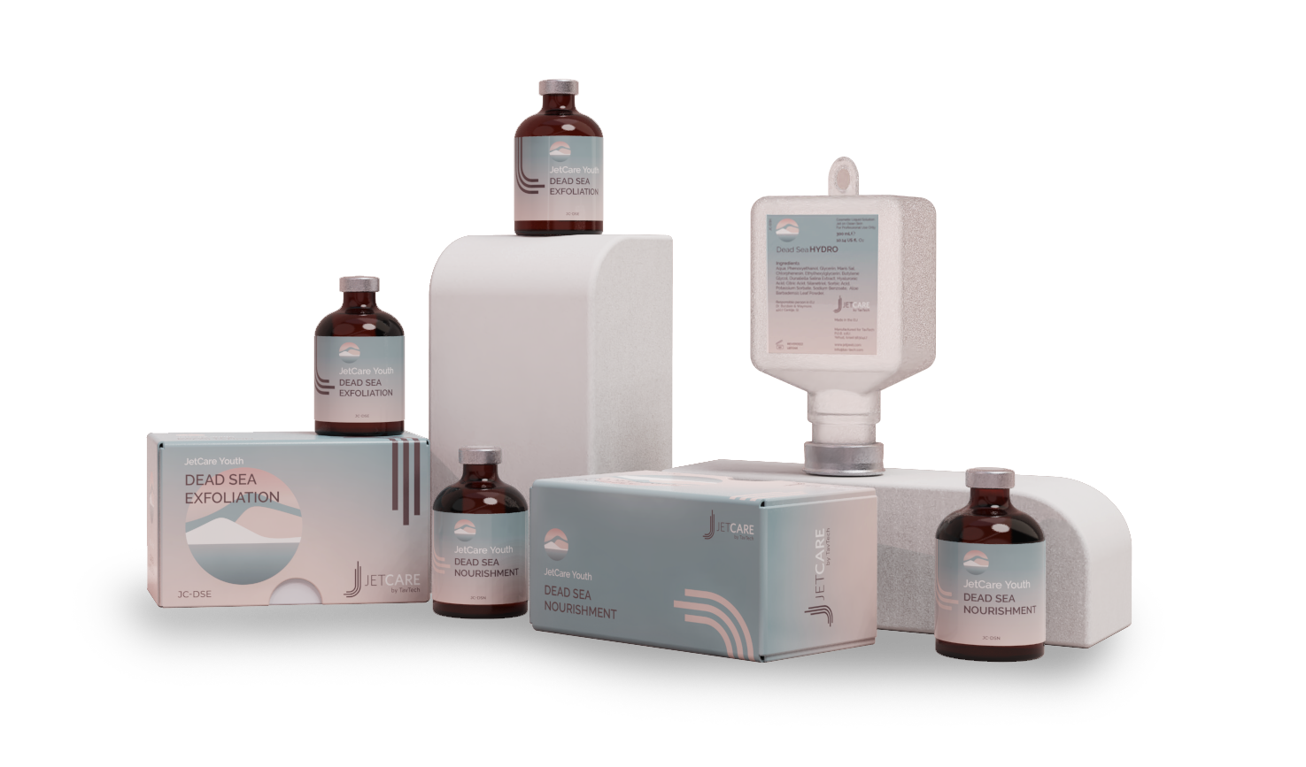
Buttocks Treatment
with JetPeel by TavTech
March 2024

Slide 5
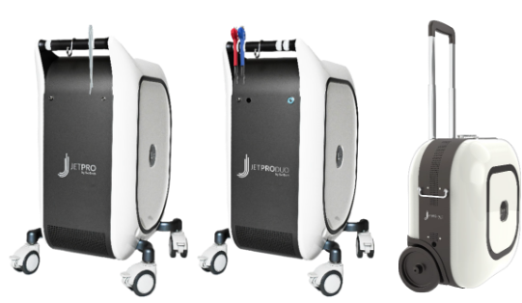
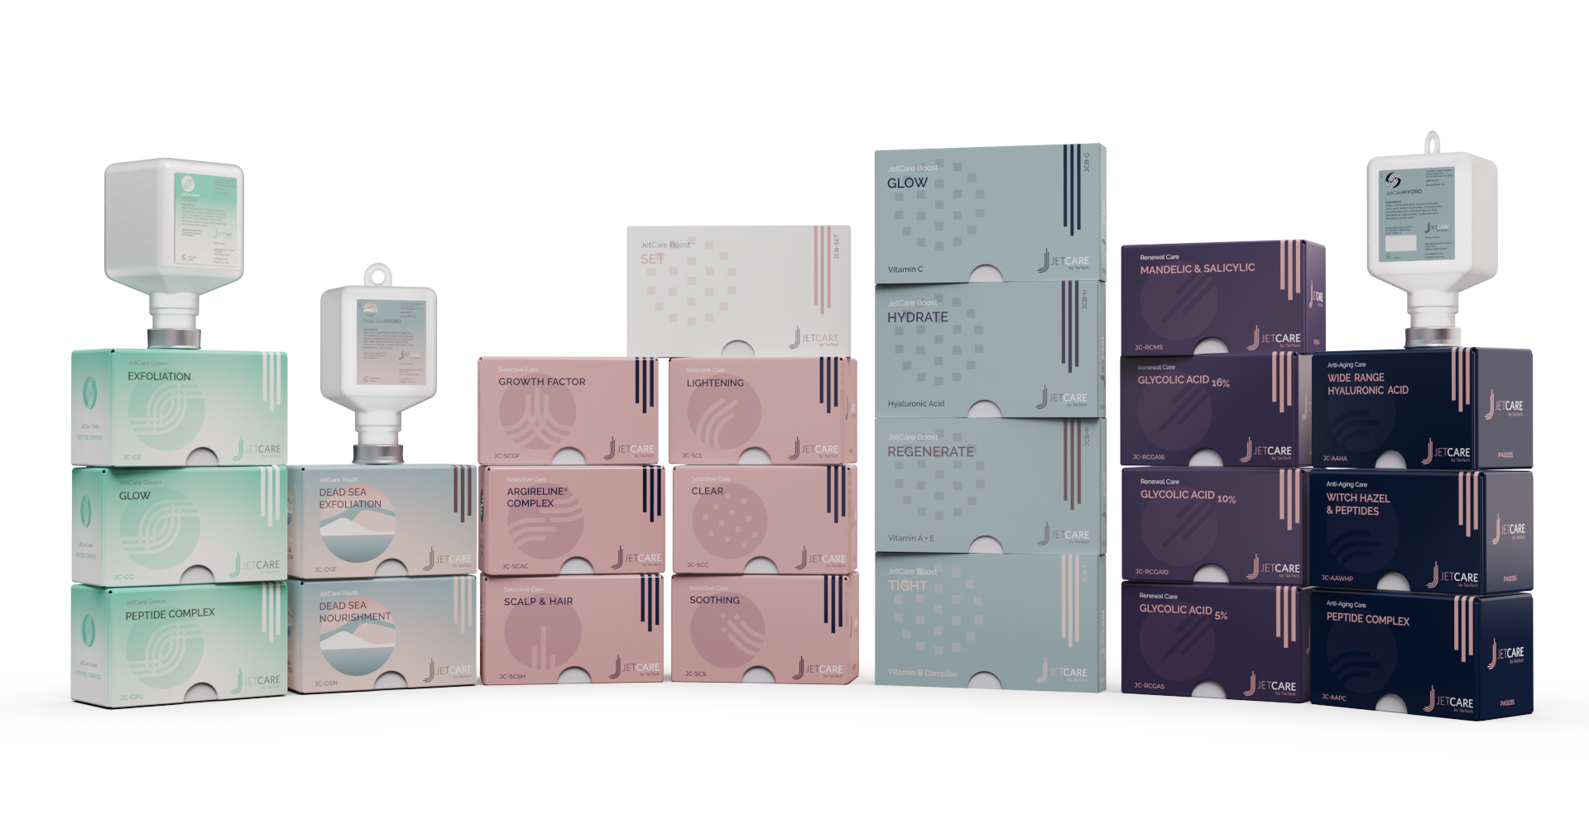
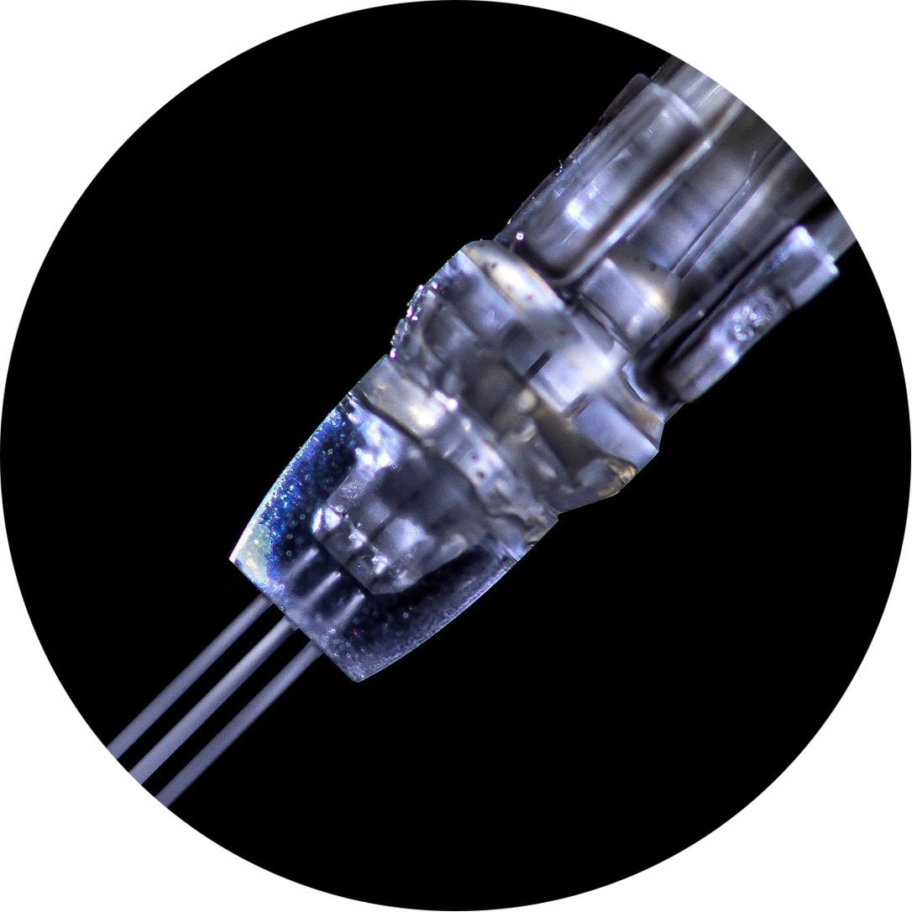
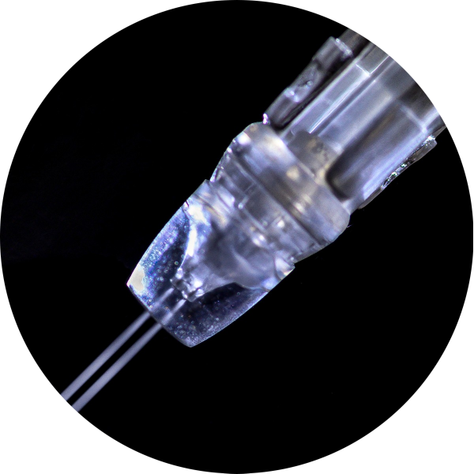
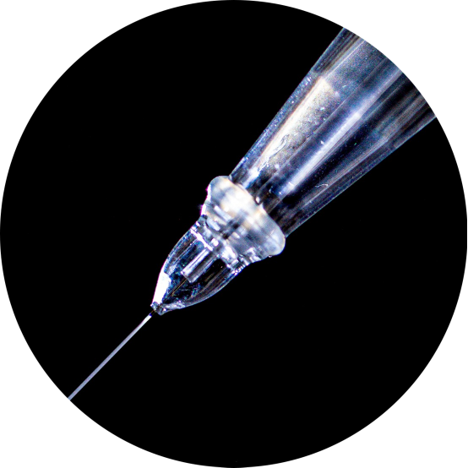
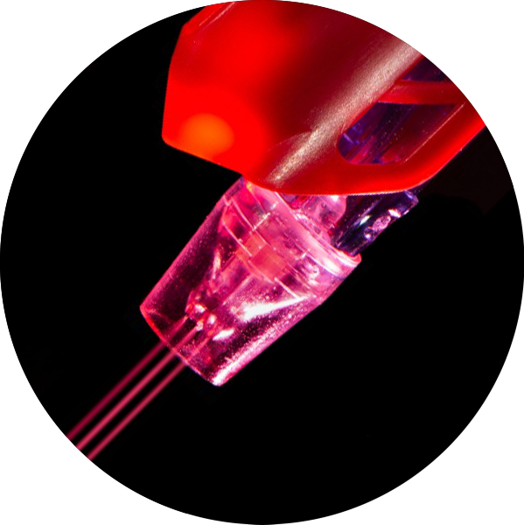
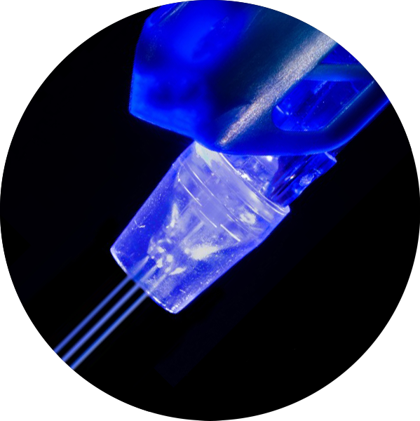
JetPeel by TavTech
Non-contact and non-invasive painless skin enhancing treatments which rejuvenates the skin and protects it from harmful environmental factors such as sand and sun
The enduring JetPro devices
The original patented JetPeel handpieces
The premium JetCare solutions

Slide 6
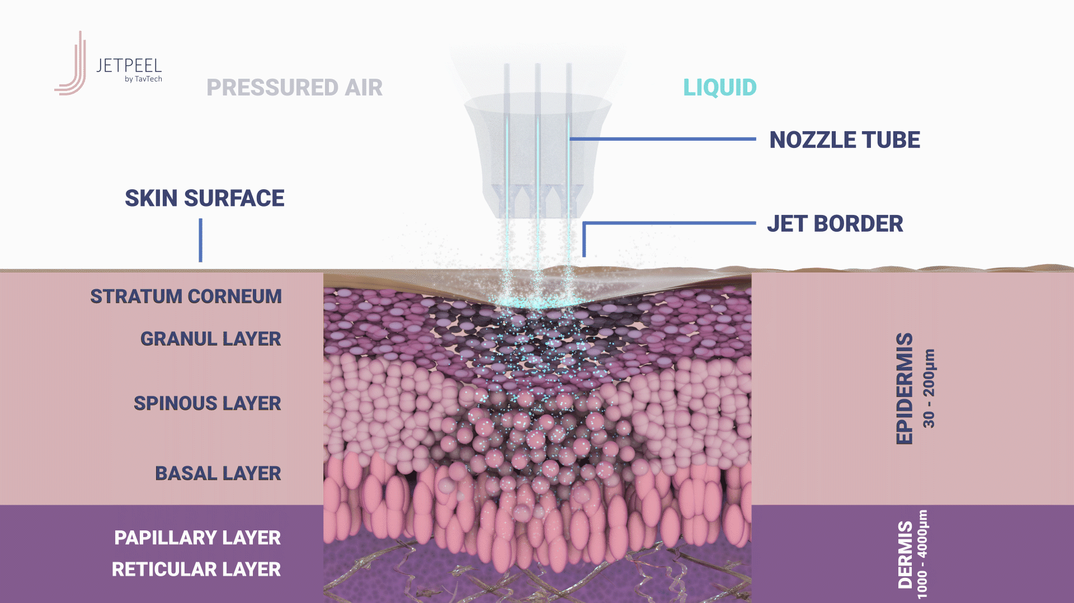
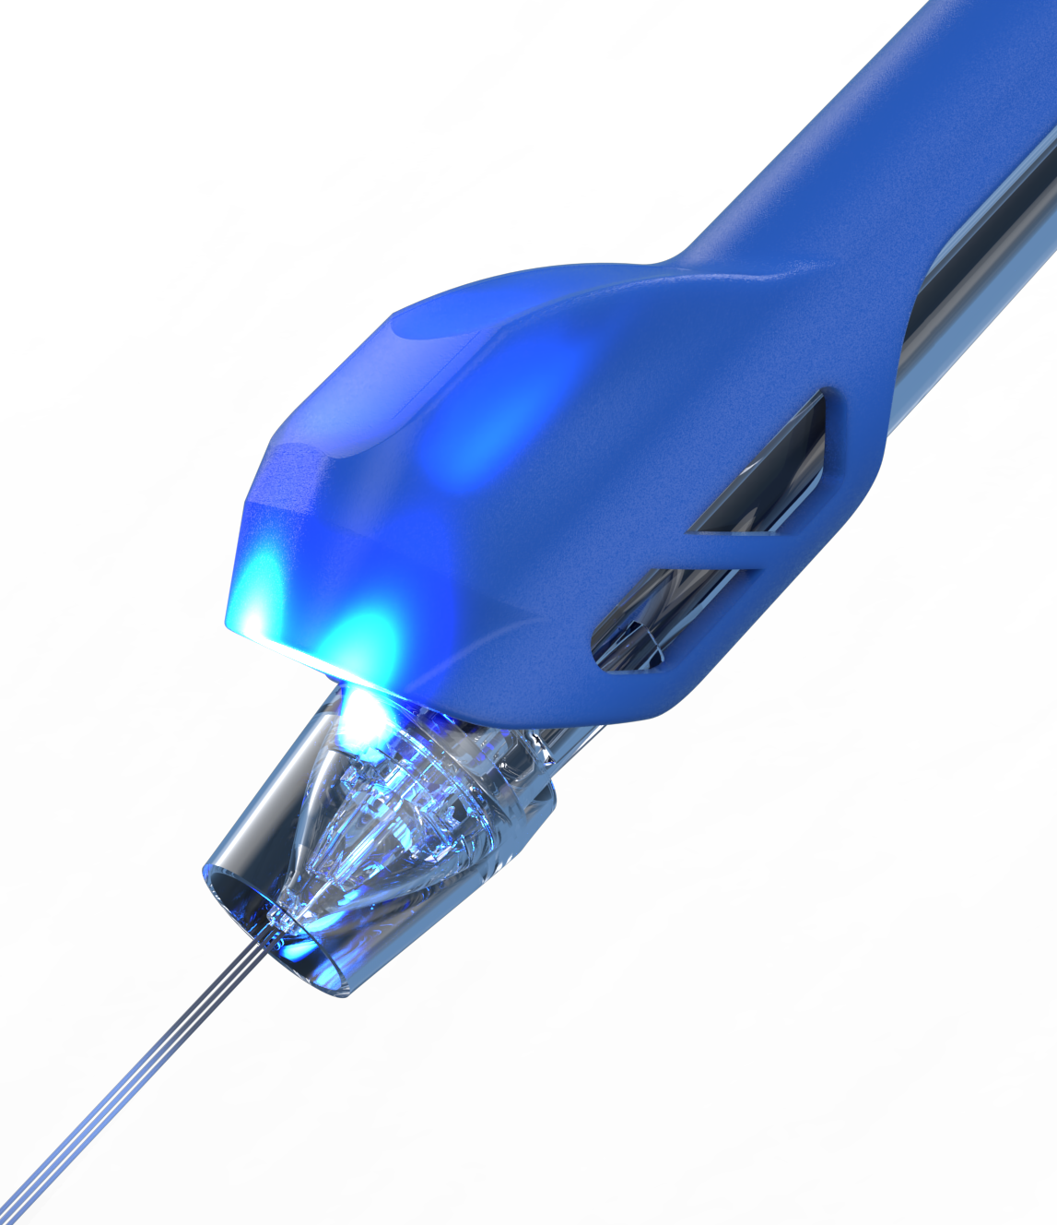
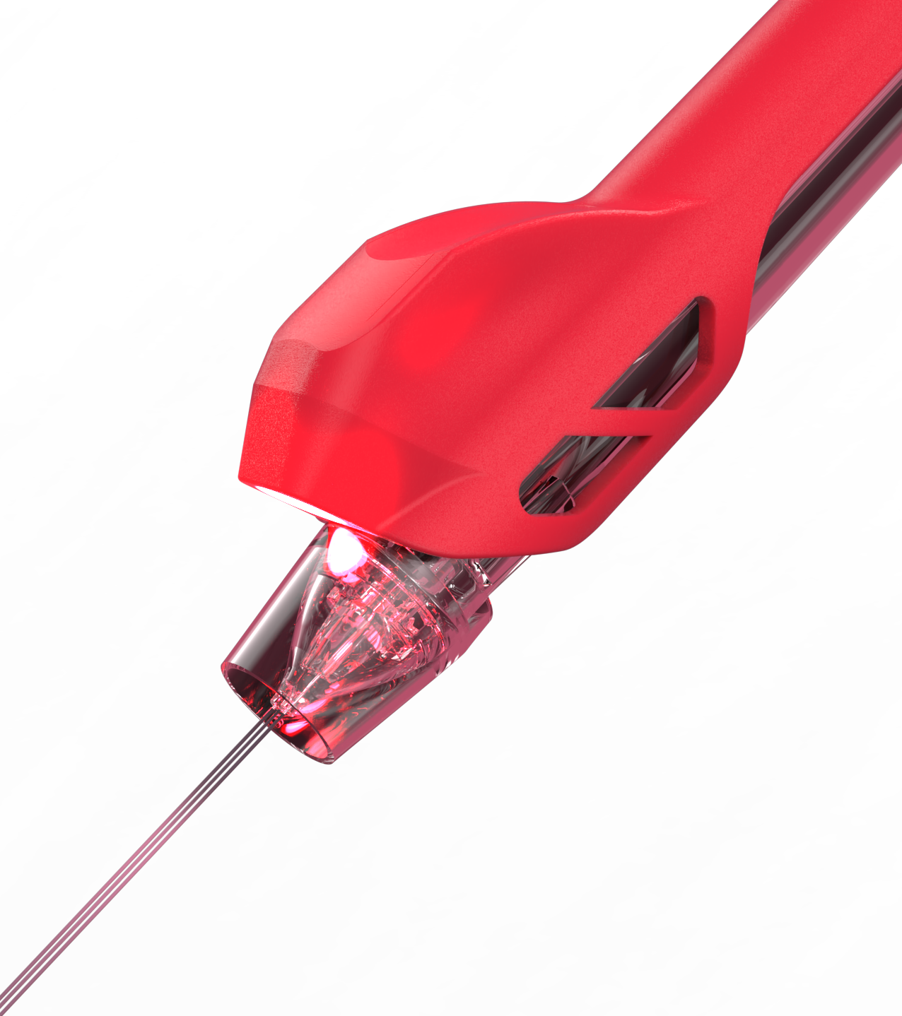
Future Proof the Skin with JetCare Youth
The needle-free skin-enhancement JetPeel treatment is performed without touching the skin through a jet stream enriched with bio-active ingredients and a LED boost to stimulate the skin cells activities and to regenerate collagen

Slide 7
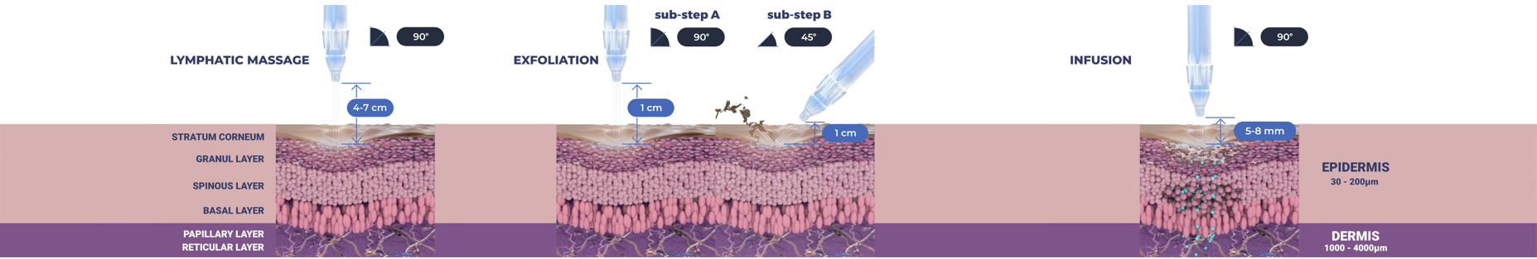

JetPeel by TavTech – Treatment Sequence
Skin pressure massage to improve micro-circulation
Pleasant exfoliation to remove dead skin cells for smoother and refreshed skin
Trans-epidermal infusion of vitamins, nutrients and minerals
Stimulate collagen and elastin production
Slow down natural aging process
Enhance skin elasticity
Delay skin imperfections

Slide 8
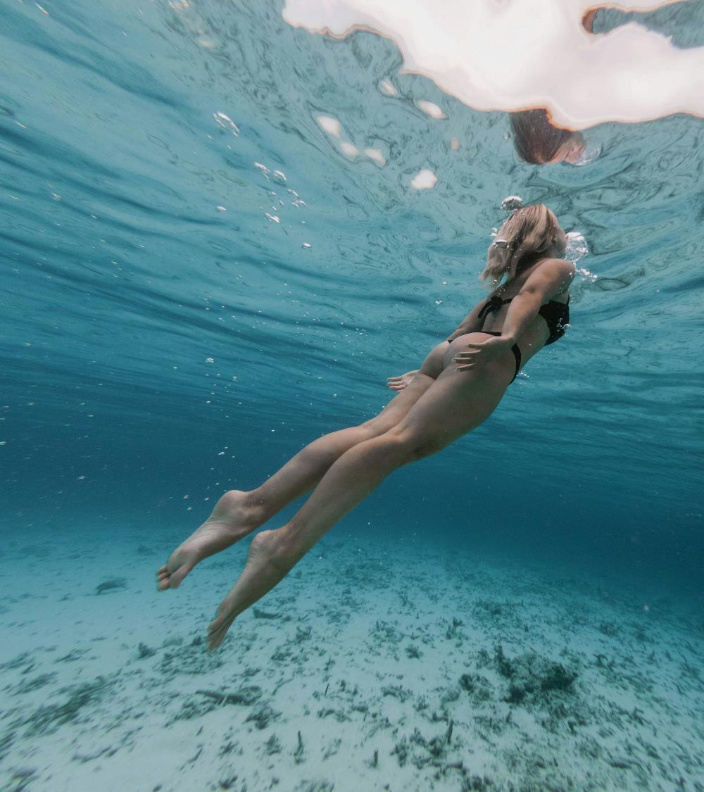

JetCare Youth enriched with Dead Sea minerals
is JetPeel’s unique Skin Aging Prevention solution

Slide 9
JetCare Youth by TavTech
Formulated with a blend of 21 Dead Sea minerals and natural antioxidants, JetCare Youth comprises 3 different formulations:
Dead Sea Hydro
Dead Sea Exfoliation
Dead Sea Nourishment
JetCare Youth modulates the biological function and prevents oxidative stress to maintain skin youth and vitality

Slide 10
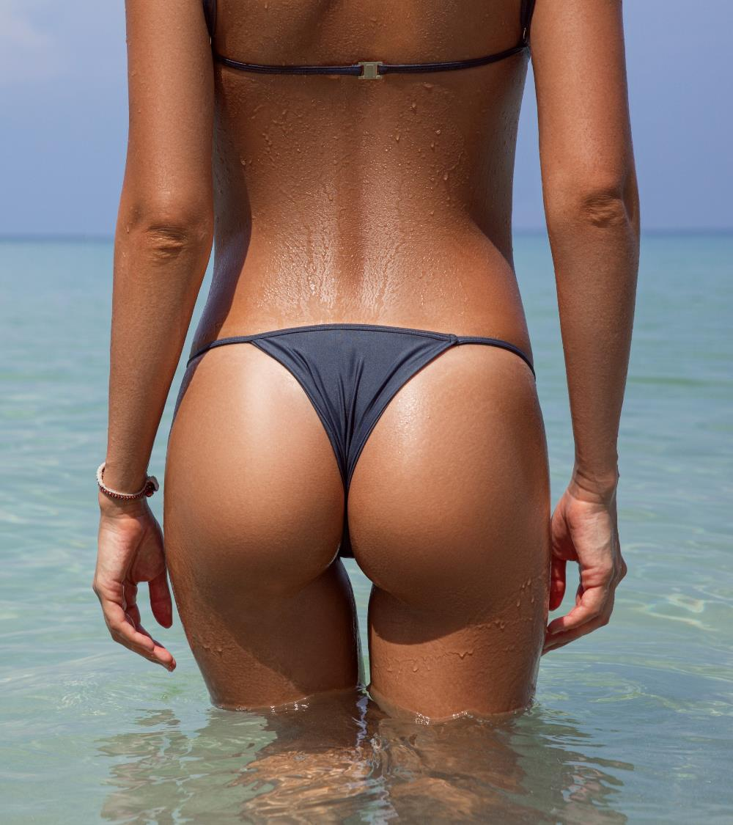
This summer “PREJUVENATE” your buttocks with JetPeel by TavTech
Stimulate collagen production and promote youthful appearance on the buttocks area
Prevent loss of skin tone before the sun and sand accelerate the aging process
Make the skin on the backside appear fuller, smoother and silky

Slide 11
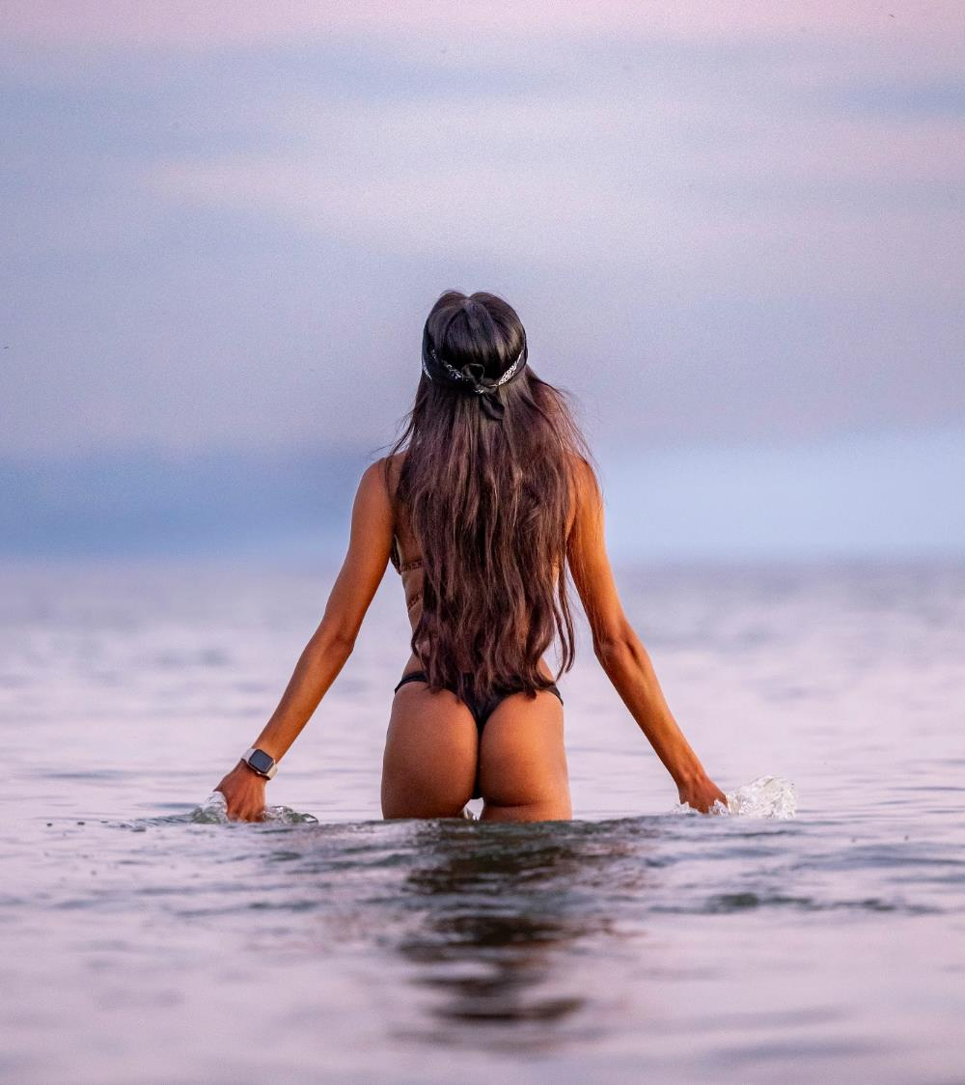
Who is this treatment dedicated to?
Beach-loving bikini–wearers in their late teens, 20’s and 30’s to preserve the skin’s natural youth

Slide 12
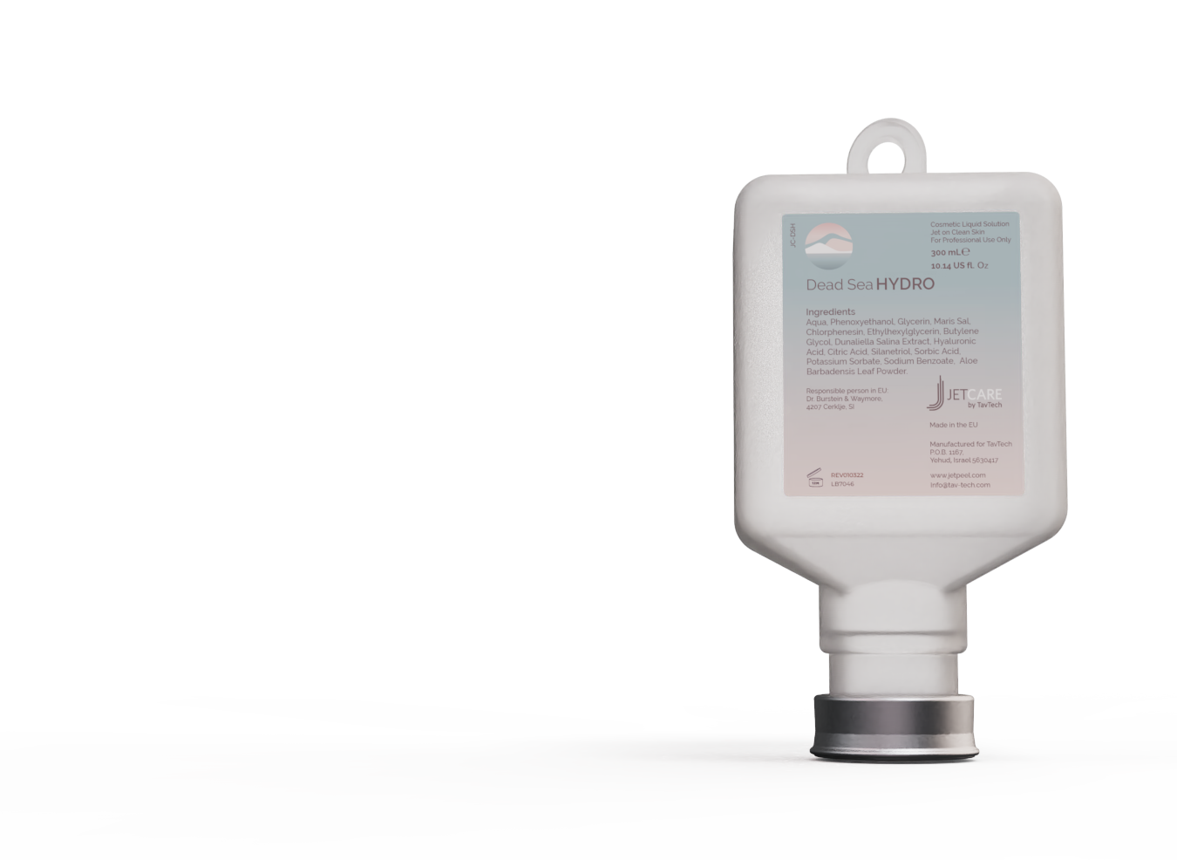
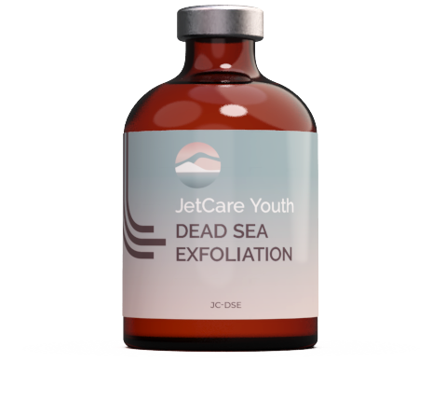
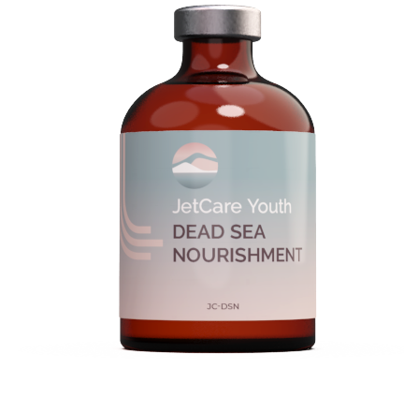
How JetPeel’s prejuvenation buttocks treatment works?
Prejuvenate your butts in the bikini season in just 3 steps!
Treatment time - 30 minutes
STEP
1
STEP
2
STEP
3
LYMPHATIC
MASSAGE
GENTLE
EXFOLIATION
INFUSION
With Dead Sea Hydro
With Dead Sea Exfoliation
With Dead Sea Nourishment

Slide 13

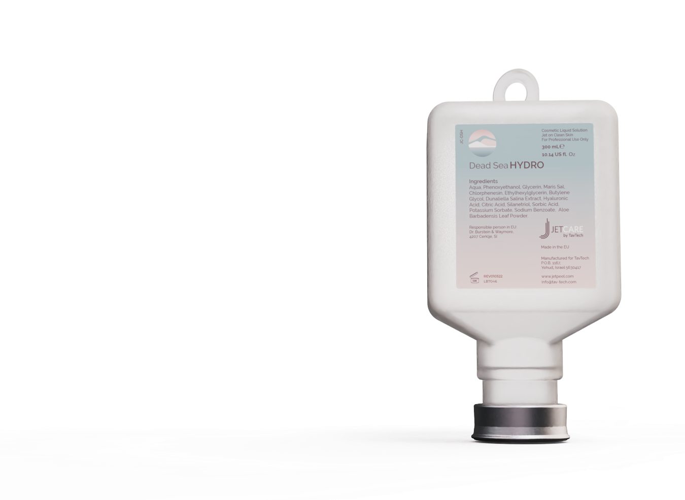
STEP 1- JetPeel 3D Massage
Stimulate micro-circulation and improve the skin tone
Enriched with Dead Sea mineral-rich salts: Helps cleanse and detoxify the skin
Dunaliella HGL: Helps reduce skin cell aging and protects from sun exposure damage
Organic Aloe Vera: Antioxidant emollient that rapidly softens and calms the skin and provides antimicrobial action.
10ml of the JetCare Dead Sea Hydro
TripleJet, held at 4 cm away from the skin at 90° to the skin
8 minutes
Notes:
If you have exfoliated with glycolic acid, wait 3-5 minutes (see also “Exfoliation Protocols”) and then repeat the same exfoliation with Jet Detox Water (same hand piece, movements and distance) to wash off the product and the debris at the same time. If you have exfoliated with mandelic acid, do not wash off the product and proceed directly to the infusion step.

Slide 14
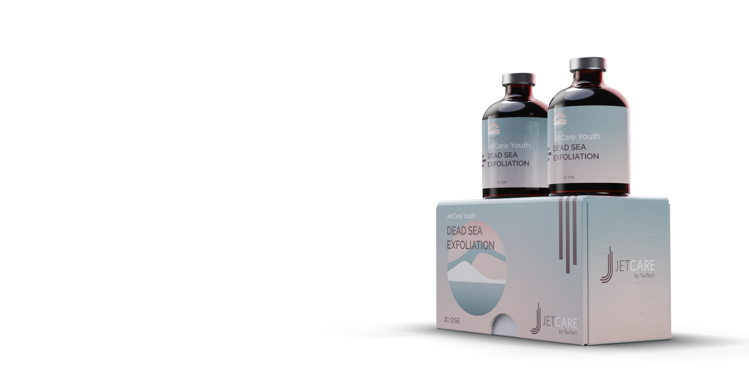
STEP 2 - Exfoliation
Exfoliates, reactivates new skin cells, preserves a youthful skin appearance
  Dunaliella HGL: Helps reduce skin cell aging and protect from sun exposure damage
  Allantoin: Helps moisturize, exfoliate and smooth the skin surface
  Lactic Acid: Gentle AHA that helps remove dead cells, stimulates cell renewal, and boosts the skin’s natural moisture
  Organic Aloe Vera: Antioxidant emollient that rapidly softens and calms the skin and provides antimicrobial action
  D-Panthenol 75%: Vitamin B₅, helps to seal in moisture, reinforce the skin’s natural barrier, and protect from the effects of exposure and aging
Approximately 6 - 8 ml of Dead Sea Exfoliation in the sub-step A, leave the acid for 8 minutes and after that wash off with approximately 8ml of Dead Sea Hydro
TripleJet, held at 1 cm away from the skin and 90° to the skin in the sub-step A, and at 45° in the skin in sub-step B
14 minutes
Notes:
If you have exfoliated with glycolic acid, wait 3-5 minutes (see also “Exfoliation Protocols”) and then repeat the same exfoliation with Jet Detox Water (same hand piece, movements and distance) to wash off the product and the debris at the same time. If you have exfoliated with mandelic acid, do not wash off the product and proceed directly to the infusion step.

Slide 15
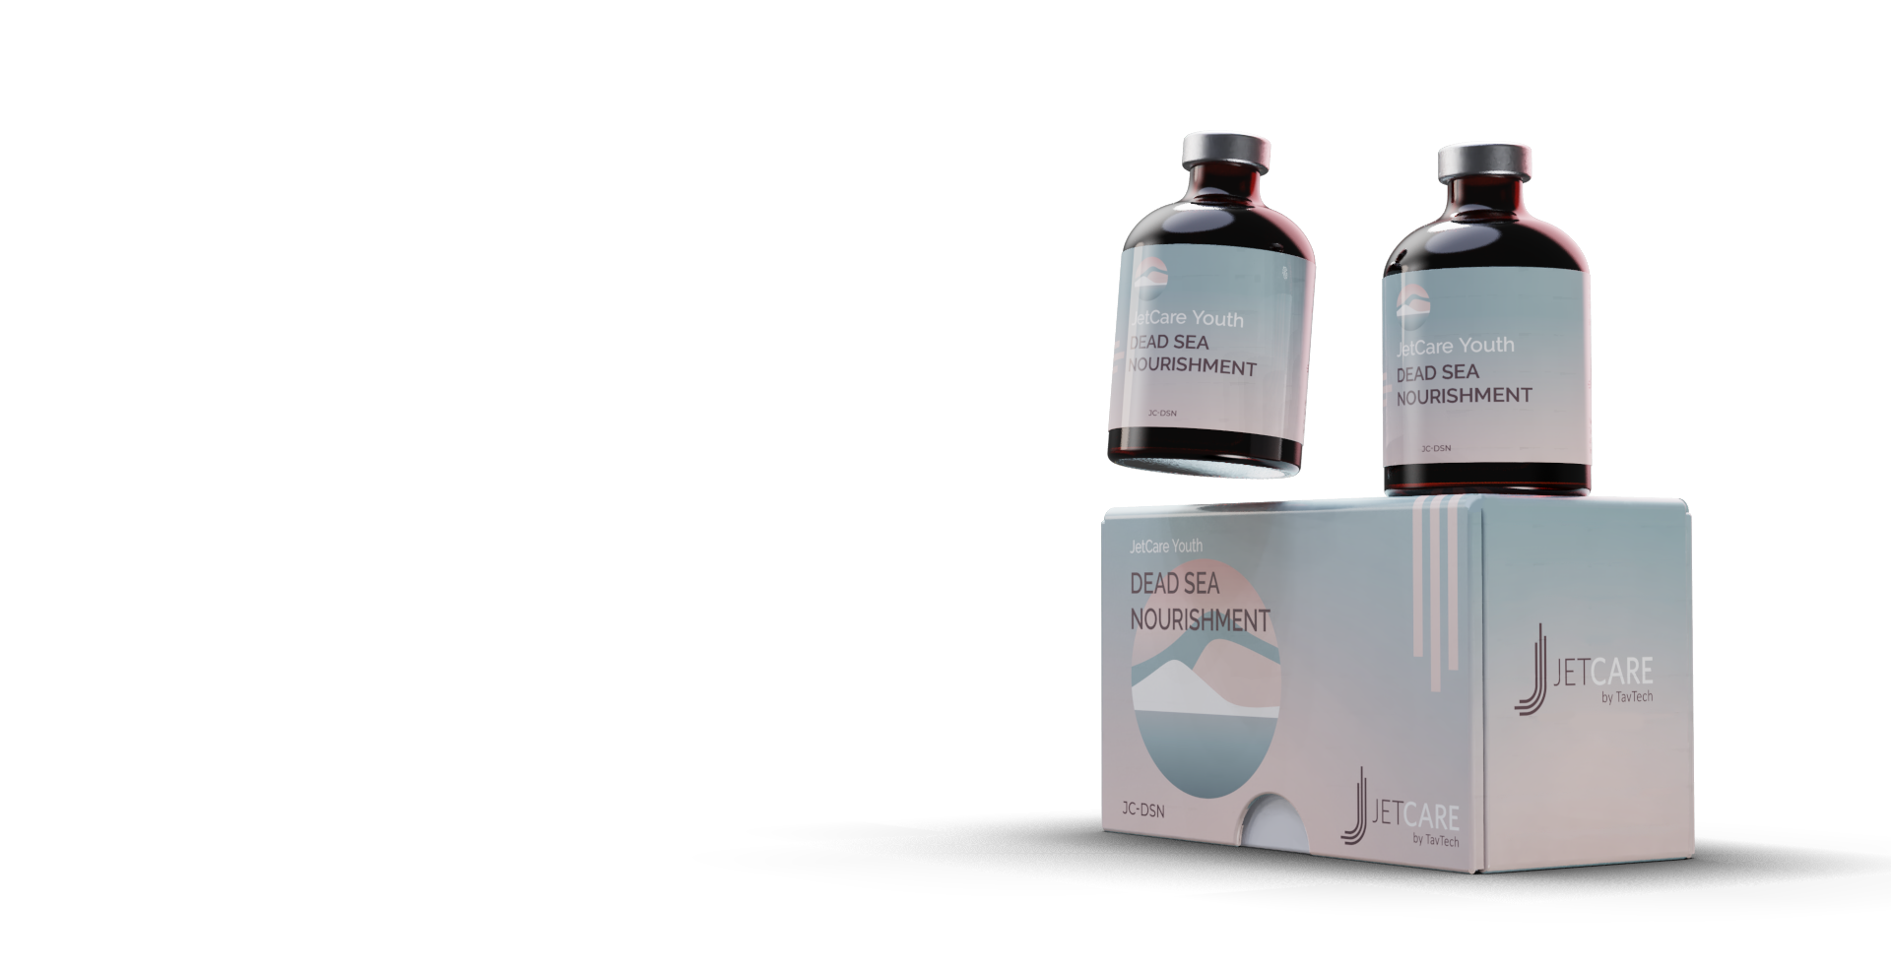
STEP 3 - Infusion
Boost skin hydration and regeneration
  Magnesium Sulfate: Extra boost of this powerful anti-inflammatory mineral that helps remove excess sebum and toxins that contribute to skin damage.
  Dunaliella HGL: Helps reduce skin cell aging and protects from sun exposure damage.
  SepitonicTM M3: Exclusive patented ingredient helps fight cell fatigue, boosts oxygen availability in the skin, and helps protect the dermis with anti-glycation action. It also acts as a carrier, helping to boost the effects of other anti-aging ingredients, strengthening the skin’s resistance to damage from everyday elements.
  Akoactive Queen: Sourced from the fresh rose petal, this ingredient is a powerful skin hydrator, helping to reduce signs of skin fatigue, refreshing overall appearance and tone.
Approximately 6 - 8ml of Dead Sea Nourishment
DoubleJet, held between 5 - 8mm away from the skin at 90° to the skin
8 minutes
Notes:
If you have exfoliated with glycolic acid, wait 3-5 minutes (see also “Exfoliation Protocols”) and then repeat the same exfoliation with Jet Detox Water (same hand piece, movements and distance) to wash off the product and the debris at the same time. If you have exfoliated with mandelic acid, do not wash off the product and proceed directly to the infusion step.

Slide 16
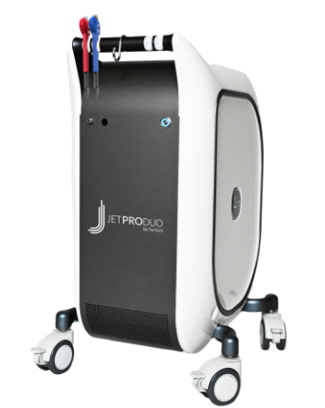
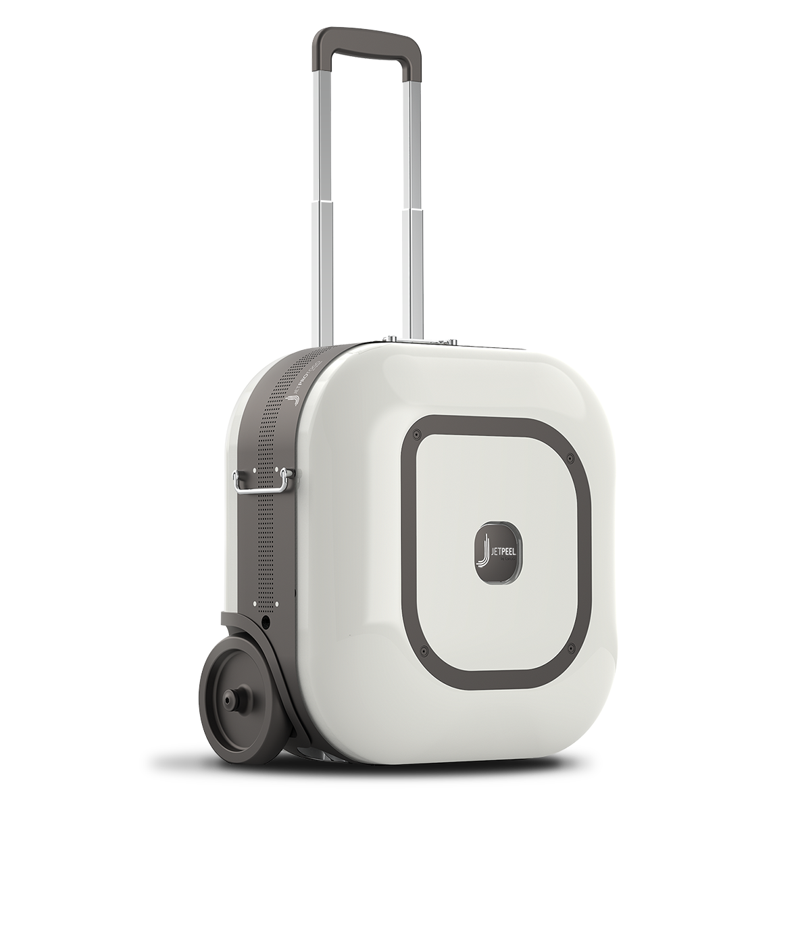
How many treatments should I have and how often?
This treatment, when performed with the JetPro Duo or with JetPro ToGo, simultaneously delivers hydroporation and red LED photoporation therapy to amplify the treatment results
6 treatment sessions to cover the bikini season
First 2 sessions:
3rd session:
4th session:
5th session:
6th session:
twice a week, 3-4 days apart
after 8-12 days
after 18-22 days
after 28-32 days
after 28-32 days
For best results, monthly treatments are highly recommended

Slide 17
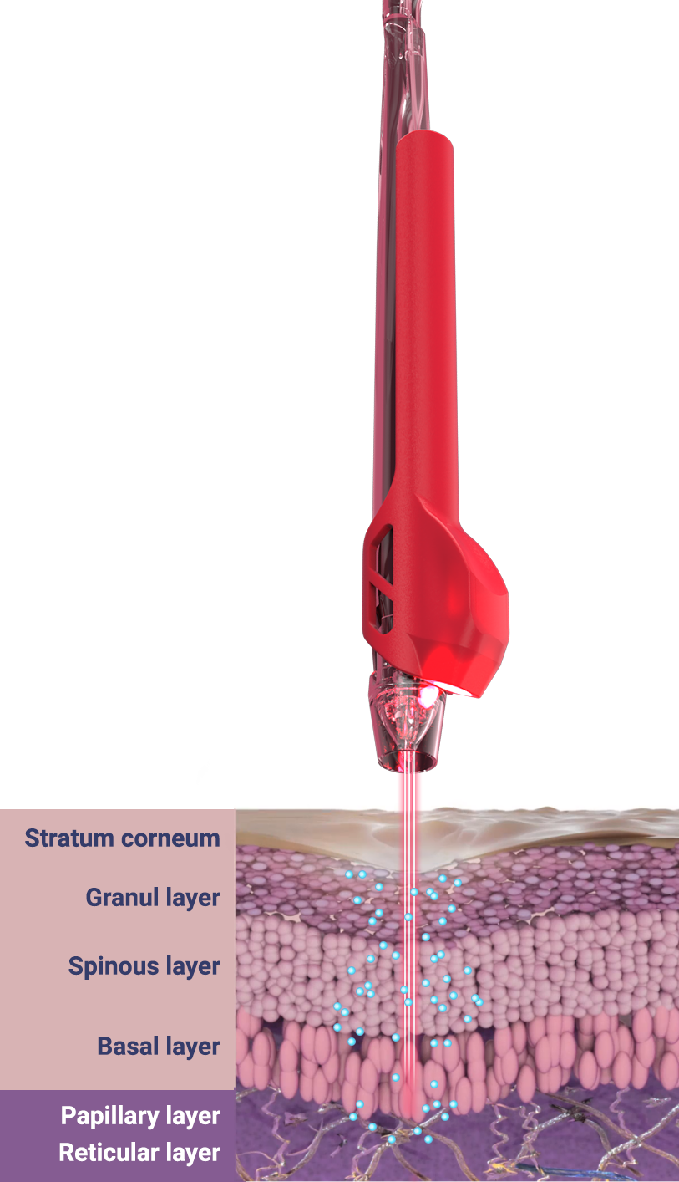
Red LED light affects mitochondrial function to produce ATP
JetPro Duo and JetPro ToGo provide the skin cells with:
Nutrients (infusion) + light therapy (photoporation) for increased efficacy

Slide 18
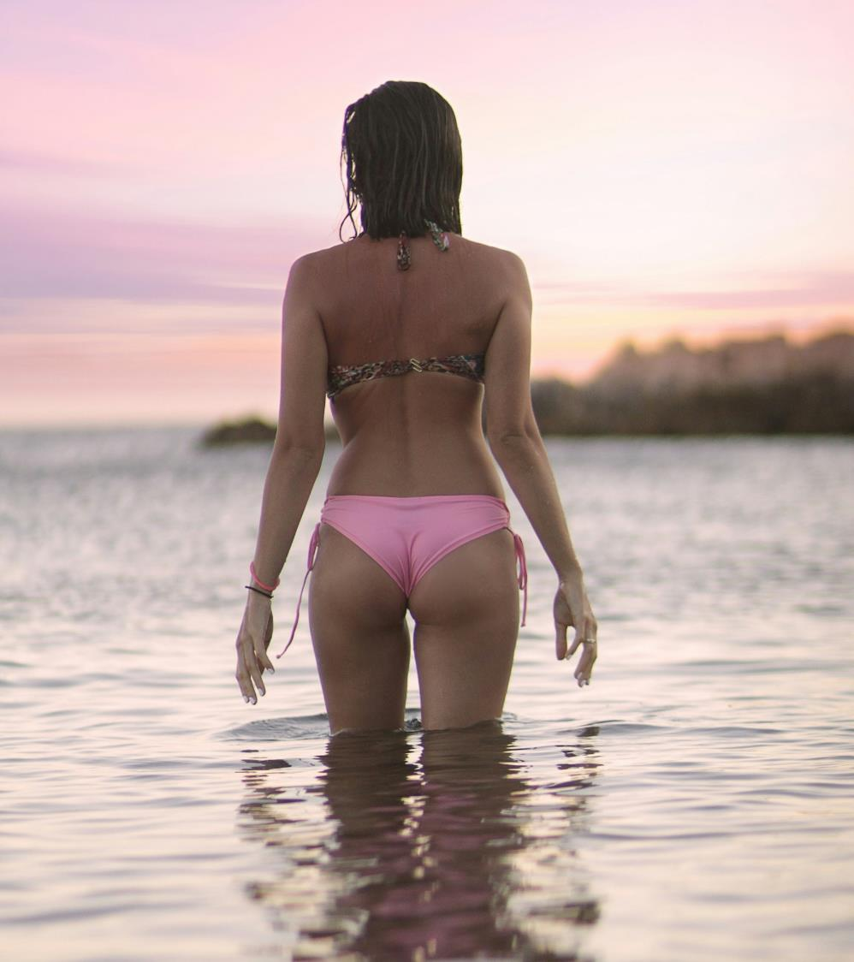
What results should we expect?
Skin refinement and an even, radiant skin tone after just one treatment
Skin protection from the damages of sun and sand exposure

Slide 19
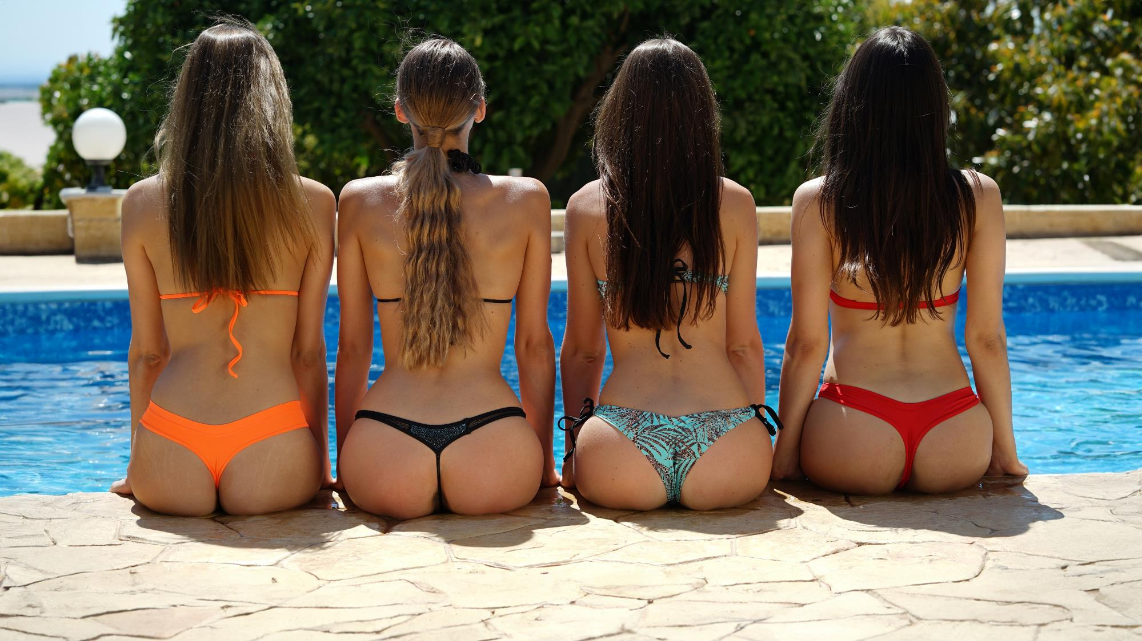
Jetpeel Buttocks Treatment
for healthy skin and self-confidence

Slide 20
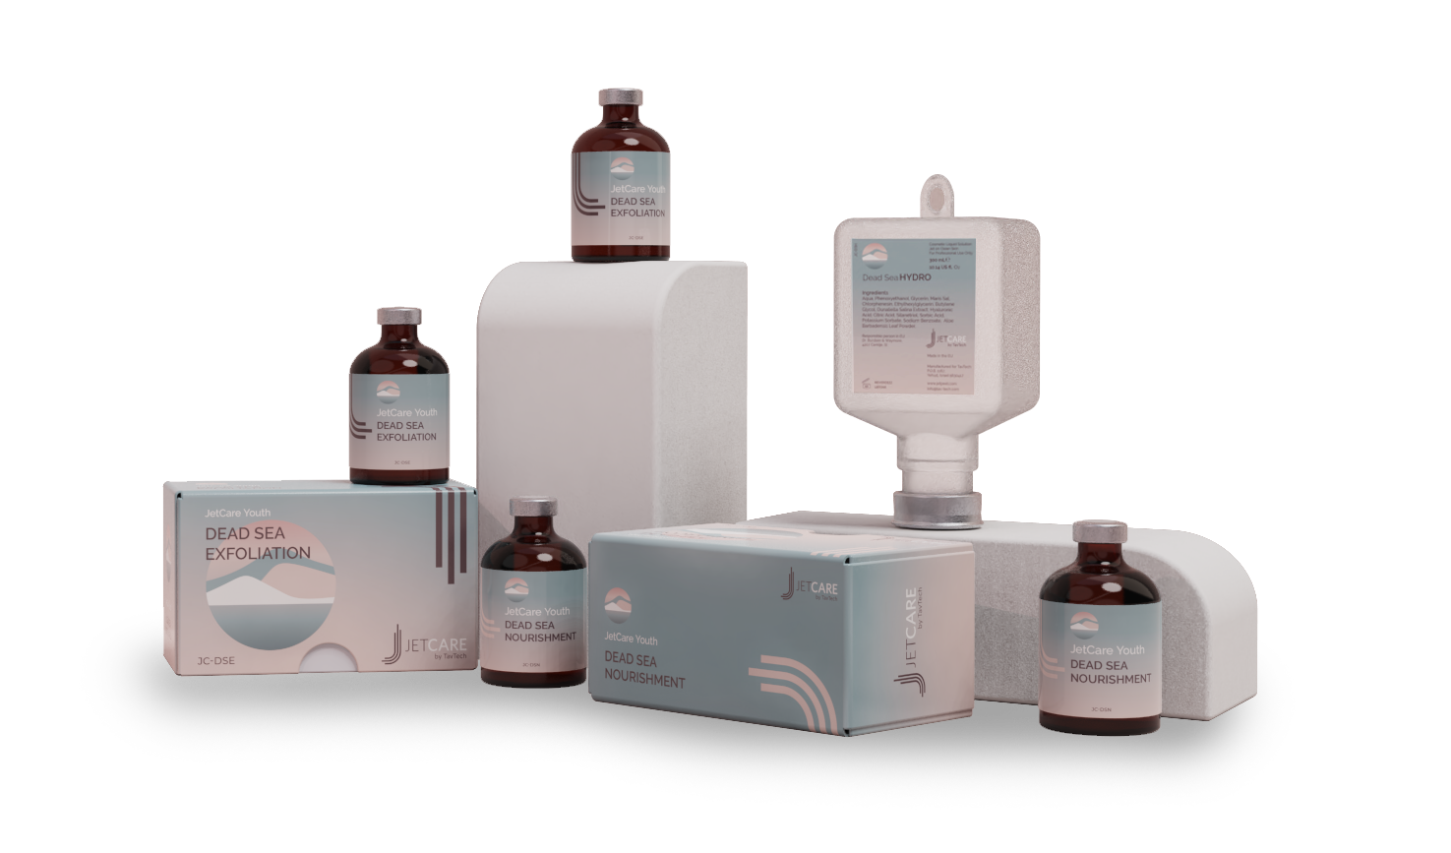
Thank you!

