Slide 1
Light Up Your JetPeel Success
With Combined Jet - LED Power

Slide 2


We provide people with an opportunity to become the best version of themselves
We believe in making people feel good …

Slide 3
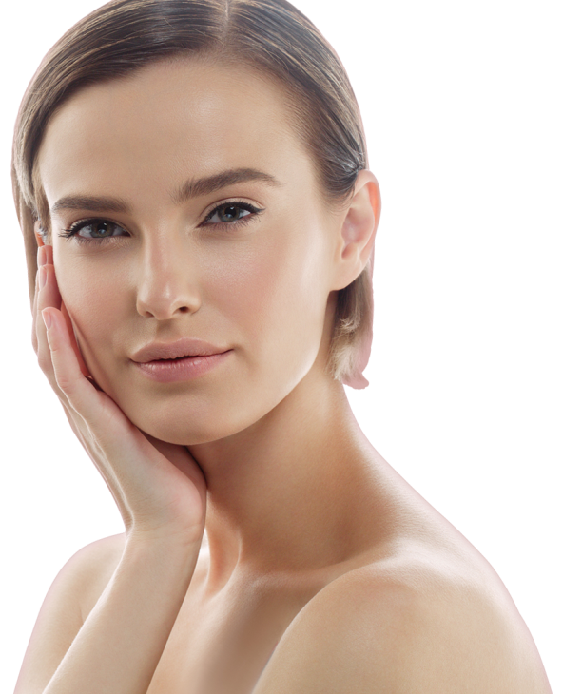


… by delivering
a powerful, instant-result treatment
Suitable for all skin types and all year-round

Slide 4
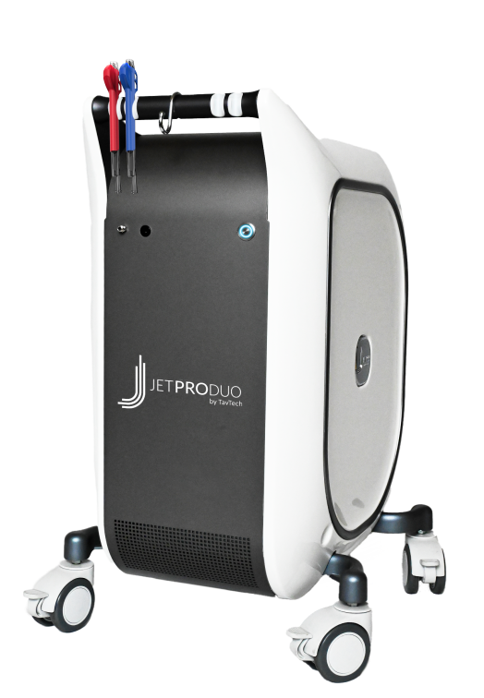

The Power of JetPeel, Plus Light…
JetPeel by TavTech is a world-renowned concept for effective aesthetic treatment based on jet-pressure technology. No pain, no downtime.
JetPeel is used every day by thousands of clinicians all over the world to treat a wide range of skin concerns such as wrinkles, fine lines, pigmentation, acne, redness, rejuvenation and more.
The new JetPro Duo includes red and blue LED add-ons to the JetPeel by TavTech handpiece for combined jet technology and LED light therapy in one treatment – amplifying the JetPeel effect.

Slide 5
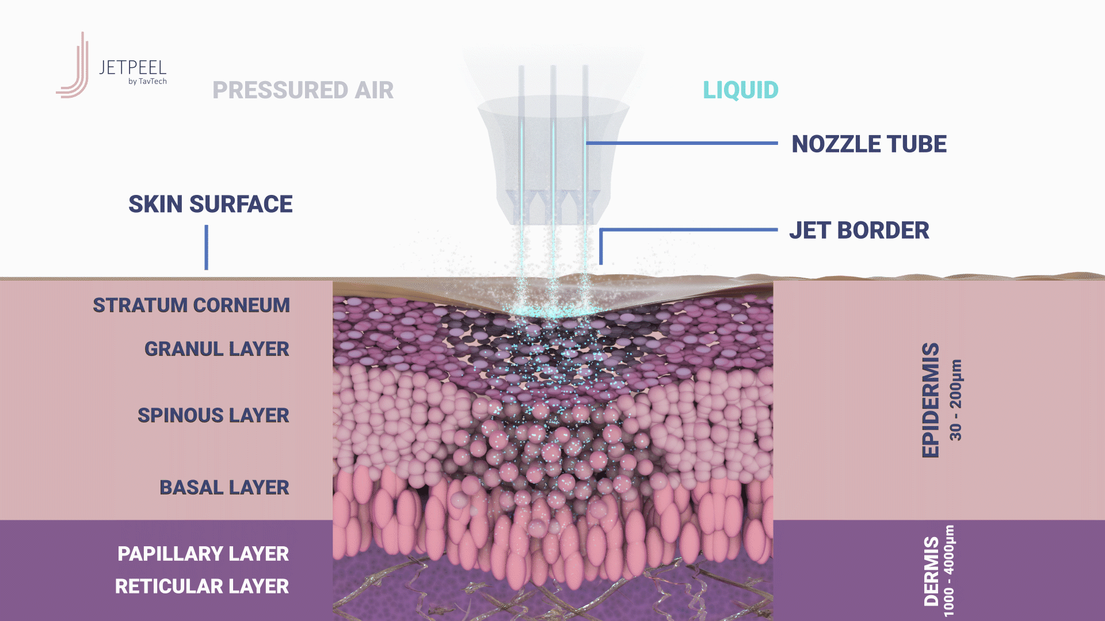
Jet pressure and the cavitation effect

Slide 6
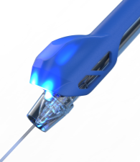
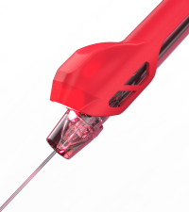
Jet pressure and the cavitation effect with LED boost

Slide 7
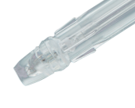
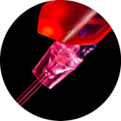
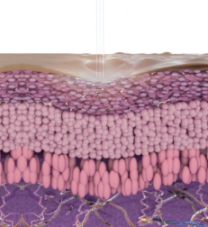
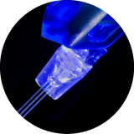
Red & Blue: The Perfect Duo Light Therapy
The JetPro Duo LED add-ons deliver two light wavelengths:
Red light: 620-630 nm
  Recommended for:
  Anti Aging, Loss of Tone & Wrinkles, Post-Acne, Lightening & Pigmentation.
Blue light: 460-470 nm
  Recommended for:
  Mild-Moderate Acne, Couperose & Sensitive Skin, Itchy & Sensitive Scalp.

Slide 8
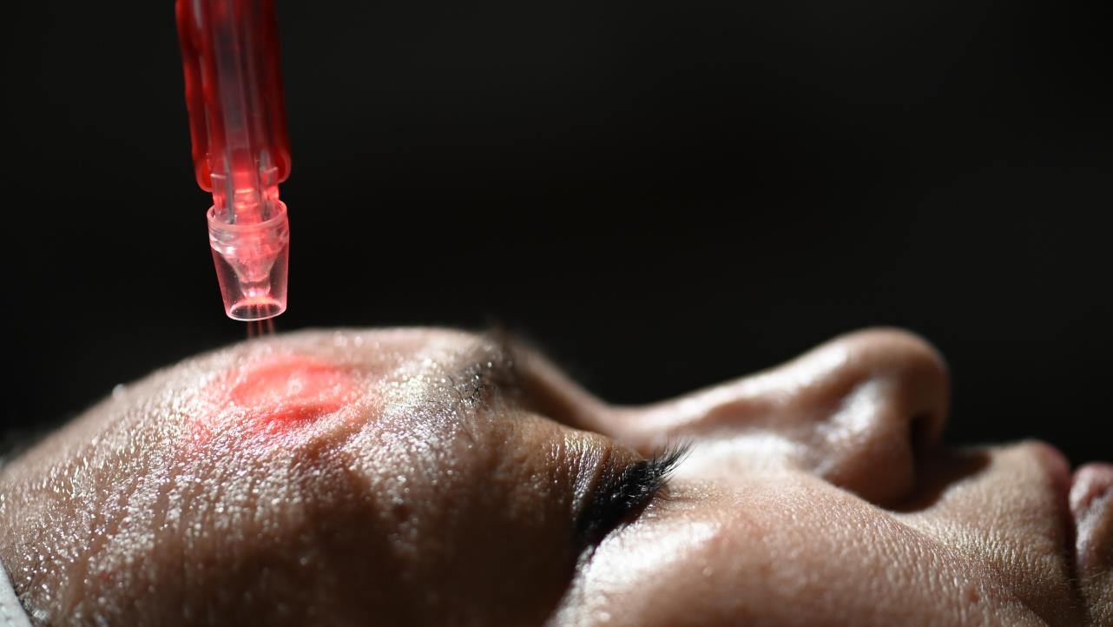

Why LED?
LED, or Light Emitting Diode, is a miniature glass-encased chip that emits a particular wavelength, or light color.
Different wavelengths penetrate to different levels of the skin, with varying aesthetic effects.
LED light therapy is clinically proven to cause natural photo-biochemical reactions in the skin.

Slide 9
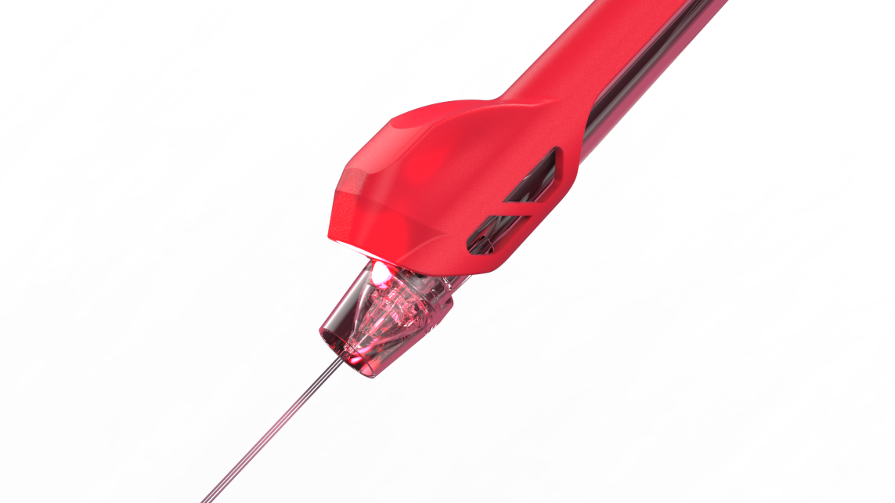
Red LED: How it helps
Red light penetrates the deeper skin layers, where it is clinically proven to stimulate fibroblast cells and boost collagen production.
Helps to smooth the appearance of fine lines and firm and lift the skin.
90% reported softer skin and fewer fine lines.
(Weiss RA, McDaniel DH, Geronemus RG et al. Clinical experience with light-emitting diode (LED) photomodulation. Dermatol Surg. 2005 Sep; 31 (9 Pt 2): 1199-1205)

Slide 10
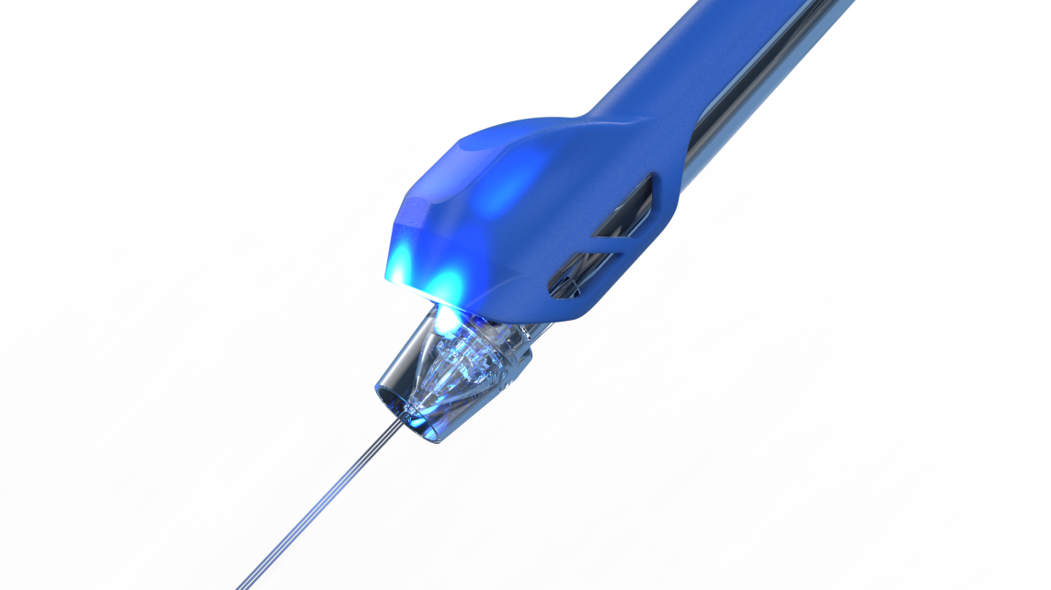
Blue LED: How it helps
Blue light penetrates to a maximum skin depth of 1mm, soothing irritation in the upper skin layers.
Renowned for its ability to target the P.acnes bacteria strain that causes acne.
Studies show a decrease in inflammatory lesions in cases of mild to moderate acne.
(Daniel R. Opel, MD, Erika Hagstrom, MD, MA, Aaron K. Pace, MD, Krissane Sisto, MD, Stefanie A. Hirano-Ali, MD, Shraddha Desai, MD, James Swan, MD. Light Emitting Diodes. J Clin Aesthet Dermatol. 2015 Jun; 8 (6): 36-44)

Slide 11


The ideal complement to existing JetPeel guidelines
JetPro Duo includes two LED add-ons to JetPeel by TavTech handpieces, integrating seamlessly with the existing JetPeel treatment guidelines.
With the JetPro Duo, clinicians can add red or blue LED light therapy to the JetPeel treatment, offering a dual jet-LED enhanced effect.
Choose the best LED add-on for the customer’s specific skin condition or concern and use simultaneously with the jet-pressure handpiece for a combined, extra powerful treatment.

Slide 12
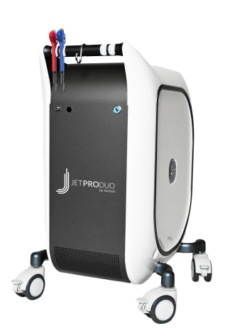
More than light
JetPro Duo by TavTech is further enhanced with additional improvements and features for an even better, smoother experience for clinician and customer:
Quieter: JetPro Duo operates at 20% reduced noise level during standby and at 10% reduced noise level during treatment compared to JetPro, for a soothing, pleasant in-clinic experience.
Improved storage: The front handle on JetPro Duo provides space for hanging up to 4 handpieces for greater ease of use.
Start easier: On the JetPro Duo device, the Start button is located at the front, for easier start and stop operation.

Slide 13

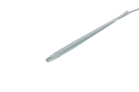
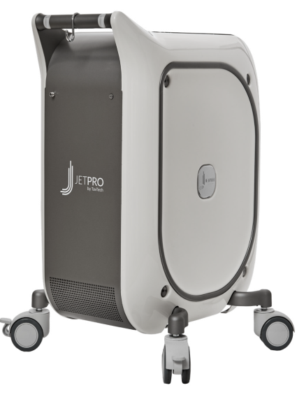
JetPro vs. JetProDuo
Red and Blue LED add-ons
4 slots for hanging handpieces
On / Off switch moved from back to more convenient position in front
JetPro
Jet Pressure-energy
JetPro Duo
Jet Pressure-energy + LED add-on

Slide 14

The JetPro Duo benefits
Improved results: JetPro Duo delivers jet pressure treatment and LED light therapy in one, for more powerful results.
No extra treatment time: JetPro Duo is simultaneous Jet-LED therapy, so you can provide two complementary treatments with no extra time needed.
No extra direct costs: Simply use the JetPeel handpiece with the Red or Blue LED add-ons; no additional cost per treatment.

Slide 15
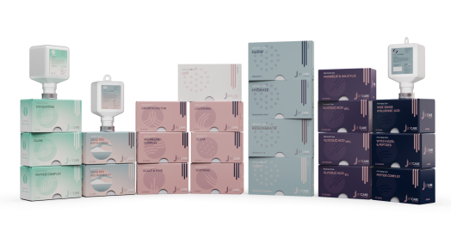
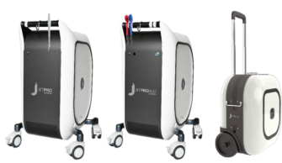





JetPeel by TavTech – the perfect trio combining:
      the enduring JetPro devices,
      the original patented JetPeel handpieces, and
      premium JetCare solutions
designed exclusively for use together to deliver outstanding results

Slide 16
Thank you

