Slide 1
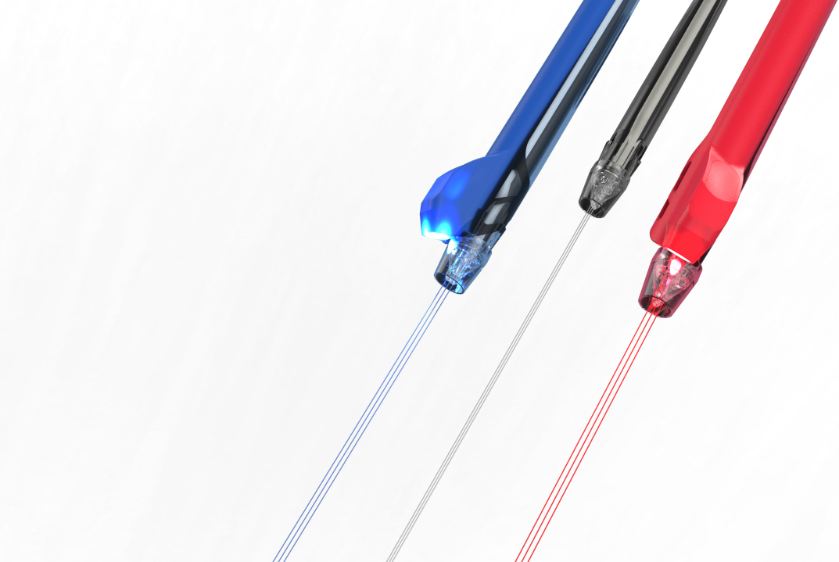

JetPeel
Jet-LED Combination Therapies

Slide 2
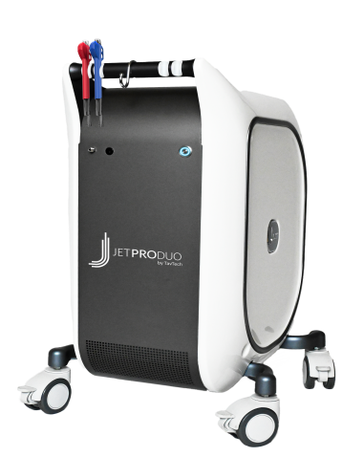






The JetPeel jet pressure energy system for:
JetPeel System
Lymphatic Massage
Exfoliation
Trans-epidermal Infusion of a rich variety of nutrients and solutions
Anti-Aging Care
Scalp & Hair
Lightening
Clear
Soothing
Growth Factor
Renewal Care

Slide 3

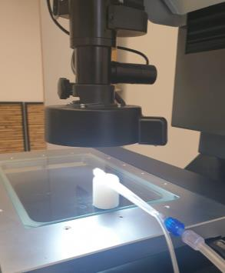
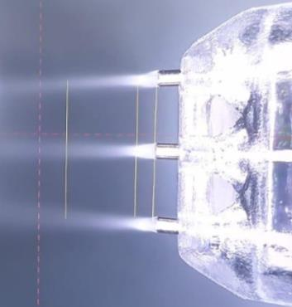
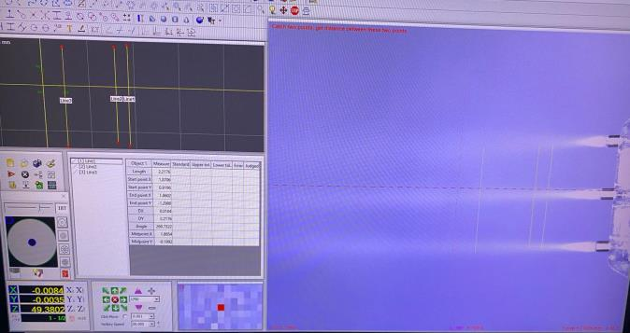






The science behind the patented handpieces
Researched and perfected over several decades:
Unique nozzle
Pressure
Flow rate
Spray pattern
Droplet size & speed
Reach
Impact

Slide 4

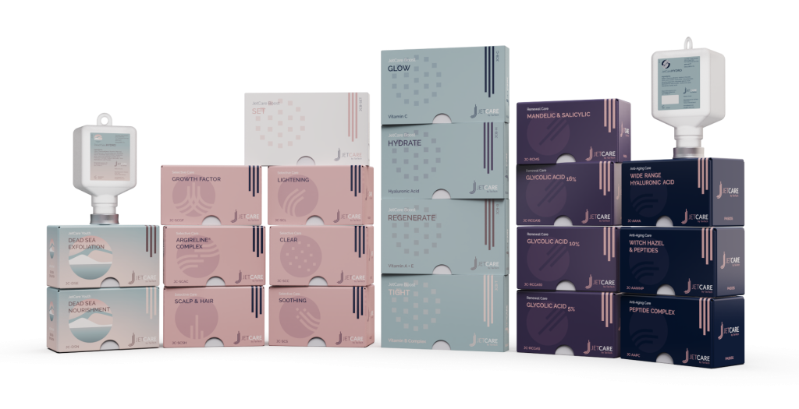
A variety of solutions, vitamins, minerals and acids
and an array of treatment guidelines

Slide 5

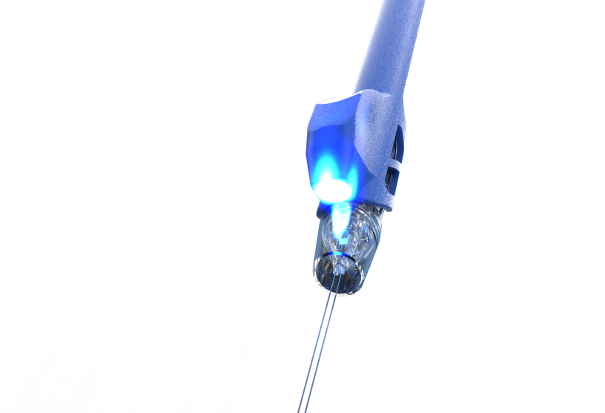
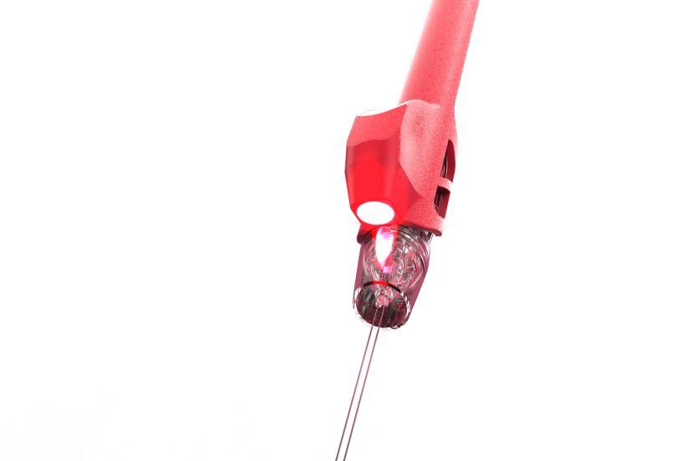
Combined and Simultaneous Therapy
Jet + LED
Designed to be used simultaneously
Unique combination of
2 POWERFUL ENERGIES
Outstanding results
Without any additional treatment time or consumables

Slide 6


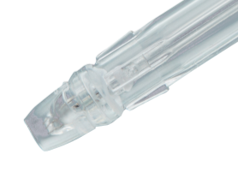
Super powerful treatment
Bio synergy Jet + LED
Promotes skin rejuvenation & regeneration for healthy skin functions
JET STREAMS
Deliver nutrients
into the dermis without needles.
The jet streams rejuvenate
the skin at a cellular level
RED LED ADD-ON
Simultaneously boost
collagen and elasticity, and
speed up cell renewal
BLUE LED ADD-ON
Extra powerful results.
Kill acne-causing bacteria
and reduce inflammation

Slide 7
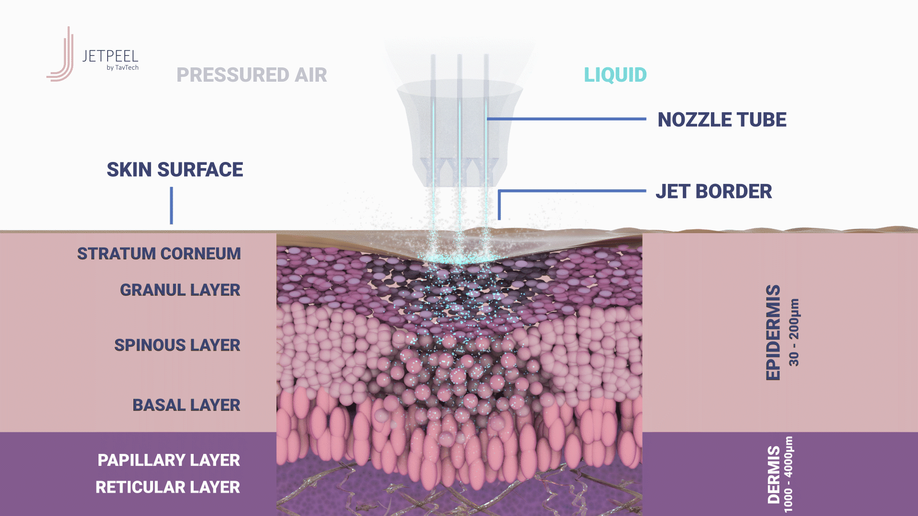
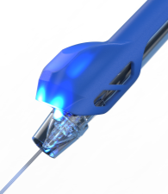
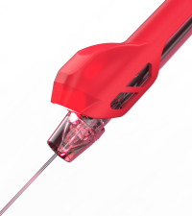
Jet pressure and the cavitation effect with LED boost

Slide 8
The positive light therapy
LED Therapy stimulates natural cell regeneration
LED Light recharges your skin cells’ batteries
LED light therapy is based on the principle that living cells are able to absorb light and are influenced by it.
Photo-biomodulation:
  Boosts collagen production
  Stimulates blood flow
  Increases cell turnover
  Calms skin
  Reduces blemishes
LED stimulates cell functions
for a healthier, radiant and younger looking skin

Slide 9

LED handpiece add-on’s on the JetPro Duo model
JetPro Duo
with LED add-ons
Red light: 620-630 nm
  Recommended for:
  Anti Aging, Loss of Tone & Wrinkles, Post-Acne, Lightening & Pigmentation.
Blue light: 460-470 nm
  Recommended for:
  Mild-Moderate Acne, Couperose & Sensitive Skin, Itchy & Sensitive Scalp.

Slide 10
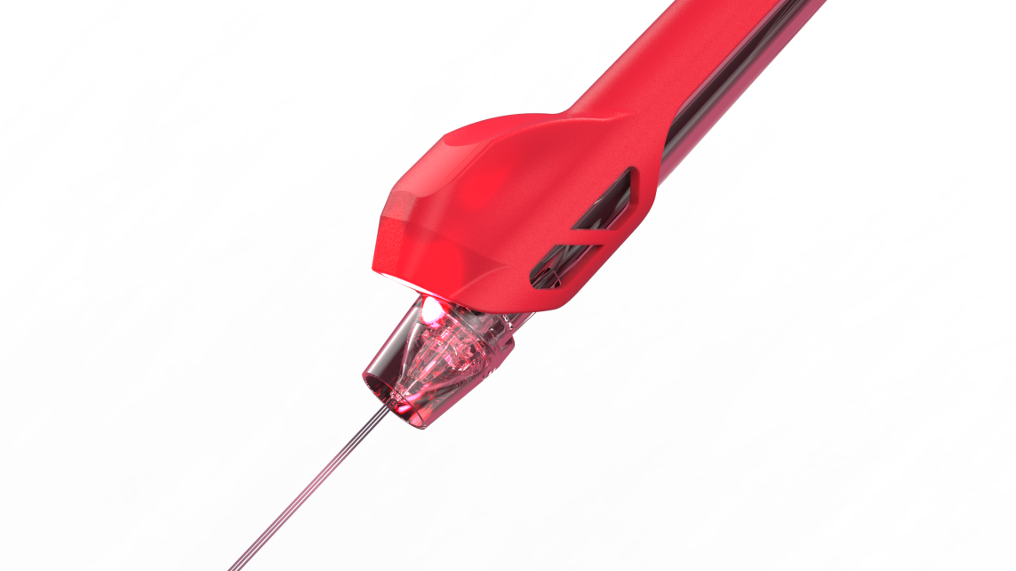

Red LED: How it helps
Red LED light affects mitochondrial function to produce ATP
* Weiss RA, McDaniel DH, Geronemus RG et al. Clinical experience with light-emitting diode (LED) photomodulation. Dermatol Surg. 2005 Sep; 31 (9 Pt 2): 1199-1205
Red light penetrates the deeper skin layers where it is clinically proven to stimulate fibroblast cells and boost collagen production.
Helps to smooth the appearance of fine lines and firm and lift the skin.
90% reported softer skin and fewer fine lines.*

Slide 11
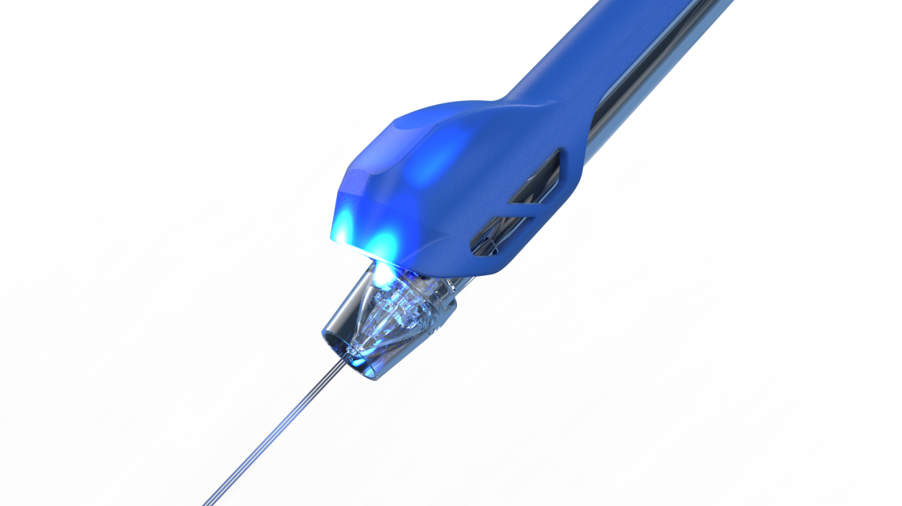
Blue LED: How it helps
Blue LED targets acne bacteria, reduces skin breakouts and reduces inflammation
* Daniel R. Opel, MD, Erika Hagstrom, MD, MA, Aaron K. Pace, MD, Krissane Sisto, MD, Stefanie A. Hirano-Ali, MD, Shraddha Desai, MD, James Swan, MD. Light Emitting Diodes. J Clin Aesthet Dermatol. 2015 Jun; 8 (6): 36-44
Blue light penetrates to a maximum skin depth of 1mm, soothing irritation in the upper skin layers.
Known for its ability to target the P.acnes bacteria strain that causes acne.
Studies show a decrease in inflammatory lesions in cases of mild to moderate acne.*

Slide 12
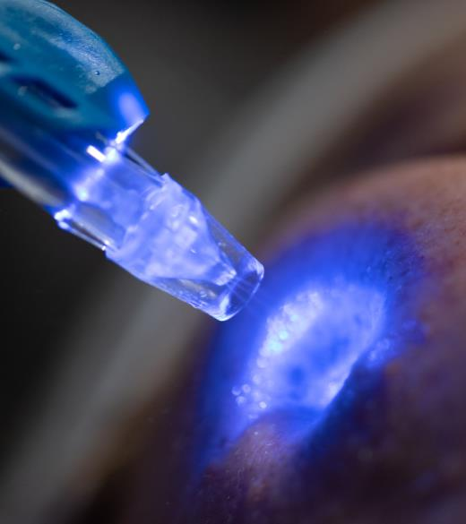
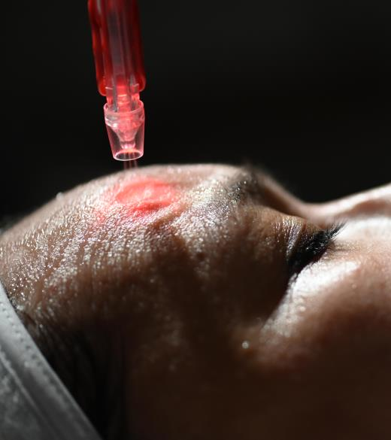
Notes:
12

Slide 13
JetPeel BEFORE
other aesthetic procedures

Slide 14
JetPeel treatment 2 DAYS BEFORE other aesthetic procedures helps stimulate cutaneous collagen, elastin, hyaluronic acid, and assists the skin during the healing process
JetPeel helps to:
Oxygenate
Increase blood flow
Increase skin nutrition
Prevent sweeling
Defend
Reduce bacteria proliferation
Reduce the risk of infection
Prevent inflammation
Hydrate
Improve skin cell activities
Protect skin barrier
Accelerate healing process
Regenerate
Increase skin elasticity
Increase collagen and dermis density
Stimulate skin rejuvenation

Slide 15
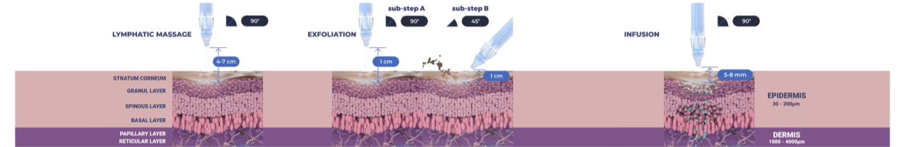
JetPeel Treatment Sequence
STEP
STEP
STEP
STEP
1
2
3
4
LYMPHATIC MASSAGE
Relaxing massage for detoxifying the skin and stimulating micro-circulation
EXFOLIATION
Preps the skin to receive the nourishment from the following infusion treatment
INFUSION
Deep, effective delivery of active ingredients into the skin
BOOSTER INFUSION
Post-infusion step to amplify the treatment result

Slide 16
Step 1 - Lymphatic Massage
STEP
STEP
STEP
STEP
1
2
3
4
LYMPHATIC MASSAGE
Relaxing massage for detoxifying the skin and stimulating micro-circulation
EXFOLIATION
Preps the skin to receive the nourishment from the following infusion treatment
INFUSION
Deep, effective delivery of active ingredients into the skin
BOOSTER INFUSION
Post-infusion step to amplify the treatment result

Slide 17
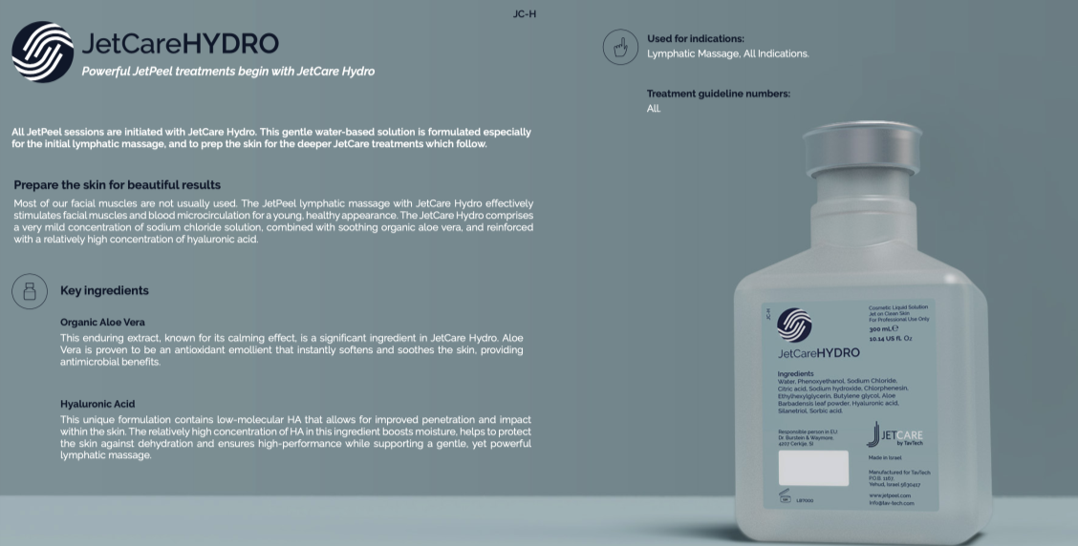

Slide 18
JetPeel’s Lymphatic Massage before and after other aesthetic procedures help to:
Detoxify the skin
Decrease inflammation
Optimize skin health
Decrease skin pain
Promote healing process
Clear out bacteria and toxins
Increase skin hydration

Slide 19
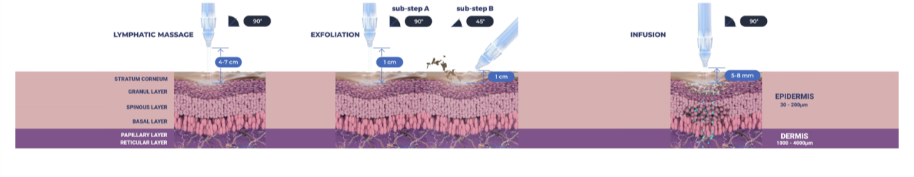
Step 2 - Exfoliation
STEP
STEP
STEP
STEP
1
2
3
4
LYMPHATIC MASSAGE
Relaxing massage for detoxifying the skin and stimulating micro-circulation
EXFOLIATION
Preps the skin to receive the nourishment from the following infusion treatment
INFUSION
Deep, effective delivery of active ingredients into the skin
BOOSTER INFUSION
Post-infusion step to amplify the treatment result

Slide 20
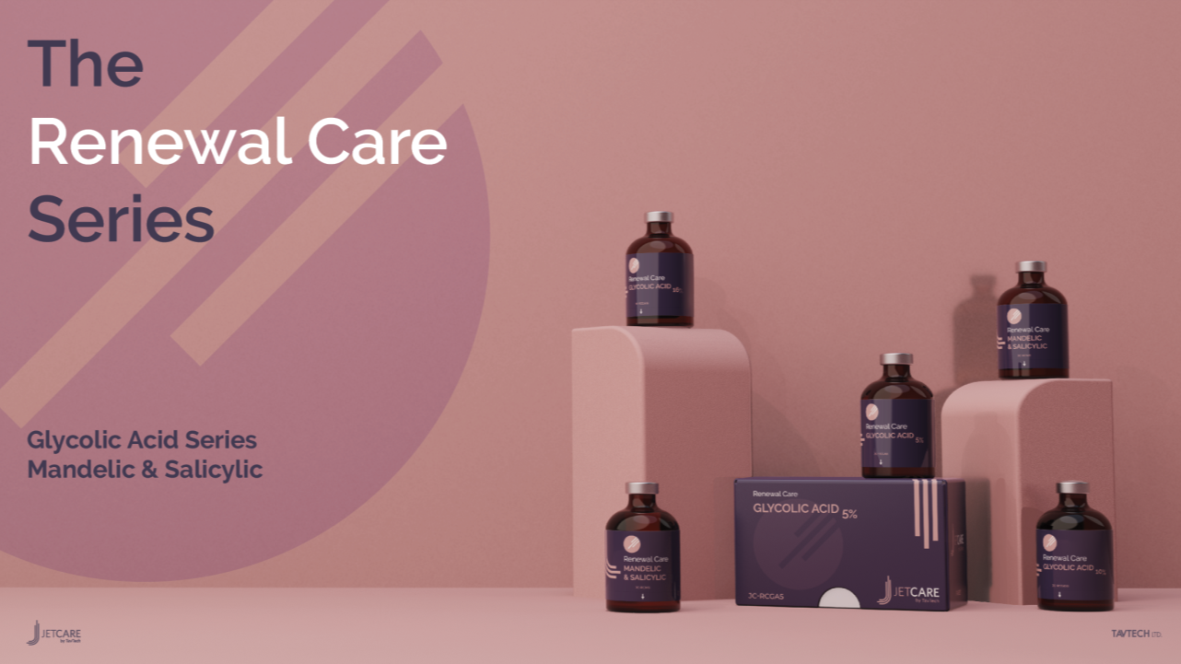

Slide 21
The importance of skin exfoliation
in medical aesthetic procedures:
Eliminates dead skin cells, dirt and oil that can cause clogged pores
Improves skin texture and discolorations
Diminishes skin imperfections
Stimulates cells turnover and skin regeneration
Improves deep wrinkles and photoaging
Stimulates collagen production

Slide 22
Step 3 – Infusion
STEP
STEP
STEP
STEP
1
2
3
4
LYMPHATIC MASSAGE
Relaxing massage for detoxifying the skin and stimulating micro-circulation
EXFOLIATION
Preps the skin to receive the nourishment from the following infusion treatment
BOOSTER INFUSION
Post-infusion step to amplify the treatment result
INFUSION
Deep, effective delivery of active ingredients into the skin

Slide 23
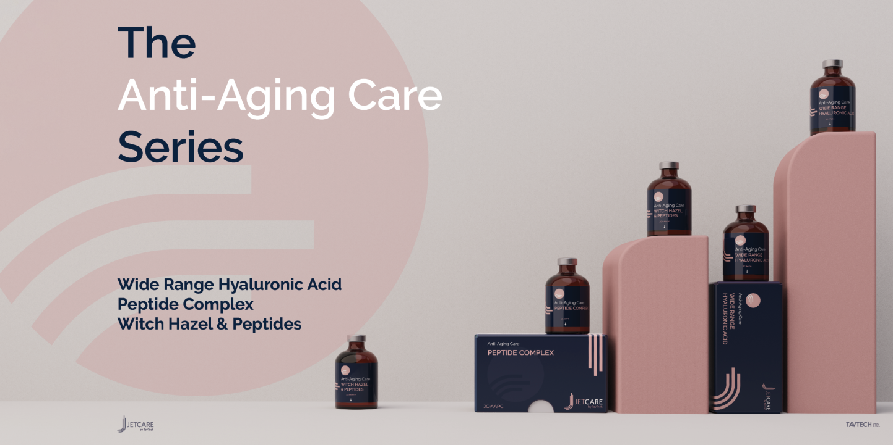

Slide 24
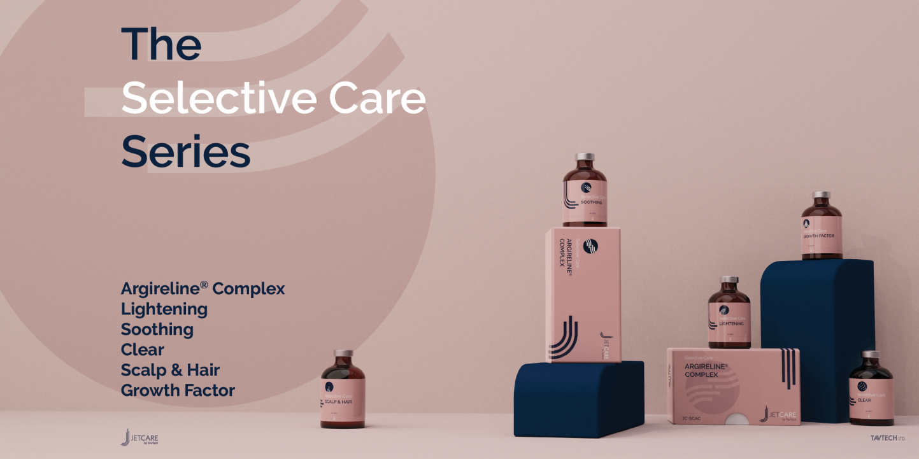
Argireline® is a trademark of Lipotec S.A. or its affiliates

Slide 25
Infusion supports skin cell activities
Promote keratinocyte proliferation
Improve skin pigmentation
Support extracellular matrix and fibroblast
Increase hydration
Promote cell growth and collagen
Support skin structure
Prevent oxidative stress

Slide 26
Step 4 – Booster Infusion
STEP
STEP
STEP
STEP
1
2
3
4
LYMPHATIC MASSAGE
Relaxing massage for detoxifying the skin and stimulating micro-circulation
EXFOLIATION
Preps the skin to receive the nourishment from the following infusion treatment
INFUSION
Deep, effective delivery of active ingredients into the skin
BOOSTER INFUSION
Post-infusion step to amplify the treatment result

Slide 27
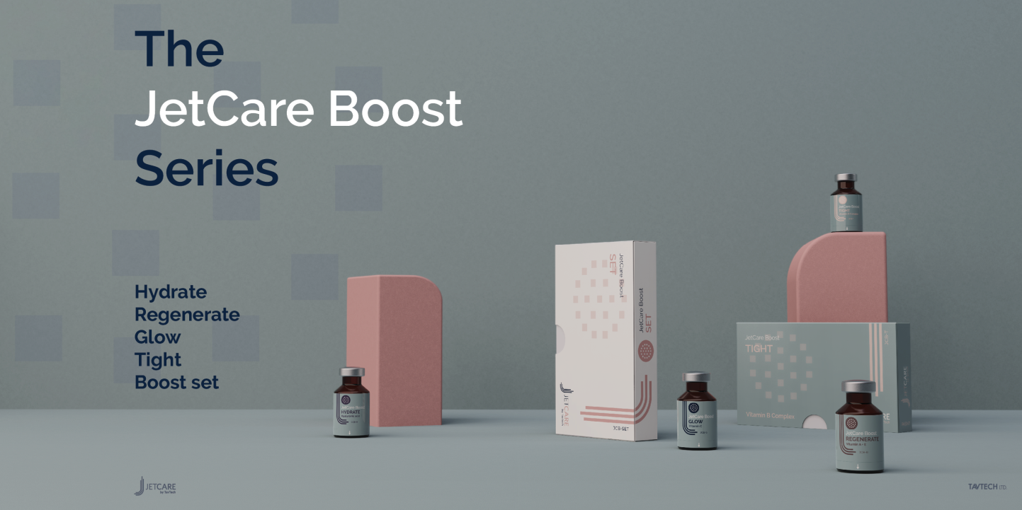

Slide 28
The Booster Infusion
amplifies results
This step targets multiple skin concerns by delivering a high concentration of hyaluronic acid and vitamins which:
Improve texture
Increase elasticity
Hydrate and plum
Restore radiance and overall skin appearance

Slide 29
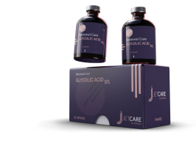
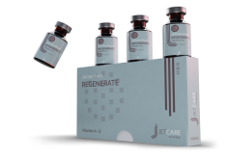
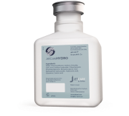
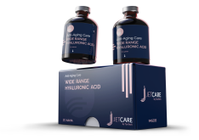
JETPEEL 2 DAYS BEFORE OTHER AESTHETIC PROCEDURES
STEP
STEP
STEP
STEP
1
2
3
4
LYMPHATIC MASSAGE
USE: JetCare Hydro
Smooth skin texture
Moisturize
Support skin barrier and reduce water loss
Decrease dryness and skin irritation
EXFOLIATION
INFUSION
USE: JetCare Wide Range Hyaluronic Acid
Increase skin hydration
Regulate tissue repair
Reduce breakout of collagen and elastin matrix
Strengthen connective tissue
BOOSTER INFUSION
USE: JetCare Boost Regenerate
Fortify the functioning of the skin’s natural barrier
Rejuvenate skin tissue
Repair skin damage
USE: JetCare Glycolic Acid 5%
Increase skin turnover
Collagen synthesis
Increase skin elasticity and firmness
Improve skin texture
Increase skin hydration
Hyaluronic Acid, organic Aloe Vera
Glycolic acid 5% - pH 3.5%, organic Aloe Vera , Pro-Vitamin B₅ Panthenol, Allantoin
5 molecular weights of Hyaluronic Acid,
Regu-Age®
Vitamins A and E, Pentavitin ®, Ragu-age®, Roman Chamomile Extract

Slide 30
JetPeel Protocol
 | Step 1 Lymphatic Massage | Step 2 Exfoliation | Step 3 Infusion | Step 4 Booster Infusion
Handpiece | Triple | Triple | Triple or Magic | Triple or magic
Distance from skin | 4-7 cm | 1 cm | 0.5-0.8 cm | 0.5-0.8 cm
Handpiece Angle | 90° | 90° | 90° | 90°
Time | 10-15 minutes | 5-7 minutes | 5-7 minutes | 5-7 minutes
Use | 18ml of JetCare Hydro | 5ml of JetCare Renewal Care Glycolic Acid 5% | 5ml of JetCare Anti-Aging Wide Range Hyaluronic Acid | 3ml of JetCare Boost Hydrate
Remarks |  | Leave on the skin for 5-8 minutes, and then wash with 8ml of JetCare Hydro with Triple handpiece at 45°-60°

Slide 31
JetPeel AFTER
other aesthetic procedures

Slide 32
Botox - 1 month after* Important note: do not use the JetCare Boost TIGHT solution for approximately 4 months after a botox treatment. Vitamin B can make the botox disappear in a short time.
Filler - 1 month after
RF - can be performed on the same day
IPL - 2 weeks after
Ablative laser - 2-3 months after* Important note: sometimes it can be done earlier but without performing the exfoliation.
Non-ablative laser - 2 weeks after* Important note: JetPeel treatment can help rid the dots from the skin quickly.
Microneedling – 1-2 weeks after
When should a JetPeel treatment be performed AFTER other aesthetic procedures?
  *IMPORTANT NOTE: The times indicated above can change. This depends on the intensity of different aesthetic procedures and on individual skin healing process. DO NOT perform any JetPeel treatment on open skin.

Slide 33
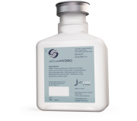

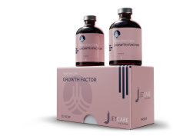
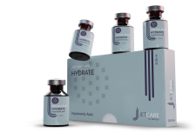
Protocol A: Post-medical aesthetic procedures
STEP
STEP
STEP
STEP
1
2
3
4
LYMPHATIC MASSAGE
USE: JetCare Hydro
Smooth skin texture
Moisturize
Support skin barrier and reduce water loss
Prevent dryness and skin irritation
EXFOLIATION
USE: JetCare Glycolic Acid 5%
Increase skin turnover
Collagen synthesis
Increase skin elasticity and firmness
Improve skin texture
Increase skin hydration
INFUSION
USE: JetCare Growth Factor
Replenish natural growth factors
Accelerate skin repair
Increase skin renewal
Boost collagen
BOOSTER INFUSION
USE: JetCare Boost Hydrate
Protect the extracellular matrix from collagen degradation
Restore the antioxidant defences
Immediate anti-ageing and wrinkles filler effect
Smooths skin texture
Hyaluronic Acid, organic Aloe Vera
Glycolic acid 5% - pH 3.5%, organic Aloe Vera, Pro-vitamin B₅ Panthenol, Allantoin
3% EGF (Epidermal Growth Factor) complex of 5 different growth factors, Vitamin B₉, Niacinamide, Betaine
PrimalHyal™ Ultrafiller, Niacinamide, Betaine

Slide 34
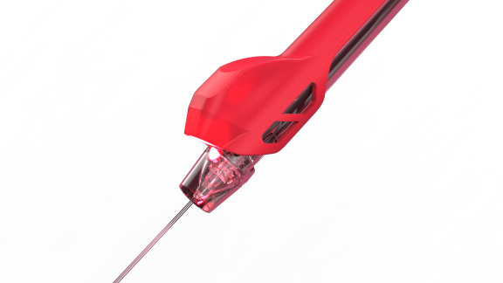
Protocol A – AFTER aesthetic procedures
Recommended Treatment Cycle
First 6 treatments: 1-2 times every week for 3-6 weeks
After 6 treatments: Maintenance treatments every 3-4 weeks
Note: alternate between Protocol A and Protocol B
 | Step 1 Lymphatic Massage | Step 2 Exfoliation | Step 3 Infusion | Step 4 Booster Infusion
Handpiece | Triple | Triple | Triple or Magic | Triple or magic
Distance from skin | 4-7 cm | 1 cm | 0.5-0.8 cm | 0.5-0.8 cm
Handpiece Angle | 90° | 90° | 90° | 90°
Time | 10-15 minutes | 5-7 minutes | 5-7 minutes | 5-7 minutes
Use | 18ml of JetCare Hydro | 5ml of JetCare Renewal Care Glycolic Acid 5% | 5ml of JetCare Selective Care Growth Factor | 3ml of JetCare Boost Hydrate
Remarks |  | Levae on the skin for 5-8 minutes and then wash with 8ml of JetCare Hydro. Use triple handpiece at 45°-60°

Slide 35
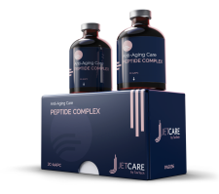


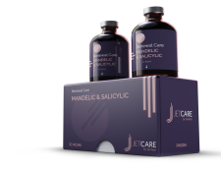
Protocol B: Post medical aesthetic procedures
STEP
STEP
STEP
STEP
1
2
3
4
LYMPHATIC MASSAGE
USE: JetCare Hydro
Smooth skin texture
Moisturize
Support skin barrier and reduce water loss
Prevent dryness and skin irritation
EXFOLIATION
USE: JetCare Mandelic & Salicylic
Remove dirt, bacteria, clear pores, purify unclogged pores
Brighten skin and smoothen skin texture.
Improve cell turnover
Improve skin hydration
Reduce wrinkles and aging signs
INFUSION
USE: JetCare Peptide Complex
Stimulate epidermal and dermal activity
Increase collagen production
Increase dermis density and skin firmness.
BOOSTER INFUSION
USE: JetCare Boost Regenerate
Fortify the functioning of the skin’s natural barrier
Rejuvenate skin tissue
Repair skin damage
Hyaluronic Acid, organic Aloe Vera
Mandelic 4% (AHA), Salicylic 2% (BHA), Malic 1% (AHA), Glycolic 0.7% (AHA) , Lactic 0.7%, ABC fruit extract, D-Phanthenol, Roman Chamomile Extract, Aloe
Replexium™, Juveleven ™, Pentavitin® , Regu-Age®,
Niacinamide, Betaine
Vitamins A and E, Pentavitin ®, Ragu-age®,
Roman Chamomile Extract

Slide 36
Protocol B – AFTER aesthetic procedures
Recommended Treatment Cycle
First 6 treatments: 1-2 times every week for 3-6 weeks
After 6 treatments: Maintenance treatments every 3-4 weeks
Note: alternate between Protocol B and Protocol A
 | Step 1 Lymphatic Massage | Step 2 Exfoliation | Step 3 Infusion | Step 4 Booster Infusion
Handpiece | Triple | Triple | Triple or Magic | Triple or magic
Distance from skin | 4-7 cm | 1 cm | 0.5-0.8 cm | 0.5-0.8 cm
Handpiece Angle | 90° | 90° | 90° | 90°
Time | 10-15 minutes | 5-7 minutes | 5-7 minutes | 5-7 minutes
Use | 18ml of JetCare Hydro | 5ml of JetCare Renewal Care Mandelic & Salicylic | 5ml of JetCare Anti-Aging Peptide Complex | 3ml of JetCare Boost Regenerate
Remarks |  | Wash with 8ml of JetCare Hydro if necessary. Triple handpiece at 45°-60°

Slide 37


Slide 38
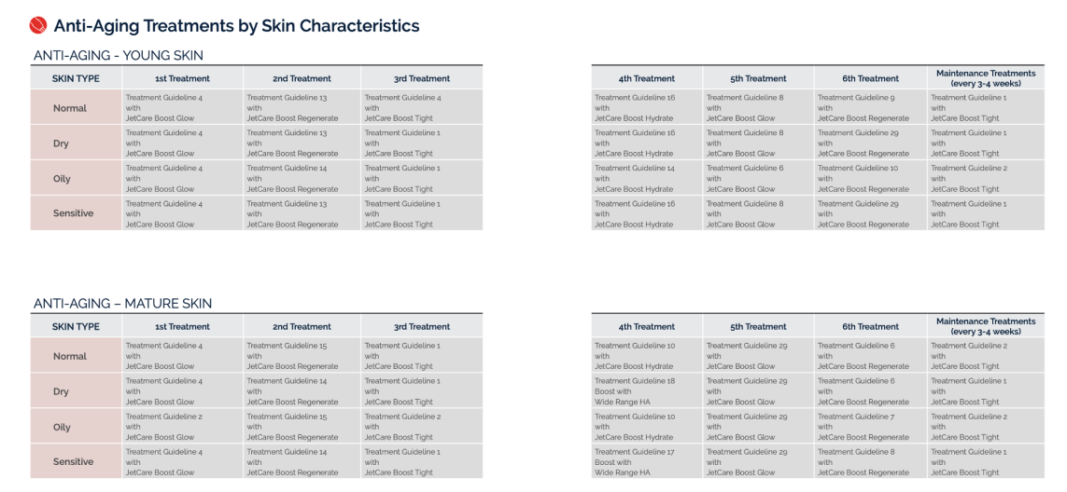

Slide 39
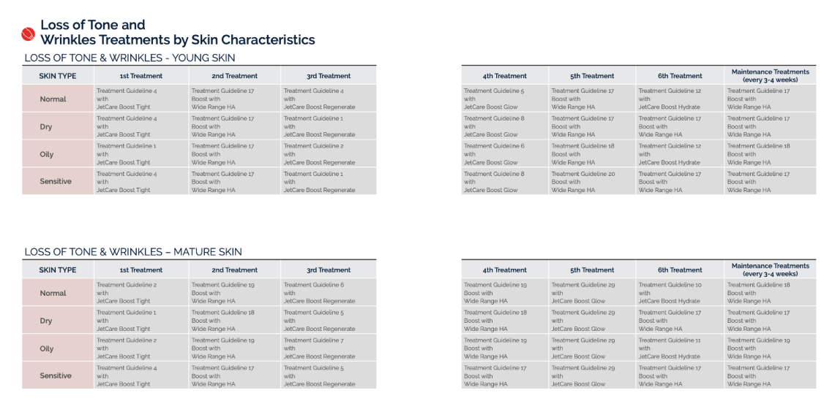

Slide 40
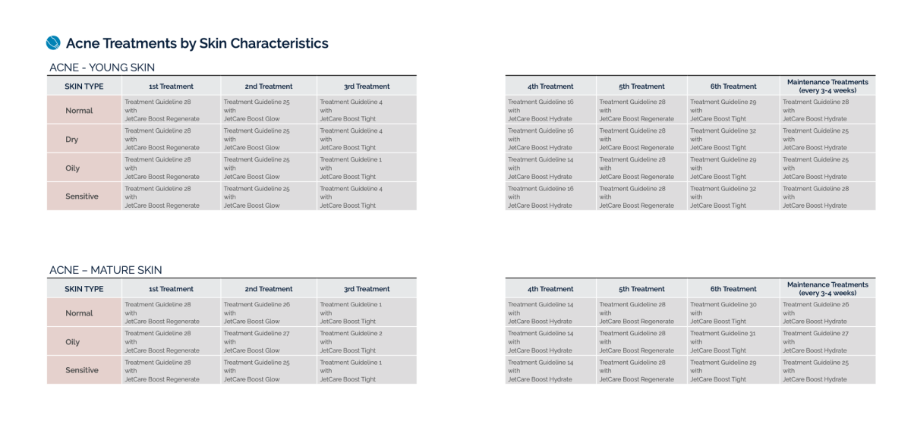

Slide 41
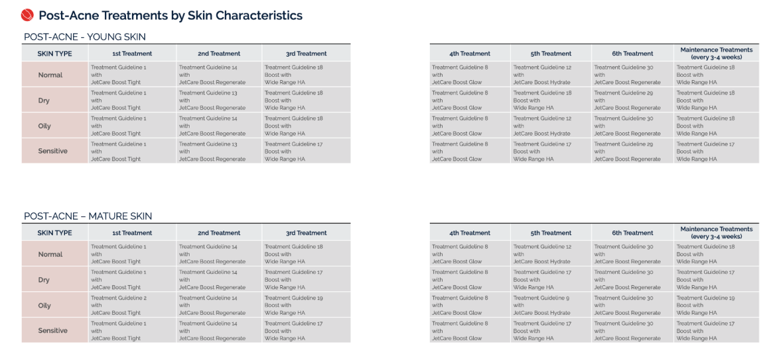

Slide 42
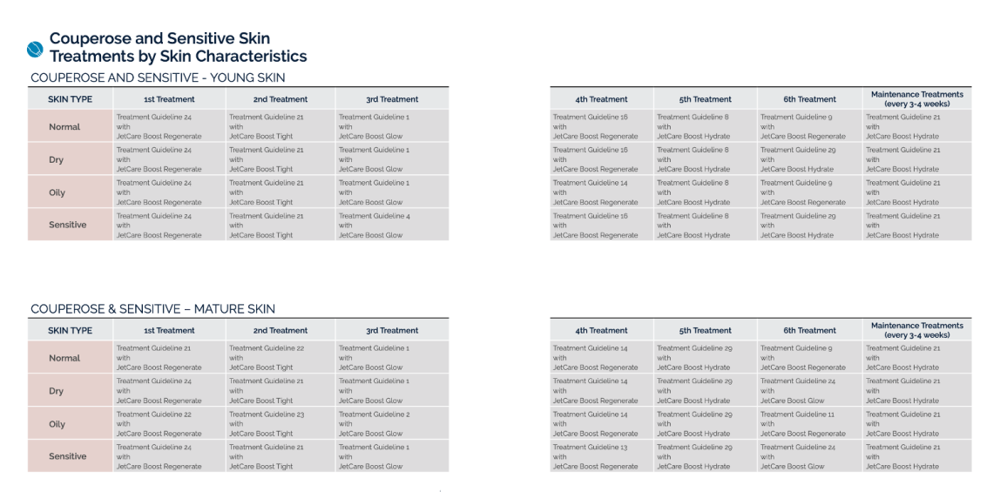

Slide 43
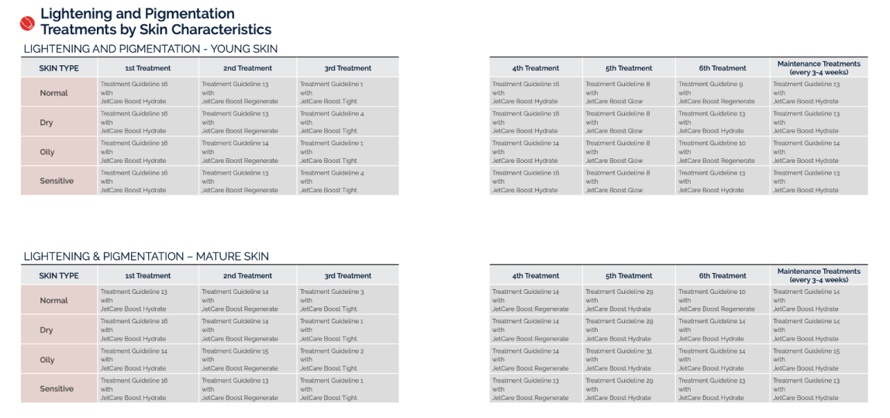

Slide 44
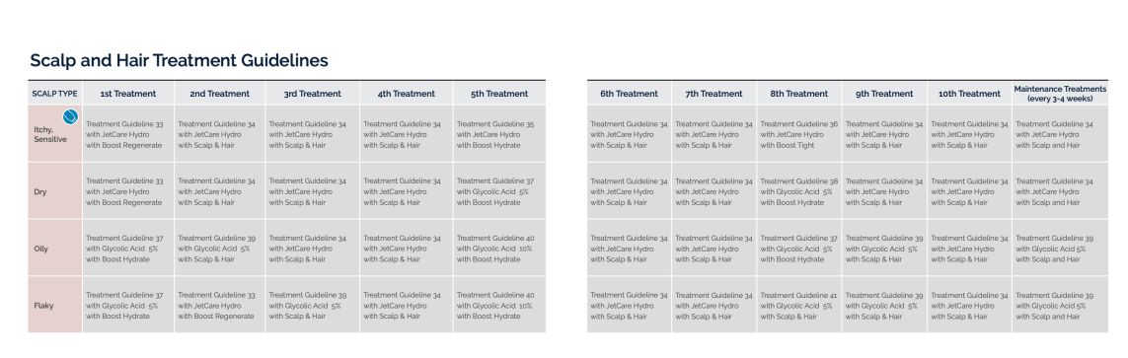

Slide 45


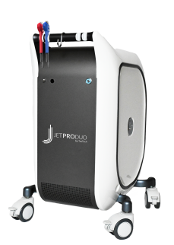

JetPeel by TavTech
The perfect trio combining:
The enduring JetPro devices
The original patented JetPeel handpieces
The premium JetCare solutions
Designed exclusively for use together to deliver outstanding results

Slide 46
Thank you

