Slide 1


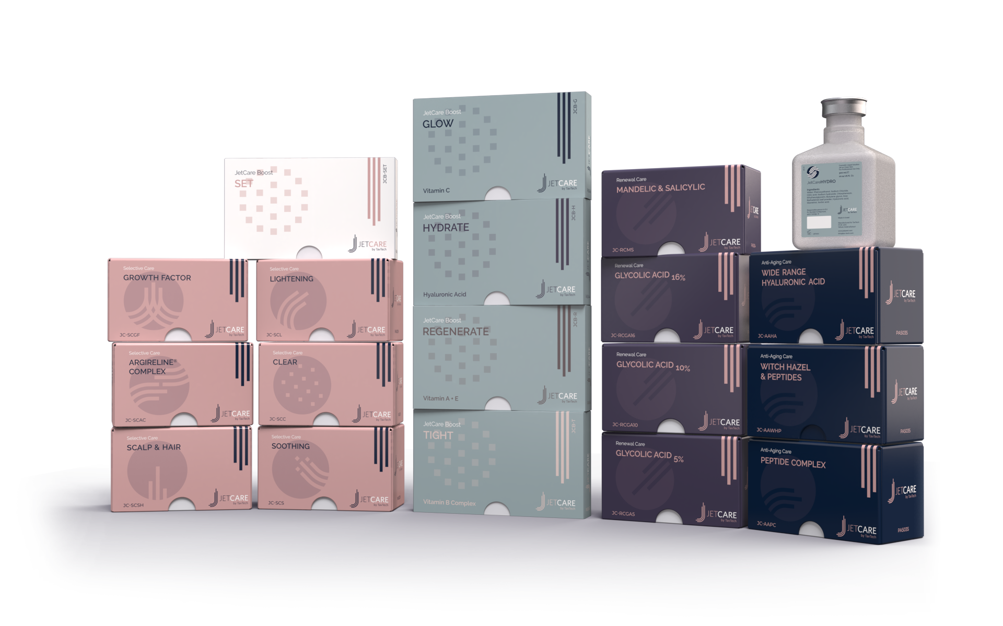
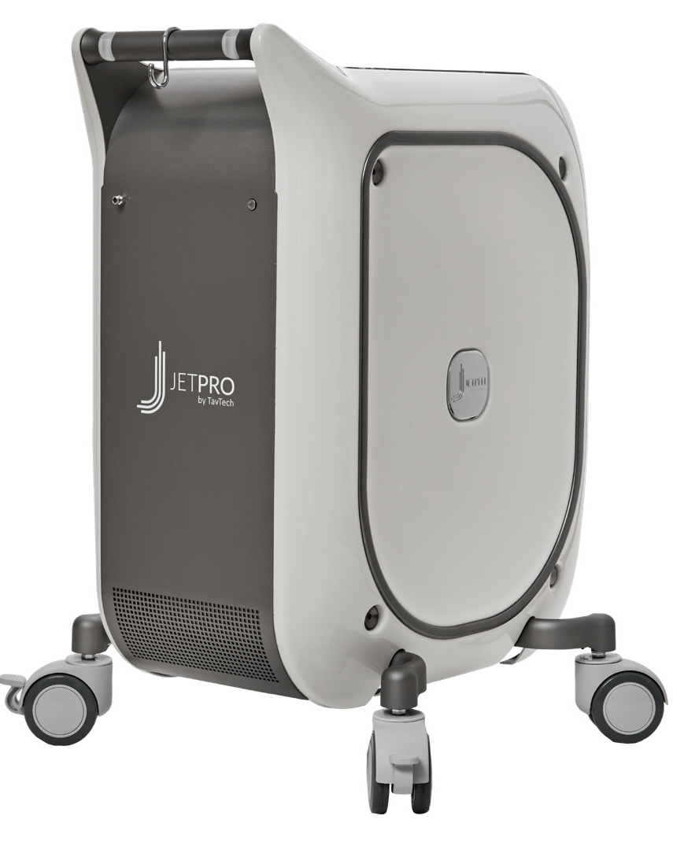
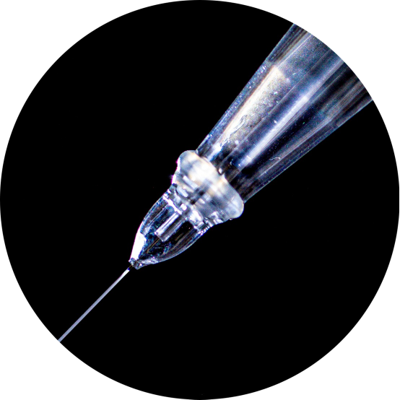
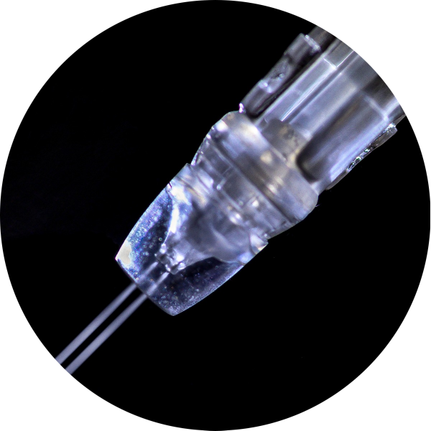
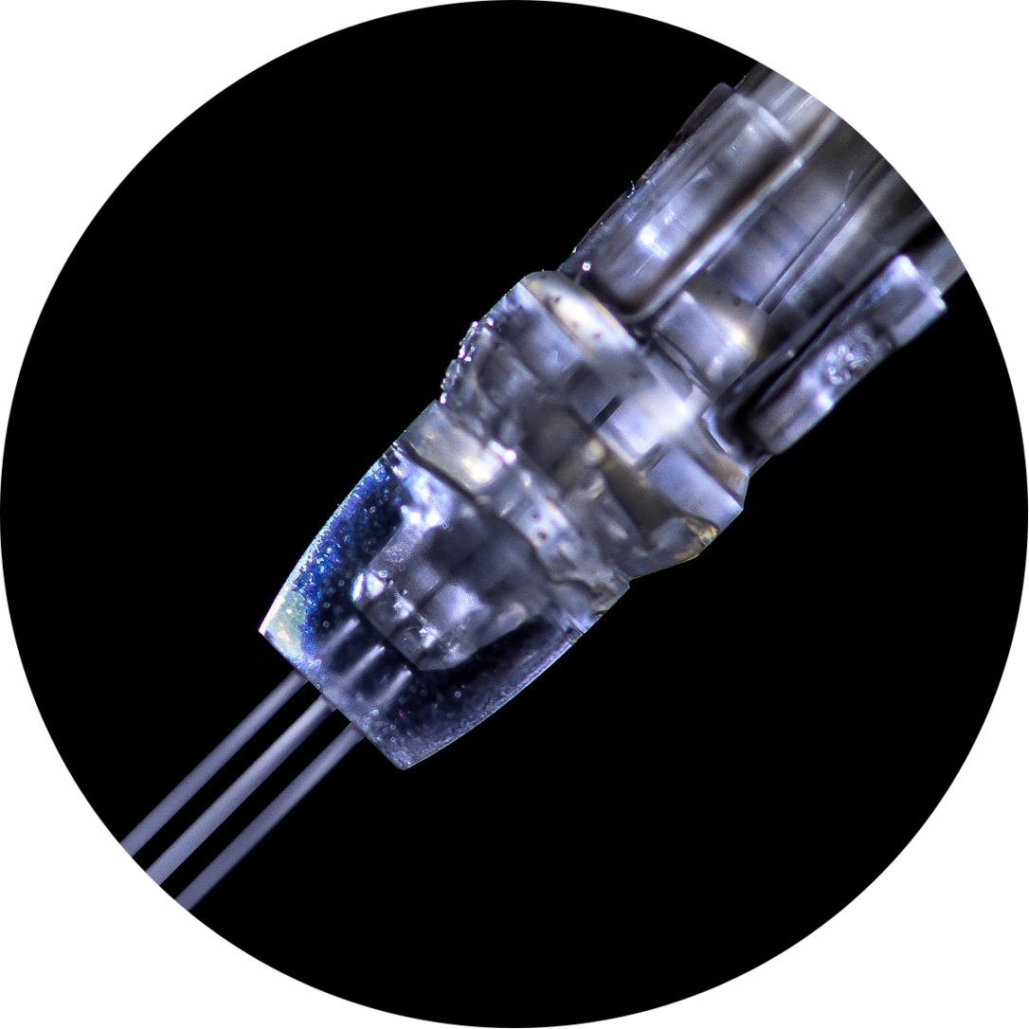
JetPeel by TavTech Academy

Slide 2

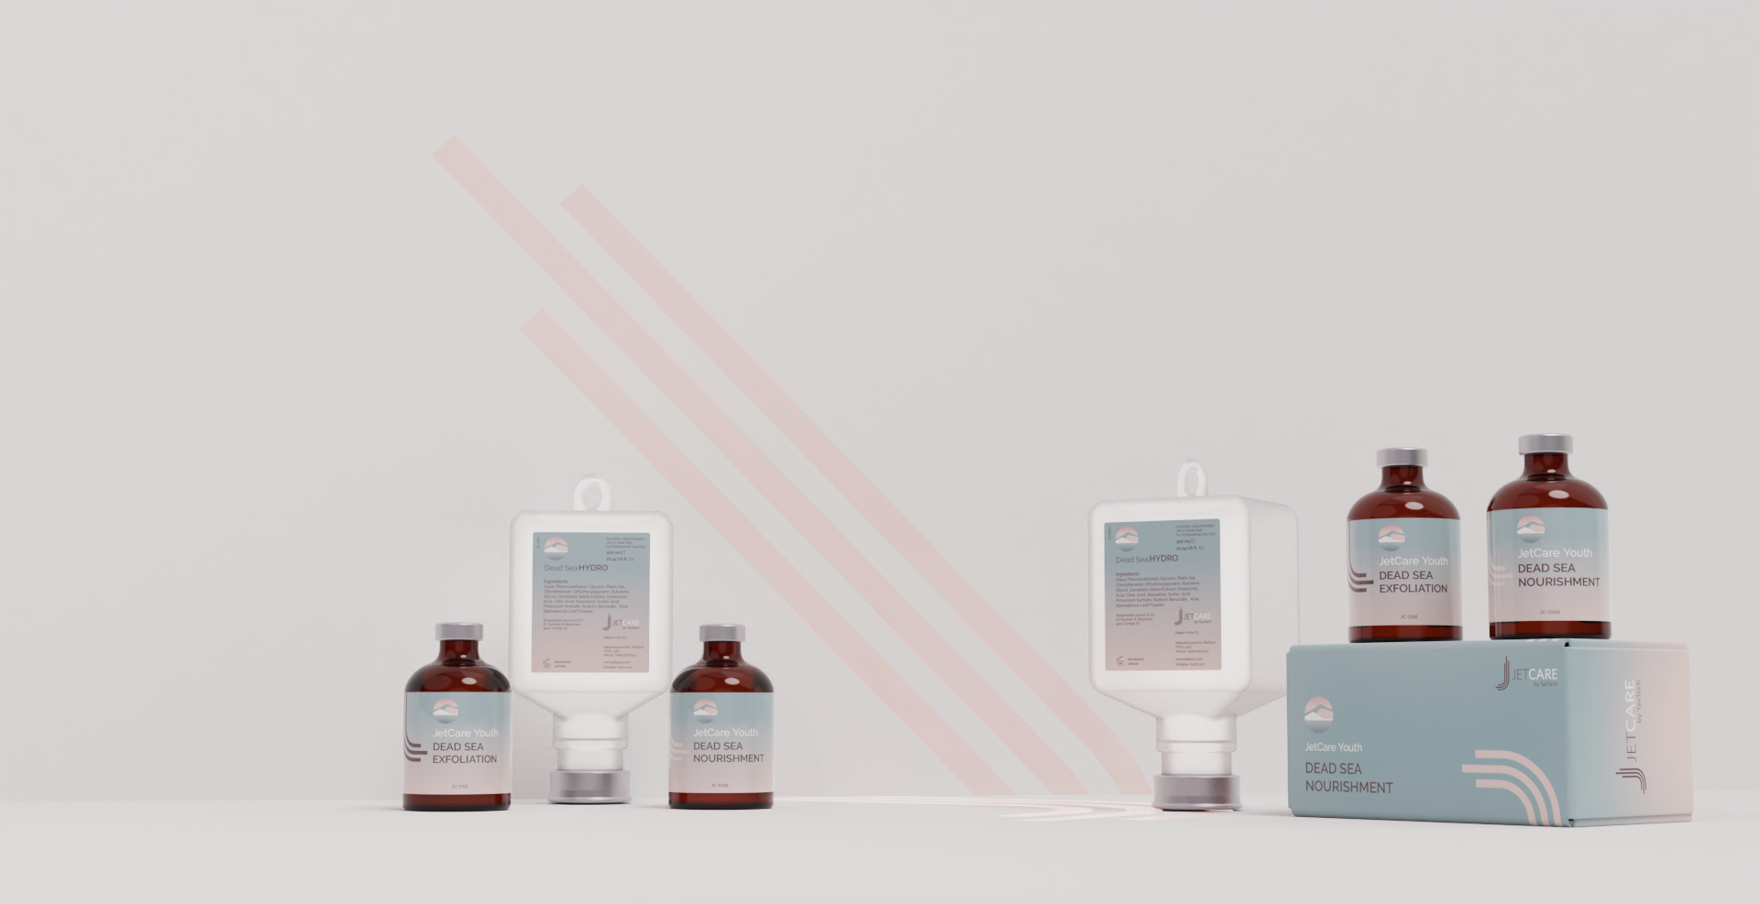
JetCare Youth
JetPeel’s New Prejuvenation Treatment

Slide 3

Future Proof the Skin with JetCare Youth
JetCare Youth is a powerful treatment line based on Dead Sea minerals, specially formulated for “prejuvenation” of younger skin.
It offers a new approach to skin prevention and rejuvenation, helping to prevent skin damage before it occurs and preserve the skin’s current smooth glow and youthful appearance.
Developed by TavTech, innovators of JetPeel jet pressure-energy technology, for use in conjunction with the unique JetPeel handpieces, JetPro device and JetCare treatment guidelines.

Slide 4
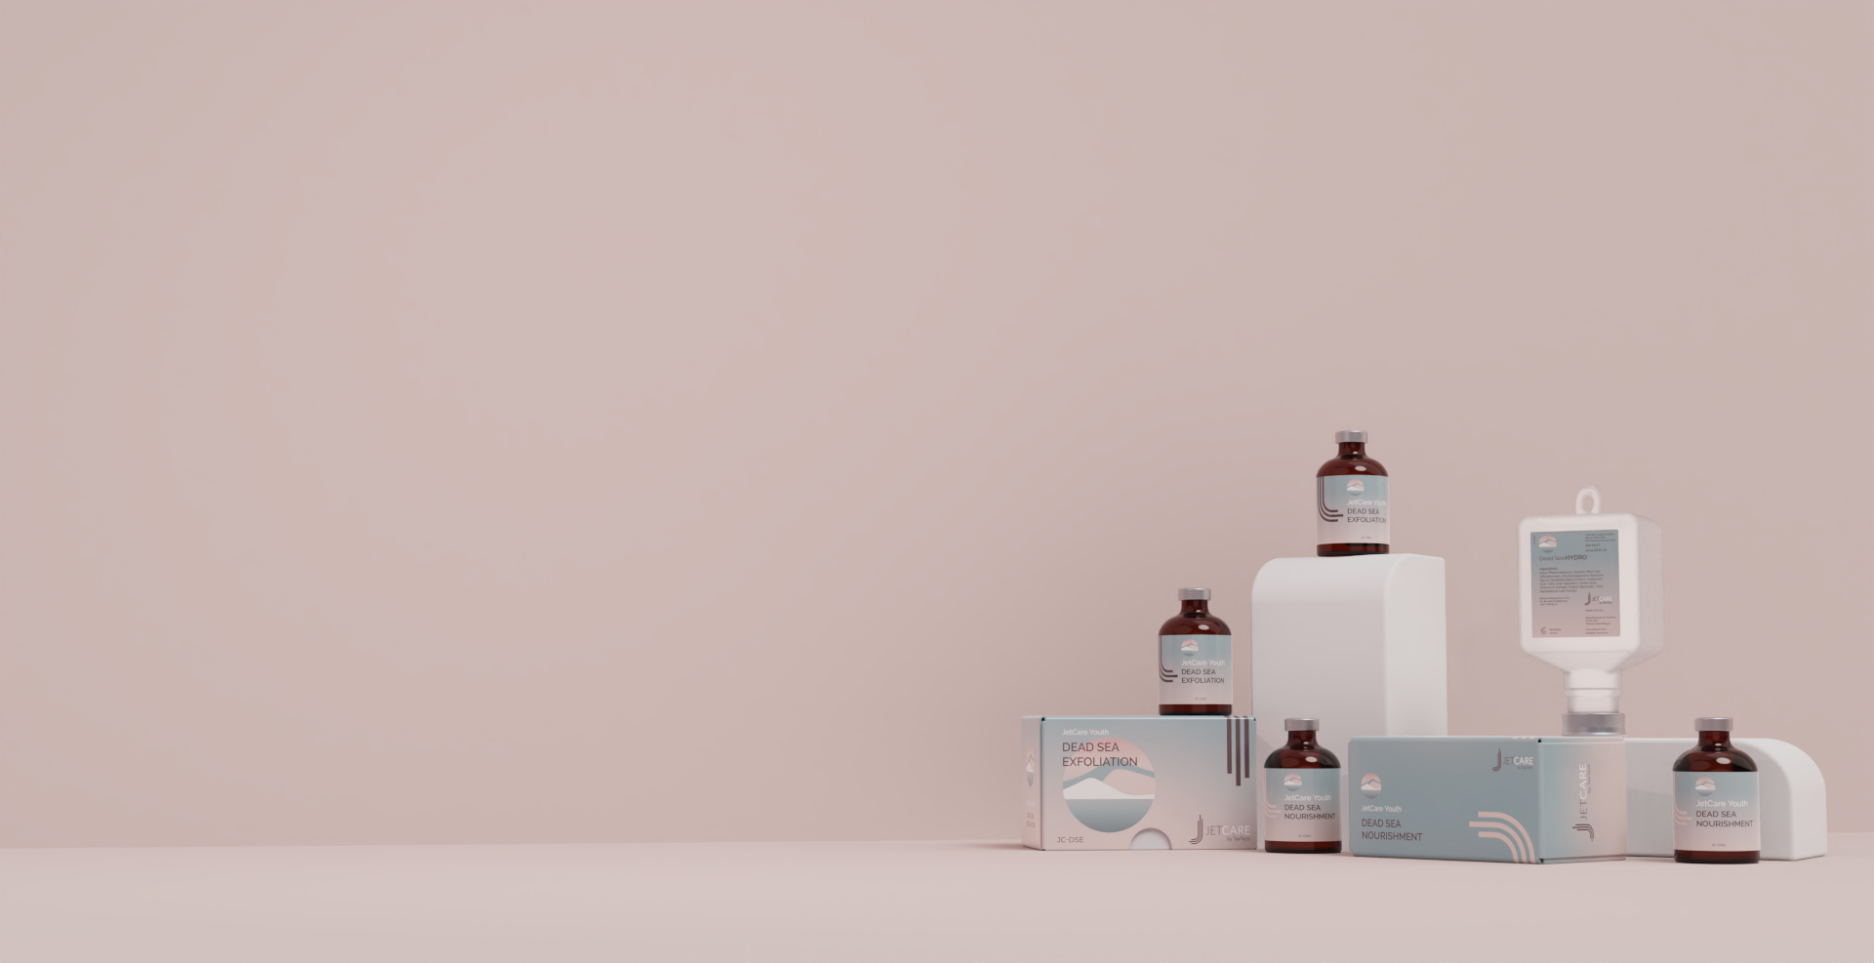
JetCare Youth – Prevent, Protect, Preserve, Rejuvenate
“Prejuvenation” is a powerful trend in aesthetic care, as more people in their 20’s and 30’s aim to preserve the natural youth of their skin.
JetCare Youth treatment products are enriched with protective Dead Sea minerals and natural replenishing ingredients to ward off the appearance of fine lines, sagging skin and dullness before it sets in.
The JetCare Youth protocol is delivered with the innovative jet pressure-energy technology of JetPeel that amplifies the beneficial effects of Dead Sea minerals.

Slide 5

The Power of the Dead Sea
The Dead Sea is the world’s most famous ancient spa, gifting natural salt enriched with a unique concentrated blend of 21 powerful minerals.
Dead Sea minerals are clinically proven for their nourishing and regenerative benefits for the skin.
JetCare Youth delivers the anti-aging properties of Dead Sea minerals into the skin via the non-invasive, needle-free JetPro by TavTech jet pressure-energy device, ensuring outstanding results with no downtime or side effects.

Slide 6

Who Benefits from JetCare Youth?
Younger women and men, aged in their early 20’s to late 30’s, enabling aesthetic clinicians and clinics to broaden their services and offerings to additional age groups and target markets*.
JetCare Youth is designed to preserve the natural youth and beauty inherent in the skin.
Targeted to youthful skin in the early stages of collagen loss, loss of elasticity and photodamage that leads to fine lines and sagging skin later.
* A 2018 survey of the members of the American Academy of Facial Plastic and Reconstructive Surgery (AAFPRS) showed that nearly 75% of facial plastic surgeons had reported an increase in patients younger than 30 years of age.
Notes:
If you have exfoliated with glycolic acid, wait 3-5 minutes (see also “Exfoliation Protocols”) and then repeat the same exfoliation with Jet Detox Water (same hand piece, movements and distance) to wash off the product and the debris at the same time. If you have exfoliated with mandelic acid, do not wash off the product and proceed directly to the infusion step.

Slide 7
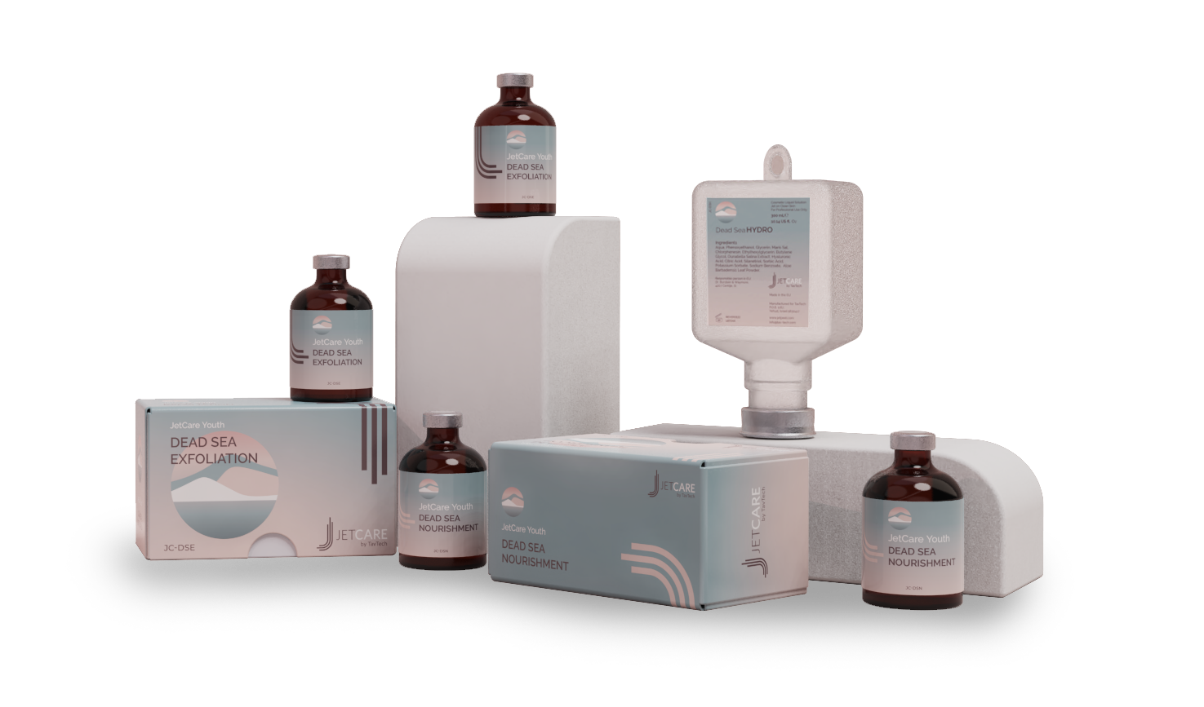
JetCare Youth – Treatment Trio
The enduring JetPro device
The original patented JetPeel TripleJet handpiece
JetCare Youth solutions:
Dead Sea Hydro
Dead Sea Exfoliation
Dead Sea Nourishment
Suitable for all skin types, all year round

Slide 8
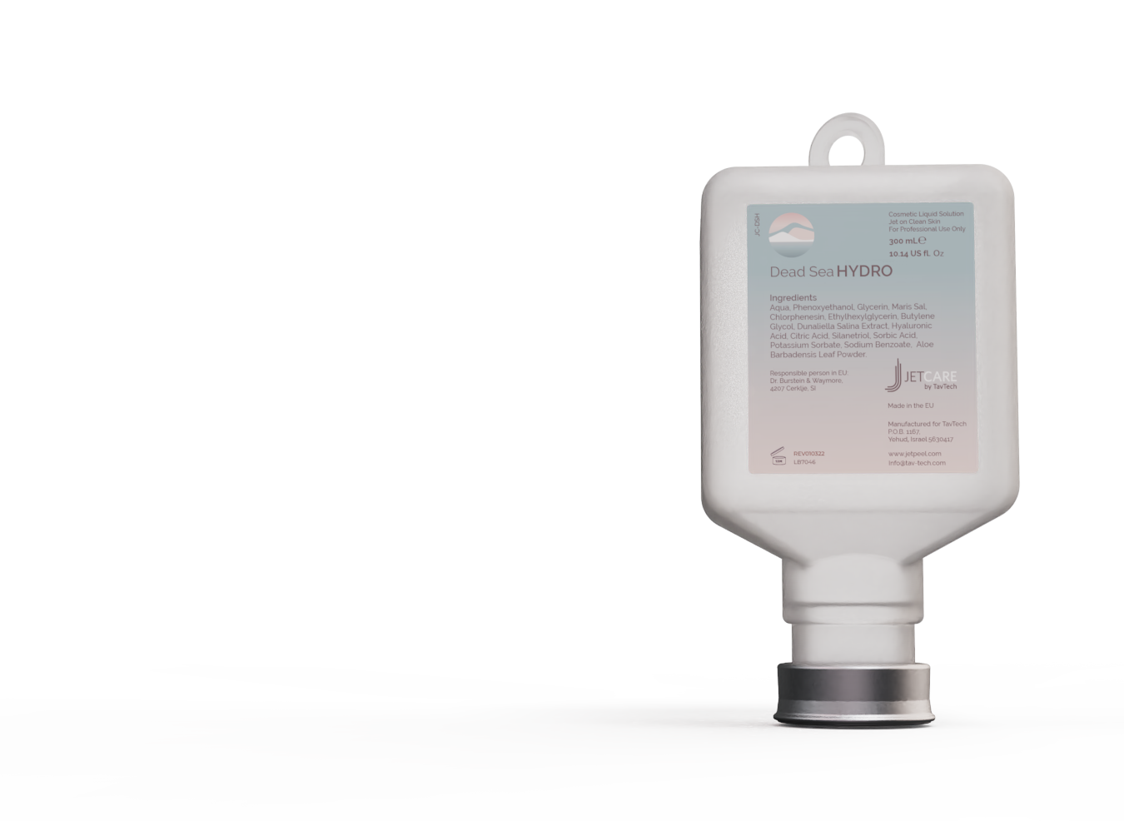
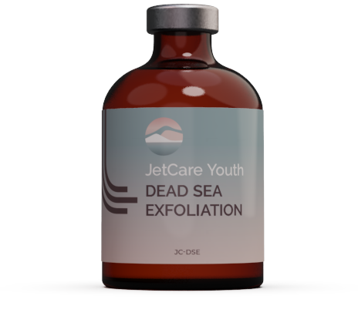
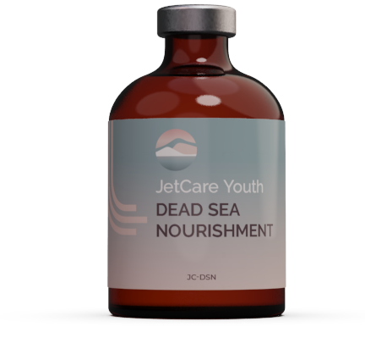
JetCare Youth – Treatment Sequence
STEP
1
STEP
2
STEP
3
LYMPHATIC
MASSAGE
GENTLE
EXFOLIATION
INFUSION
With Dead Sea Hydro
With Dead Sea Exfoliation
With Dead Sea Nourishment

Slide 9
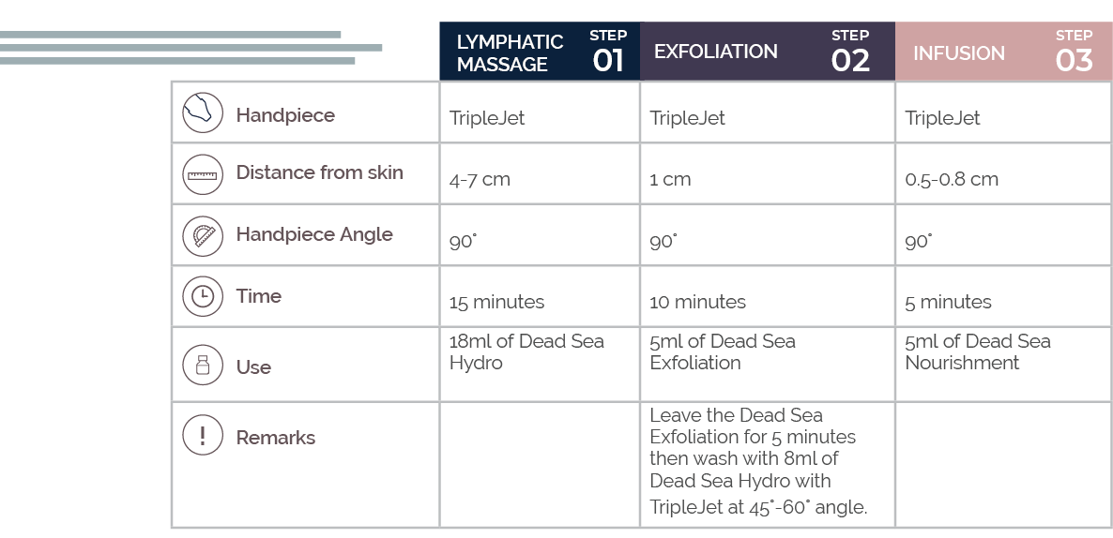
JetCare Youth – Treatment Guideline

Slide 10
JetCare Youth Products
JetCare Youth formulas are based on a complex of Dead Sea minerals that act to help prevent the skin’s natural aging processes and preserve a smooth, youthful glow.
The main minerals include:
  Magnesium for detoxing and purifying the epidermis
  Potassium that helps hydrate the skin
  Sodium to reduce free radical action
  Calcium to help promote skin cell growth and stimulate the production of antioxidants.
Notes:
If you have exfoliated with glycolic acid, wait 3-5 minutes (see also “Exfoliation Protocols”) and then repeat the same exfoliation with Jet Detox Water (same hand piece, movements and distance) to wash off the product and the debris at the same time. If you have exfoliated with mandelic acid, do not wash off the product and proceed directly to the infusion step.

Slide 11
Dead Sea HYDRO
Formulated for step 1:
Pre-treatment lymphatic massage to prep the skin to receive the nourishment of the later treatment steps.
Enriched with Dead Sea mineral-rich salts to help cleanse and detoxify the skin.
Also contains:
  Dunaliella HGL: Helps reduce skin cell aging and protects from sun exposure damage.
  Organic Aloe Vera: Antioxidant emollient that rapidly softens and calms the skin and provides antimicrobial action.
Notes:
If you have exfoliated with glycolic acid, wait 3-5 minutes (see also “Exfoliation Protocols”) and then repeat the same exfoliation with Jet Detox Water (same hand piece, movements and distance) to wash off the product and the debris at the same time. If you have exfoliated with mandelic acid, do not wash off the product and proceed directly to the infusion step.

Slide 12
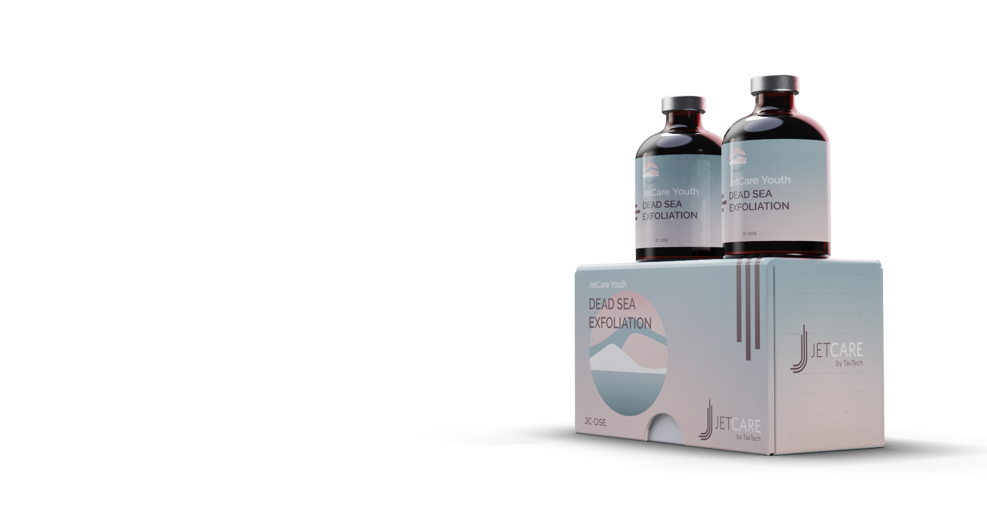
Dead Sea Exfoliation
Formulated for step 2: Gentle exfoliation and replenishment.
Delivers the deep nourishment of rich Dead Sea minerals, ensuring an exceptional replenishing and hydrating effect even as it gently removes the layer of impurities and dead skin cells on the epidermal surface.
Also contains:
  Dunaliella HGL: Helps reduce skin cell aging and protect from sun exposure damage.
  Allantoin: Helps moisturize, exfoliate and smooth the skin surface.
  Lactic Acid: Gentle AHA that helps remove dead cells, stimulates cell renewal, and boosts the skin’s natural moisture.
  Organic Aloe Vera: Antioxidant emollient that rapidly softens and calms the skin and provides antimicrobial action.
  D-Panthenol 75%: Vitamin B₅, helps to seal in moisture, reinforce the skin’s natural barrier, and protect from the effects of exposure and aging.
Notes:
If you have exfoliated with glycolic acid, wait 3-5 minutes (see also “Exfoliation Protocols”) and then repeat the same exfoliation with Jet Detox Water (same hand piece, movements and distance) to wash off the product and the debris at the same time. If you have exfoliated with mandelic acid, do not wash off the product and proceed directly to the infusion step.

Slide 13
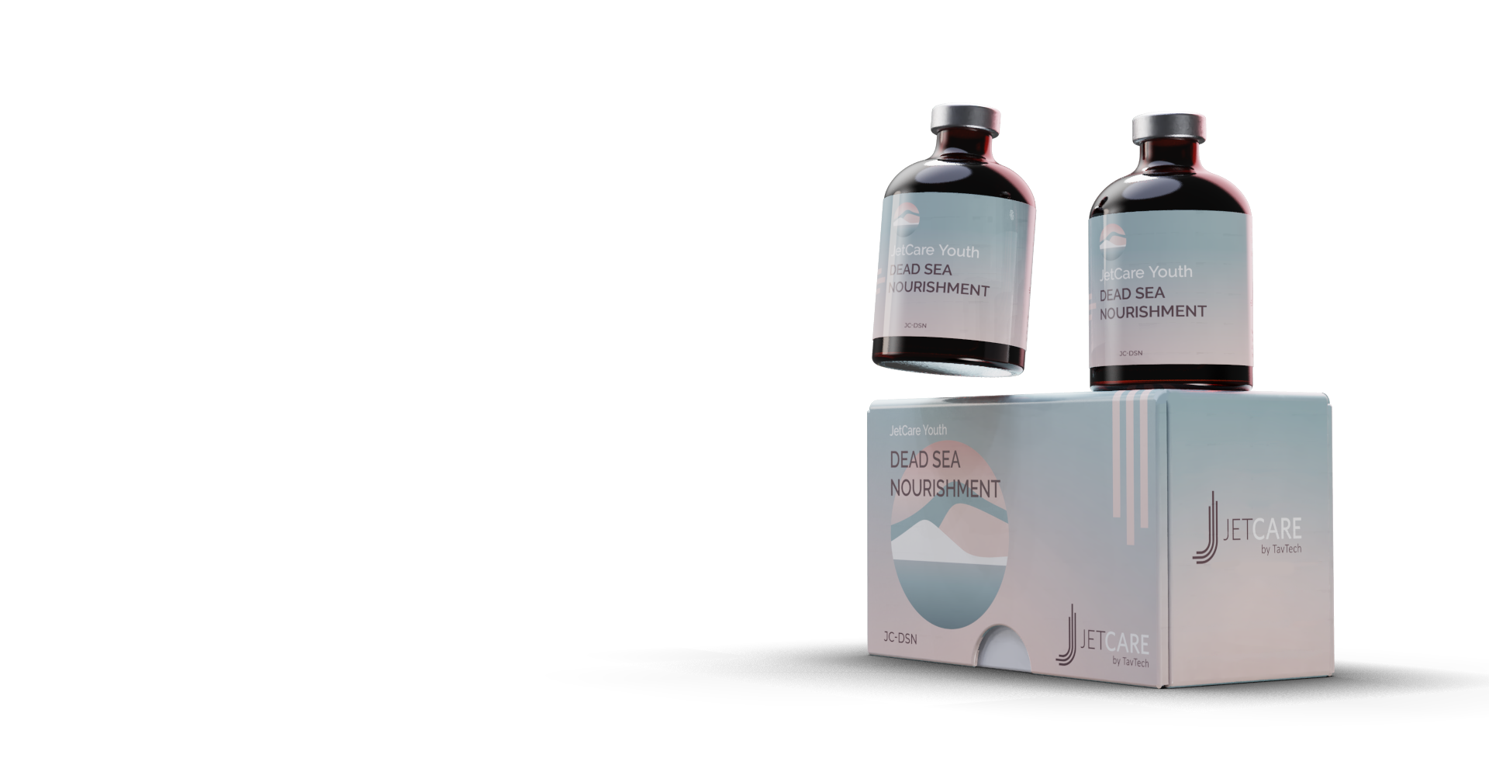
Dead Sea Infusion
Formulated for step 3: the final stage of the JetCare Youth protocol: Nourishing infusion.
Richly formulated with powerful Dead Sea minerals and age-defying ingredients. Supports the skin with renowned detox, hydration and regeneration action that can help prevent future impact and preserve the skin’s own barrier and youthful integrity.
Also contains:
  Magnesium Sulfate: Extra boost of this powerful anti-inflammatory mineral that helps remove excess sebum and toxins that contribute to skin damage.
  Dunaliella HGL: Helps reduce skin cell aging and protects from sun exposure damage.
  SepitonicTM M3: Exclusive patented ingredient helps fight cell fatigue, boosts oxygen availability in the skin, and helps protect the dermis with anti-glycation action. It also acts as a carrier, helping to boost the effects of other anti-aging ingredients, strengthening the skin’s resistance to damage from everyday elements.
  Akoactive Queen: Sourced from the fresh rose petal, this ingredient is a powerful skin hydrator, helping to reduce signs of skin fatigue, refreshing overall appearance and tone.
Notes:
If you have exfoliated with glycolic acid, wait 3-5 minutes (see also “Exfoliation Protocols”) and then repeat the same exfoliation with Jet Detox Water (same hand piece, movements and distance) to wash off the product and the debris at the same time. If you have exfoliated with mandelic acid, do not wash off the product and proceed directly to the infusion step.

Slide 14

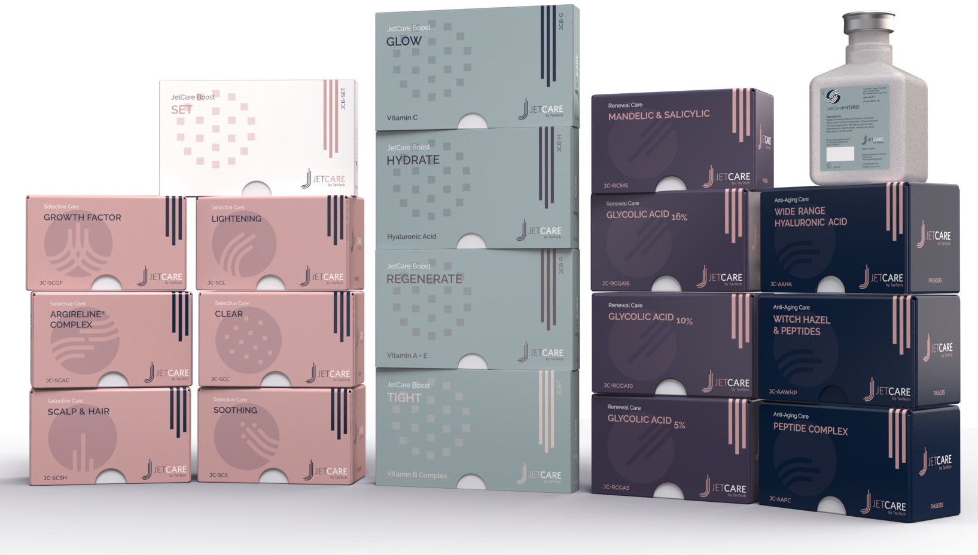

About JetCare
Developed exclusively by TavTech in conjunction with a leading, renowned cosmetics formulation laboratory.
JetCare products deliver powerfully effective JetPeel treatments in the clinic, spa or cosmetic salon, and are the only solutions sanctioned and approved by TavTech for use with its handpieces and devices.
JetCare by TavTech is trusted by cosmeticians and specialists worldwide, and the only choice for the ultimate JetPeel treatment experience.

Slide 15
JetPeel by TavTech Academy

Slide 16
Thank you!

