Slide 1


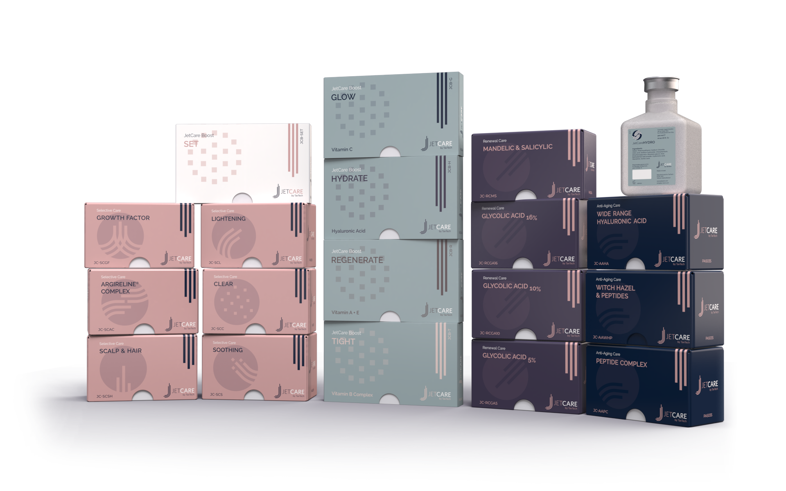
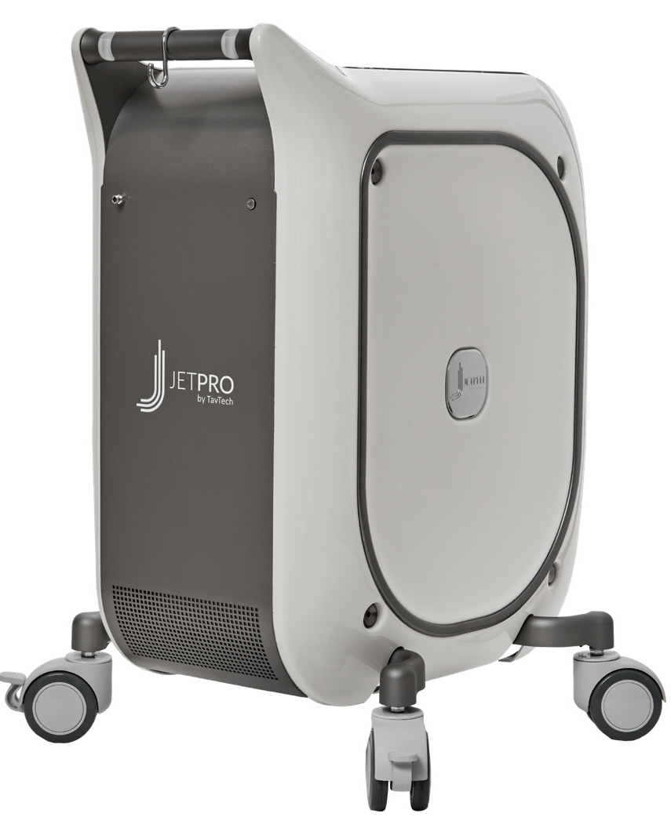
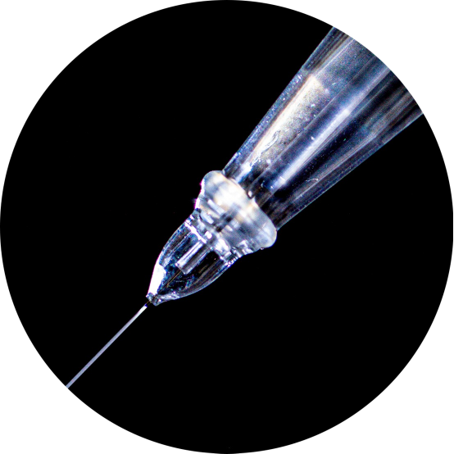
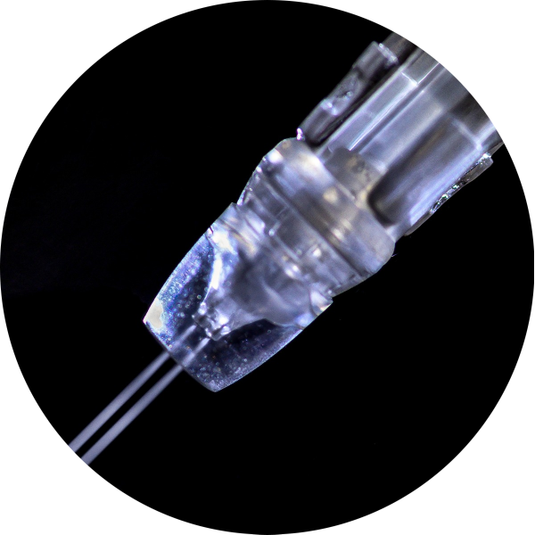
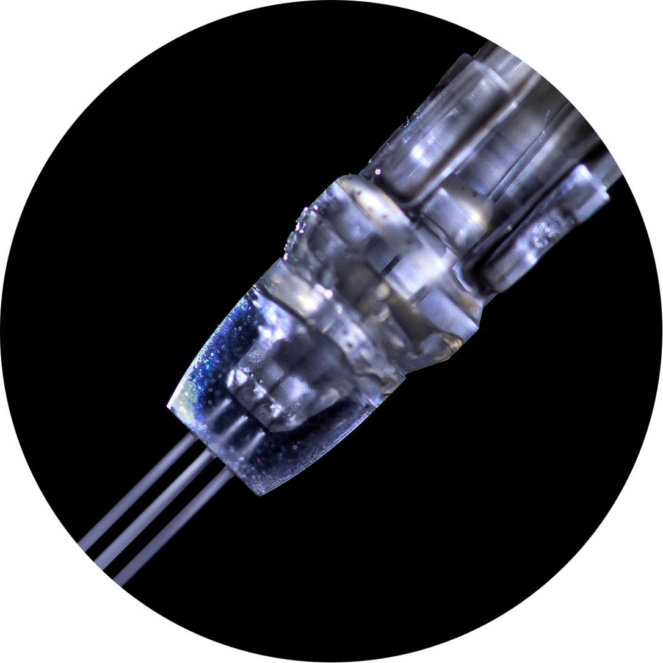
JetPeel by TavTech Academy

Slide 2
Feels More Beautiful Than Ever

Slide 3

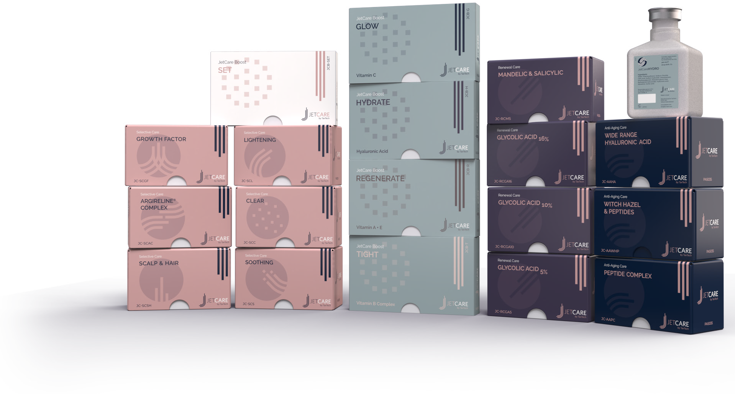
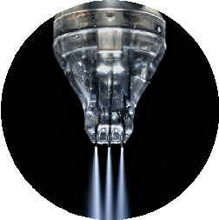
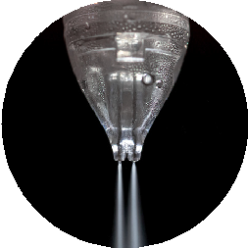
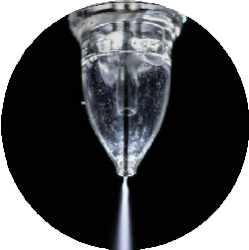
JetCare by TavTech: JetPeel’s premium brand of cosmetic aesthetic liquid solutions
Developed by TavTech in conjunction with a renowned cosmetics formulation laboratory
Formulas carefully crafted with cutting-edge ingredients sourced from the highest quality cosmetic suppliers
JetCare solutions are the only solutions sanctioned and approved by TavTech for use with its Jet Pressure energy devices and unique JetPeel handpieces

Slide 4
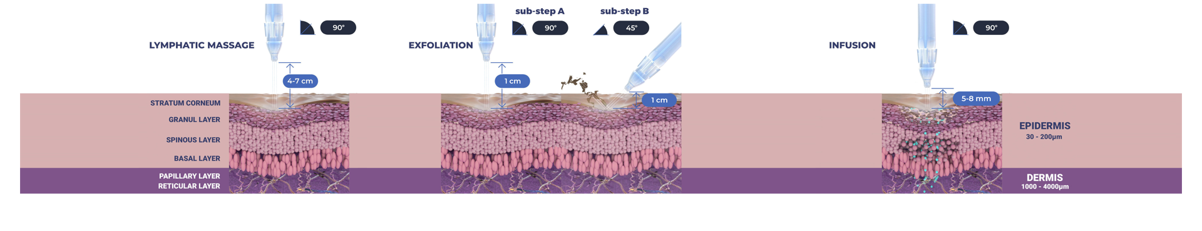
The Treatment Sequence – Face & Body
STEP
STEP
STEP
STEP
1
2
3
4
LYMPHATIC MASSAGE
Relaxing massage for detoxifying the skin and stimulating micro-circulation
EXFOLIATION
Preps the skin to receive the nourishment from the following infusion treatment
INFUSION
Deep, effective delivery of active ingredients into the skin
BOOSTER INFUSION
Post-infusion step to amplify the treatment result

Slide 5
The Treatment Sequence – Face & Body
STEP
STEP
STEP
STEP
1
2
3
4
LYMPHATIC MASSAGE
Relaxing massage for detoxifying the skin and stimulating micro-circulation
EXFOLIATION
Preps the skin to receive the nourishment from the following infusion treatment
INFUSION
Deep, effective delivery of active ingredients into the skin
BOOSTER INFUSION
Post-infusion step to amplify the treatment result

Slide 6

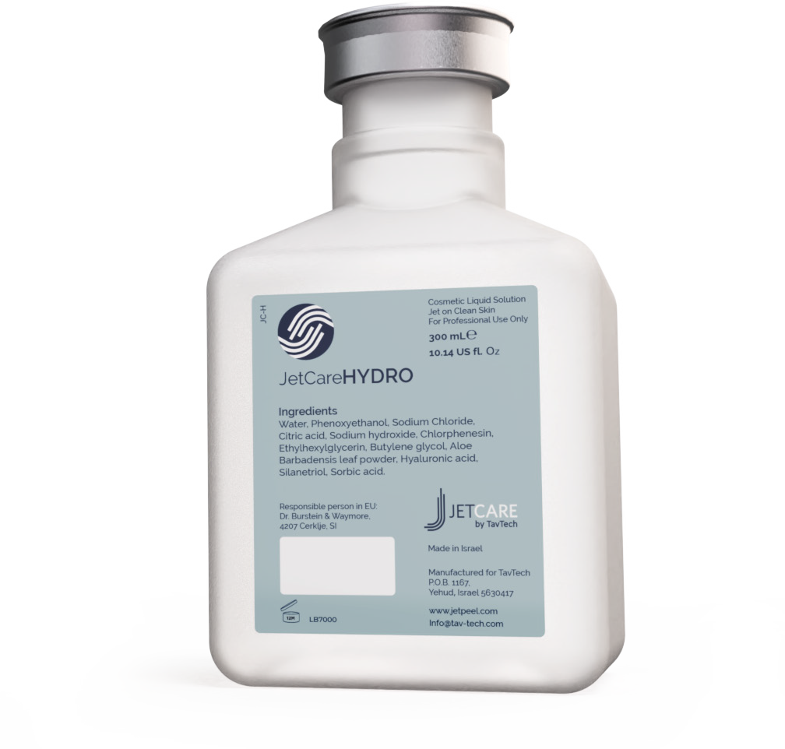
JetCareHYDRO
(Replaces Jet Detox Water)
All JetPeel sessions begin with JetCare Hydro
Gentle solution formulated for the initial lymphatic massage, and to prep the skin for the deeper JetCare treatments
Hyaluronic Acid concentration reformulated, significantly higher than in former version
Enriched with higher concentrations of organic concentrated Aloe Vera
Solid plastic bottle, won’t puncture during transportation
300 ml - 20% more than in former version

Slide 7
The Treatment Sequence – Face & Body
STEP
STEP
STEP
STEP
1
2
3
4
LYMPHATIC MASSAGE
Relaxing massage for detoxifying the skin and stimulating micro-circulation
EXFOLIATION
Preps the skin to receive the nourishment from the following infusion treatment
INFUSION
Deep, effective delivery of active ingredients into the skin
BOOSTER INFUSION
Post-infusion step to amplify the treatment result

Slide 8
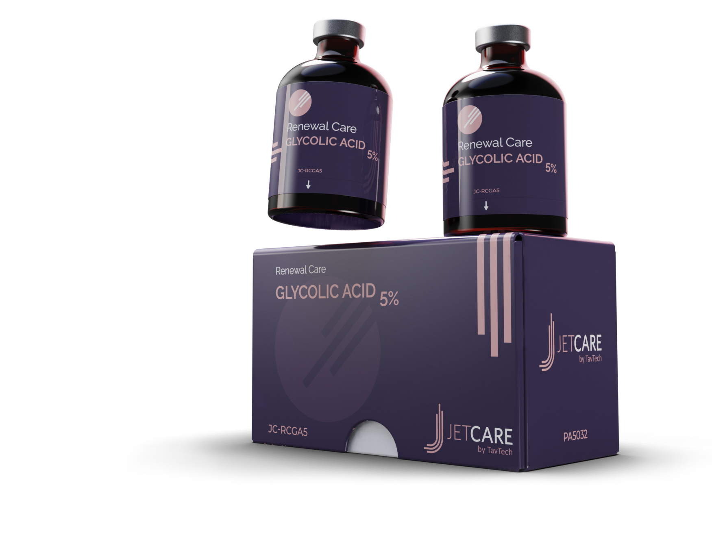
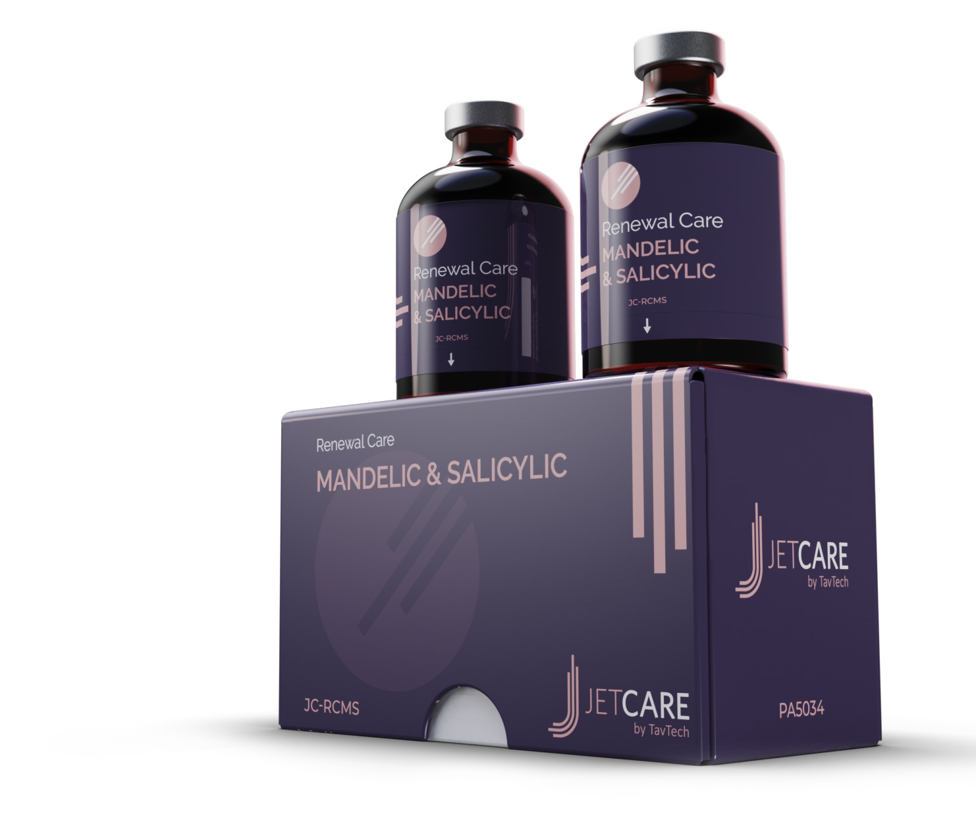
Renewal Care Series
The ultimate exfoliating treatment line enriched with AHA’s and BHA’s
The Renewal Care Series is adjusted to pH of 3.5, the ideal range for rejuvenating the skin, activating skin enzymes and barrier peptides, and for balancing the Natural Moisturizing Factor (NMF)
Glycolic Acid Series
(Replaces Renewal Complex 1, 2, 3)
Personalized exfoliation containing Glycolic Acid, Organic Aloe Vera and Pro-Vitamin B5 Panthenol
Available in 3 concentrations:
5% Glycolic acid – for delicate and normal skin
10% Glycolic acid – for normal to oily skin
16% Glycolic acid – for mature skin
Mandelic & Salicylic Series
(Replaces Renewal Complex 4)
The gentlest way to achieve a deep exfoliating and resurfacing effect
Solution enriched with the ideal blend of AHA & BHA for maximum benefit

Slide 9
The Treatment Sequence – Face & Body
STEP
STEP
STEP
STEP
1
2
3
4
LYMPHATIC MASSAGE
Relaxing massage for detoxifying the skin and stimulating micro-circulation
EXFOLIATION
Preps the skin to receive the nourishment from the following infusion treatment
INFUSION
Deep, effective delivery of active ingredients into the skin
BOOSTER INFUSION
Post-infusion step to amplify the treatment result

Slide 10
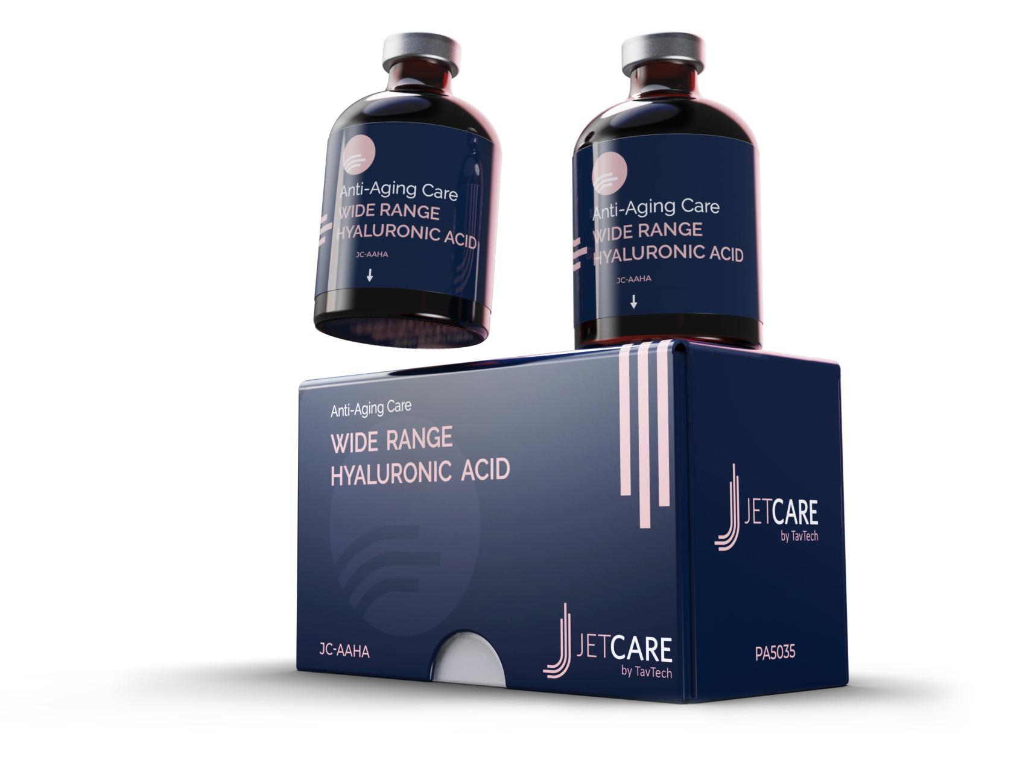
Anti Aging Care Series
Wide Range Hyaluronic Acid
(Replaces Anti-Aging Complex 1)
Unique wide-range complex containing five molecular weights of HA that enable simultaneous infusion into different layers of the skin
Low- and medium-weight HA molecules can go deeper into the skin, increasing hydration over time
High-weight HA molecules lie on the surface level, for instant hydration
Combined with Regu-age®, a synergistic blend of patented peptides and proteins that demonstrates fast action anti-aging benefits

Slide 11
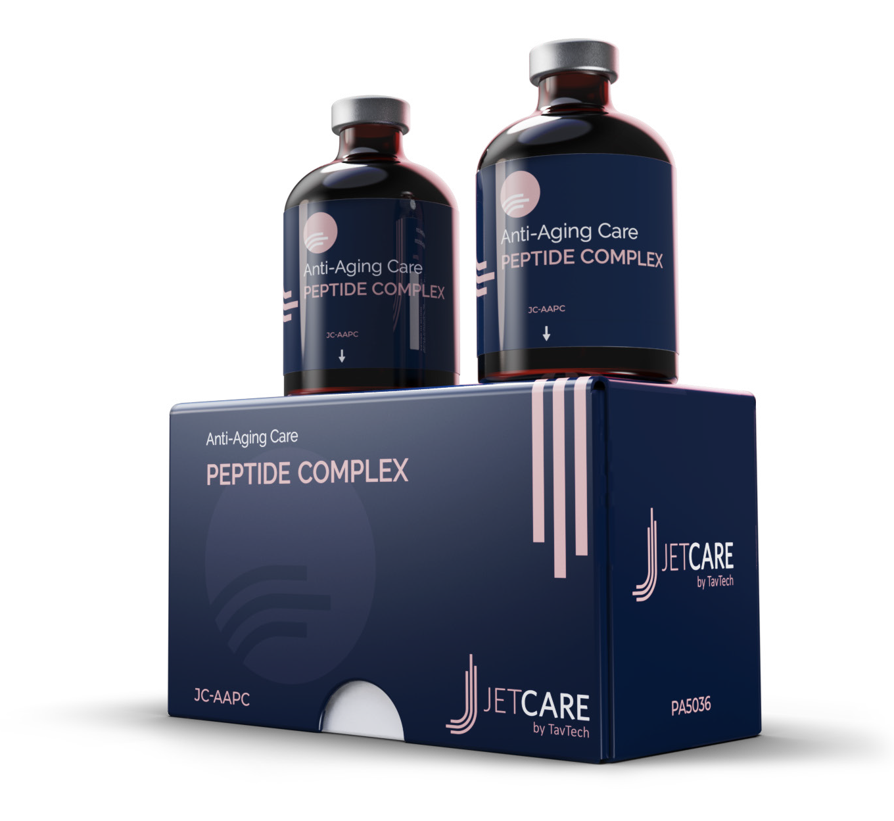
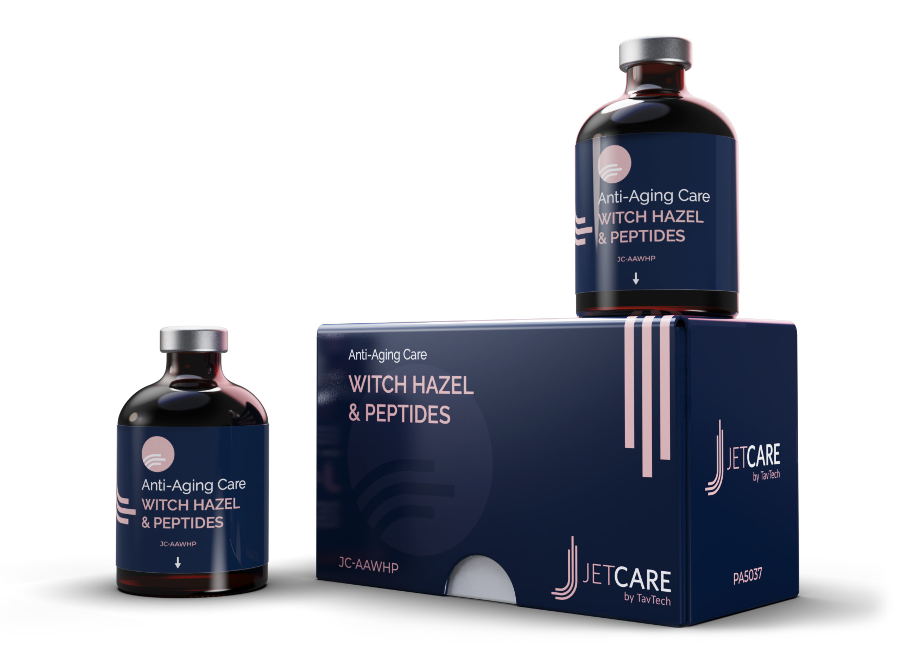
Peptide Complex
Witch Hazel & Peptides
(Replaces Anti-Aging Complex 3)
(Replaces Anti-Aging Complex 2)
Formulated for skin showing signs of aging and loss of elasticity
Concentrated amino-rich peptide blend helps restore firmness and a youthful appearance
Reinforced with:
Replexium™ - a fusion of two patented skin bioavailable peptides and proteins
Juveleven™ - a powerful skin protecting hexapeptide
Pentavitin® - natural, plant- based carbohydrate complex
Regu-age® - synergistic blend of patented purified soy and rice peptides and biotech produced yeast protein
Purifying solution for radiant complexion
Selected peptides blend helps to fortify the skin’s firmness and elasticity
Richly concentrated with Witch Hazel extract, a strong astringent for all skin types and powerful natural calming agent
Reinforced with:
Regu-age® - synergistic blend of patented purified soy and rice peptides and biotech produced yeast
Replexium™ - a fusion of two patented skin bioavailable peptides and proteins
Betaine – a natural humectant, helps retain hydration

Slide 12
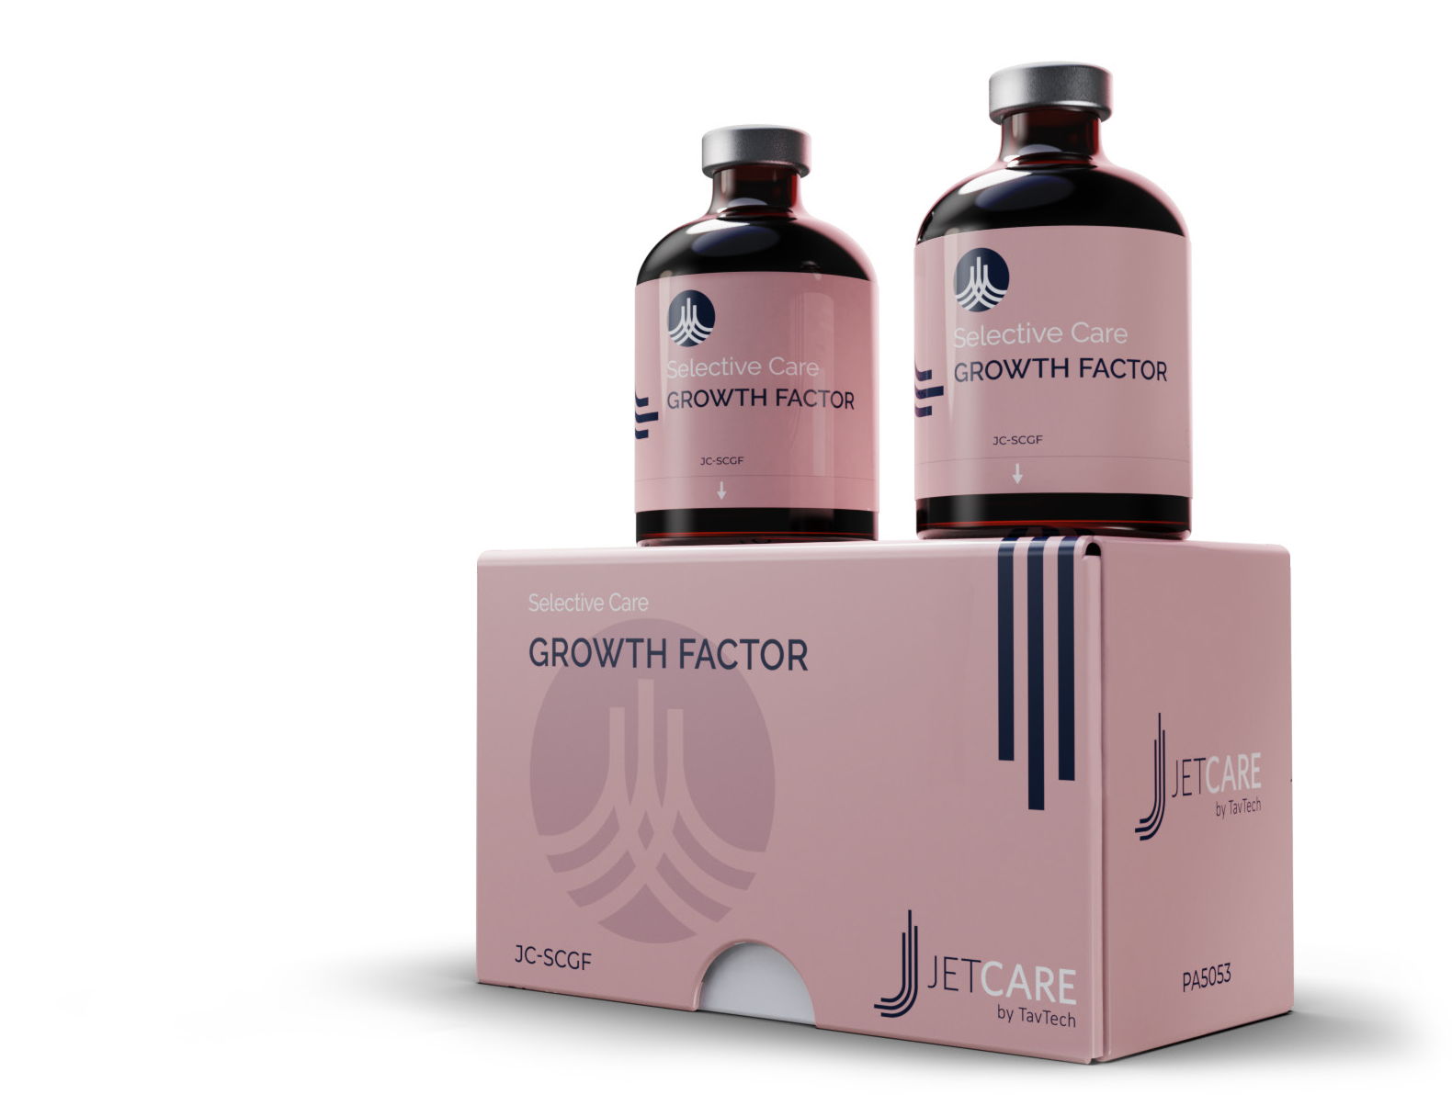
Selective Care Series
Growth Factor
New addition to the JetCare line designed to meet the biochemistry of the skin
Advanced skin rejuvenation technology with new active ingredients adapted to galenics
Harnesses the power of biotechnologically produced EGF (Epidermal Growth Factor) complex
Optimal active ingredient concentrations formulated to get into the skin layer in which they are most effective
Powerful skin firming and anti-aging agent
NEW PRODUCT

Slide 13
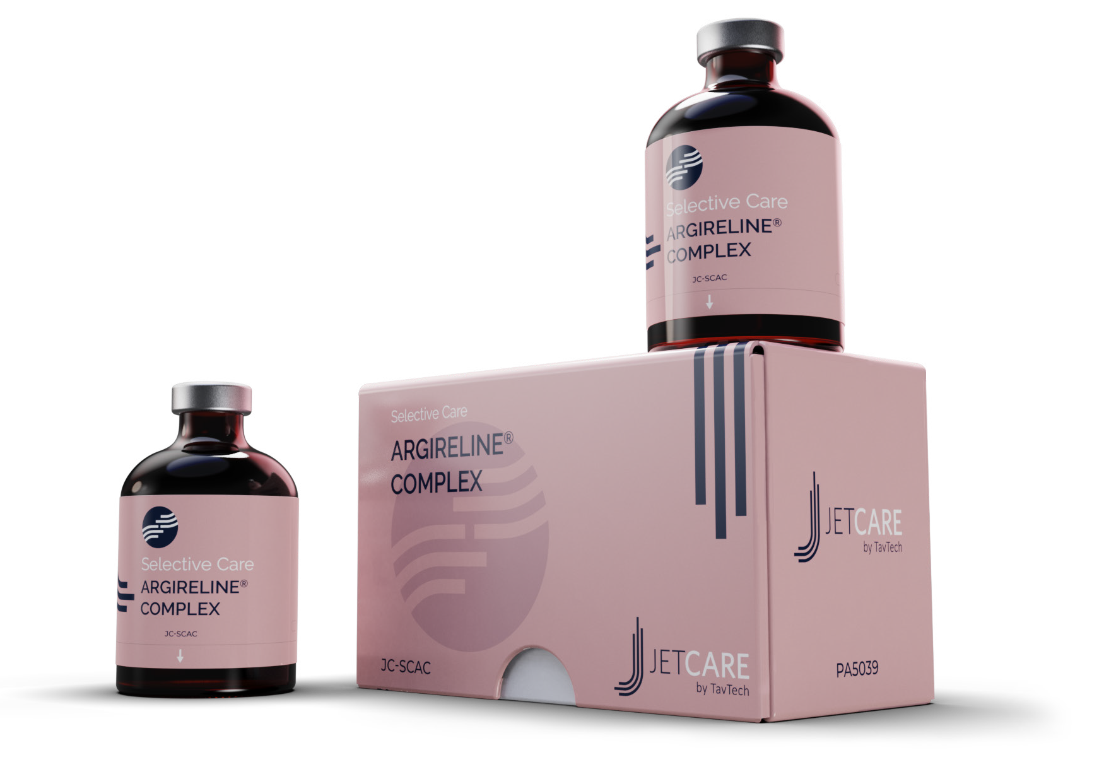
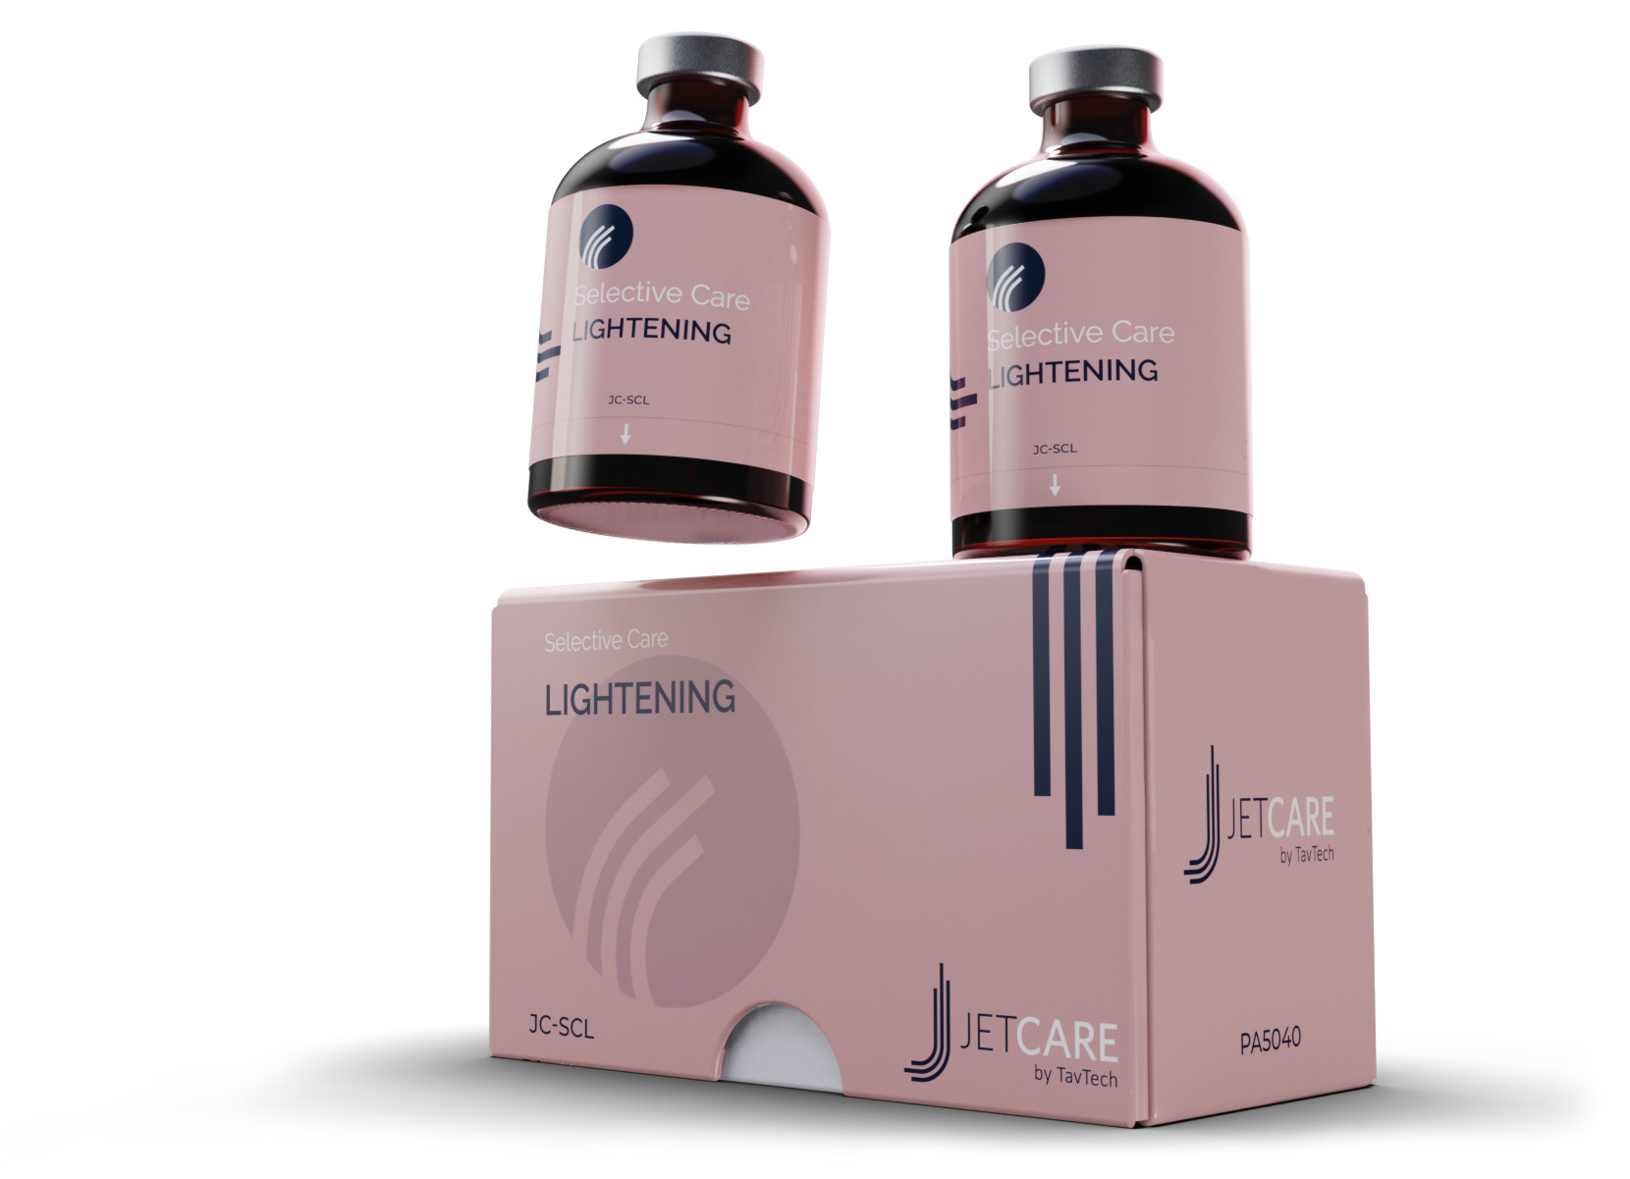
Argireline® Complex
Lightening
(Replaces Whitening Complex 1)
(Replaces ATX-Nat)
The key to achieving the appearance of brighter skin and an even toned complexion
Contains alpha-arbutin - a natural derivative of hydroquinone
Fortified with:
Niacinamide (Vit B3)
Beta-white™
Salicylic acid
Argireline® is a hexapeptide that reduces fine wrinkles and lines
Contains Argireline® peptide solution, resulting in significantly more acetyl hexapeptide than former version
Combined with Vitamin B5 and a triple molecular weight Hyaluronic Acid
Extremely effective anti-aging treatment
Argireline ® is a trademark of Lipotec S.A. or its affiliates

Slide 14


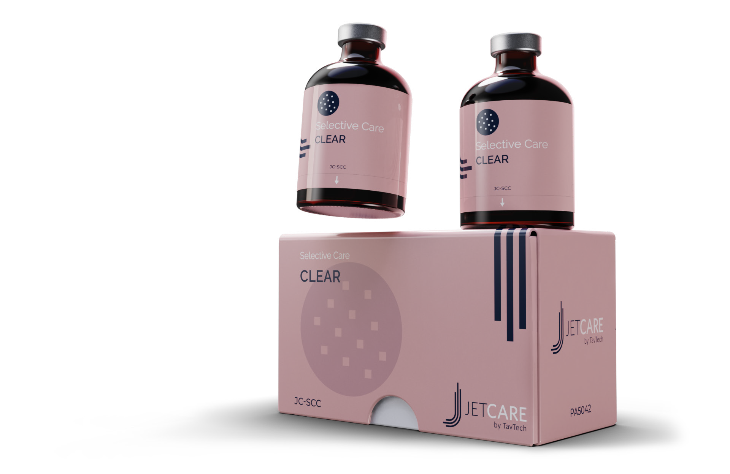
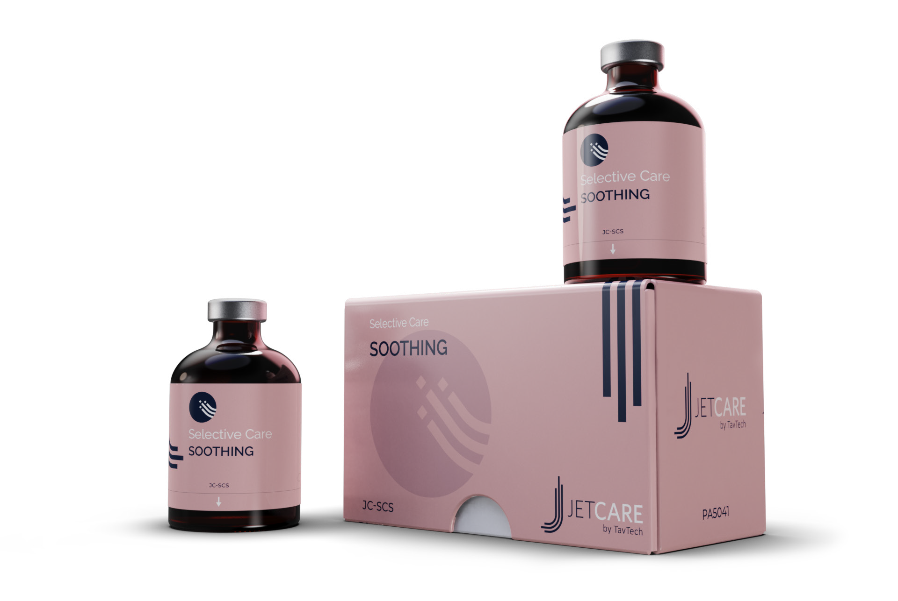
Clear
Soothing
(Replaces Couperose and Sensitive Skin)
(Replaces Pure - Acne)
Specially formulated to achieve clear, even, calm skin
Rich in Neutrazen™ and Salicylic Acid to help purify clogged pores
Fortified with Niacinamide (Vit B3)
Added Allantoin (soothing agent)
Contains significantly higher concentration of Azeoglicina®
Fortified with Nordic cotton extract, known as a soothing agent
Helps to relieve redness and blemishes
Calming ingredients hydrate, nourish and smooth uneven skin

Slide 15
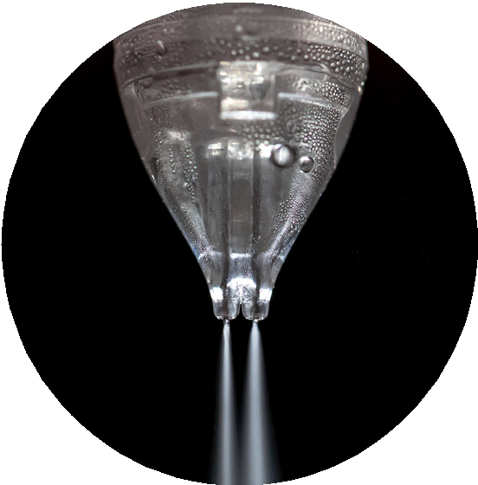
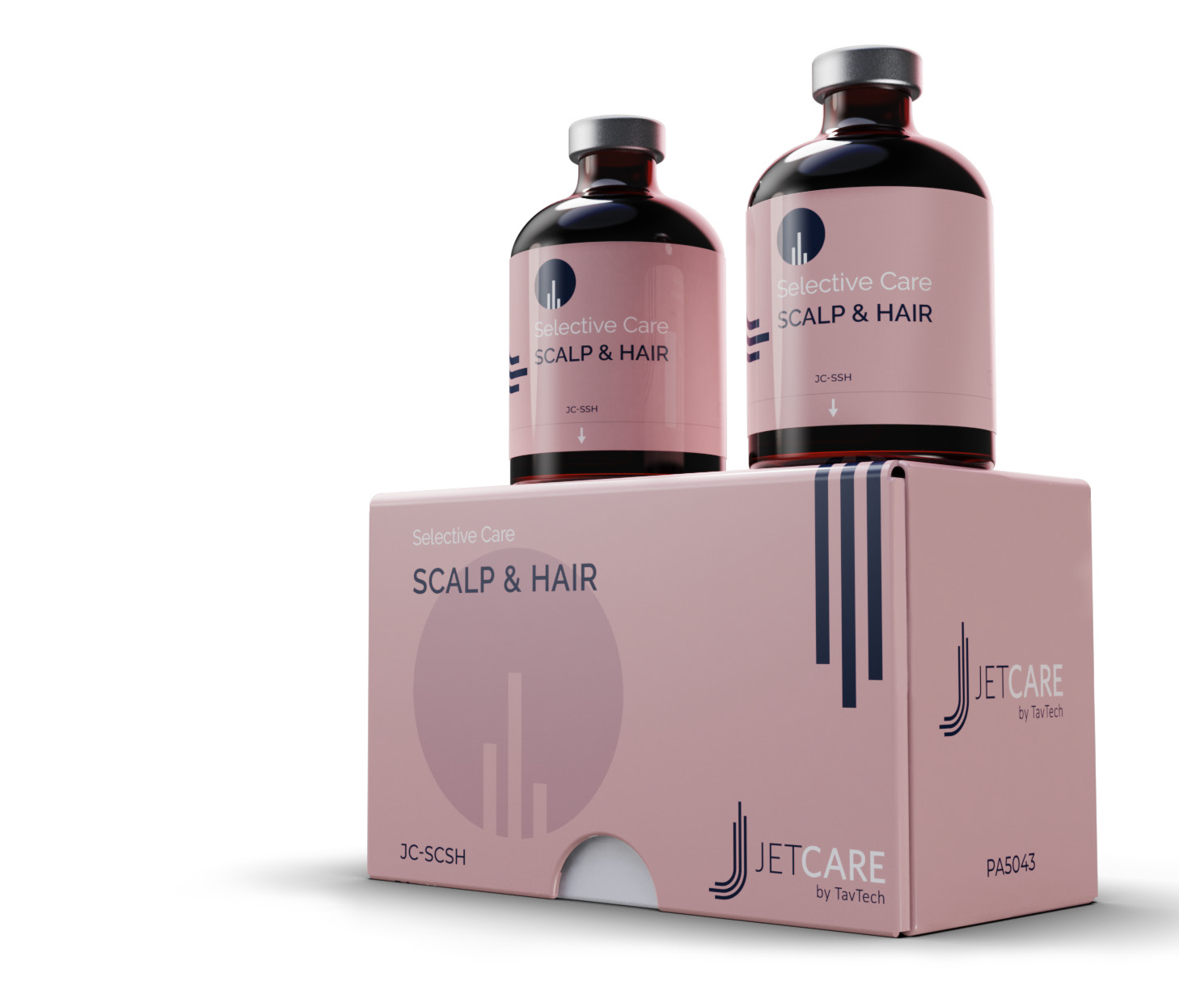
Scalp & Hair
Recommended to be used with NEW DoubleJet Handpiece
For men and women
Creates the conditions for enhanced fullness and volume
Formulated with innovative targeted ingredients
Rich in Biotin Vitamin B7 that helps rejuvenate the scalp
Contains:
Root Biotech™ - deeply nourishing for a fuller, healthy look
Redensyl™ - amino acids and antioxidants for healthier hair
Capixyl™ - a Biomimetic peptide with red clover extract (Biochanin A) which helps create thicker, fuller and healthier hair

Slide 16
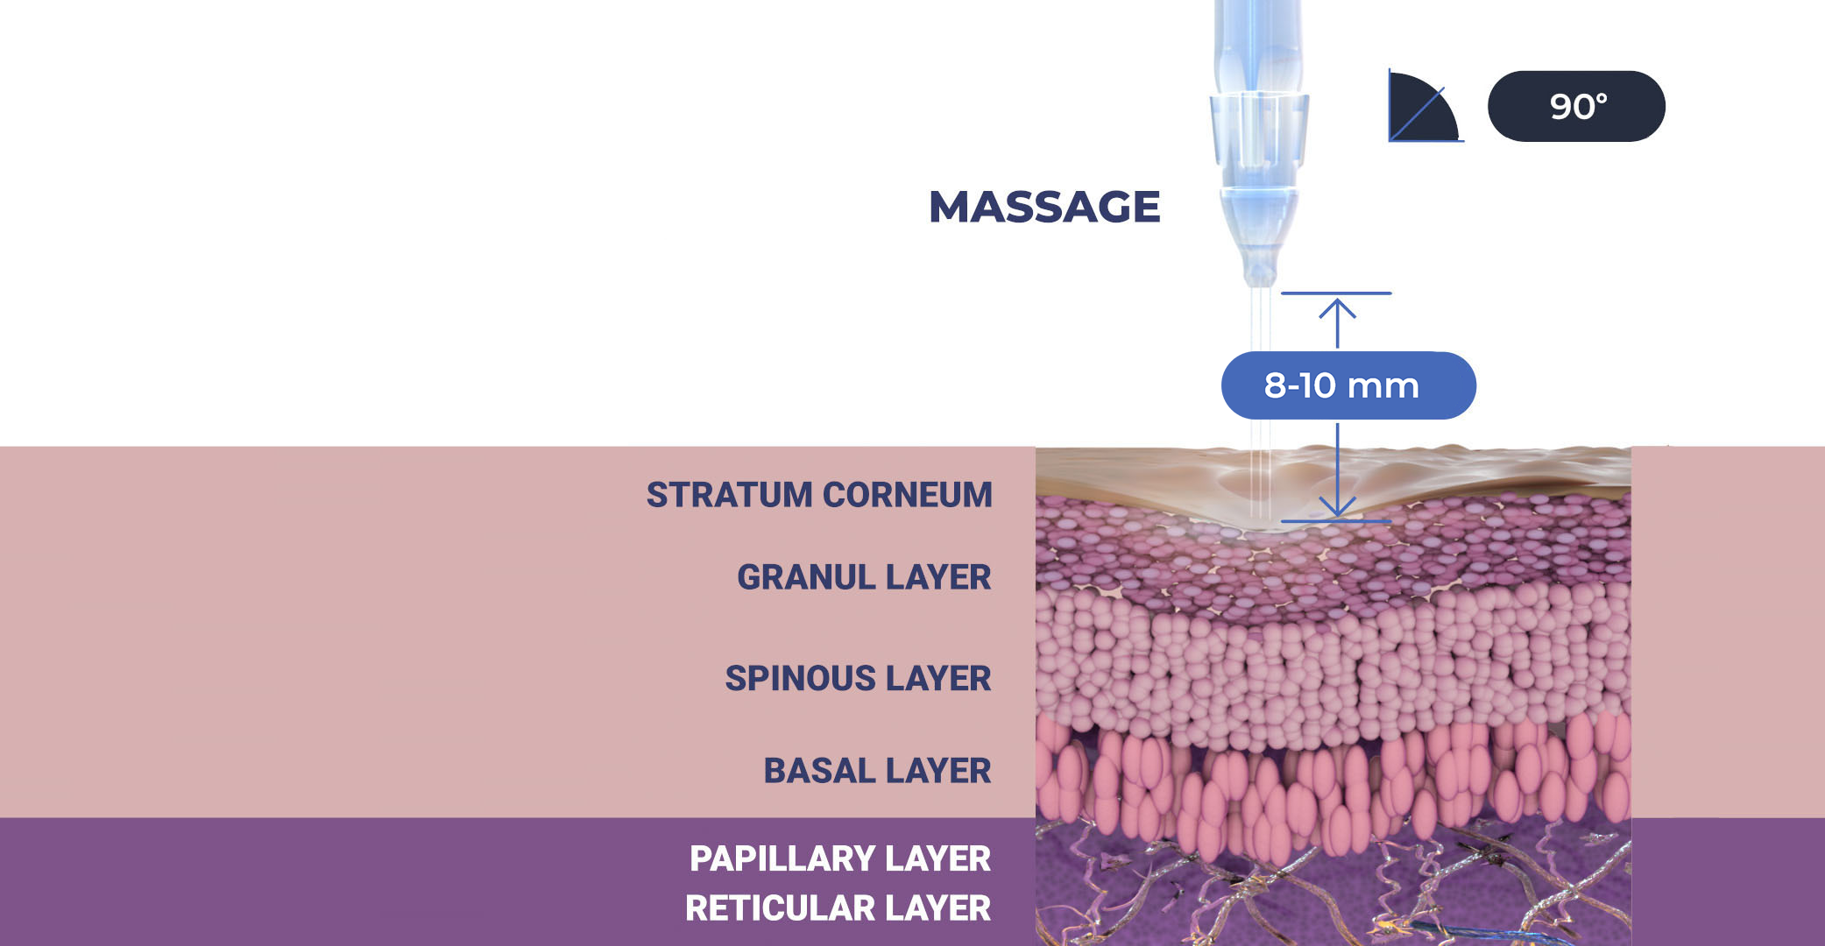

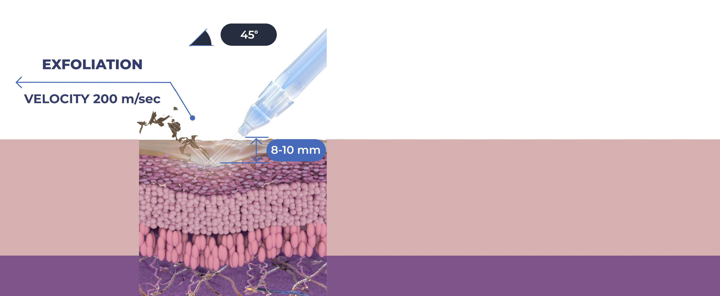
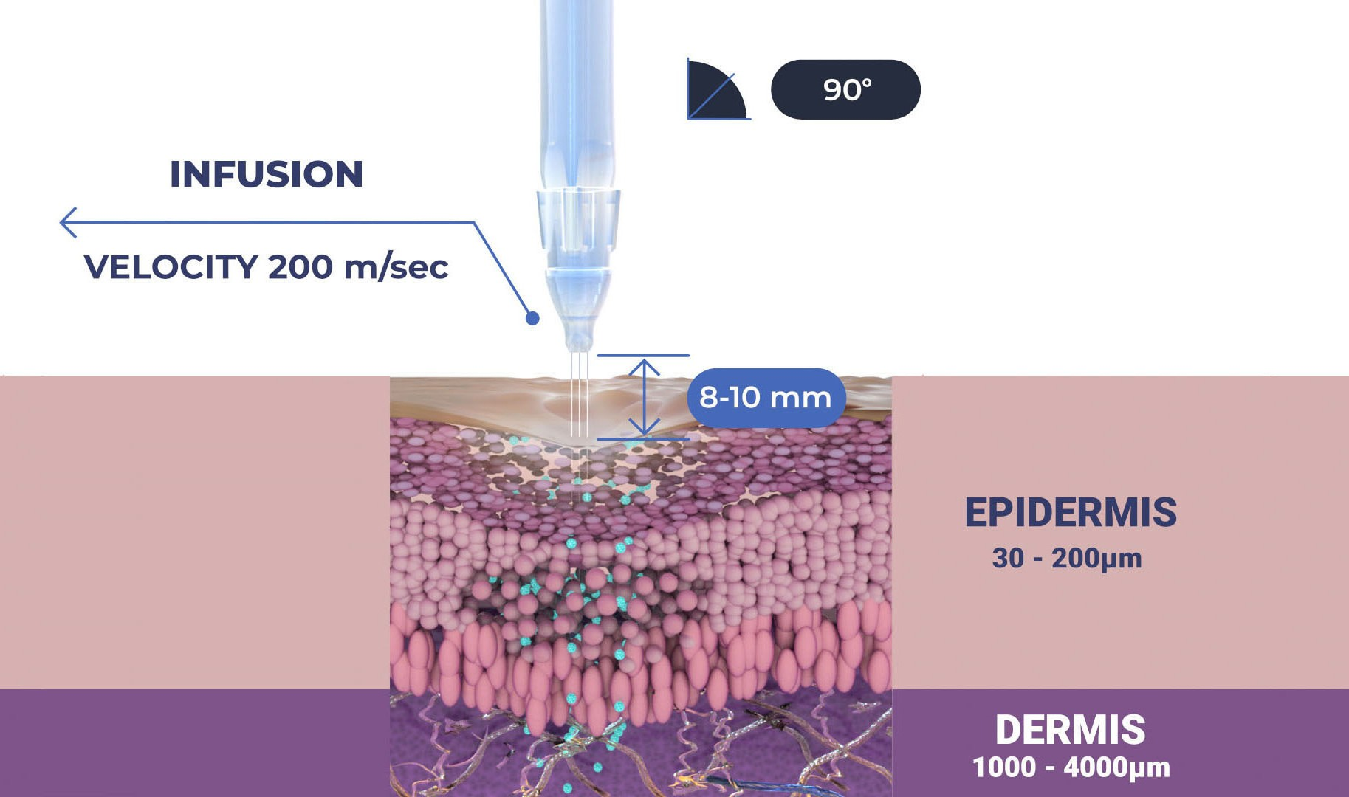

The Treatment Sequence: Scalp & Hair
STEP
STEP
1
1
2
MASSAGE AND EXFOLIATION
Relaxing massage and exfoliation to prep the scalp to receive the nourishment from the following infusion treatment
INFUSION
Deep, effective delivery of active ingredients into the scalp

Slide 17
The Treatment Sequence – Face & Body
STEP
STEP
STEP
STEP
1
2
3
4
LYMPHATIC MASSAGE
Relaxing massage for detoxifying the skin and stimulating micro-circulation
EXFOLIATION
Preps the skin to receive the nourishment from the following infusion treatment
INFUSION
Deep, effective delivery of active ingredients into the skin
BOOSTER INFUSION
Post-infusion step to amplify the treatment result

Slide 18


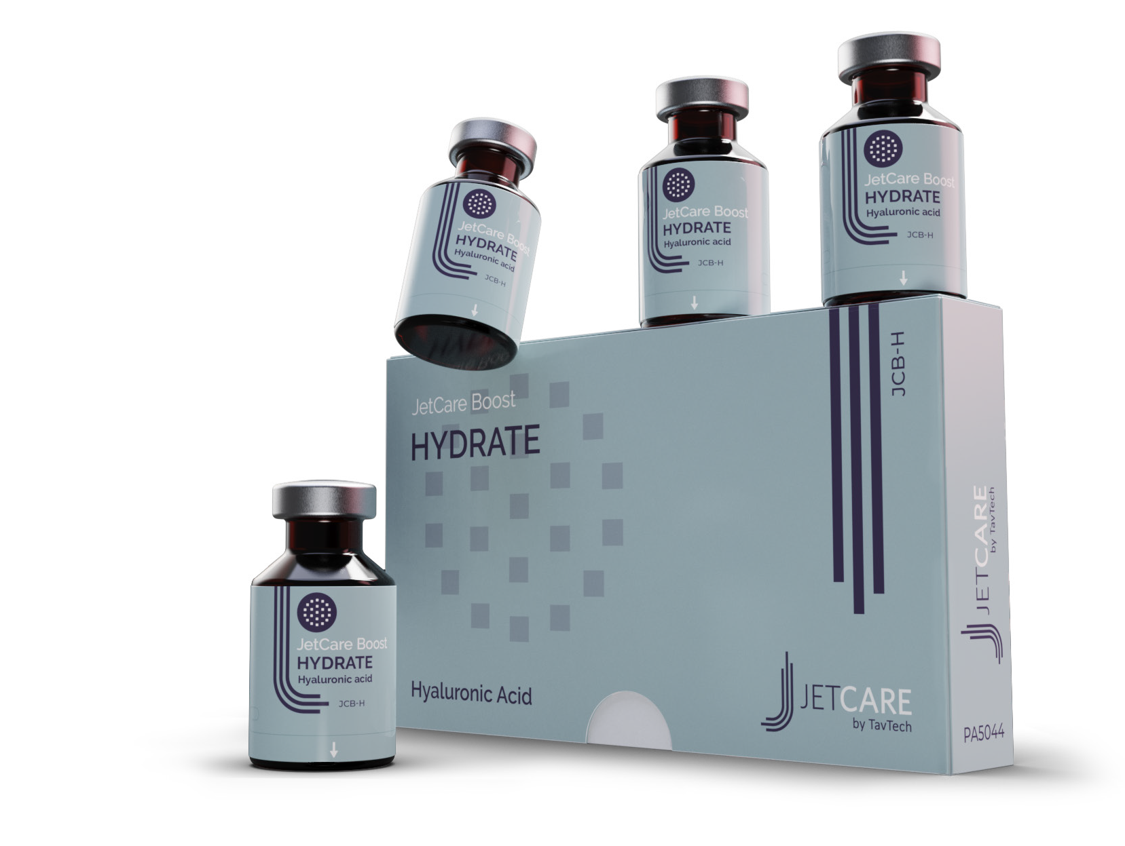
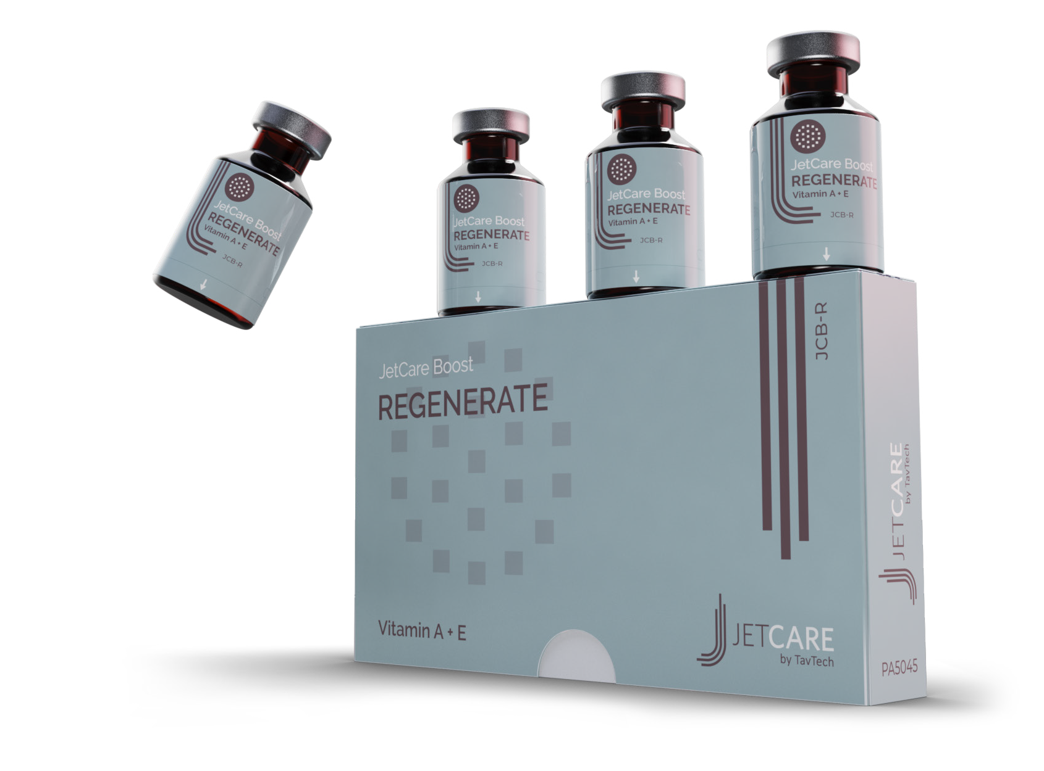
JetCare Boost Series
New and improved booster formulas designed to amplify the power of JetPeel infusions
Jet Boost Hydrate (HA)
State-of-the-art HA formula for the ultimate filler effect and beautifully smooth skin
Maximum concentration of PrimalHyal™ Ultrafiller, an innovative HA derivative
Regenerate (Vit A + E)
Serum booster enriched with vitamins A and E for high performance anti-aging action
Specially formulated to regenerate the skin with the antioxidant power

Slide 19


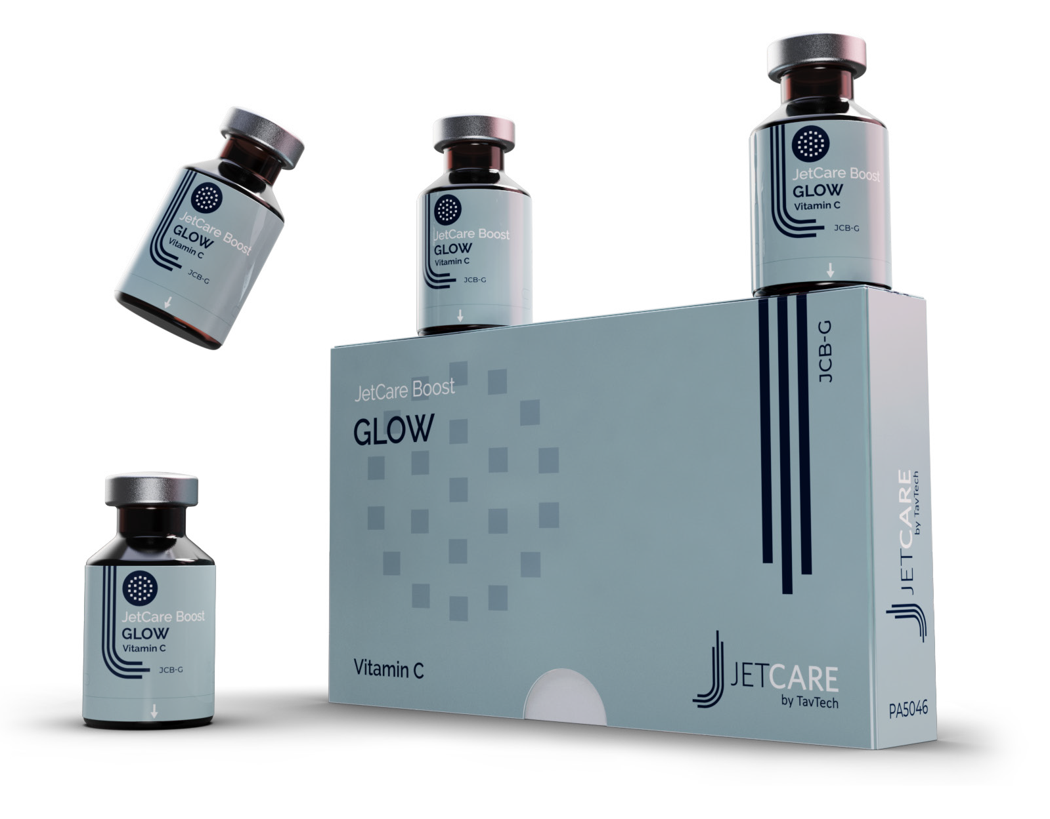
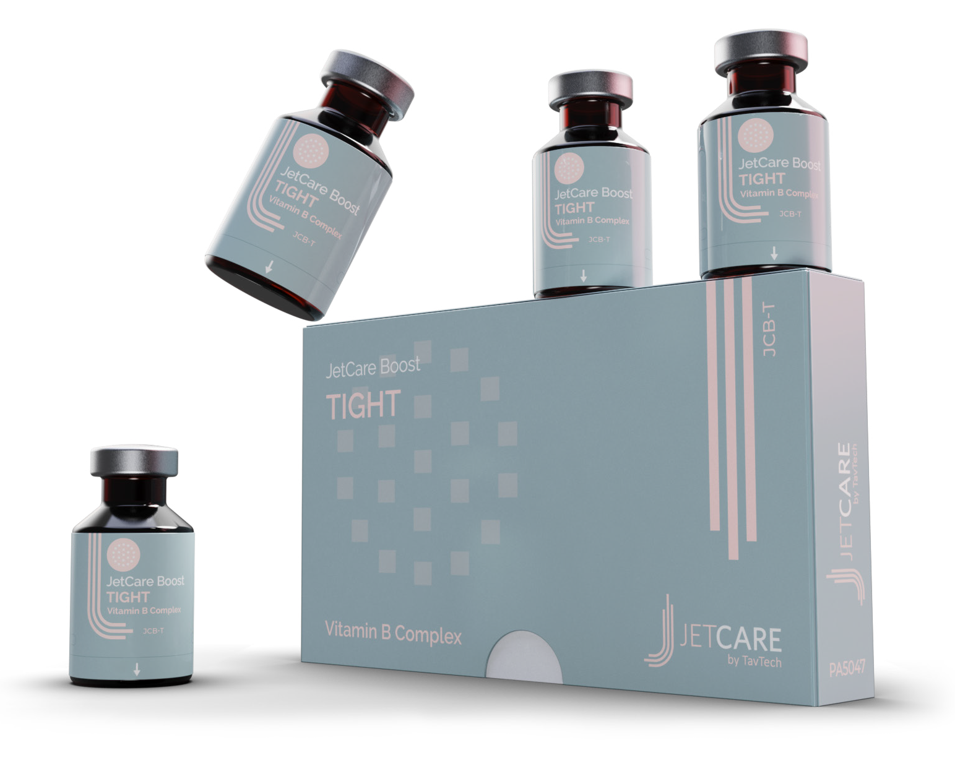
Jet Boost Glow (Vit C)
Tight (Vit B Complex)
Excellent booster for a beautiful glow effect
Updated formula contains stable vitamin C derivative - this is clearly seen by its yellow color
Enriched with ACB fruit mix, natural extract of vegetative sources of AHA
Power booster delivers effective tightening and hydrating action
Complex of 3 vitamin B derivatives - B3, B5, B7 (vs. only B5 in previous version)
Synergetic effect for a wide range of skin rejuvenation processes

Slide 20
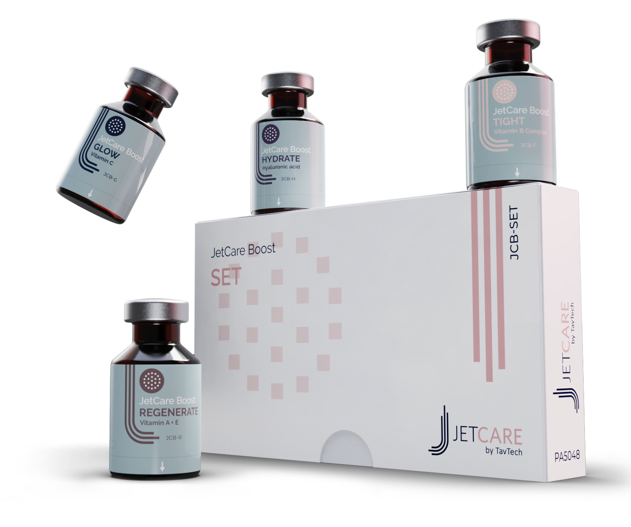
JetCare Boost Set
Set of 4 JetCare Boost varieties, for every skin type and need
Amplify JetPeel sessions with the perfect finish:
JetCare Boost Hydrate (HA)
State-of-the-art HA for ultimate filler and volumizing effect
JetCare Boost Regenerate (Vit A + E)
Anti-oxidant power of Vitamins A and E for high-performance anti-aging
JetCare Boost Glow (Vit C)
Delivers the glow benefits of Vitamin C directly to the skin
JetCare Boost Tight (Vit B complex)
The firming power of Vitamins B3, B5, and B7

Slide 21
Following the upgrade of the JetPeel device to JetPro, there was an important need to use the latest biochemical and dermatological research and the latest developments in active cosmetic ingredients in order to upgrade JetPeel’s line of cosmetics
Formulation guidelines included:
Optimization of trans-epidermal transport by adjusting concentrations and viscosity to the treatment goal: which skin layer should be reached and where should the active ingredients achieve a sustained effect
Optimization and reformulation of the active ingredients based on the latest research and the most advanced supply sources
Reduction of frictional resistance in the handpieces resulting in a constant flow and an increase in the efficacy of the handpiece

Slide 22
A solid R&D platform for on-going JetCare innovation
      continually to be upgraded
      always based on new research
The premium range of JetCare solutions guarantee treatment success and customer satisfaction due to the calibration, coherence and correlation between the device, handpieces and reagents
A new world of JetCare awaits…

Slide 23
JetPeel by TavTech – the perfect trio combining:
      the enduring JetPro device,
      the original patented JetPeel handpieces, and
      premium JetCare solutions
designed exclusively for use together to deliver outstanding results

Slide 24
THANK YOU!

Slide 25
JetPeel by TavTech Academy

