Slide 1


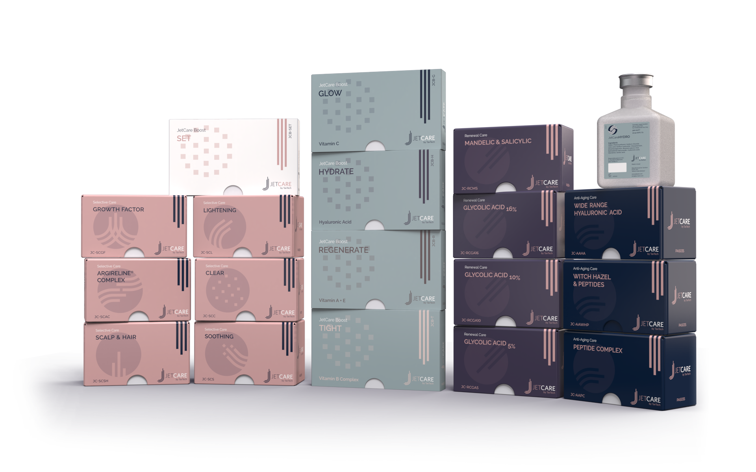
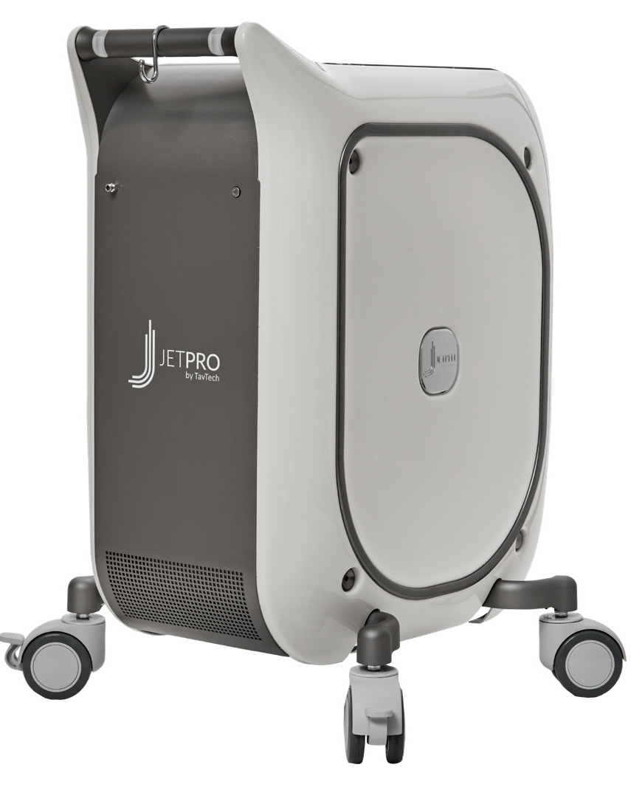
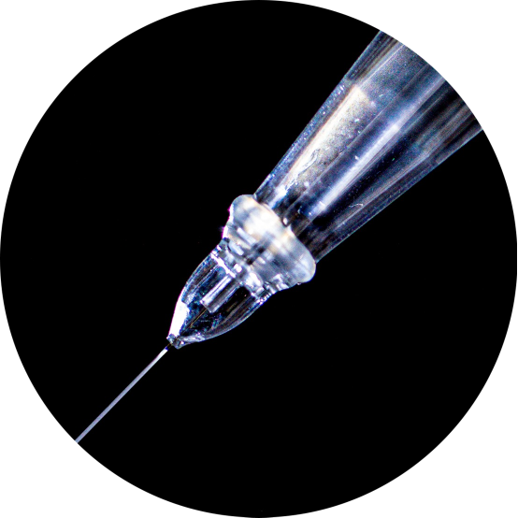
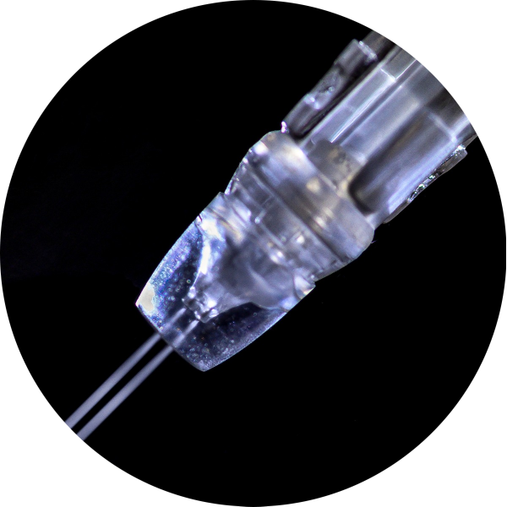
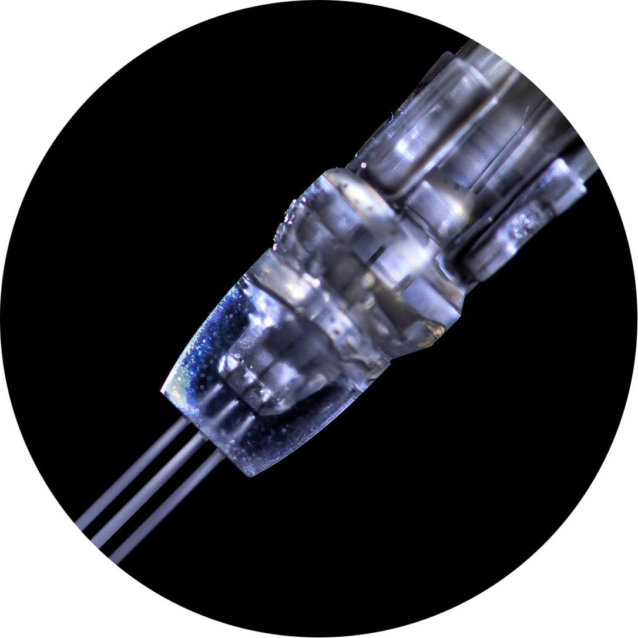
JetPeel by TavTech Academy

Slide 2



We provide people with an opportunity to become the best version of themselves
We believe in making people feel good …

Slide 3
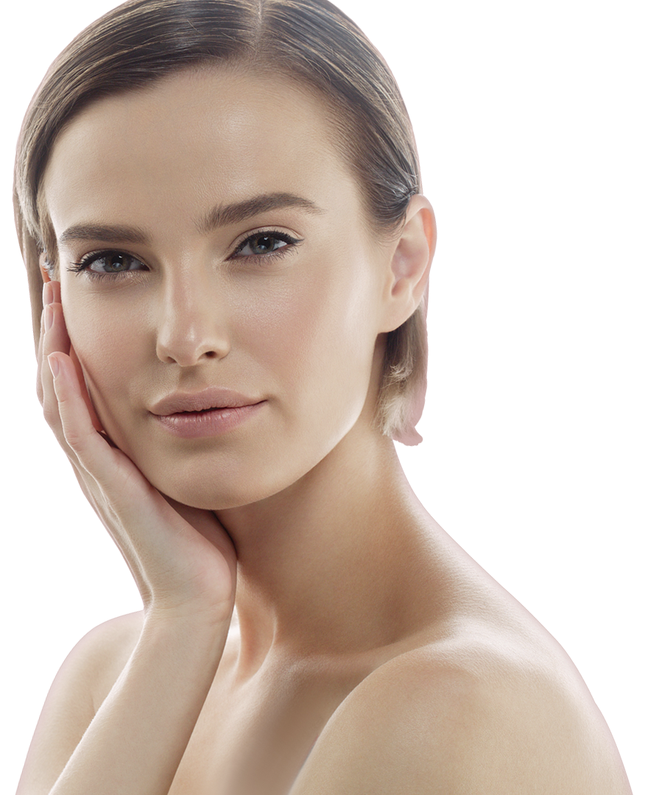
… by delivering
a powerful, instant-result treatment
Suitable for all skin types and all year-round

Slide 4
JetPeel by TavTech Training Program
1. JetPeel Technology and Solutions: Training Introduction
2. Lymphatic Massage with JetPeel
2.1. Lymphatic Massage with JetPeel – Face & Neck
2.2. Lymphatic Massage with JetPeel – Body
3. Exfoliation with JetPeel
3.1. Exfoliation with JetPeel – Face & Neck
4. Infusion with JetPeel
4.1. Infusion with JetPeel – Face & Neck
5. Scalp & Hair with JetPeel
6. JetPeel Handpieces

Slide 5
4.1. Infusion with JetPeel - Face & Neck

Slide 6
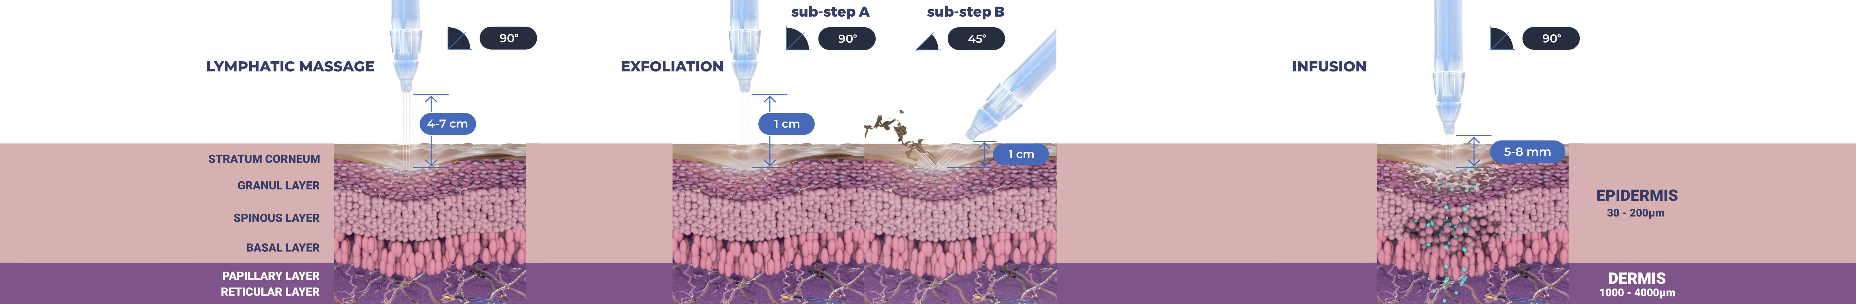
Treatment Sequence for Face and Body
The versatility of JetPeel: Face and Body
Unique jet pressure energy

Slide 7
The treatment sequence
STEP
1
STEP
2
STEP
3
STEP
4
LYMPHATIC
MASSAGE
GENTLE
EXFOLIATION
EFFECTIVE
INFUSION
BOOSTER
INFUSION
A pleasant and relaxing massage for detoxifying the skin and stimulating micro-circulation
Removing dead skin cells prepares the skin to receive the nourishment from the following Infusion Step
This step provides effective and deep delivery of active ingredients into the skin
Post-infusion step to amplify treatment result

Slide 8
The treatment sequence - Steps 3 and 4 - Infusion
STEP
1
STEP
2
STEP
3
STEP
4
LYMPHATIC
MASSAGE
GENTLE
EXFOLIATION
EFFECTIVE
INFUSION
BOOSTER
INFUSION
A pleasant and relaxing massage for detoxifying the skin and stimulating micro-circulation
Removing dead skin cells prepares the skin to receive the nourishment from the following Infusion Step
This step provides effective and deep delivery of active ingredients into the skin
Post-infusion step to amplify treatment result

Slide 9
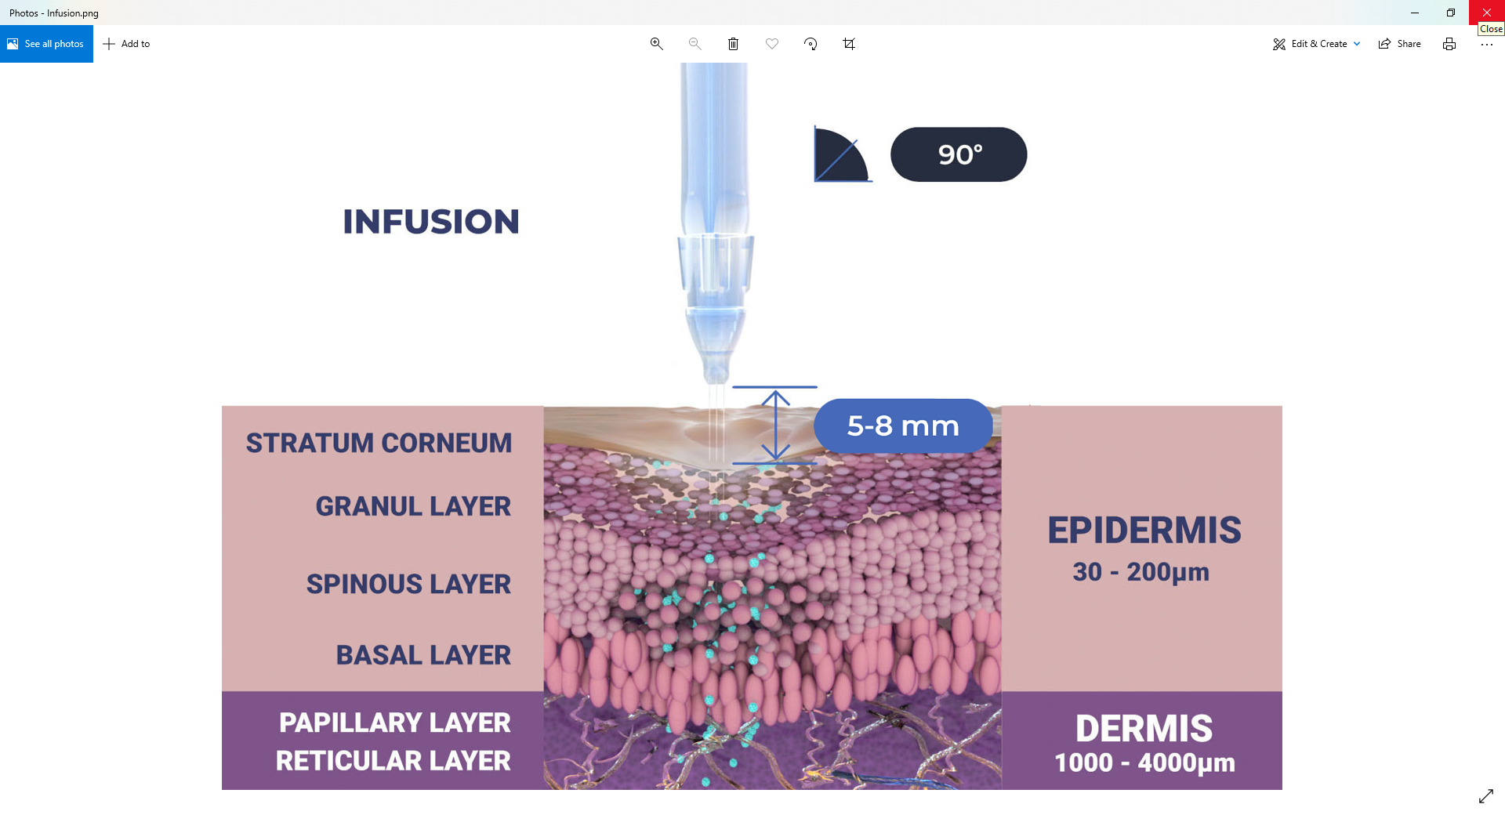
The treatment sequence - Steps 3 and 4 - Infusion

Slide 10
Infusion
Materials & Methods

Slide 11
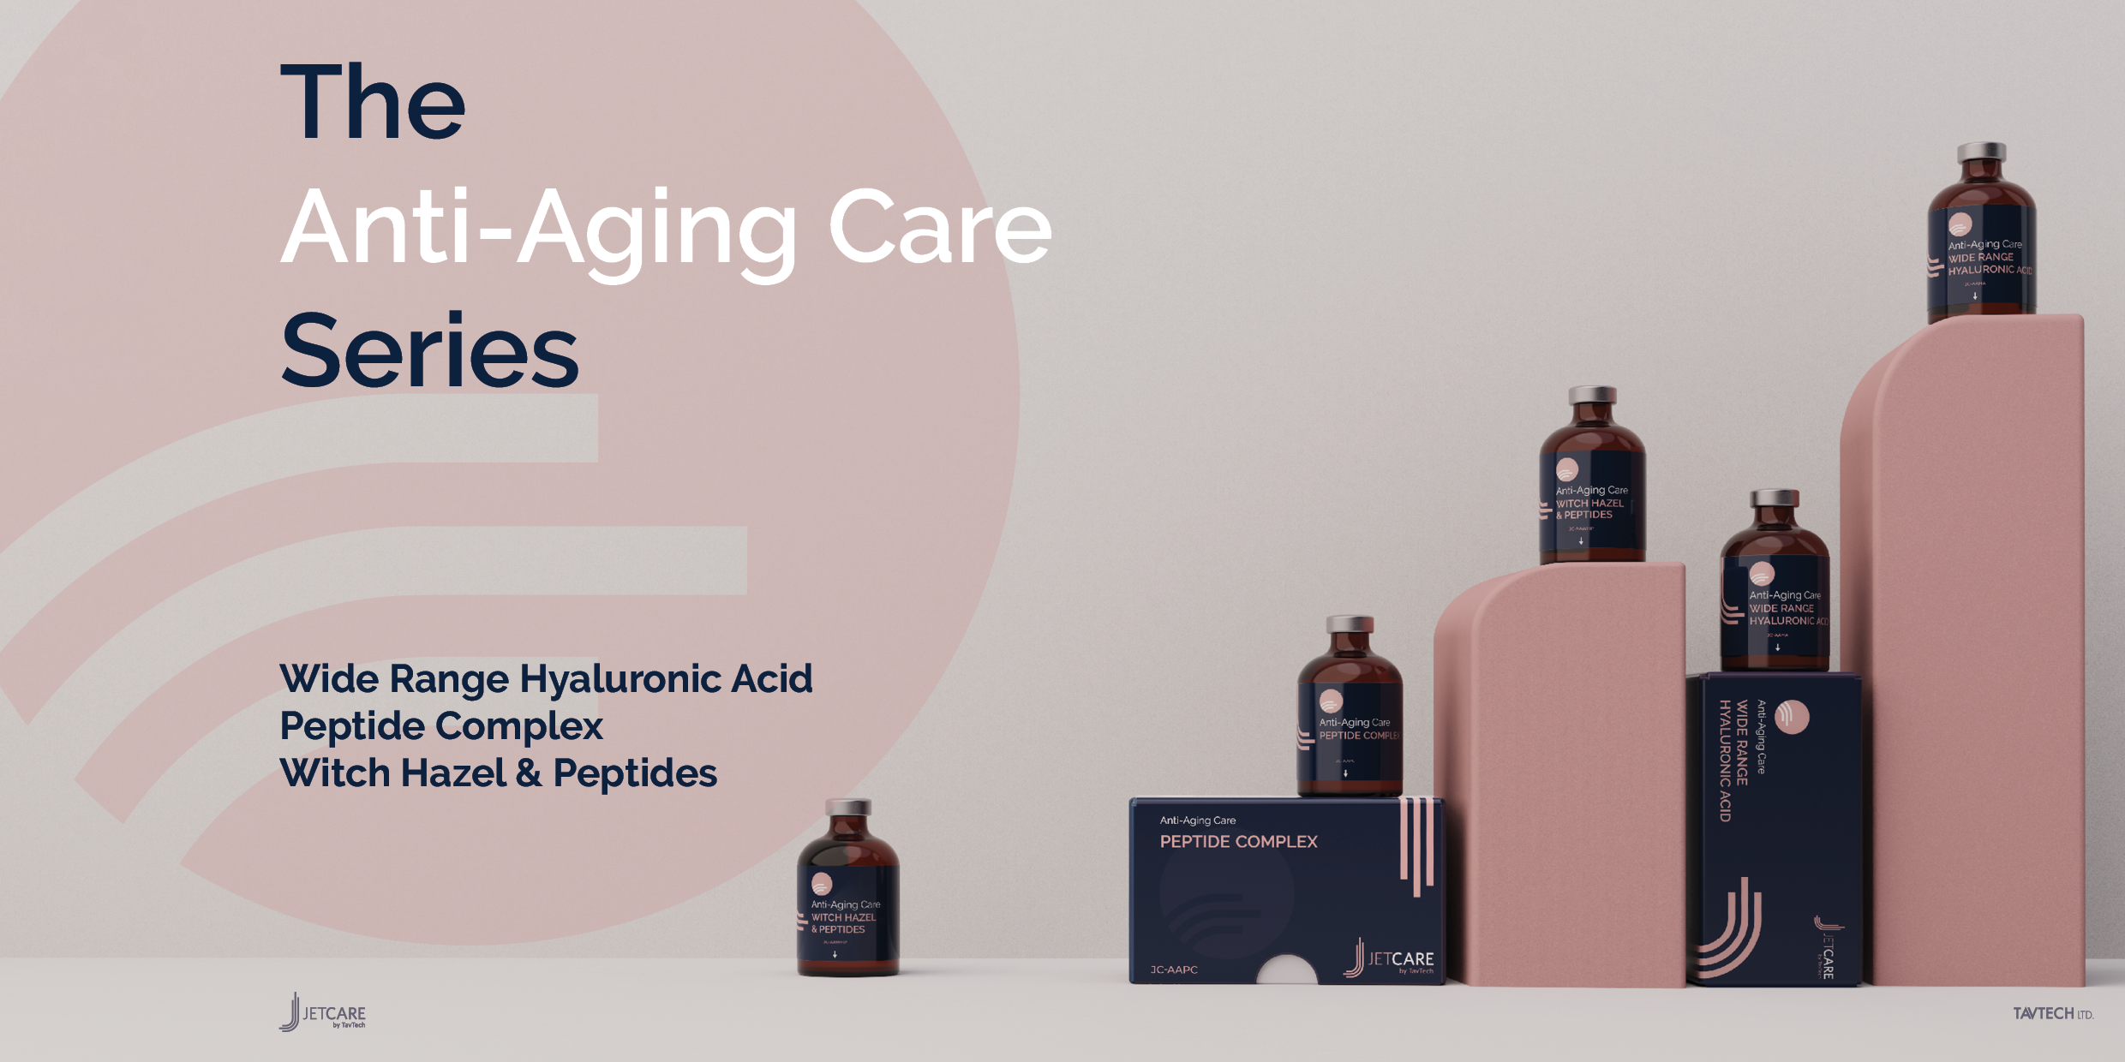

Slide 12
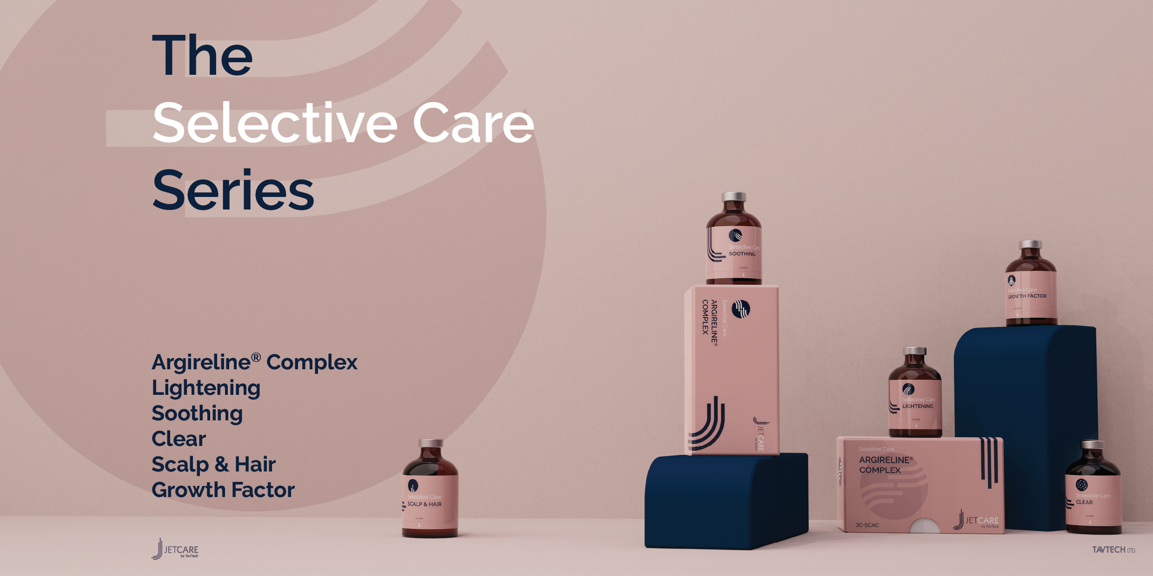
Argireline® is a trademark of Lipotec S.A. or its affiliates

Slide 13
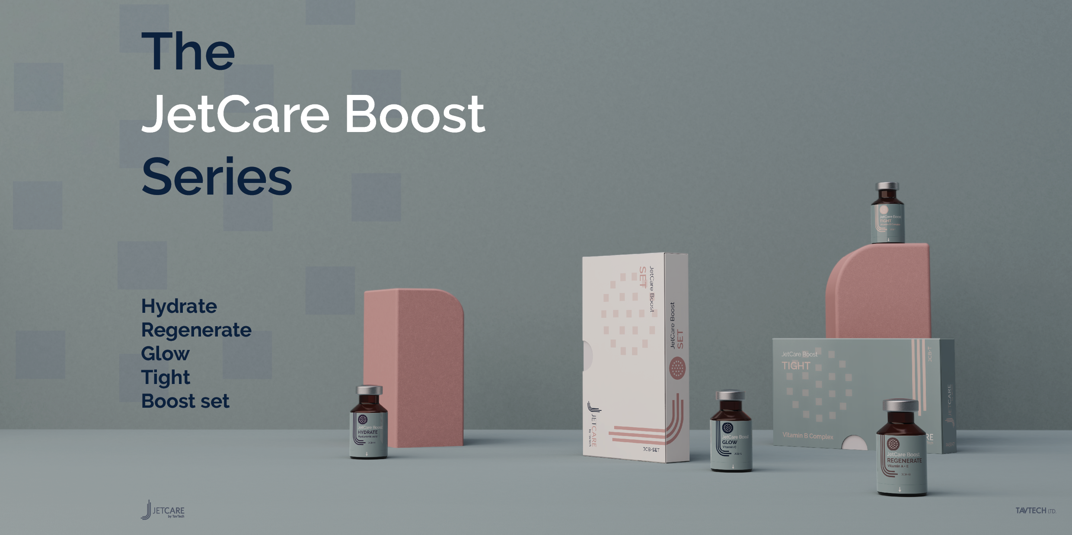

Slide 14

Step 3 - Facial infusion with JetPeel
Infusion is to be done following Exfoliation for effective results.
Choose the relevant JetCare solution from the treatment guideline according to the skin condition and desired indications.
It is recommended to use the TripleJet handpiece, followed by the SingleJet Narrow (Magic) handpiece for specific locations.
Keep the handpiece at a 90° angle relative to the skin surface and keep 0.5-0.8 cm distance from it.
Move in zigzag motions, covering the entire treatment area. Try to keep a consistent pace.
Duration of a complete facial infusion treatment is 5 to 7 minutes, and it uses ~5 ml of the chosen JetCare solution.

Slide 15
Step 4 - Facial boost infusion with JetPeel
Boost Infusion will be done following infusion as per treatment by skin characteristics.
Choose the relevant JetCare boost from the treatment guideline according to the skin condition and desired indications.
It is recommended to use the TripleJet handpiece, followed by the SingleJet Narrow (Magic) handpiece for specific locations.
Keep the handpiece at a 90° angle relative to the skin surface and keep 0.5-0.8 cm distance from it.
Move in zigzag motions, covering the entire treatment area. Try to keep a consistent pace.
Duration of a complete facial infusion treatment is 5 to 7 minutes, and it uses ~3ml of the chosen JetCare boost.

Slide 16
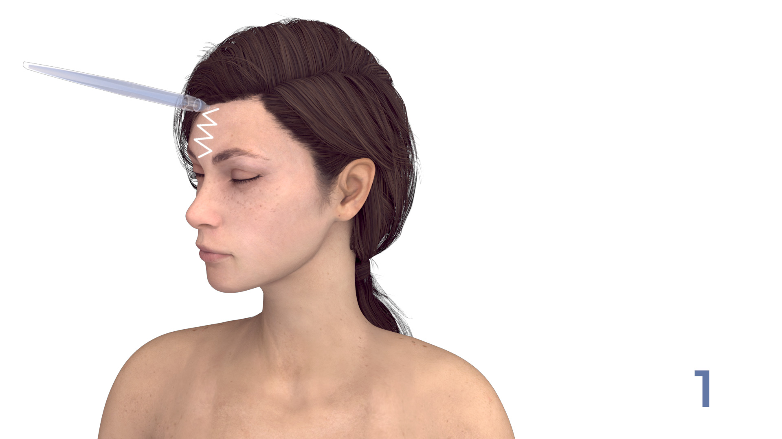
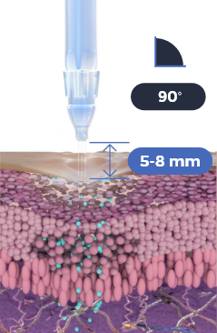
Use the TripleJet handpiece held at 90° to the skin and at 5-8 mm from the skin. Choose from the JetCare Anti-Aging, JetCare Selective and JetCare Boost solutions according to the JetPeel Treatment Guidelines.
Repeat 3 times
Move in zigzag motions covering the entire area.
Important:
Perform the infusion movement slowly
01

Slide 17

Use the TripleJet handpiece held at 90° to the skin and at 5-8 mm from the skin. Choose from the JetCare Anti-Aging, JetCare Selective and JetCare Boost solutions according to the JetPeel Treatment Guidelines.
Repeat 3 times
Move in zigzag motions covering the entire area.
Important:
Perform the infusion movement slowly
02

Slide 18

Use the TripleJet handpiece held at 90° to the skin and at 5-8 mm from the skin. Choose from the JetCare Anti-Aging, JetCare Selective and JetCare Boost solutions according to the JetPeel Treatment Guidelines.
Repeat 3 times
Move in zigzag motions covering the entire area.
Important:
Perform the infusion movement slowly
03

Slide 19

Use the TripleJet handpiece held at 90° to the skin and at 5-8 mm from the skin. Choose from the JetCare Anti-Aging, JetCare Selective and JetCare Boost solutions according to the JetPeel Treatment Guidelines.
Repeat 3 times
Move in zigzag motions covering the entire area.
Important:
Perform the infusion movement slowly
04

Slide 20

Use the TripleJet handpiece held at 90° to the skin and at 5-8 mm from the skin. Choose from the JetCare Anti-Aging, JetCare Selective and JetCare Boost solutions according to the JetPeel Treatment Guidelines.
Repeat 3 times
Move in zigzag motions covering the entire area.
Important:
Perform the infusion movement slowly
05

Slide 21

Use the TripleJet handpiece held at 90° to the skin and at 5-8 mm from the skin. Choose from the JetCare Anti-Aging, JetCare Selective and JetCare Boost solutions according to the JetPeel Treatment Guidelines.
Repeat 3 times
Move in zigzag motions covering the entire area.
Important:
Perform the infusion movement slowly
06

Slide 22

Use the TripleJet handpiece held at 90° to the skin and at 5-8 mm from the skin. Choose from the JetCare Anti-Aging, JetCare Selective and JetCare Boost solutions according to the JetPeel Treatment Guidelines.
Repeat 3 times
Move in zigzag motions covering the entire area.
Important:
Perform the infusion movement slowly
07

Slide 23

Use the TripleJet handpiece held at 90° to the skin and at 5-8 mm from the skin. Choose from the JetCare Anti-Aging, JetCare Selective and JetCare Boost solutions according to the JetPeel Treatment Guidelines.
Repeat 3 times
Move in zigzag motions covering the entire area.
Important:
Perform the infusion movement slowly
08

Slide 24

Use the TripleJet handpiece held at 90° to the skin and at 5-8 mm from the skin. Choose from the JetCare Anti-Aging, JetCare Selective and JetCare Boost solutions according to the JetPeel Treatment Guidelines.
Repeat 3 times
Move in zigzag motions covering the entire area.
Important:
Perform the infusion movement slowly
09

Slide 25

Use the TripleJet handpiece held at 90° to the skin and at 5-8 mm from the skin. Choose from the JetCare Anti-Aging, JetCare Selective and JetCare Boost solutions according to the JetPeel Treatment Guidelines.
Repeat 3 times
Move in zigzag motions covering the entire area.
Important:
Perform the infusion movement slowly
10

Slide 26
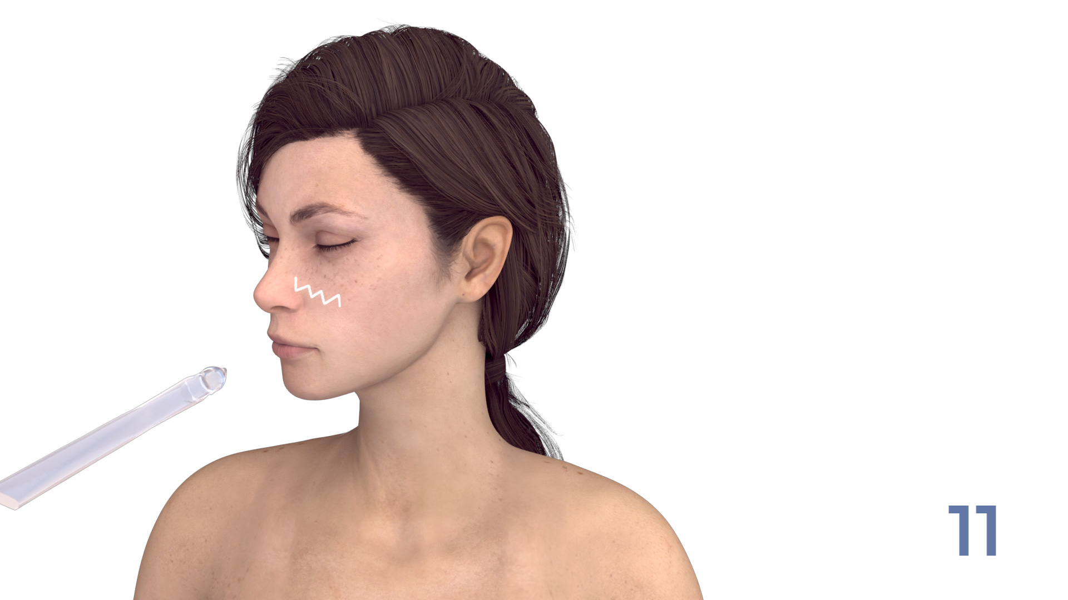
Use the TripleJet handpiece held at 90° to the skin and at 5-8 mm from the skin. Choose from the JetCare Anti-Aging, JetCare Selective and JetCare Boost solutions according to the JetPeel Treatment Guidelines.
Repeat 3 times
Move in zigzag motions covering the entire area.
Important:
Perform the infusion movement slowly
11

Slide 27

Use the TripleJet handpiece held at 90° to the skin and at 5-8 mm from the skin. Choose from the JetCare Anti-Aging, JetCare Selective and JetCare Boost solutions according to the JetPeel Treatment Guidelines.
Repeat 3 times
Move in zigzag motions covering the entire area.
Important:
Perform the infusion movement slowly
12

Slide 28

Use the TripleJet handpiece held at 90° to the skin and at 5-8 mm from the skin. Choose from the JetCare Anti-Aging, JetCare Selective and JetCare Boost solutions according to the JetPeel Treatment Guidelines.
Repeat 3 times
Move in zigzag motions covering the entire area.
Important:
Perform the infusion movement slowly
13

Slide 29

For deep wrinkles and fine lines:
Change to the SingleJet Narrow (Magic) handpiece to infuse wrinkle lines. Hold at 90° to the skin and at 5-8 mm from the skin.
Repeat 3 times
For more deep wrinkles you can pass more than once
Swap solution according to chosen Treatment Guideline.
Move by following the lines until you cover the entire wrinkle areas.
Important:
Perform the infusion movement slowly
14

Slide 30
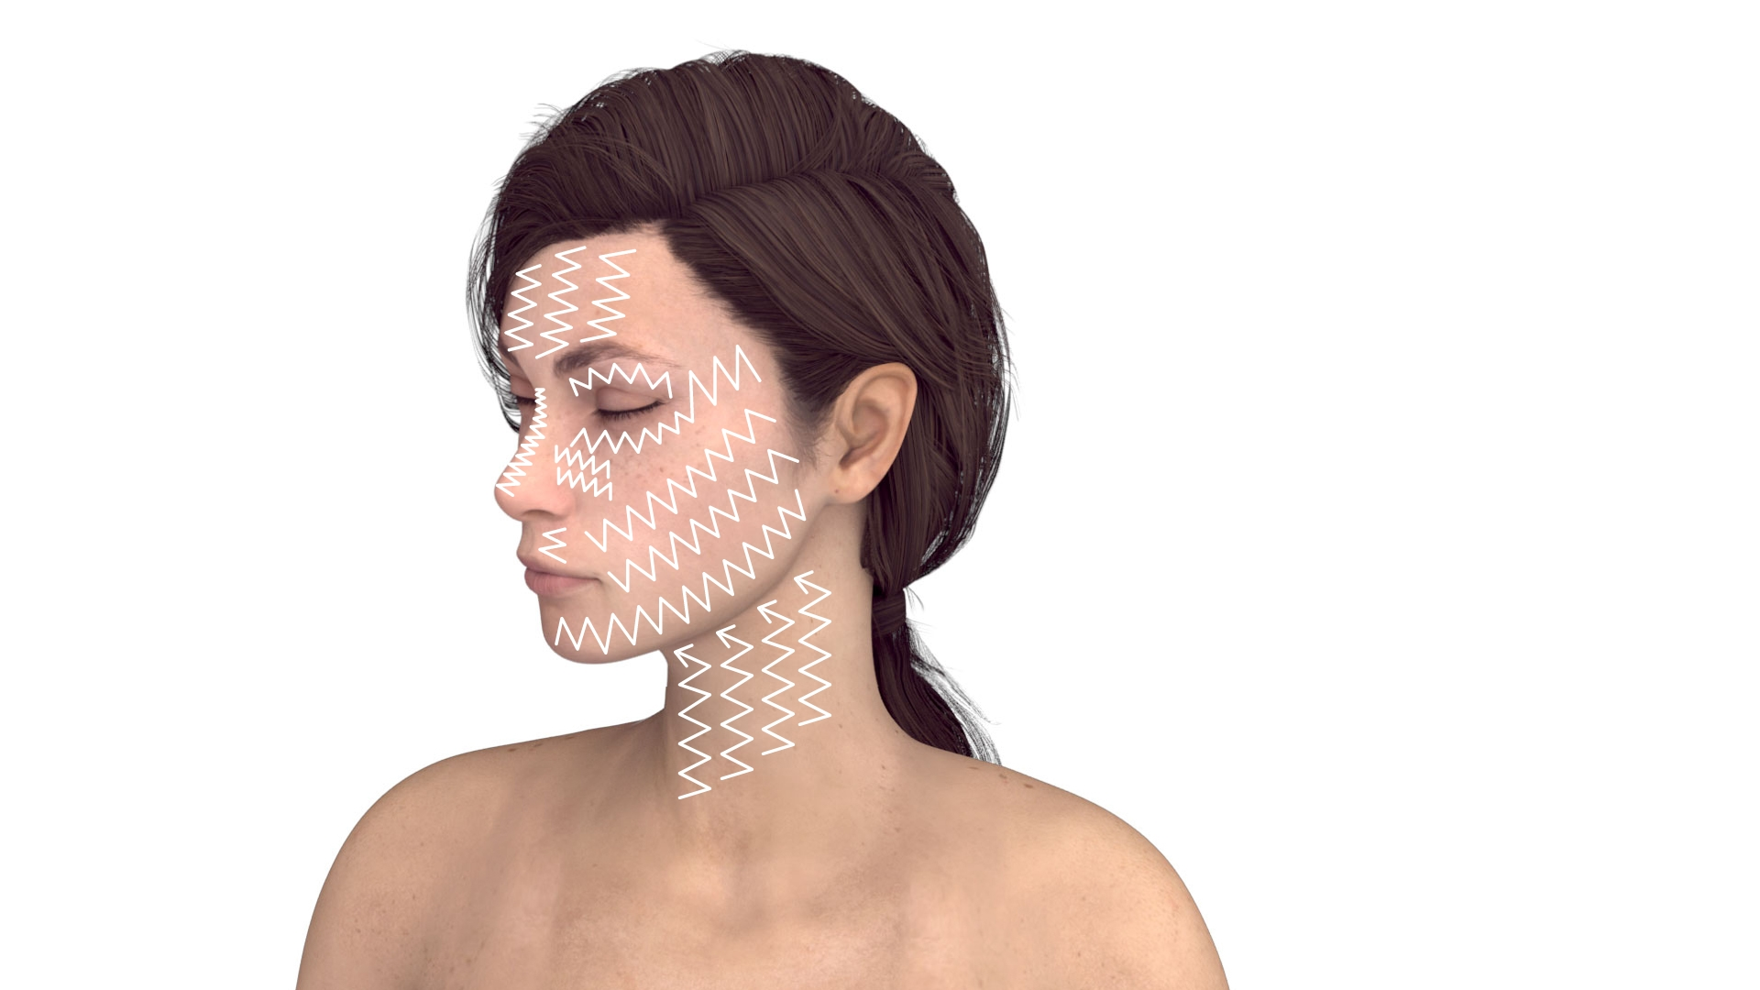
Use the TripleJet handpiece held at 90° to the skin and at 5-8 mm from the skin. Choose from the JetCare Anti-Aging, JetCare Selective and JetCare Boost solutions according to the JetPeel Treatment Guidelines.
Full overview
Repeat 3 times
Move in zigzag motions covering the entire area.
Important:
Perform the infusion movement slowly

Slide 31

For deep wrinkles and fine lines:
Change to the SingleJet Narrow (Magic) handpiece to infuse wrinkle lines. Hold at 90° to the skin and at 5-8 mm from the skin.
Full overview
Repeat 3 times
Swap solution according to chosen Treatment Guideline.
Move by following the lines until you cover the entire wrinkle areas.
Important:
Perform the infusion movement slowly

Slide 32
Contraindications
Open wounds
Severe sensitivity to cold
Skin neoplasms
Active cancer
Trigeminal nerve inflammation
Active sinusitis or laryngitis
Active herpes
Active bronchial asthma
Thrombosis
The system has not been tested or evaluated on pregnant or lactating women, nor on children and infants, therefore is not intended for use on these groups of users

Slide 33
JetPeel by TavTech
The perfect trio combining:
The enduring JetPro device
The original patented JetPeel handpieces
The premium JetCare solutions
Designed exclusively for use together to deliver outstanding results

Slide 34
JetPeel by TavTech Training Program
1. JetPeel Technology and Solutions: Training Introduction
2. Lymphatic Massage with JetPeel
2.1. Lymphatic Massage with JetPeel – Face & Neck
2.2. Lymphatic Massage with JetPeel – Body
3. Exfoliation with JetPeel
3.1. Exfoliation with JetPeel – Face & Neck
4. Infusion with JetPeel
4.1. Infusion with JetPeel – Face & Neck
5. Scalp & Hair with JetPeel
6. JetPeel Handpieces

Slide 35
THANK YOU!

Slide 36
JetPeel by TavTech Academy

