Slide 1


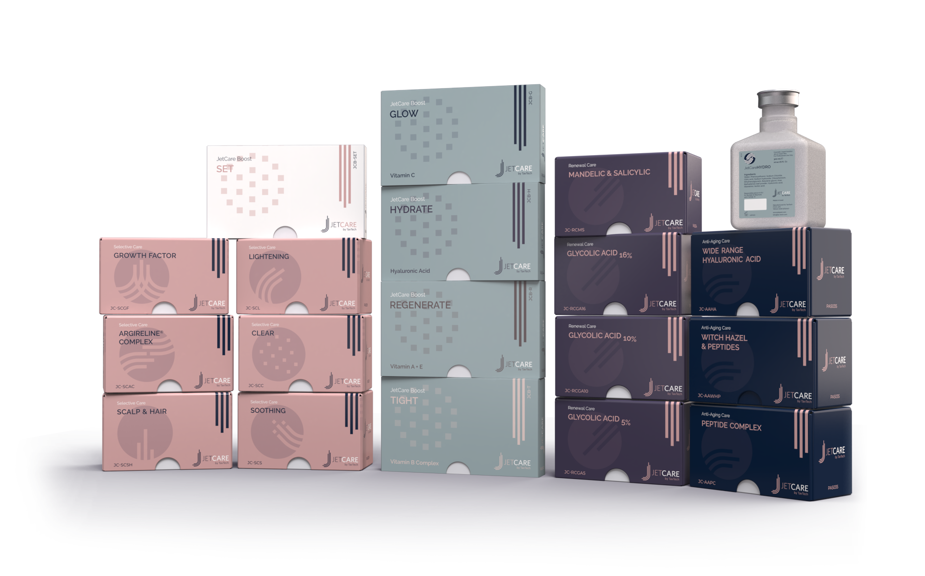
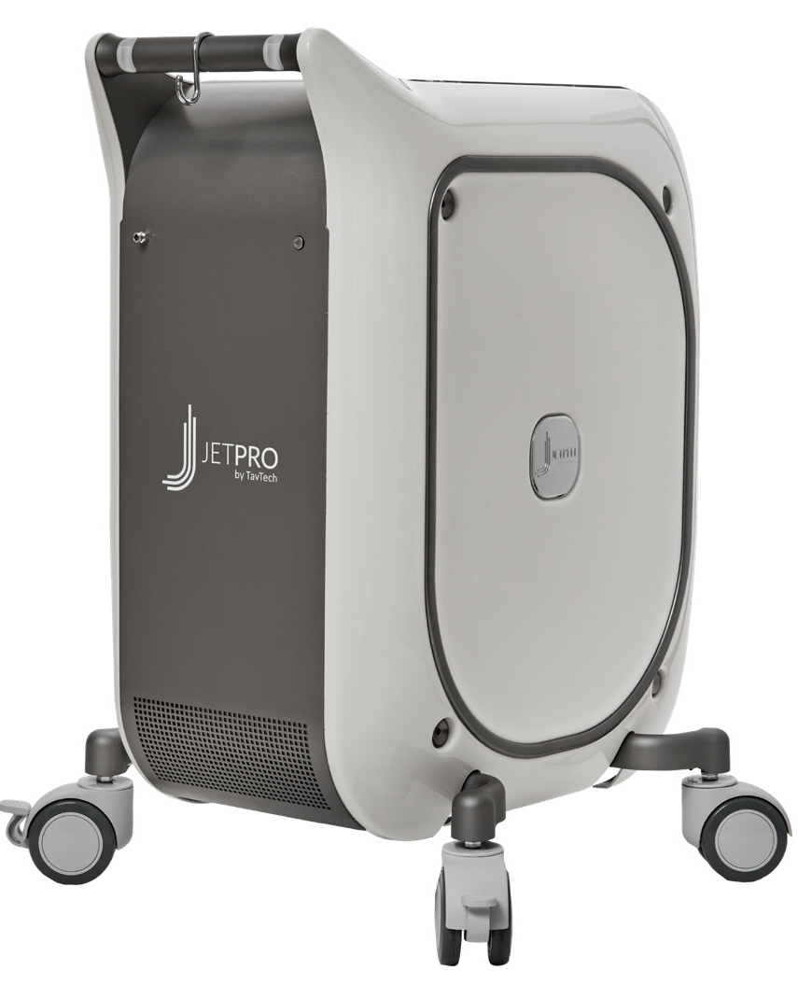
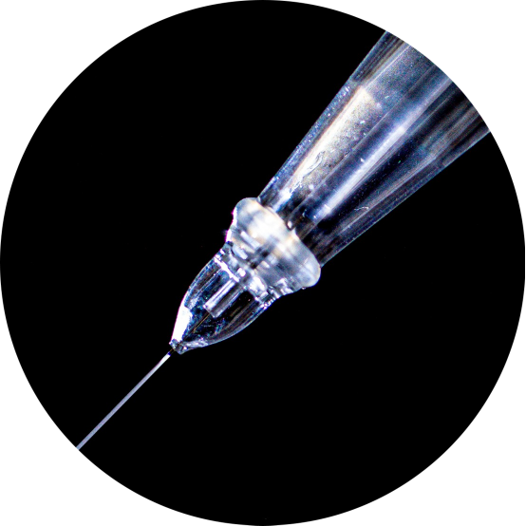
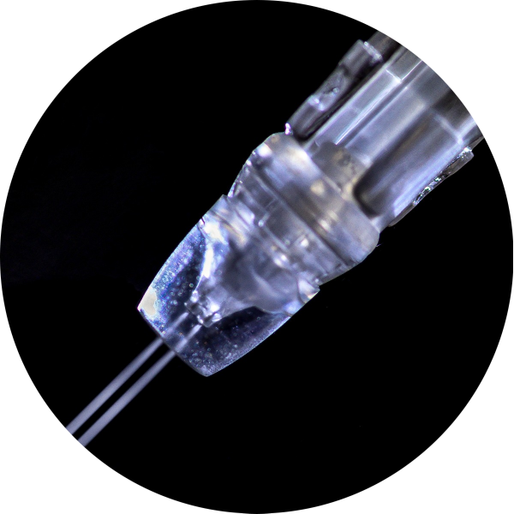
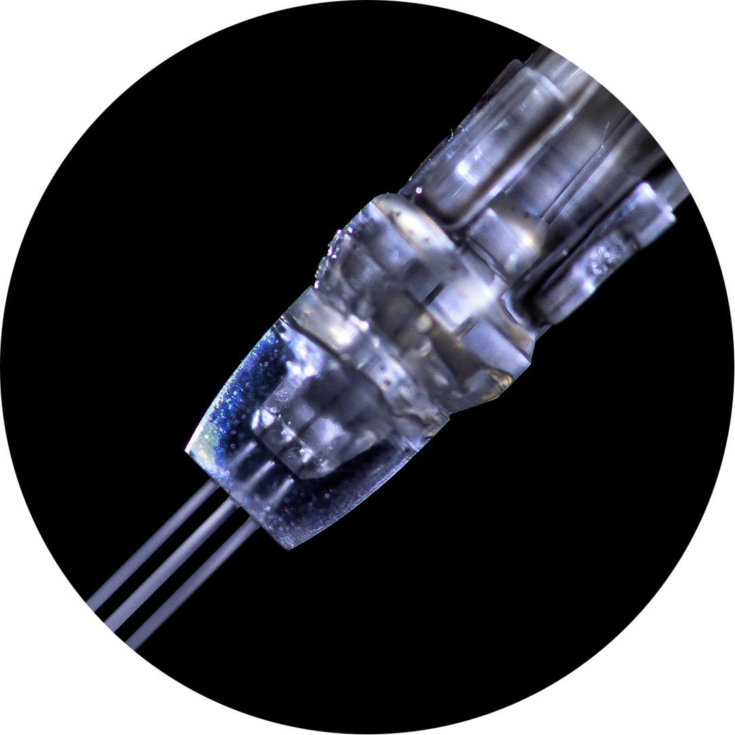
JetPeel by TavTech Academy

Slide 2



We provide people with an opportunity to become the best version of themselves
We believe in making people feel good …

Slide 3
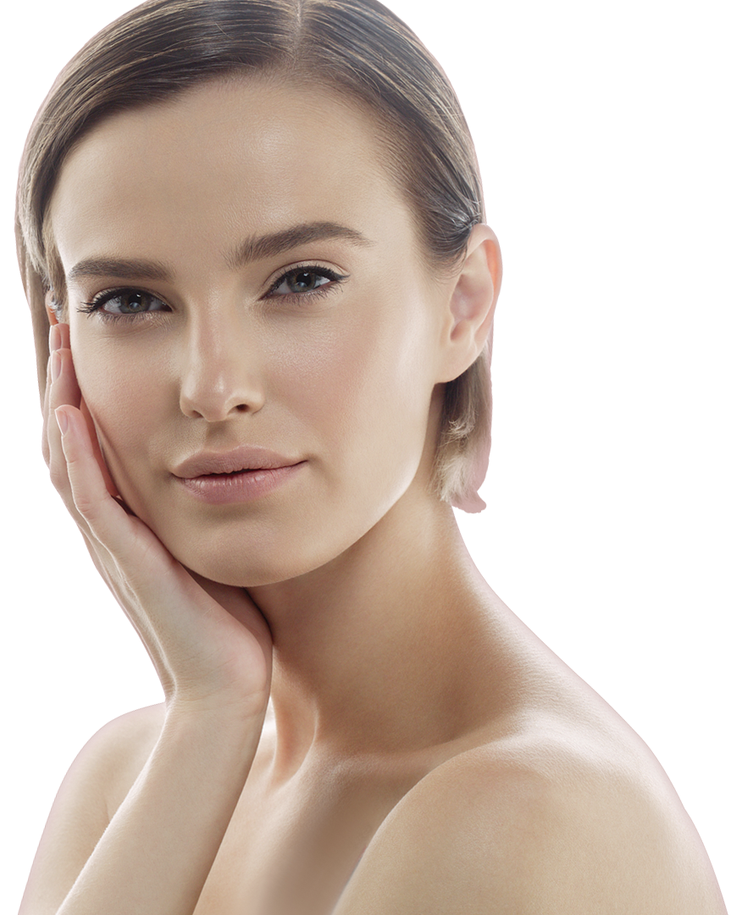
… by delivering
a powerful, instant-result treatment
Suitable for all skin types and all year-round

Slide 4
JetPeel by TavTech Training Program
1. JetPeel Technology and Solutions: Training Introduction
2. Lymphatic Massage with JetPeel
2.1. Lymphatic Massage with JetPeel – Face & Neck
2.2. Lymphatic Massage with JetPeel – Body
3. Exfoliation with JetPeel
3.1. Exfoliation with JetPeel – Face & Neck
4. Infusion with JetPeel
4.1. Infusion with JetPeel – Face & Neck
5. Scalp & Hair with JetPeel
6. JetPeel Handpieces

Slide 5
4. Infusion with JetPeel

Slide 6
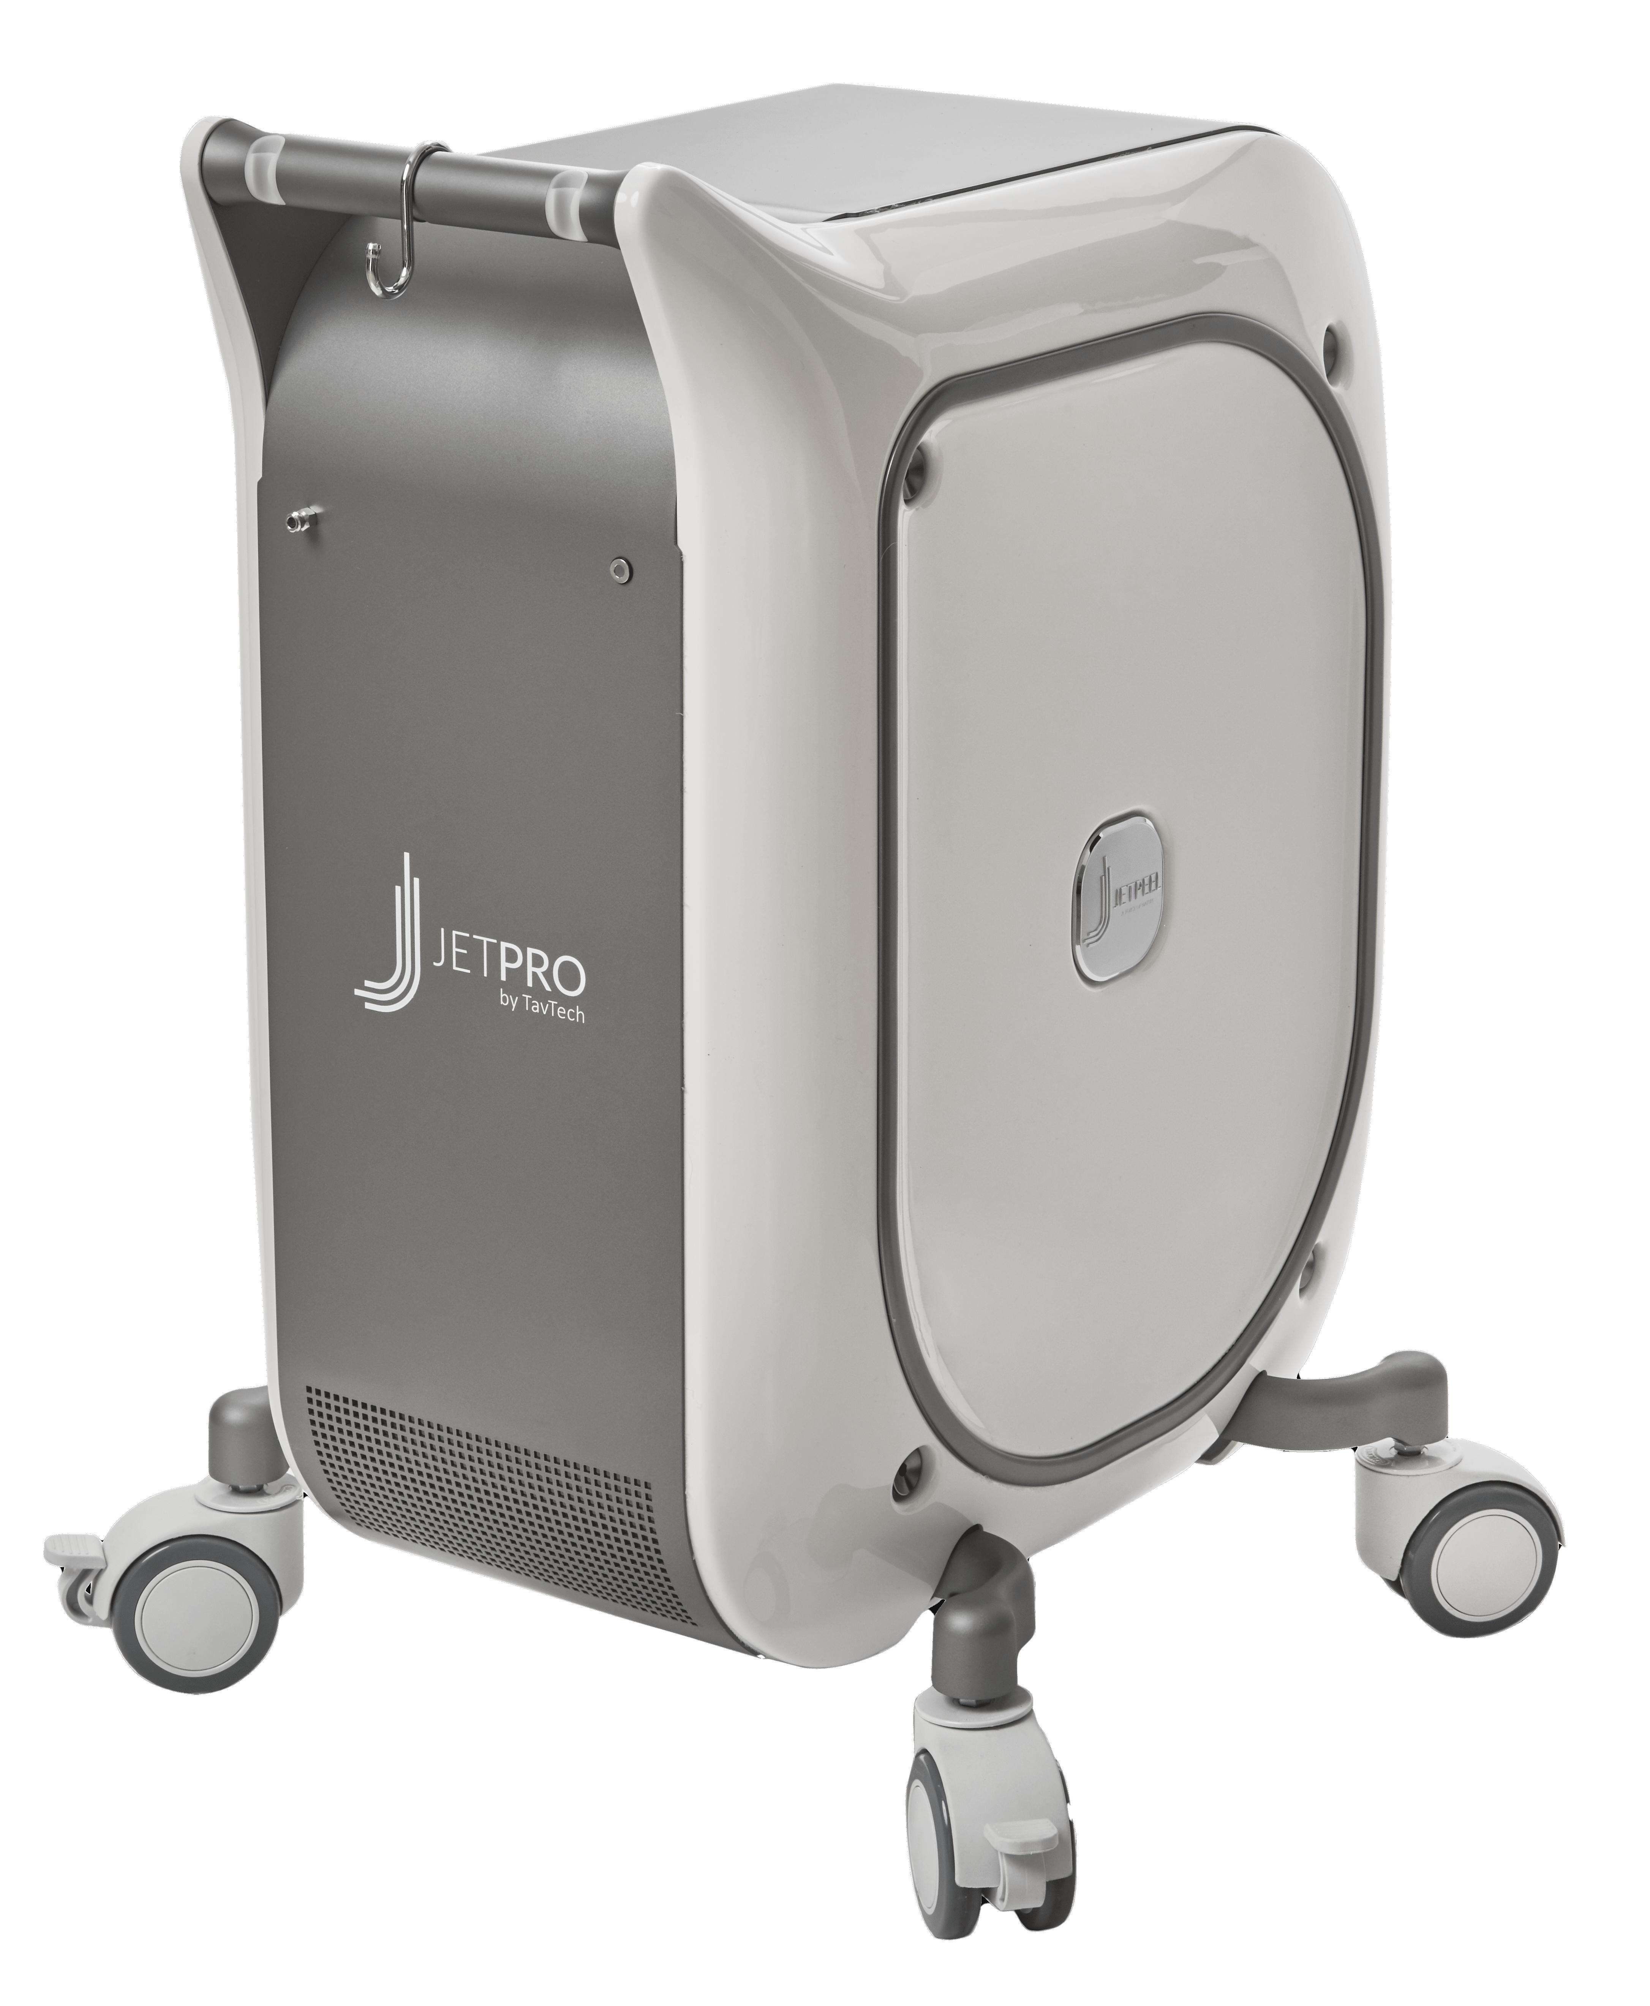






The JetPeel jet pressure energy system provides trans-epidermal infusion of a rich variety of nutrients and solutions
JetPeel System
For the treatment of an array of skincare and aesthetics conditions
Anti-Aging Care
Scalp & Hair
Lightening
Clear
Soothing
Growth Factor
Renewal Care

Slide 7
Handpieces range
Trans-epidermal infusion
delivery system
TripleJet
3 fine nozzles
Utilizing jet propulsion technology for needle-less, pain-free, non-invasive, non-ablative, trans-epidermal delivery
DoubleJet
2 fine nozzles
SingleJet Narrow (Magic)
1 fine nozzle

Slide 8
JetCare -
A variety of solutions, vitamins, minerals and acids
and an array of treatment guidelines

Slide 9
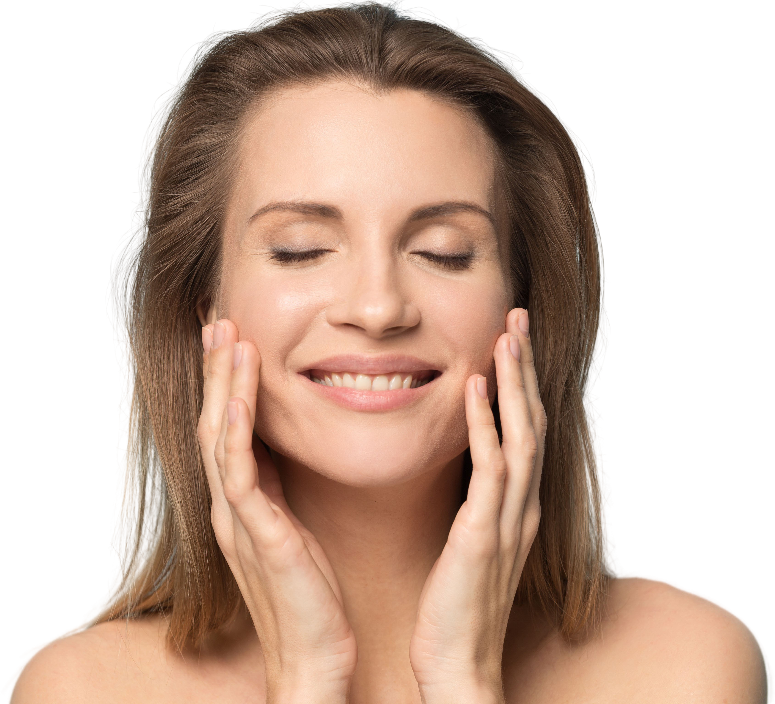
The enduring way to:
JetPeel way
Perform a Lymphatic Massage
Exfoliate
Infuse Skin Nutrients without Needles
Stimulate Collagen and Elastin Fibers
Tighten
Brighten
Eliminate Blemishes
Smooth Skin Imperfections

Slide 10

An innovative aesthetic energy-based concept
Aesthetic medicine has primarily been based on surgical approaches for many years, but now, in order to solve the problem of aging skin, there is an increasing interest in non-invasive, non-ablative and painless procedures that have immediate visible effects, are without downtime and offer a pleasant patient experience.
JetPeel: One of the most fascinating, non-invasive, non-ablative, safe and painless devices, useful for pleasant and effective trans-epidermal delivery of nourishing solutions without the use of needles.
Infusion with JetPeel rejuvenates the skin without lasers or injections. The innovation of the JetPeel infusion technique, which is based on jet pressure-energy, is also relevant for skin pigmentation irregularities and to remove keratoses, acne, hair loss, scars, stretch marks, and other skin related conditions.

Slide 11
How does JetPeel infusion work?
JetPeel Infusion is an advanced aesthetic treatment that allows practitioners to non-invasively administer a range of nutritional skin care procedures with outstanding results.
JetPeel Infusion is the most advanced and versatile skin therapy system on the market for painless trans-epidermal infusion with no needles and no injections.
JetPeel Infusion takes cosmetic solutions, accelerates them using pressurized air to high velocities (200 m/sec, 660 ft/sec) and with a unique and patented JetPeel handpiece, breaks the accelerated liquid into micro-droplets.
The jet stretches the skin at the point of contact, causing cavitation, leading to the broadening of micro-canals in the epidermis. This enables highly effective needle-free hydration and infusion.
JetPeel Infusion penetrates the stratum corneum and the epidermal compartment in order to deposit liquids and small molecules by using a jet stream of liquids accelerated by pressure of 95 p.s.i. through tiny single, double or triple nozzles to localized dermal deposition into the skin tissue.

Slide 12
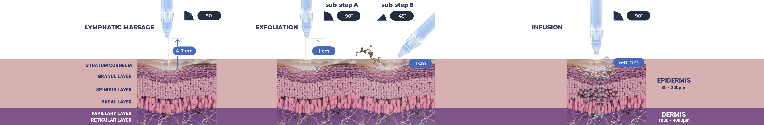
Treatment Sequence for Face and Body
The versatility of JetPeel: Face and Body
Unique jet pressure energy

Slide 13
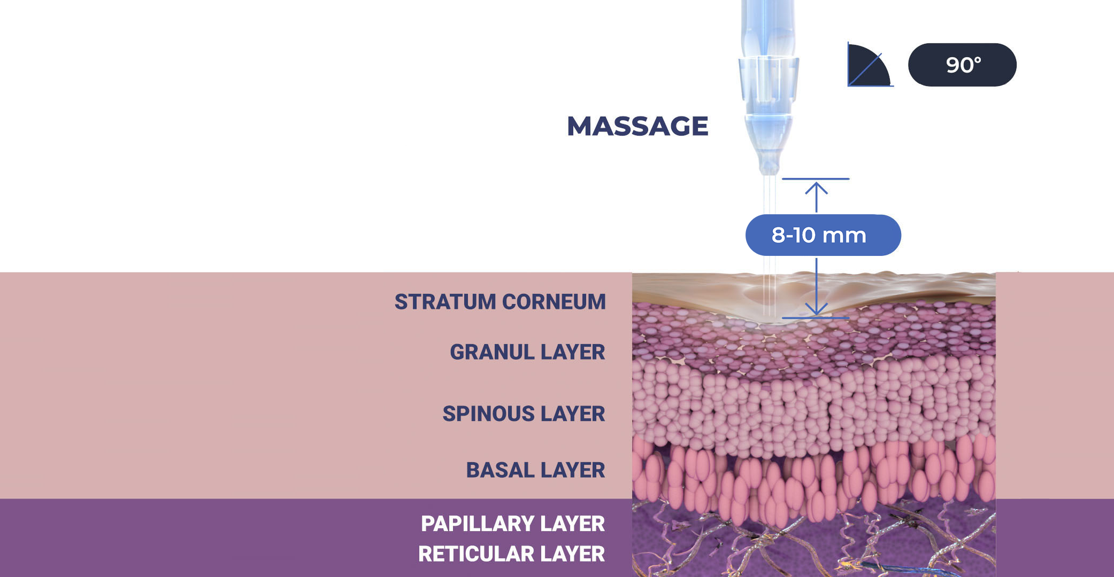

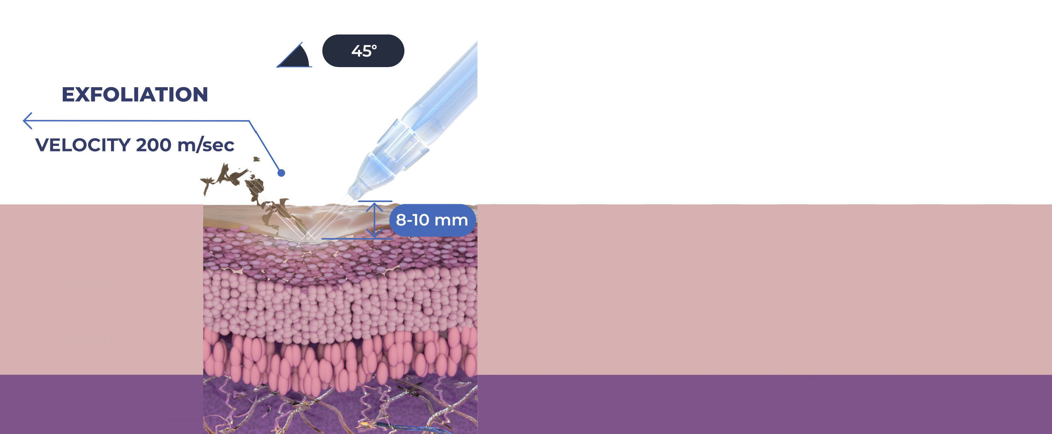
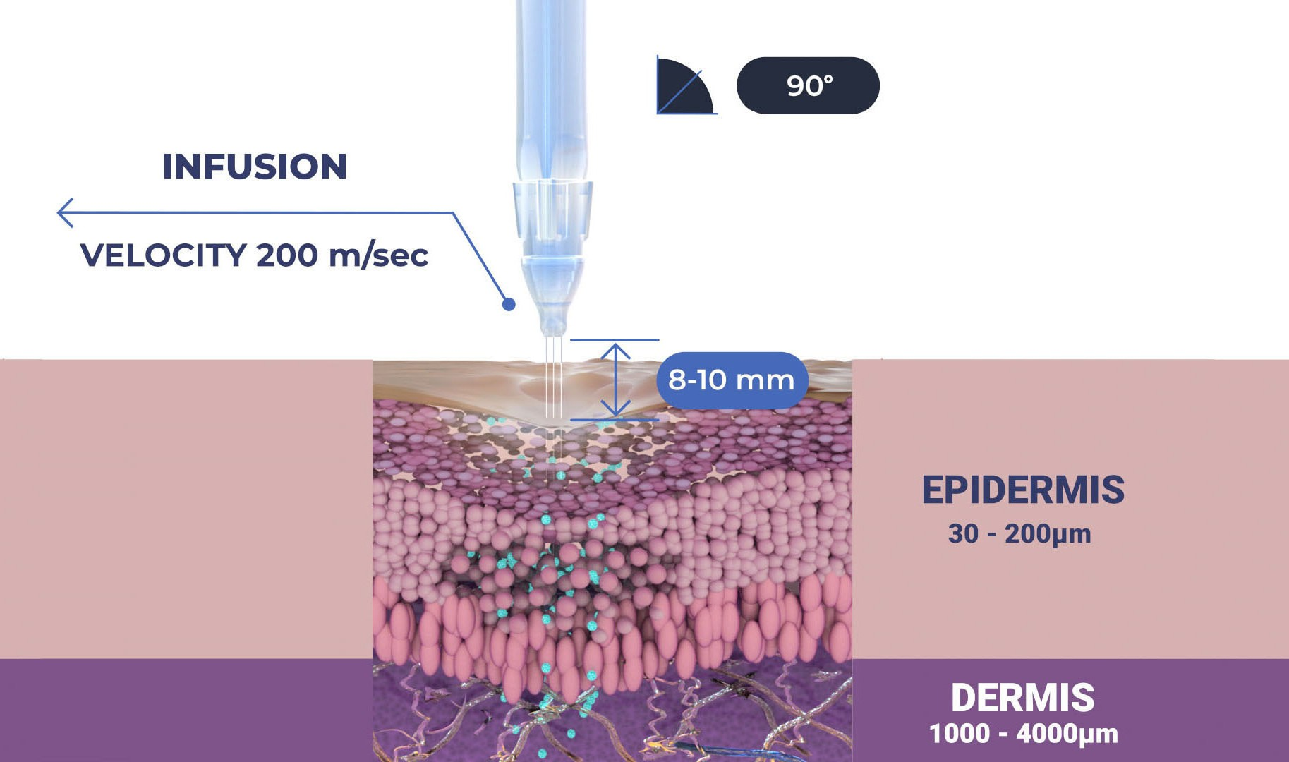

Treatment Sequence for Scalp and Hair
The versatility of JetPeel: Scalp and Hair
Unique jet pressure energy

Slide 14
The treatment sequence
STEP
1
STEP
2
STEP
3
STEP
4
LYMPHATIC
MASSAGE
GENTLE
EXFOLIATION
EFFECTIVE
INFUSION
BOOSTER
INFUSION
A pleasant and relaxing massage for detoxifying the skin and stimulating micro-circulation
Removing dead skin cells prepares the skin to receive the nourishment from the following Infusion Step
This step provides effective and deep delivery of active ingredients into the skin
Post-infusion step to amplify treatment result

Slide 15
The treatment sequence - Steps 3 and 4 - Infusion
STEP
1
STEP
2
STEP
3
STEP
4
LYMPHATIC
MASSAGE
GENTLE
EXFOLIATION
EFFECTIVE
INFUSION
BOOSTER
INFUSION
A pleasant and relaxing massage for detoxifying the skin and stimulating micro-circulation
Removing dead skin cells prepares the skin to receive the nourishment from the following Infusion Step
This step provides effective and deep delivery of active ingredients into the skin
Post-infusion step to amplify treatment result

Slide 16
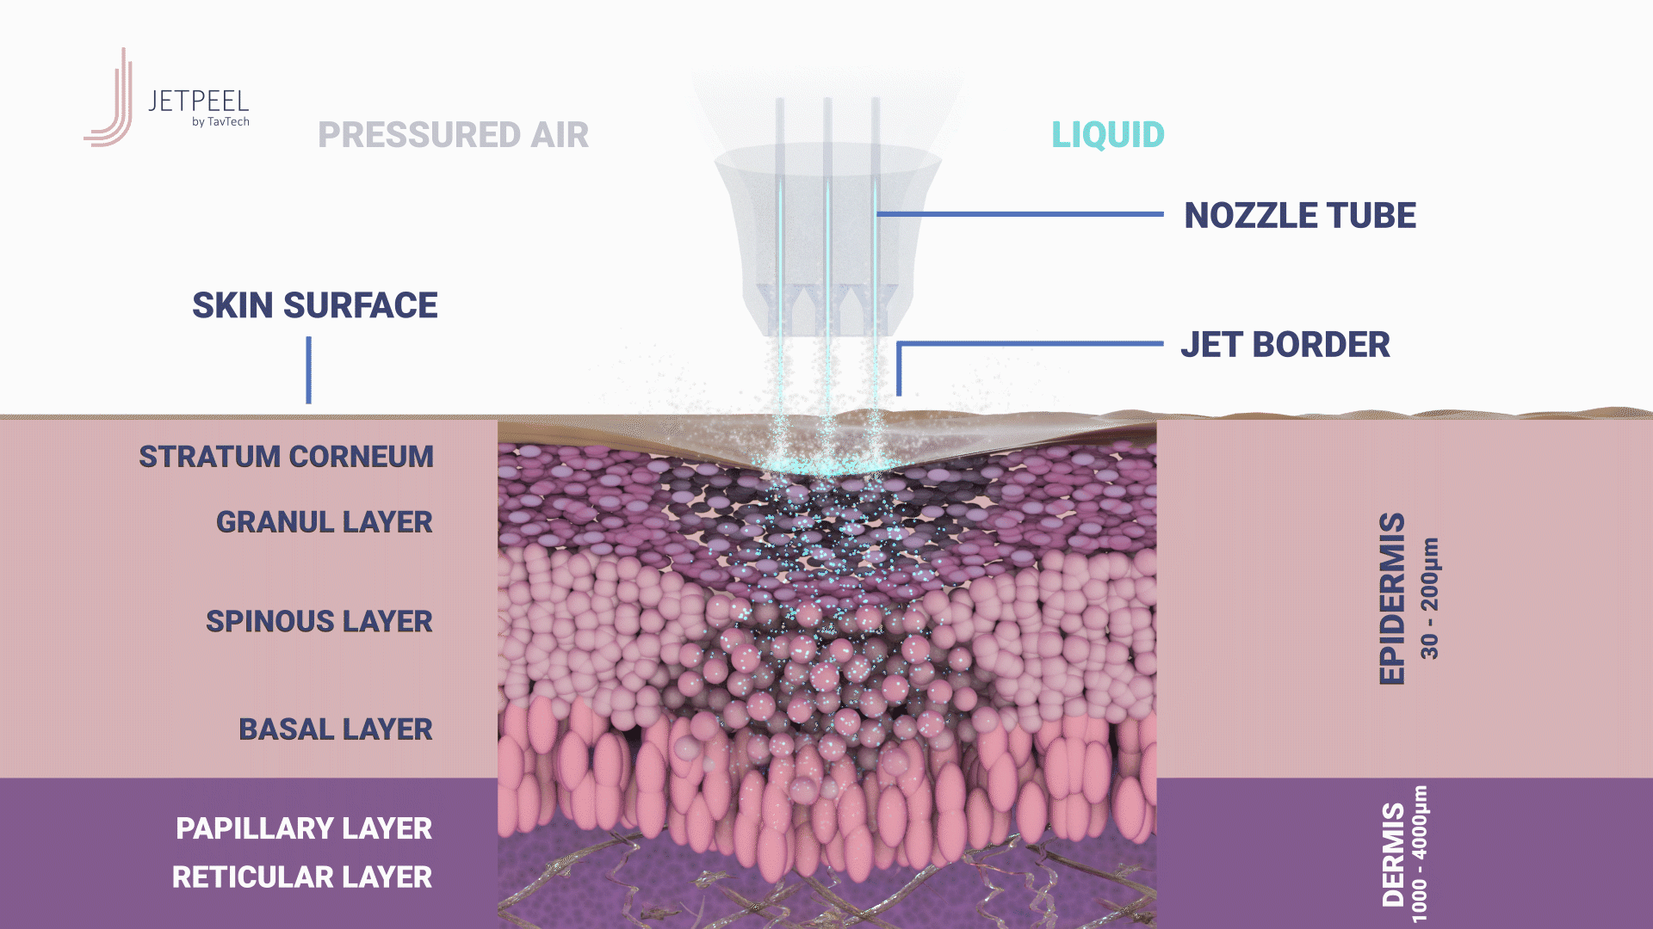
Step 3 - Jet pressure and the cavitation effect

Slide 17

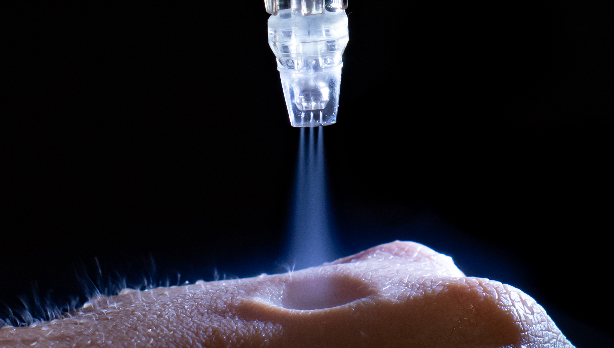
Skin stretch, opening of micro-channels, infusion
Pressure differentials
Patents Pending: US 63/238794 and 63/278128

Slide 18
A variety of handpieces
TripleJet
The uniqueness behind the JetPeel Infusion’s ability to penetrate the stratum corneum and the epidermal compartment in order to deposit liquids and small molecules is by using a jet stream of liquids accelerated by pressure up 200 m/sec. (660 ft/sec.) through a tiny single, double or triple nozzle to localized dermal deposition in the skin tissue
The most popular handpiece, which enables a larger treatment area while dividing the fluid stream into three
DoubleJet
Recommended for Scalp & Hair procedures
SingleJet Narrow (Magic)
Ensures the most powerful application mode for deeper wrinkles and fine lines

Slide 19
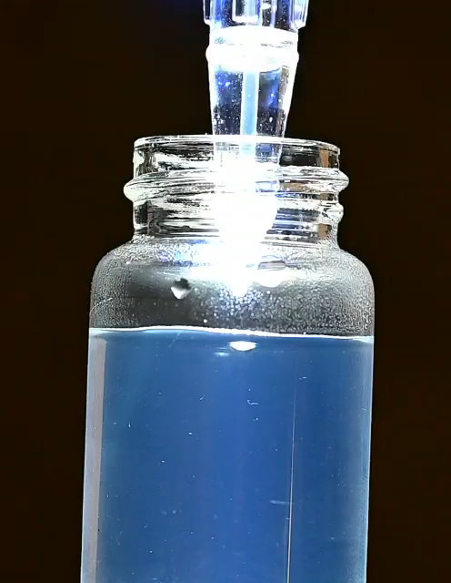

Slide 20
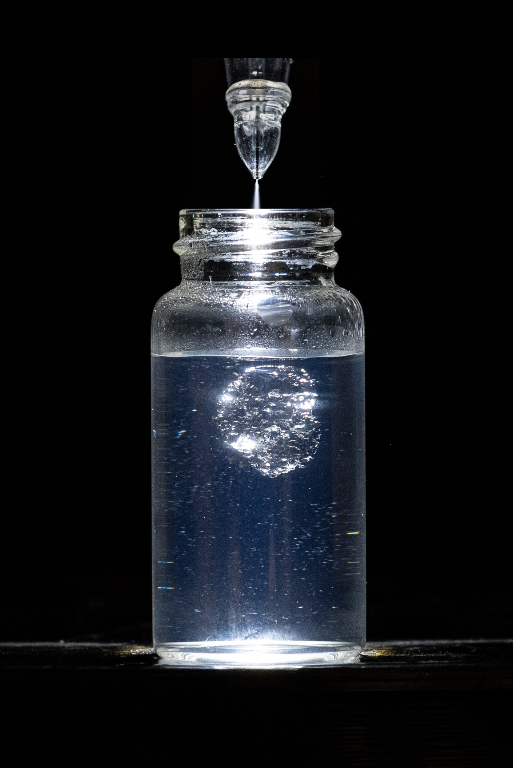
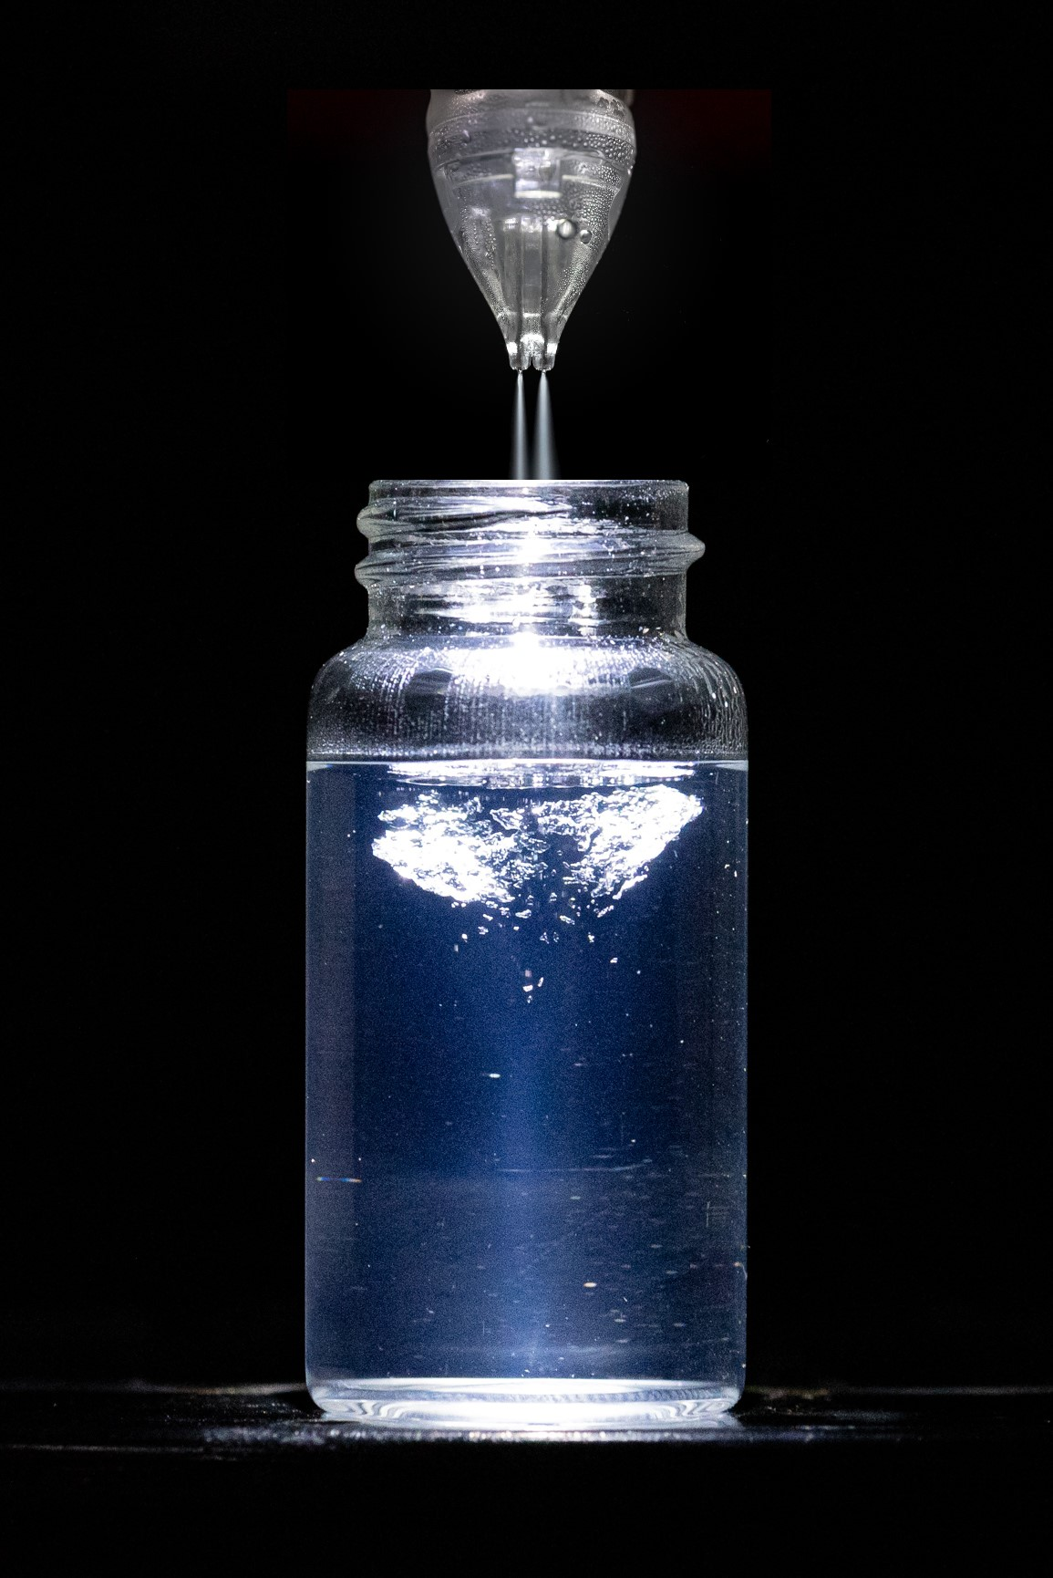
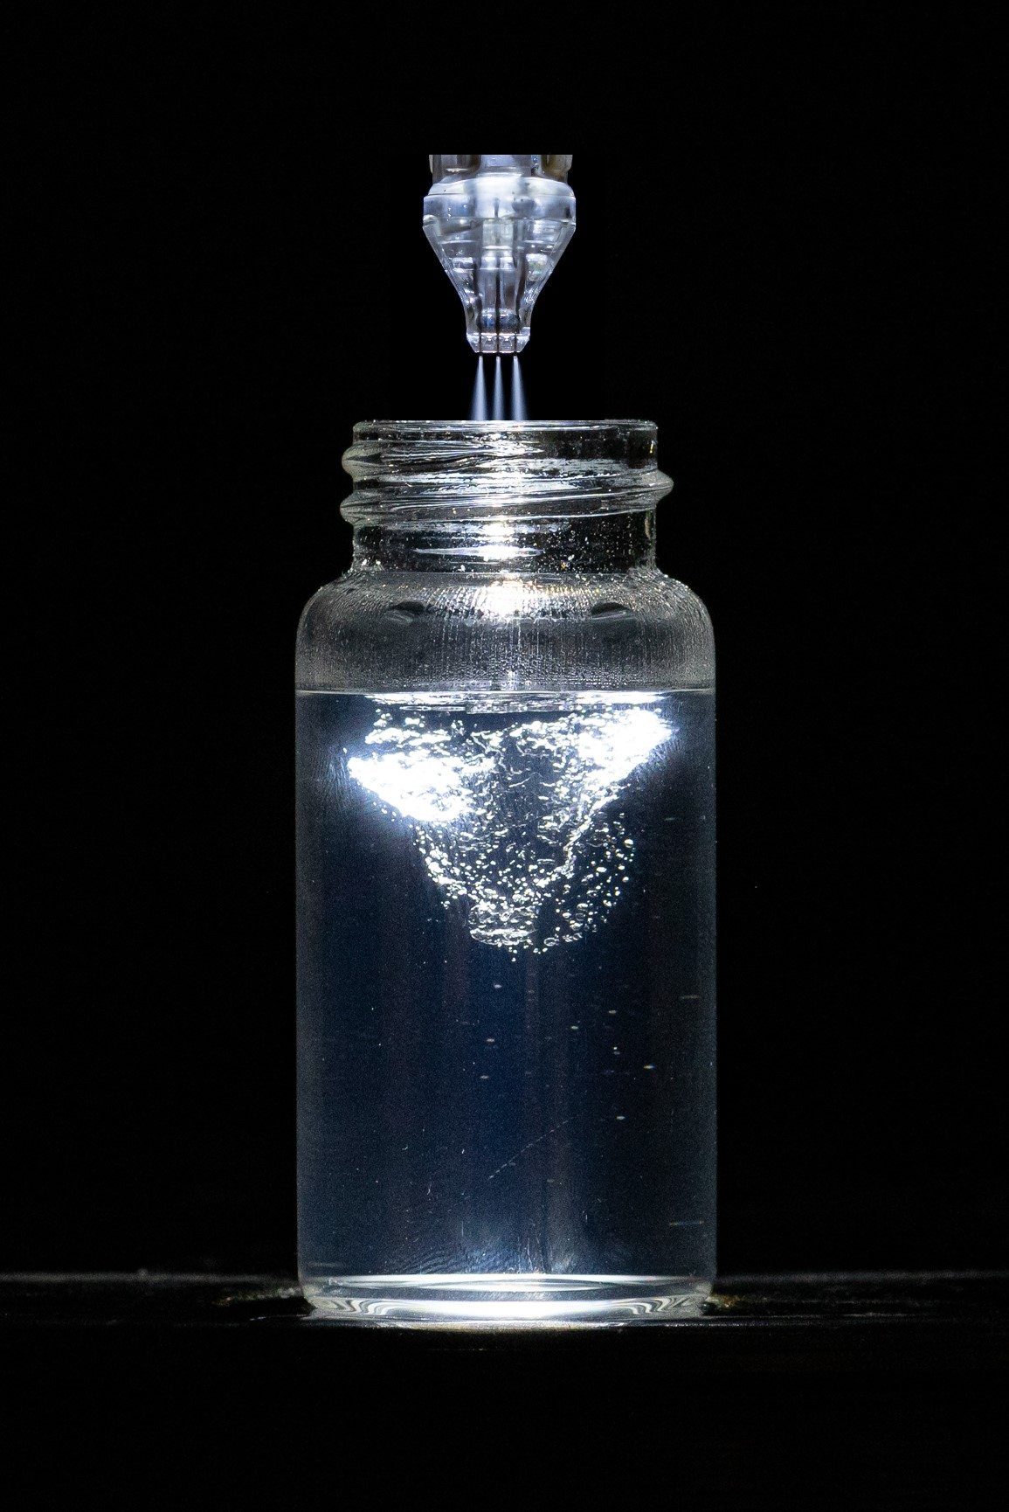
Unique handpieces for unique epidermal effects
SingleJet Narrow (Magic)
DoubleJet
TripleJet

Slide 21

Infusion with JetPeel
An innovative safe and painless aesthetic medical device for needle-less delivery of nutrients into the skin without any pain
Non-invasive, non-ablative, non-contact
No pain, no downtime
Uses technology from the aerospace industry utilizing a subsonic flow of air to break a blend of solutions and air into microdroplets, and infuse them into the skin
Infuses nutrients such as antioxidants, vitamins, hyaluronic acid and peptides

Slide 22
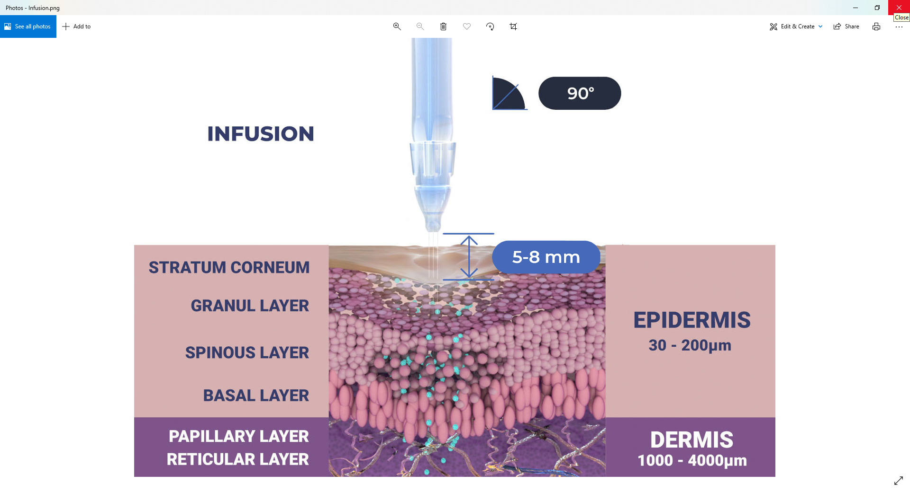
The treatment sequence - Steps 3 and 4 - Infusion

Slide 23
Infusion
Materials & Methods

Slide 24
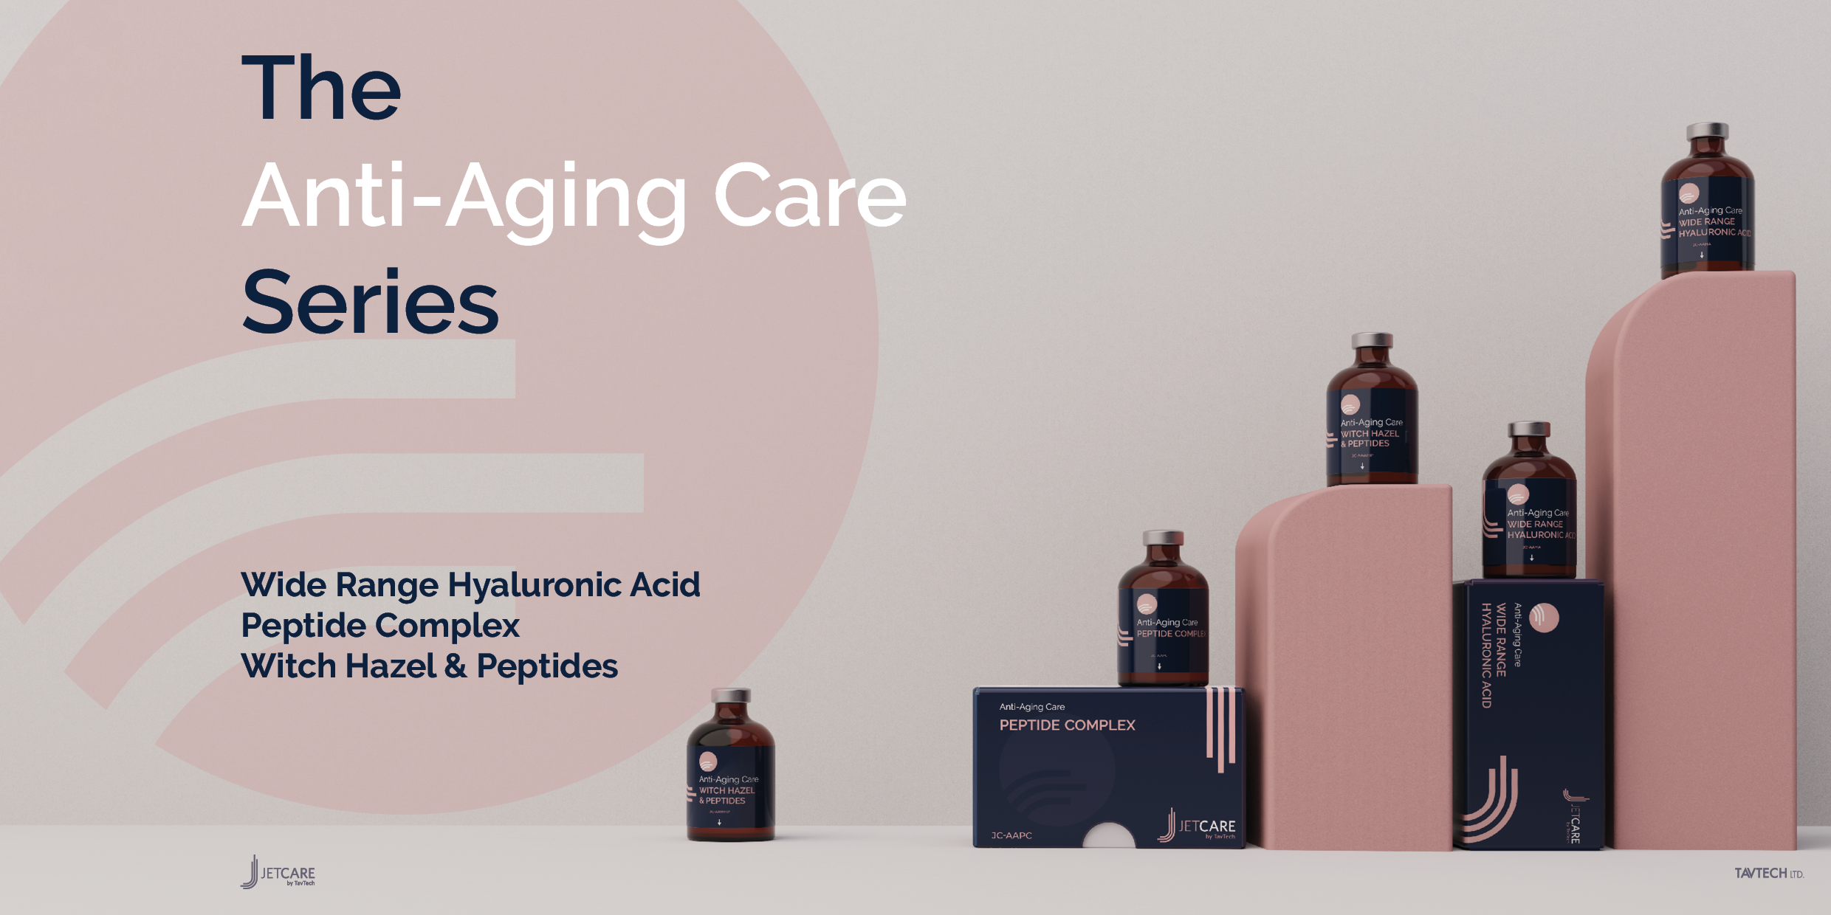

Slide 25
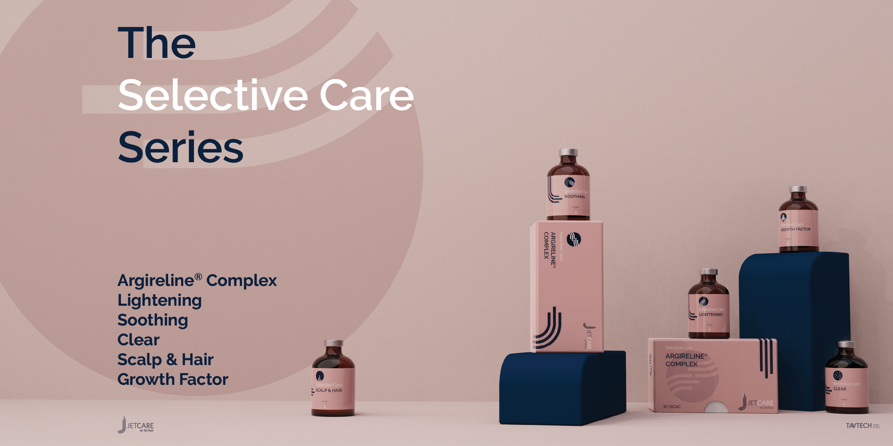
Argireline® is a trademark of Lipotec S.A. or its affiliates

Slide 26
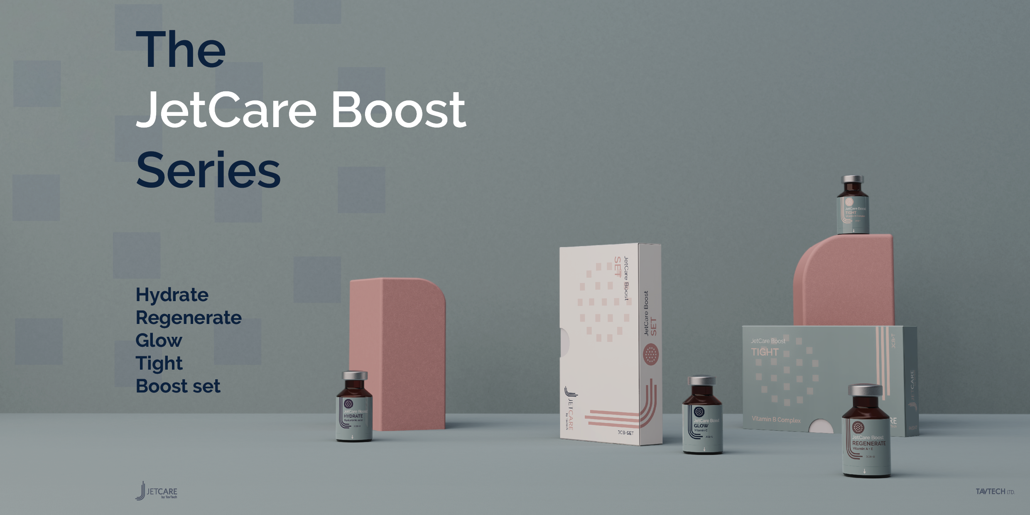

Slide 27
Step 3 - Facial infusion with JetPeel
Infusion is to be done following Exfoliation for effective results.
Choose the relevant JetCare solution from the treatment guideline according to the skin condition and desired indications.
It is recommended to use the TripleJet handpiece, followed by the SingleJet Narrow (Magic) handpiece for specific locations.
Keep the handpiece at a 90° angle relative to the skin surface and keep 0.5-0.8 cm distance from it.
Move in zigzag motions, covering the entire treatment area. Try to keep a consistent pace.
Duration of a complete facial infusion treatment is 5 to 7 minutes, and it uses ~5 ml of the chosen JetCare solution.

Slide 28
Step 4 - Facial boost infusion with JetPeel
Boost Infusion will be done following infusion as per treatment by skin characteristics.
Choose the relevant JetCare boost from the treatment guideline according to the skin condition and desired indications.
It is recommended to use the TripleJet handpiece, followed by the SingleJet Narrow (Magic) handpiece for specific locations.
Keep the handpiece at a 90° angle relative to the skin surface and keep 0.5-0.8 cm distance from it.
Move in zigzag motions, covering the entire treatment area. Try to keep a consistent pace.
Duration of a complete facial infusion treatment is 5 to 7 minutes, and it uses ~3ml of the chosen JetCare boost.

Slide 29
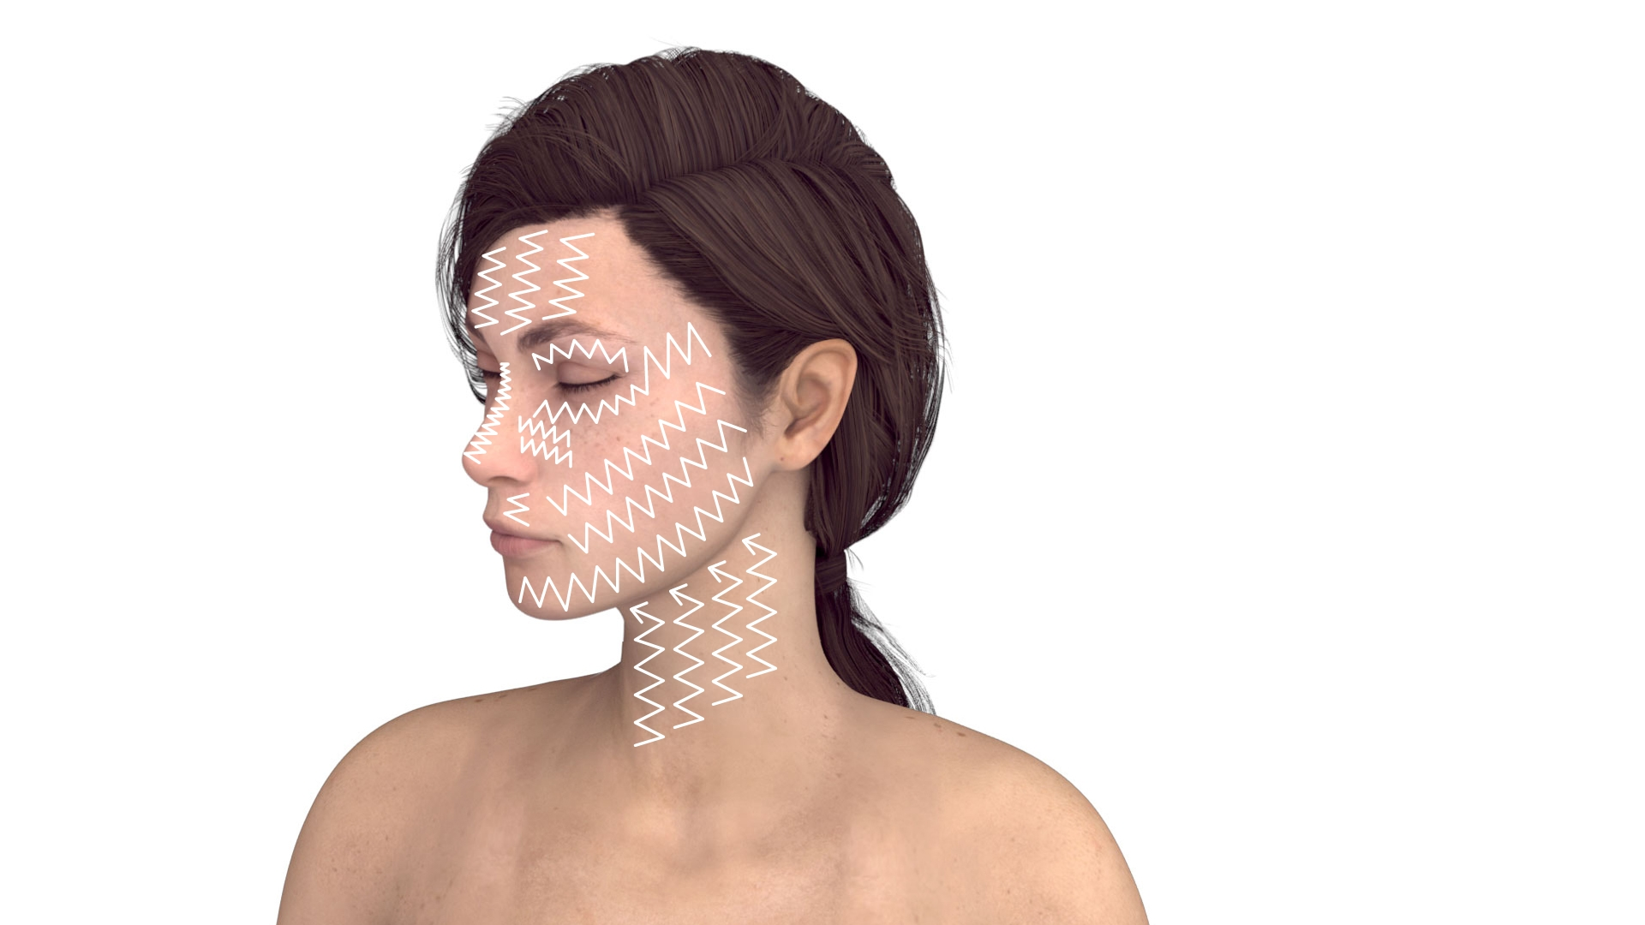
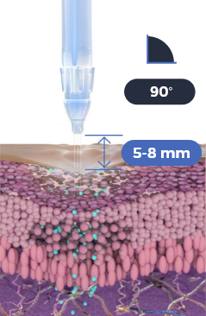
Use the TripleJet handpiece held at 90° to the skin and at 5-8 mm from the skin. Choose from the JetCare Anti-Aging, JetCare Selective and JetCare Boost solutions according to the JetPeel Treatment Guidelines.
Repeat 3 times
Move in zigzag motions covering the entire area.
Important:
Perform the infusion movement slowly

Slide 30
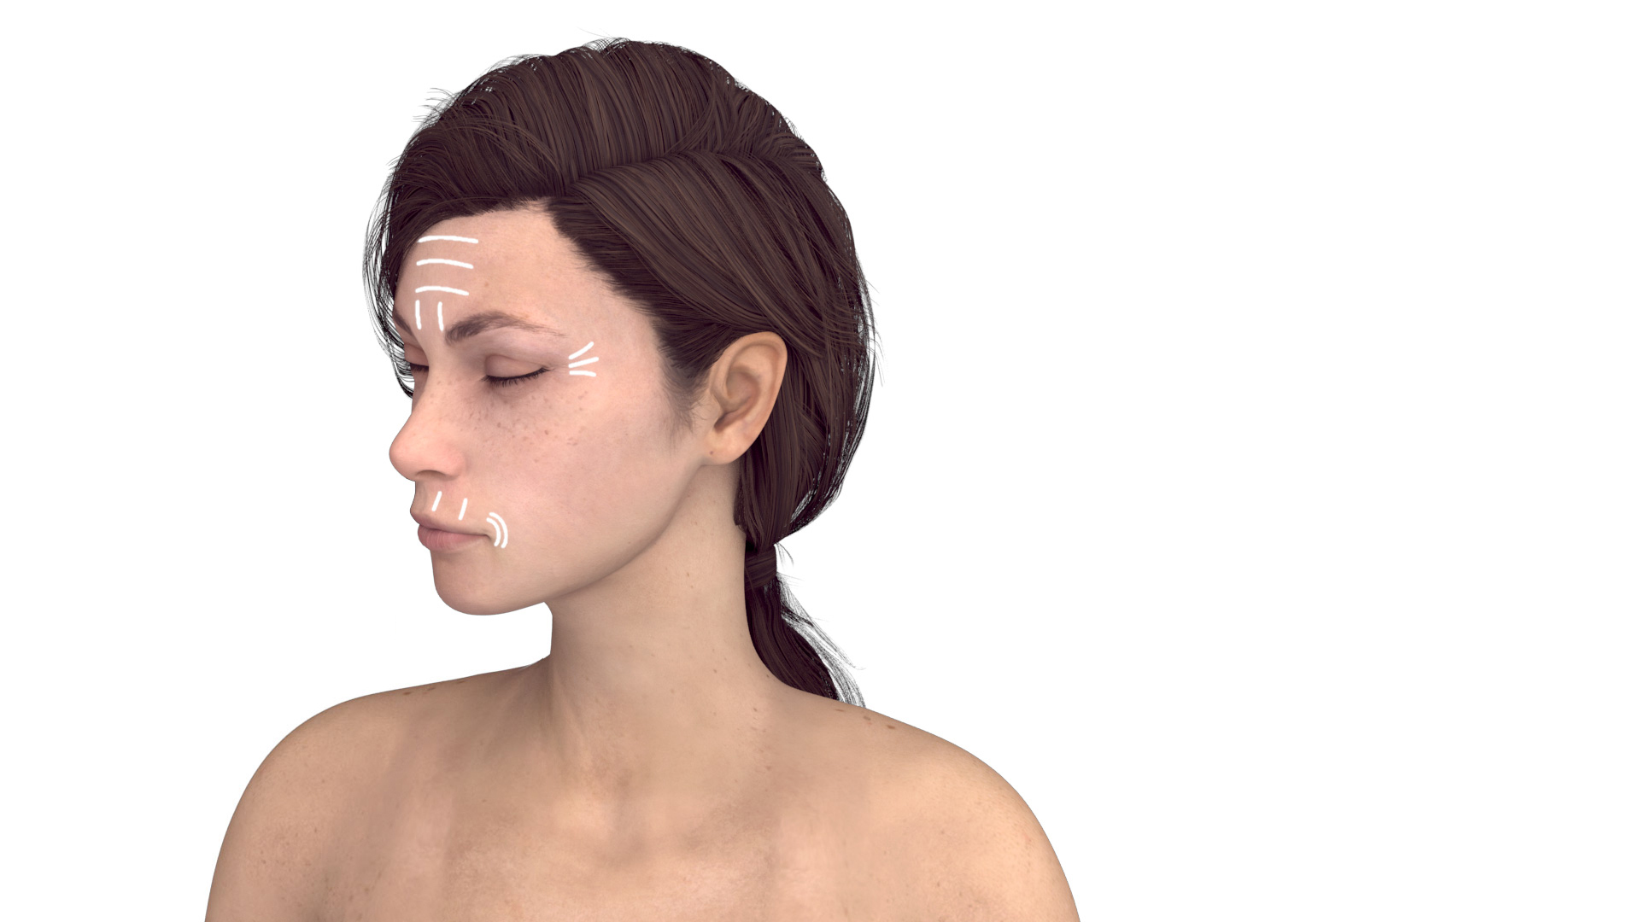
For deep wrinkles and fine lines:
Change to the SingleJet Narrow (Magic) handpiece to infuse wrinkle lines. Hold at 90° to the skin and at 5-8 mm from the skin.
Repeat 3 times
Swap solution according to chosen Treatment Guideline.
Move by following the lines until you cover the entire wrinkle areas.
Important:
Perform the infusion movement slowly

Slide 31
Why infuse with JetPeel?
Cleanses, exfoliates, hydrates, and oxygenates the skin
Non-Invasive, Non-ablative
Safe on all skin types, all year round
Pleasant, painless, soothing treatments
No downtime
Scientifically proven

Slide 32
When to infuse?
Use JetCare Anti-Aging infusion treatment to help recover the stem cells and stimulate new collagen and elastin fibers for rejuvenation & antiaging treatments
To treat pigmentations, remove keratoses, acne, sensitive skin, scars, stretch marks, hyperhidrosis and other skin related conditions
To treat hair loss
To protect the skin from the harmful environment
Infusion with JetPeel is recommended by doctors to be an efficient non-invasive approach to deliver local anaesthesia to the dermis
Immediately after Infusion with the JetPeel the skin appears noticeably fresher and younger, already after the first treatment
Longer-term effects can be achieved after just four to six sessions

Slide 33
Why does JetPeel infusion work?
    The JetPeel jet stream washes dead skin cells from the surface, cleans out pores, and removes bacteria and other debris build-ups. The jet stream acts as a powerful washer, cleansing areas that other facials miss, such as the debris that settles in epidermal cracks, inside pores, depressions in hair follicles, and the spaces between skin cells. This deep clean and exfoliation reveals a healthier, more radiant complexion, and stimulates cellular renewal.
    The JetPeel Infusion performs trans-epidermal infusion. In simpler terms, the JetPeel Infusion unique handpiece opens microchannels within the skin to infuse the deep layers of the dermis with hydrating and nourishing serums.

Slide 34
Cosmetic Medicine:
Less is More
More and more patients in cosmetic & skin clinics around the globe seek to achieve the best cosmetic outcomes with the least amount of surgery, and the least invasive and least ablative procedures, without pain and without downtime.
With advances in technology and in techniques, current thinking in medical aesthetics is “less is more”.
Patients show a clear preference for having smaller and less invasive procedures earlier to postpone or eliminate the need for surgery. There is a lot that can be done before we need to go as far as a facelift.
The results are more natural looking. Maintenance is the key and earlier, non-invasive procedures, such as with JetPeel, can delay the effects of aging on the face and the body, sometimes even negating the need for invasive procedures.

Slide 35


JetPeel treats numerous skin concerns and rejuvenates skin by:
Improving skin tone and texture
Reducing the appearance of fine lines and wrinkles
Exfoliating dead skin cells that dull your complexion
Improving the appearance of acne scars and stretch marks
Cleansing skin of acne-causing bacteria and cellular build-up
Hydrating skin so it looks plumper and healthier
Reducing brown spots and sun damage
Enabling décolletage and hand rejuvenation
Trans-epidermal infusion promotes collagen production
Revealing a fresher, more robust, and more radiant layer of skin
Treating the scalp
Improving the skin cell longevity and functions
Preventing the aging signs

Slide 36
JetPeel Infusion: A painless and pleasant treatment experience
Words like “subsonic technology” and “jet stream” may seem intimidating to some people. However, JetPeel Infusion is painless. In fact, patients find the facial to be cooling, soothing and pleasant.
Furthermore, by avoiding the use of lasers, and other invasive or ablative technologies, the jet infusion does not lead to any downtime.
Patients complete the session with more radiant skin, and are free to pursue their normal activities immediately after the facial treatment.

Slide 37
Contraindications
Open wounds
Severe sensitivity to cold
Skin neoplasms
Active cancer
Trigeminal nerve inflammation
Active sinusitis or laryngitis
Active herpes
Active bronchial asthma
Thrombosis
The system has not been tested or evaluated on pregnant or lactating women, nor on children and infants, therefore is not intended for use on these groups of users

Slide 38
JetPeel by TavTech
The perfect trio combining:
The enduring JetPro device
The original patented JetPeel handpieces
The premium JetCare solutions
Designed exclusively for use together to deliver outstanding results

Slide 39
For more information on Exfoliation Techniques with JetPeel check out the following presentations:
Infusion with JetPeel – Face & Neck

Slide 40
JetPeel by TavTech Training Program
1. JetPeel Technology and Solutions: Training Introduction
2. Lymphatic Massage with JetPeel
2.1. Lymphatic Massage with JetPeel – Face & Neck
2.2. Lymphatic Massage with JetPeel – Body
3. Exfoliation with JetPeel
3.1. Exfoliation with JetPeel – Face & Neck
4. Infusion with JetPeel
4.1. Infusion with JetPeel – Face & Neck
5. Scalp & Hair with JetPeel
6. JetPeel Handpieces

Slide 41
THANK YOU!

Slide 42
JetPeel by TavTech Academy

