Slide 1


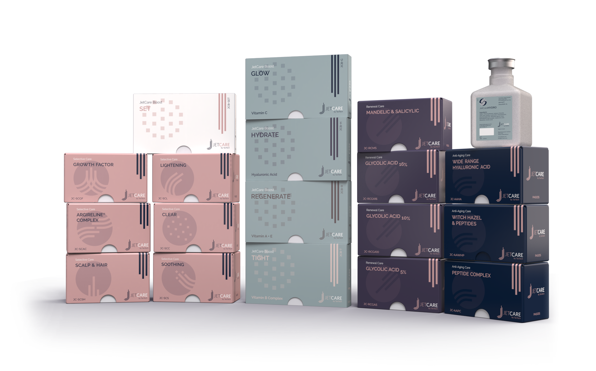
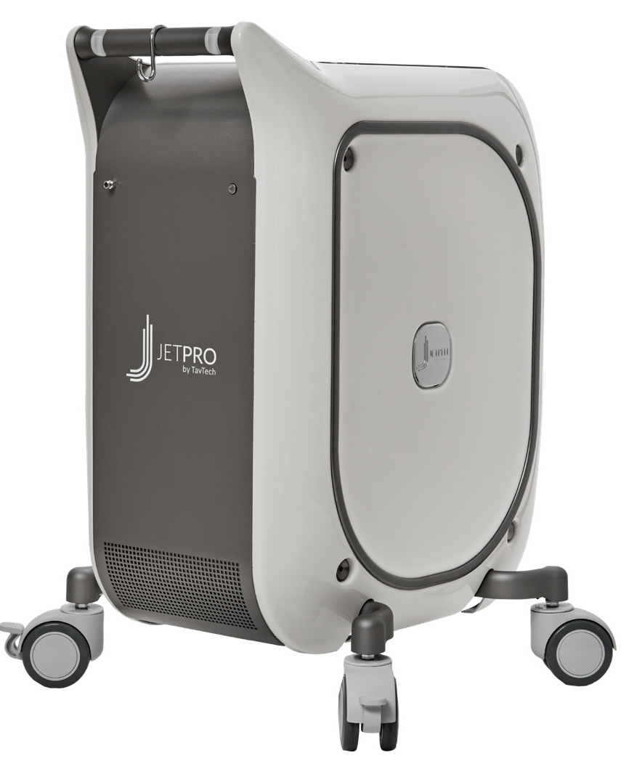
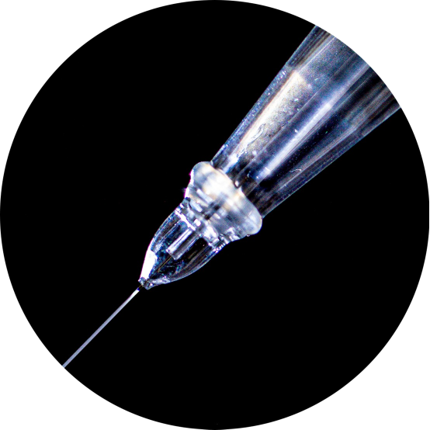
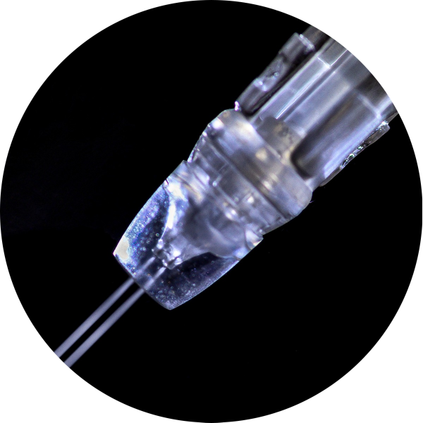
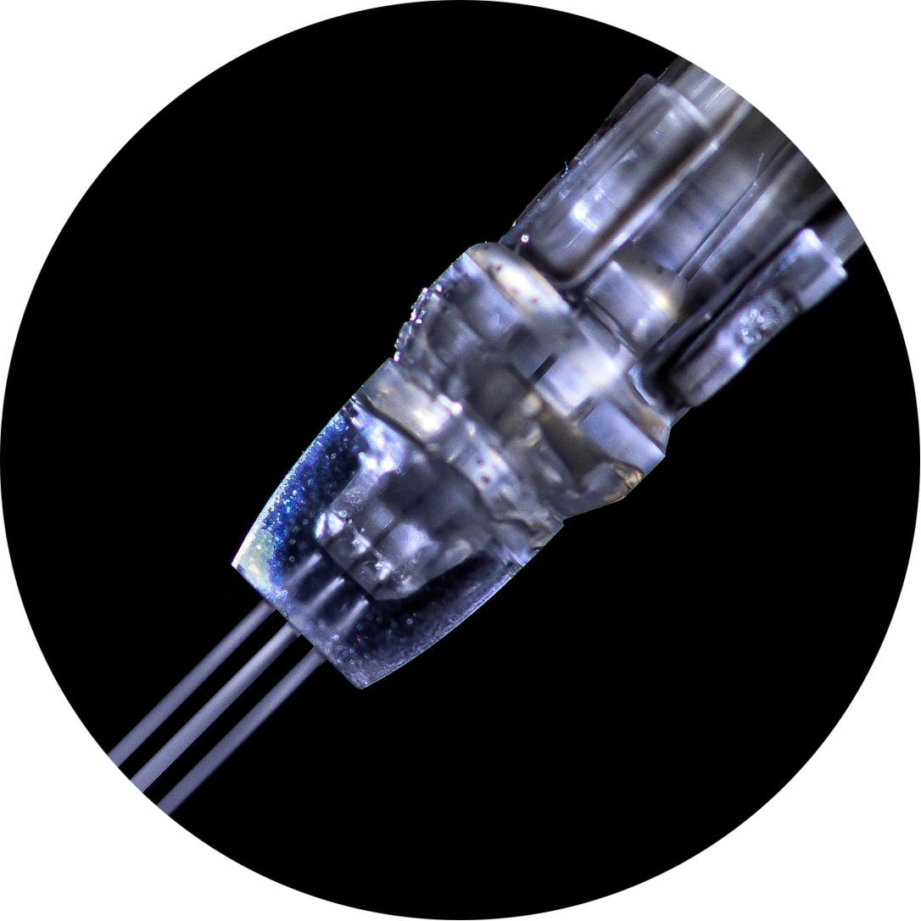
JetPeel by TavTech Academy

Slide 2



We provide people with an opportunity to become the best version of themselves
We believe in making people feel good …

Slide 3
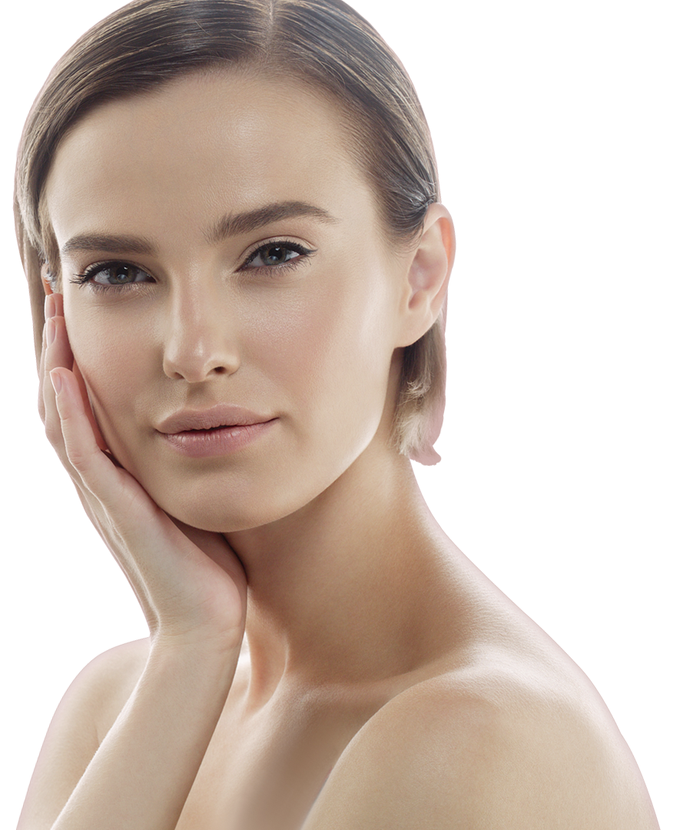
… by delivering
a powerful, instant-result treatment
Suitable for all skin types and all year-round

Slide 4
JetPeel by TavTech Training Program
1. JetPeel Technology and Solutions: Training Introduction
2. Lymphatic Massage with JetPeel
2.1. Lymphatic Massage with JetPeel – Face & Neck
2.2. Lymphatic Massage with JetPeel – Body
3. Exfoliation with JetPeel
3.1. Exfoliation with JetPeel – Face & Neck
4. Infusion with JetPeel
4.1. Infusion with JetPeel – Face & Neck
5. Scalp & Hair with JetPeel
6. JetPeel Handpieces

Slide 5
3.1. Exfoliation with JetPeel
Face & Neck

Slide 6
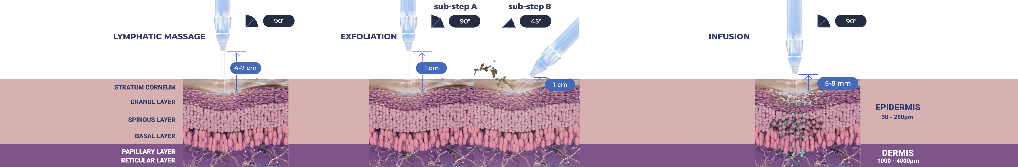
Treatment Sequence for Face and Body
The versatility of JetPeel: Face and Body
Unique jet pressure energy

Slide 7
The treatment sequence
STEP
1
STEP
2
STEP
3
STEP
4
LYMPHATIC
MASSAGE
GENTLE
EXFOLIATION
EFFECTIVE
INFUSION
BOOSTER
INFUSION
A pleasant and relaxing massage for detoxifying the skin and stimulating micro-circulation
Removing dead skin cells prepares the skin to receive the nourishment from the following Infusion Step
This step provides effective and deep delivery of active ingredients into the skin
Post-infusion step to amplify treatment result

Slide 8
The treatment sequence
STEP
1
STEP
2
STEP
3
STEP
4
LYMPHATIC
MASSAGE
GENTLE
EXFOLIATION
EFFECTIVE
INFUSION
BOOSTER
INFUSION
A pleasant and relaxing massage for detoxifying the skin and stimulating micro-circulation
Removing dead skin cells prepares the skin to receive the nourishment from the following Infusion Step
This step provides effective and deep delivery of active ingredients into the skin
Post-infusion step to amplify treatment result

Slide 9

Step 2 - Exfoliation with JetPeel
Exfoliation is a form of microdermabrasion using the JetPeel jet pressure energy system with JetCare solutions to hydrate the skin throughout the treatment
Exfoliation clears the dead skin cells (stratum corneum of the epidermis) revealing a smoother, more even texture of the skin and improving the skin appearance

Slide 10
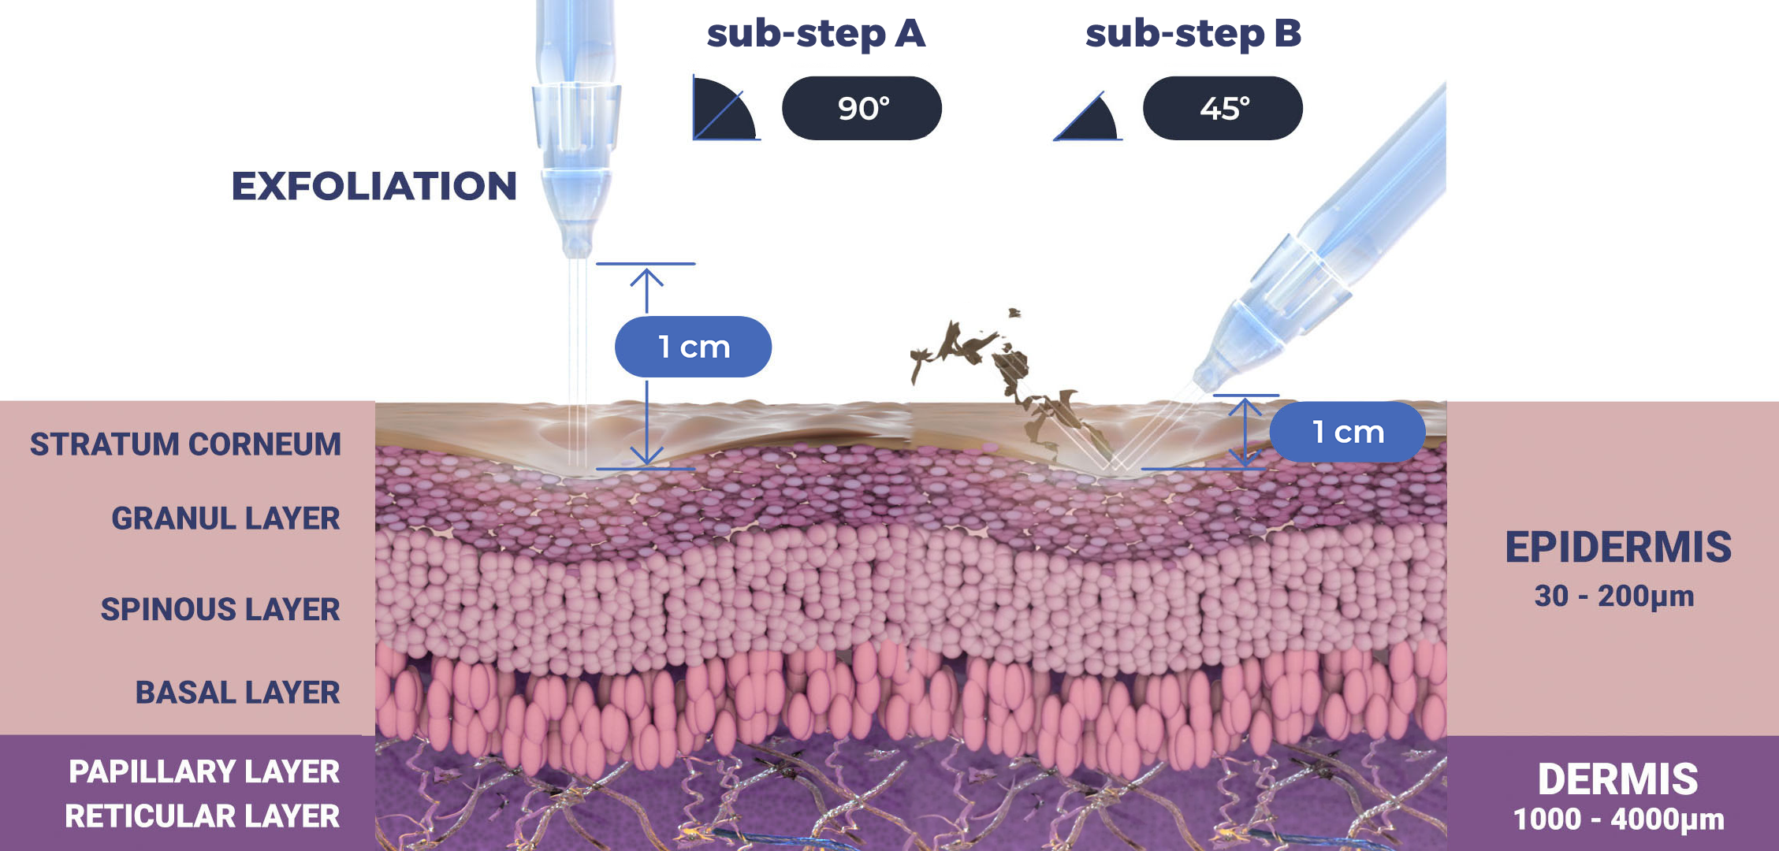
Step 2 - Exfoliation

Slide 11
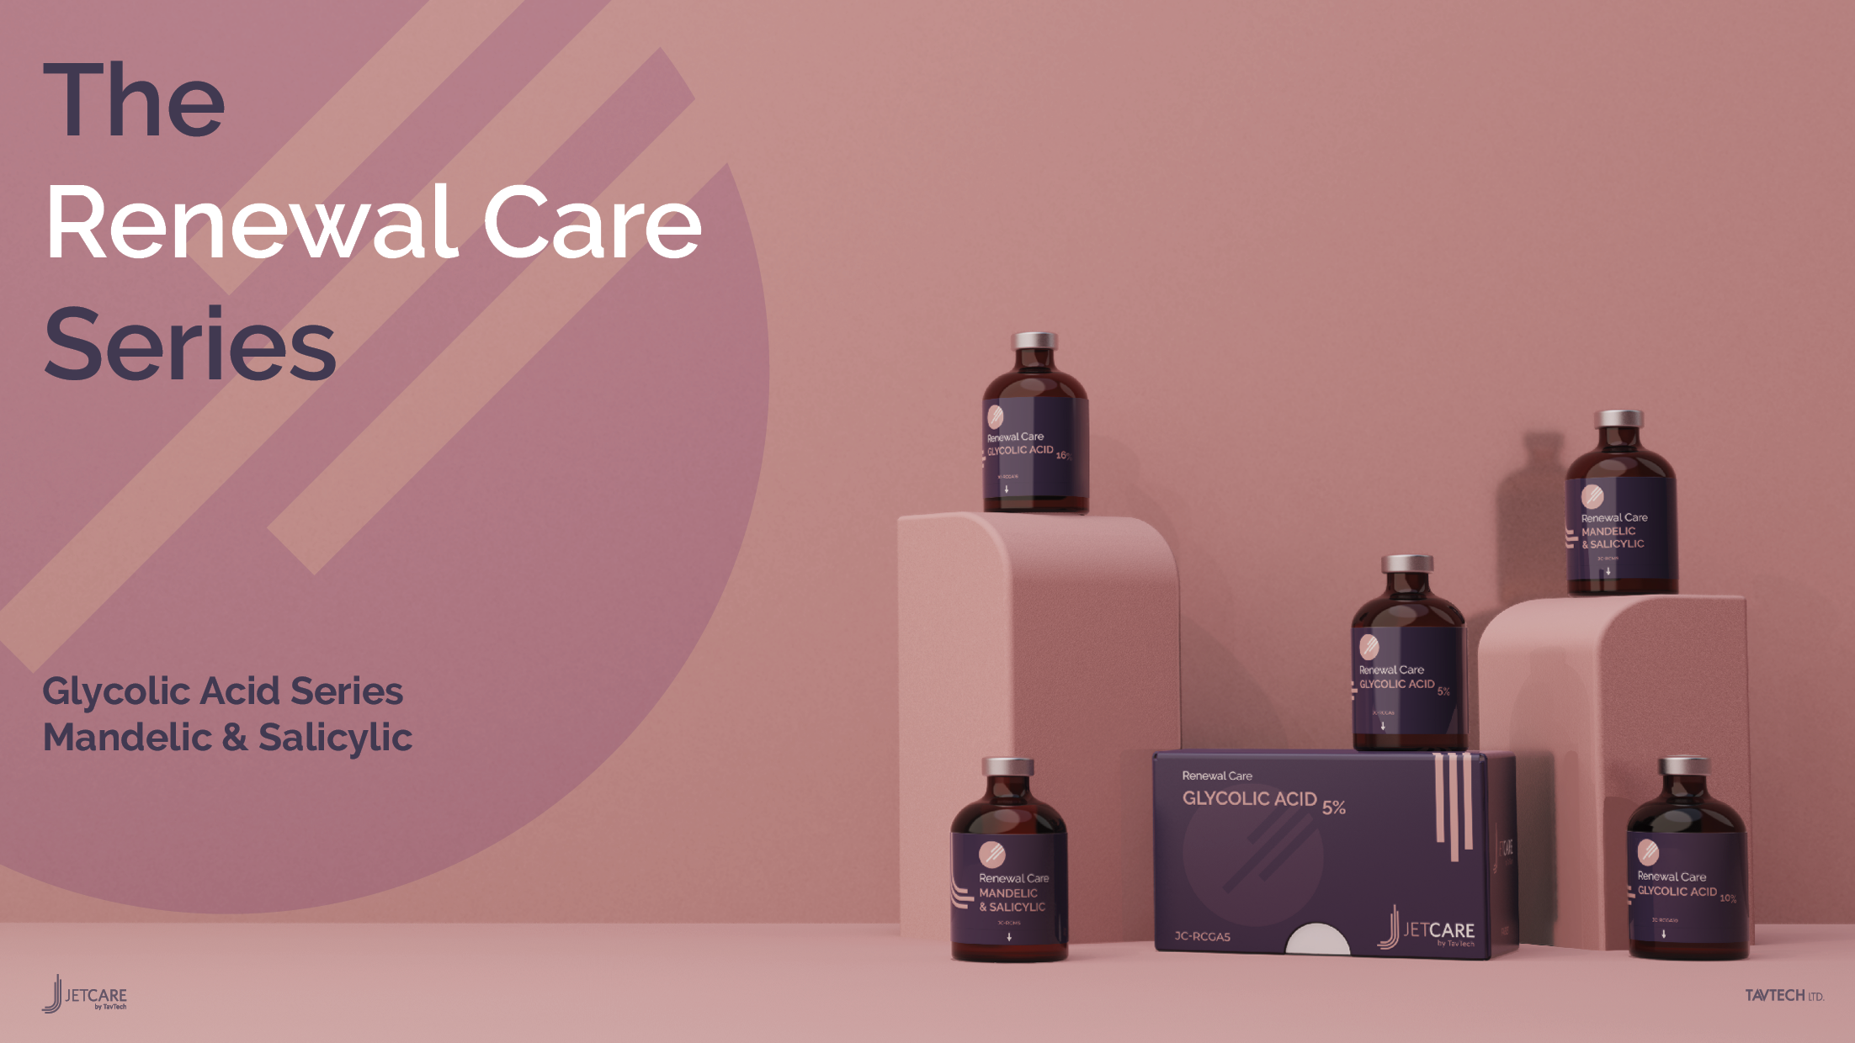

Slide 12
Exfoliation
Technique & Sequence

Slide 13
Technique
  According to the skin condition and desired exfoliation, use ~ 5 ml of either:
    Renewal Care Glycolic Acid 5%, or
    Renewal Care Glycolic Acid 10%, or
    Renewal Care Glycolic Acid 16%, or,
    Renewal Care Mandelic & Salicylic Acids
If exfoliating with Glycolic acid, leave on the skin for 5-8 minutes and only after that, wash with ~8ml of JetCare Hydro.
If exfoliating with Mandelic & Salicylic acids, then immediately after that, wash with ~8ml JetCare Hydro if necessary.
It is recommended to use the TripleJet handpiece.
For the exfoliation step - keep the handpiece at a 90° angle relative to the skin surface and keep 1cm from it.
For the washing step – keep the handpiece at a 45° - 60° angle relative to the skin surface 8-10mm from it.
Move in zigzag motions, covering the entire treatment area.
Duration of a complete facial exfoliation is about 5-7 minutes.

Slide 14
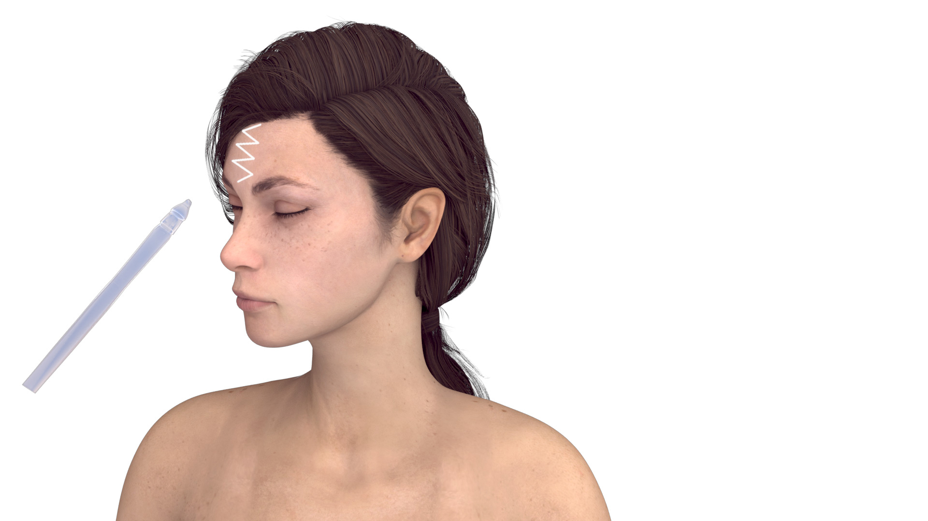
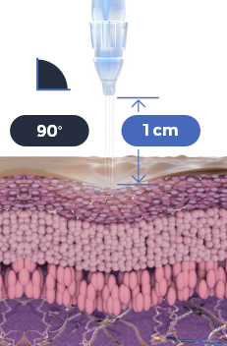

Sub-Step A
Use the TripleJet handpiece held at 90° to the skin at 1 cm from the skin
Use one of the JetCare Renewal Care solutions
Repeat 3 times
Move in zigzag motions covering the entire area

Slide 15


Sub-Step A
Use the TripleJet handpiece held at 90° to the skin at 1 cm from the skin
Use one of the JetCare Renewal Care solutions
Repeat 3 times
Move in zigzag motions covering the entire area

Slide 16


Sub-Step A
Use the TripleJet handpiece held at 90° to the skin at 1 cm from the skin
Use one of the JetCare Renewal Care solutions
Repeat 3 times
Move in zigzag motions covering the entire area

Slide 17


Sub-Step A
Use the TripleJet handpiece held at 90° to the skin at 1 cm from the skin
Use one of the JetCare Renewal Care solutions
Repeat 3 times
Move in zigzag motions covering the entire area

Slide 18


Sub-Step A
Use the TripleJet handpiece held at 90° to the skin at 1 cm from the skin
Use one of the JetCare Renewal Care solutions
Repeat 3 times
Move in zigzag motions covering the entire area

Slide 19


Sub-Step A
Use the TripleJet handpiece held at 90° to the skin at 1 cm from the skin
Use one of the JetCare Renewal Care solutions
Repeat 3 times
Move in zigzag motions covering the entire area

Slide 20


Sub-Step A
Use the TripleJet handpiece held at 90° to the skin at 1 cm from the skin
Use one of the JetCare Renewal Care solutions
Repeat 3 times
Move in zigzag motions covering the entire area

Slide 21


Sub-Step A
Use the TripleJet handpiece held at 90° to the skin at 1 cm from the skin
Use one of the JetCare Renewal Care solutions
Repeat 3 times
Move in zigzag motions covering the entire area

Slide 22


Sub-Step A
Use the TripleJet handpiece held at 90° to the skin at 1 cm from the skin
Use one of the JetCare Renewal Care solutions
Repeat 3 times
Move in zigzag motions covering the entire area

Slide 23


Sub-Step A
Use the TripleJet handpiece held at 90° to the skin at 1 cm from the skin
Use one of the JetCare Renewal Care solutions
Repeat 3 times
Move in zigzag motions covering the entire area

Slide 24


Sub-Step A
Use the TripleJet handpiece held at 90° to the skin at 1 cm from the skin
Use one of the JetCare Renewal Care solutions
Repeat 3 times
Move in zigzag motions covering the entire area

Slide 25


Sub-Step A
Use the TripleJet handpiece held at 90° to the skin at 1 cm from the skin
Use one of the JetCare Renewal Care solutions
Repeat 3 times
Move in zigzag motions covering the entire area

Slide 26


Sub-Step A
Use the TripleJet handpiece held at 90° to the skin at 1 cm from the skin
Use one of the JetCare Renewal Care solutions
Repeat 3 times
Move in zigzag motions covering the entire area

Slide 27
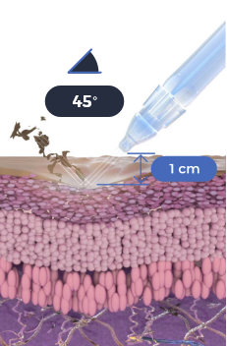
Sub-Step B
Use the TripleJet handpiece held at 45° to the skin at 1 cm from the skin
Use JetCare Hydro
Repeat 3 times
Move in zigzag motions covering the entire area

Slide 28
Sub-Step B
Use the TripleJet handpiece held at 45° to the skin at 1 cm from the skin
Use JetCare Hydro
Repeat 3 times
Move in zigzag motions covering the entire area

Slide 29
Sub-Step B
Use the TripleJet handpiece held at 45° to the skin at 1 cm from the skin
Use JetCare Hydro
Repeat 3 times
Move in zigzag motions covering the entire area

Slide 30
Sub-Step B
Use the TripleJet handpiece held at 45° to the skin at 1 cm from the skin
Use JetCare Hydro
Repeat 3 times
Move in zigzag motions covering the entire area

Slide 31
Sub-Step B
Use the TripleJet handpiece held at 45° to the skin at 1 cm from the skin
Use JetCare Hydro
Repeat 3 times
Move in zigzag motions covering the entire area

Slide 32
Sub-Step B
Use the TripleJet handpiece held at 45° to the skin at 1 cm from the skin
Use JetCare Hydro
Repeat 3 times
Move in zigzag motions covering the entire area

Slide 33
Sub-Step B
Use the TripleJet handpiece held at 45° to the skin at 1 cm from the skin
Use JetCare Hydro
Repeat 3 times
Move in zigzag motions covering the entire area

Slide 34
Sub-Step B
Use the TripleJet handpiece held at 45° to the skin at 1 cm from the skin
Use JetCare Hydro
Repeat 3 times
Move in zigzag motions covering the entire area

Slide 35
Sub-Step B
Use the TripleJet handpiece held at 45° to the skin at 1 cm from the skin
Use JetCare Hydro
Repeat 3 times
Move in zigzag motions covering the entire area

Slide 36
Sub-Step B
Use the TripleJet handpiece held at 45° to the skin at 1 cm from the skin
Use JetCare Hydro
Repeat 3 times
Move in zigzag motions covering the entire area

Slide 37
Sub-Step B
Use the TripleJet handpiece held at 45° to the skin at 1 cm from the skin
Use JetCare Hydro
Repeat 3 times
Move in zigzag motions covering the entire area

Slide 38
Sub-Step B
Use the TripleJet handpiece held at 45° to the skin at 1 cm from the skin
Use JetCare Hydro
Repeat 3 times
Move in zigzag motions covering the entire area

Slide 39
Sub-Step B
Use the TripleJet handpiece held at 45° to the skin at 1 cm from the skin
Use JetCare Hydro
Repeat 3 times
Move in zigzag motions covering the entire area

Slide 40
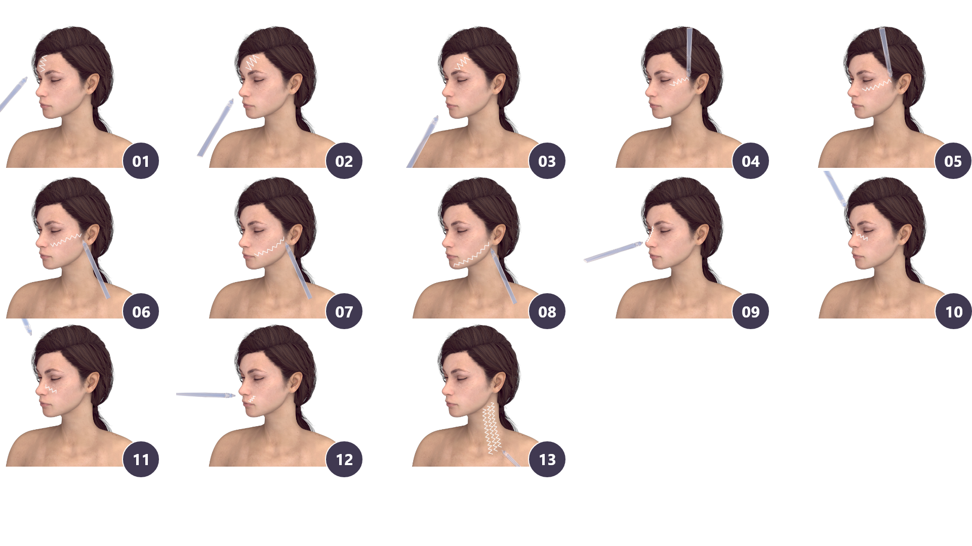
Exfoliation with JetPeel

Slide 41
JetPeel Exfoliation tips
Can you do Exfoliation to sensitive skin?
1
Stretch the skin gently with the operator’s fingers to define the skin imperfections especially close to the eyes, forehead, and lips where naturally we can have more lines and wrinkles
Yes, you can!
This treatment is recommended also for those who have sensitive or very sensitive skin, unlike other exfoliation treatments.
Exfoliation with the JetPeel exfoliates the skin without peeling or breaking the skin.
Treat the wrinkles by following the horizontal and vertical direction of the wrinkle itself
2
For other imperfections such as scars, mature skin, stretch marks, spots, large pores, treat the area more than once
3

Slide 42
Contraindications
Open wounds
Severe sensitivity to cold
Skin neoplasms
Active cancer
Trigeminal nerve inflammation
Active sinusitis or laryngitis
Active herpes
Active bronchial asthma
Thrombosis
The system has not been tested or evaluated on pregnant or lactating women, nor on children and infants, therefore is not intended for use on these groups of users

Slide 43
JetPeel by TavTech
The perfect trio combining:
The enduring JetPro device
The original patented JetPeel handpieces
The premium JetCare solutions
Designed exclusively for use together to deliver outstanding results

Slide 44
JetPeel by TavTech Training Program
1. JetPeel Technology and Solutions: Training Introduction
2. Lymphatic Massage with JetPeel
2.1. Lymphatic Massage with JetPeel – Face & Neck
2.2. Lymphatic Massage with JetPeel – Body
3. Exfoliation with JetPeel
3.1. Exfoliation with JetPeel – Face & Neck
4. Infusion with JetPeel
4.1. Infusion with JetPeel – Face & Neck
5. Scalp & Hair with JetPeel
6. JetPeel Handpieces

Slide 45
THANK YOU!

Slide 46
JetPeel by TavTech Academy

