Slide 1


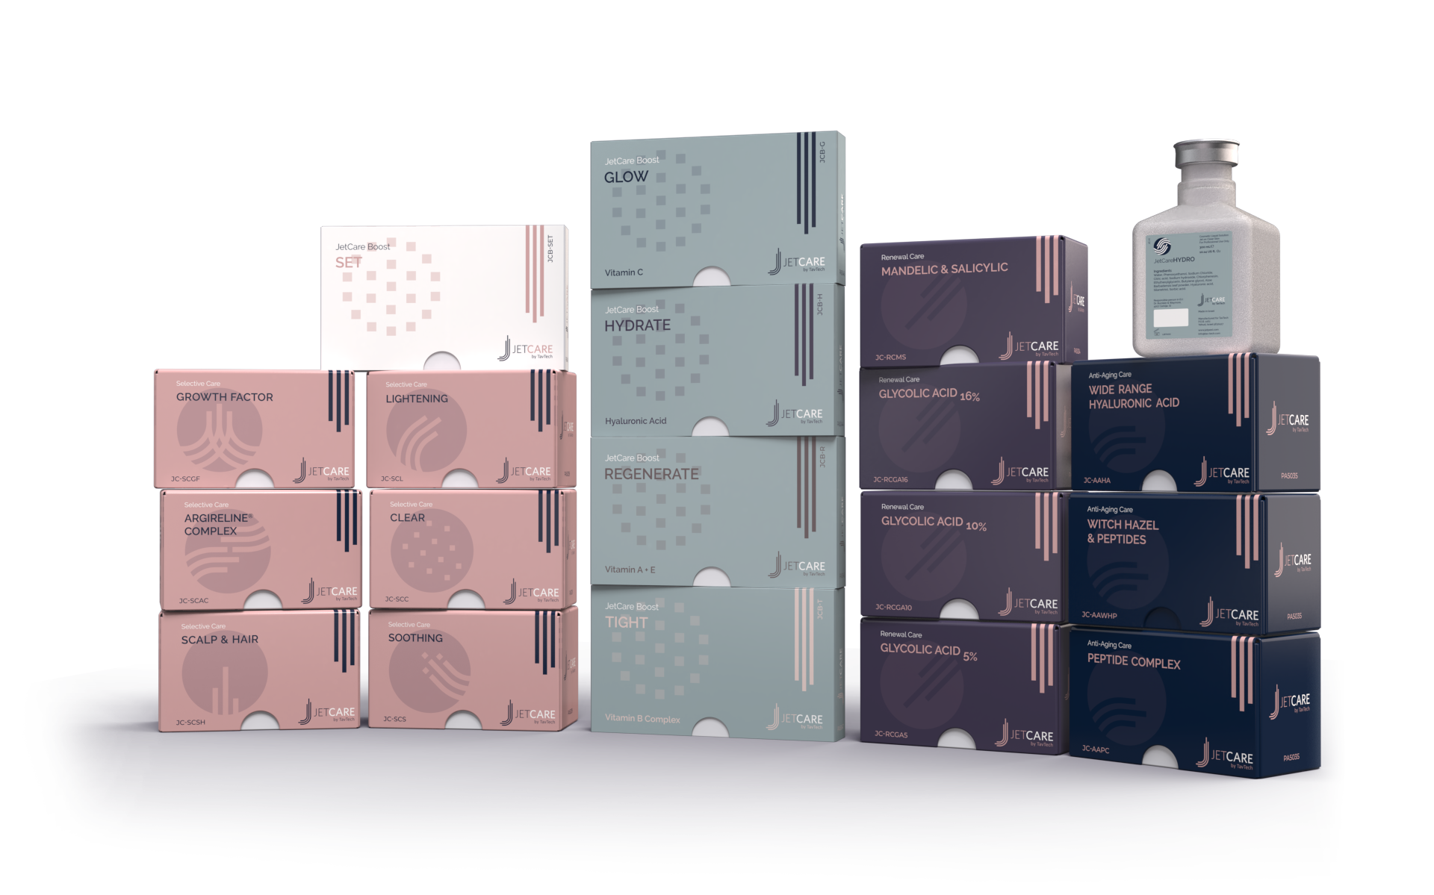
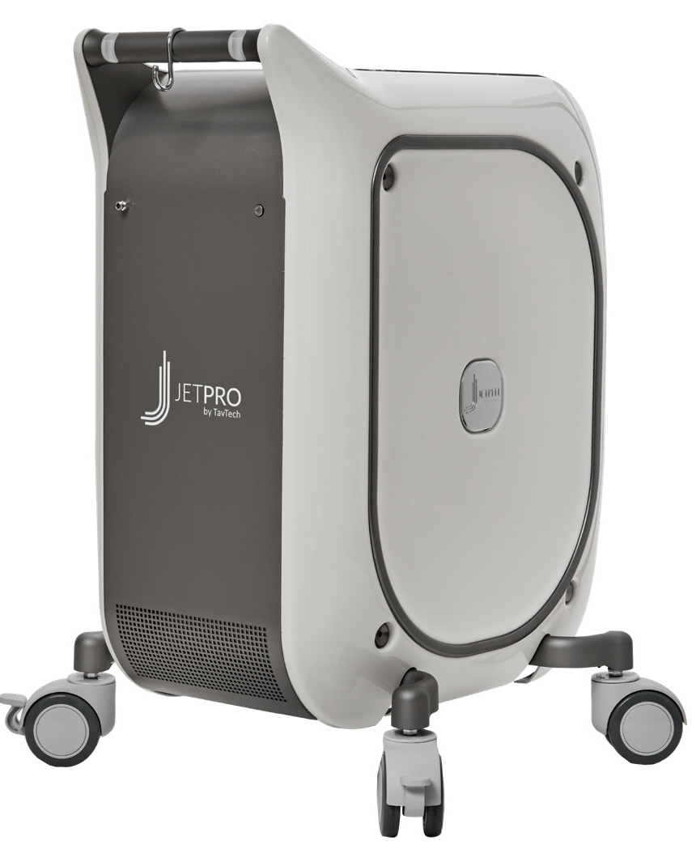
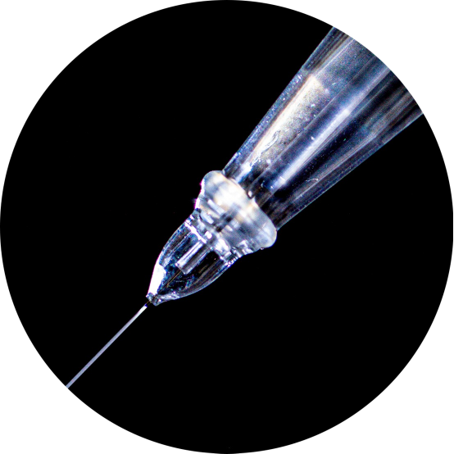
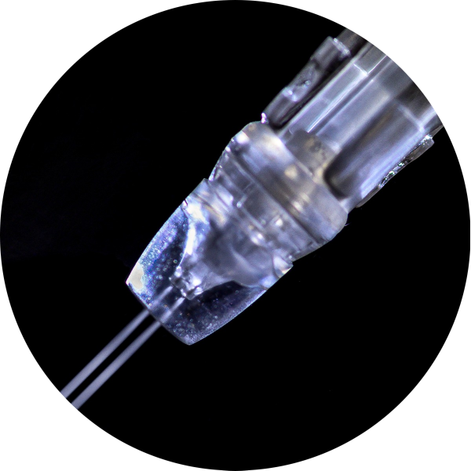
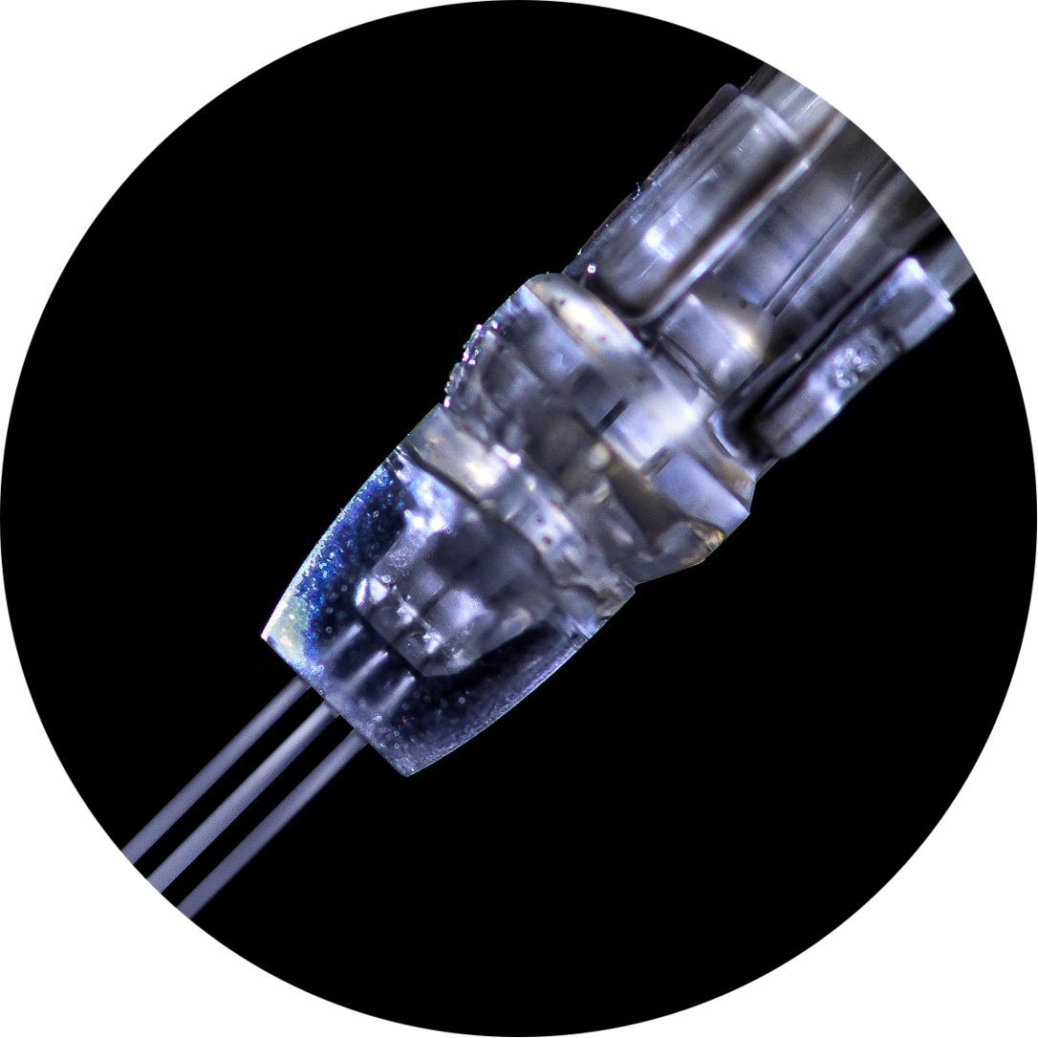
JetPeel by TavTech Academy

Slide 2



We provide people with an opportunity to become the best version of themselves
We believe in making people feel good …

Slide 3
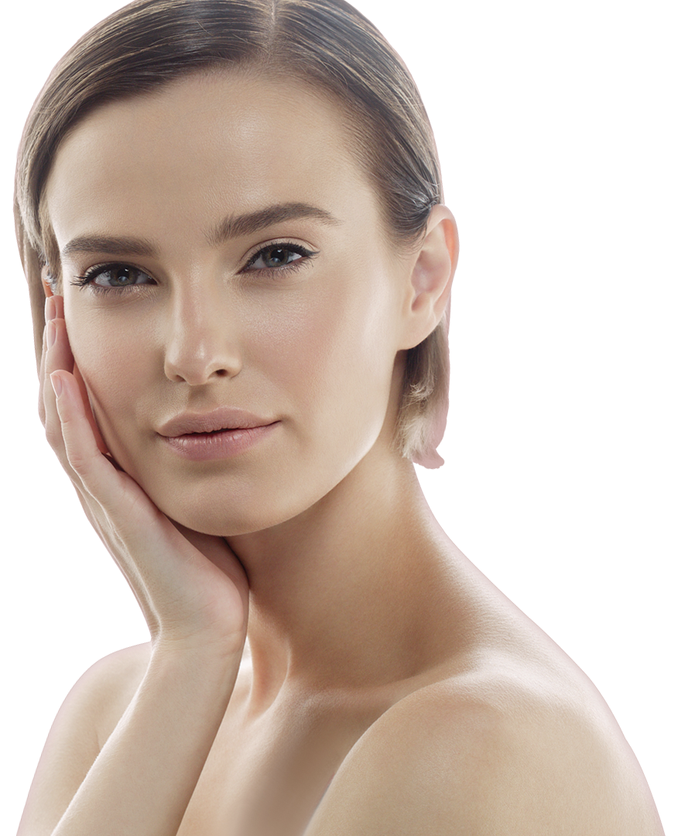
… by delivering
a powerful, instant-result treatment
Suitable for all skin types and all year-round

Slide 4
JetPeel by TavTech Training Program
1. JetPeel Technology and Solutions: Training Introduction
2. Lymphatic Massage with JetPeel
2.1. Lymphatic Massage with JetPeel – Face & Neck
2.2. Lymphatic Massage with JetPeel – Body
3. Exfoliation with JetPeel
3.1. Exfoliation with JetPeel – Face & Neck
4. Infusion with JetPeel
4.1. Infusion with JetPeel – Face & Neck
5. Scalp & Hair with JetPeel
6. JetPeel Handpieces

Slide 5
3. Exfoliation with JetPeel

Slide 6
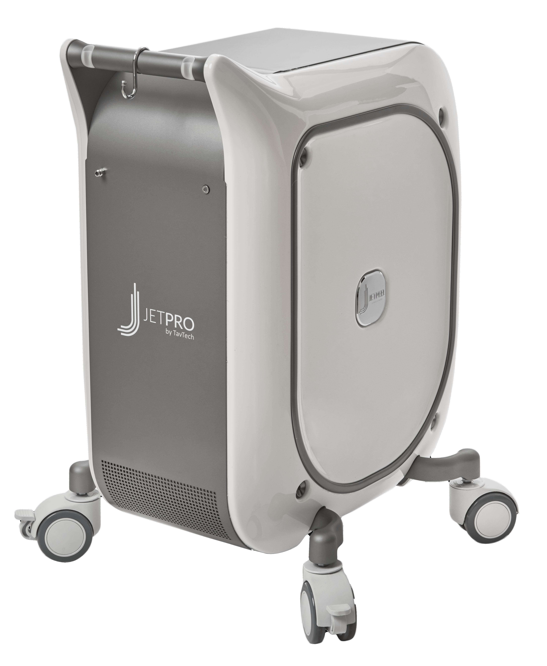






The JetPeel jet pressure energy system provides trans-epidermal infusion of a rich variety of nutrients and solutions
JetPeel System
For the treatment of an array of skincare and aesthetics conditions
Anti-Aging Care
Scalp & Hair
Lightening
Clear
Soothing
Growth Factor
Renewal Care

Slide 7
Handpieces range
Trans-epidermal infusion
delivery system
TripleJet
3 fine nozzles
Utilizing jet propulsion technology for needle-less, pain-free, non-invasive, non-ablative, trans-epidermal delivery
DoubleJet
2 fine nozzles
SingleJet Narrow (Magic)
1 fine nozzle

Slide 8
JetCare -
A variety of solutions, vitamins, minerals and acids
and an array of treatment guidelines

Slide 9
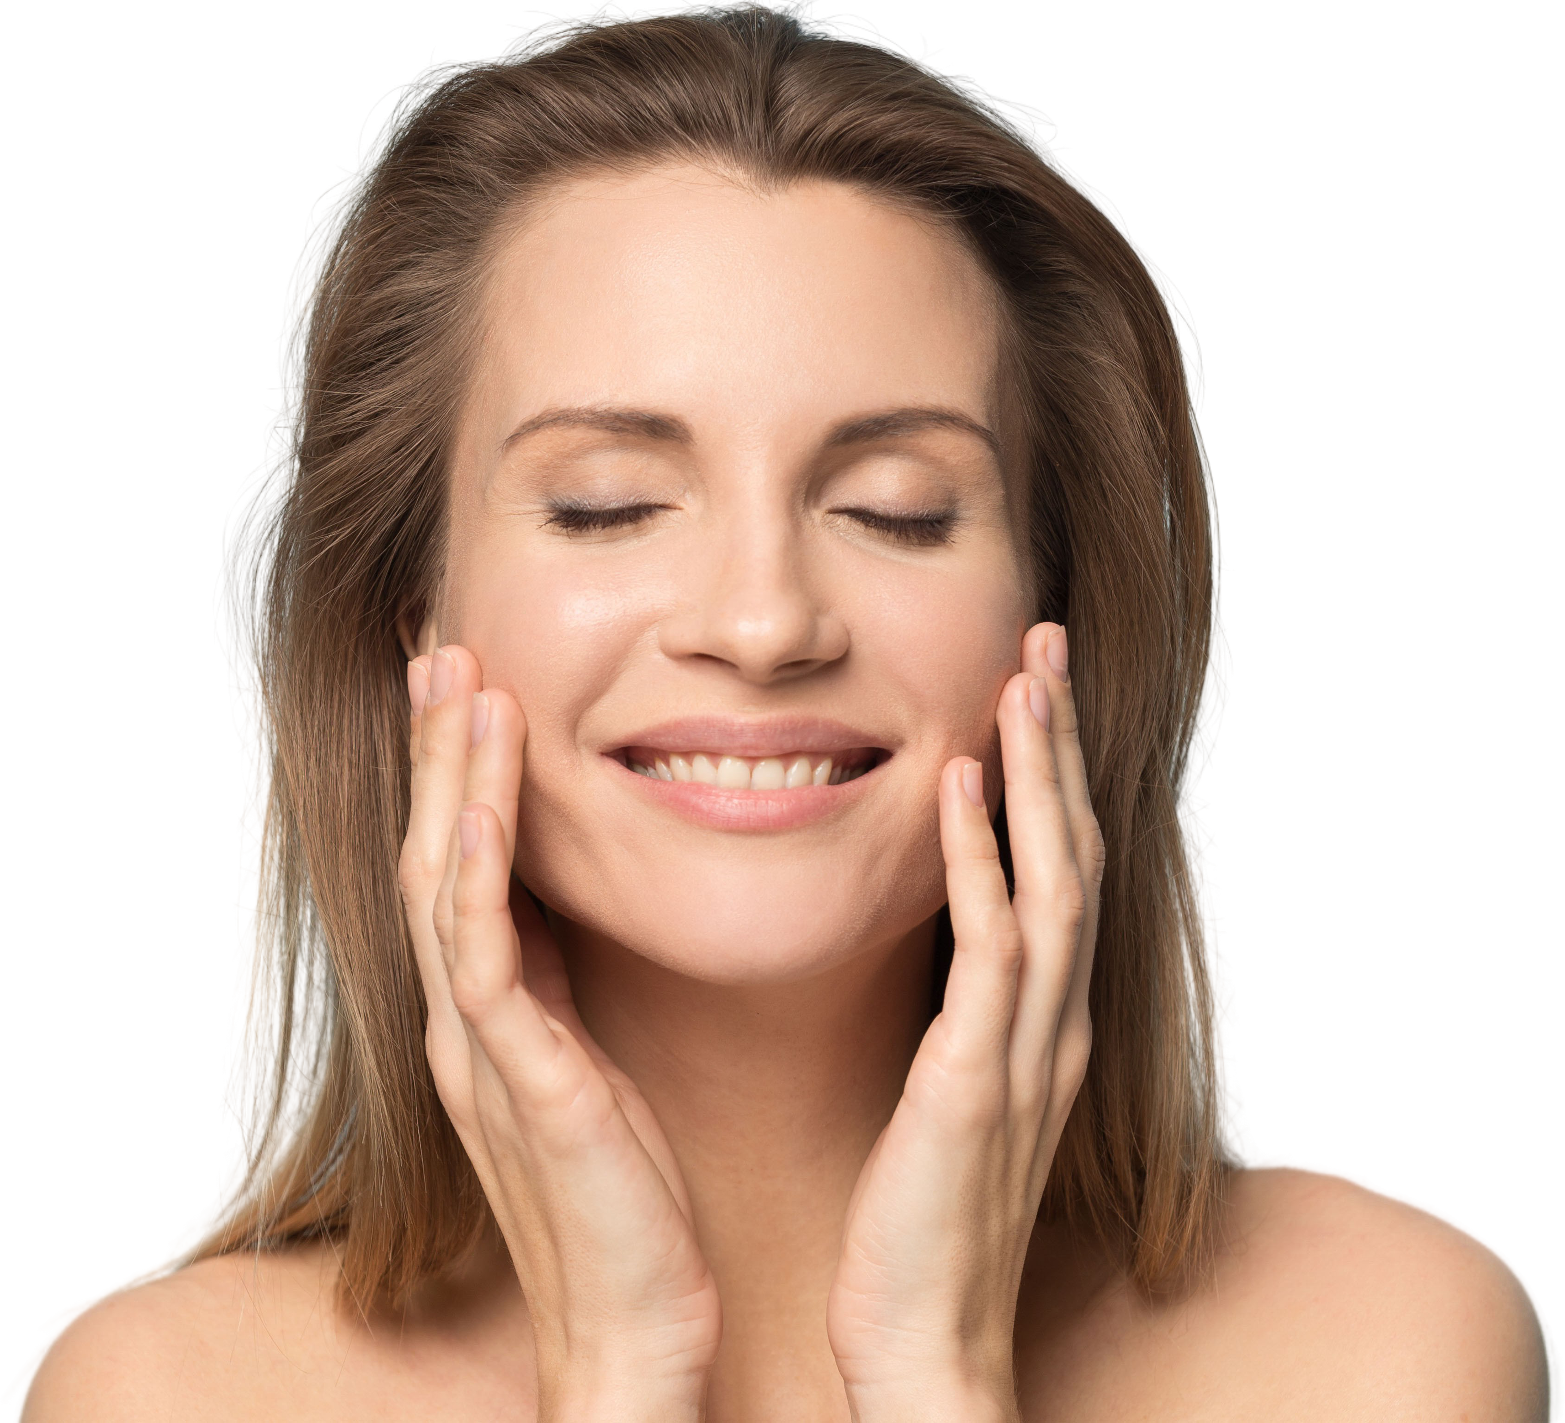
The enduring way to:
JetPeel way
Perform a Lymphatic Massage
Exfoliate
Infuse Skin Nutrients without Needles
Stimulate Collagen and Elastin Fibers
Tighten
Brighten
Eliminate Blemishes
Smooth Skin Imperfections

Slide 10
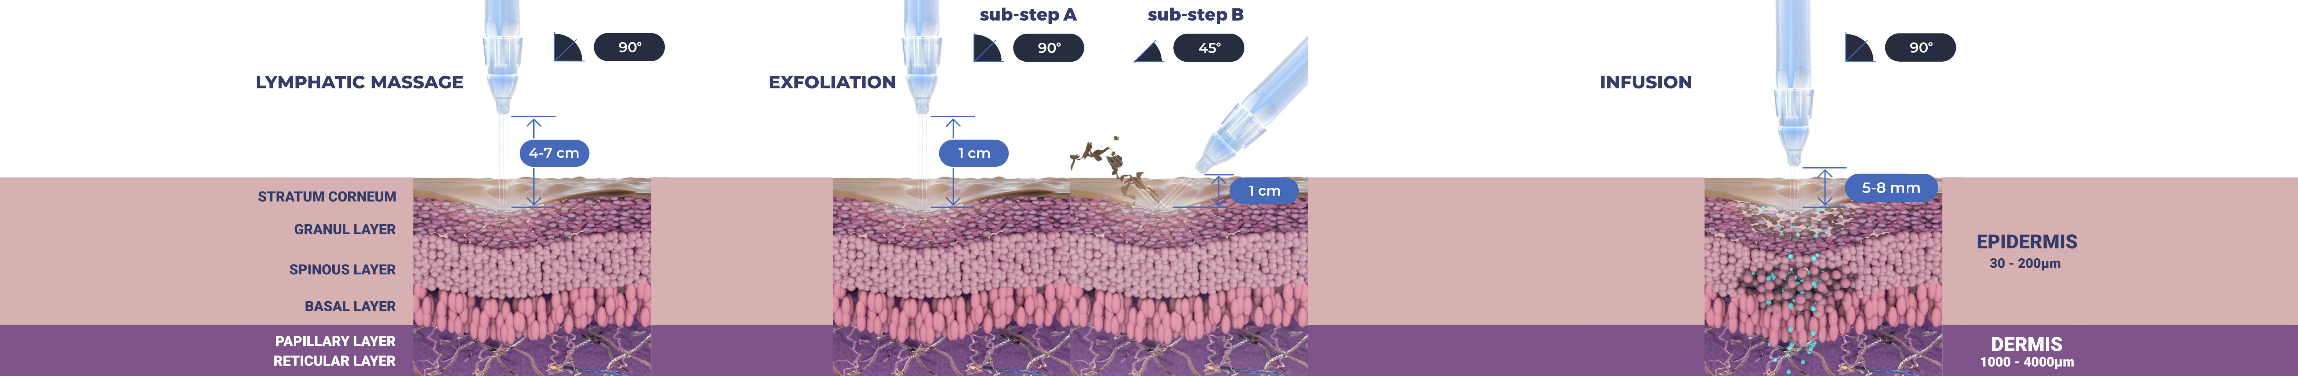
Treatment Sequence for Face and Body
The versatility of JetPeel: Face and Body
Unique jet pressure energy

Slide 11
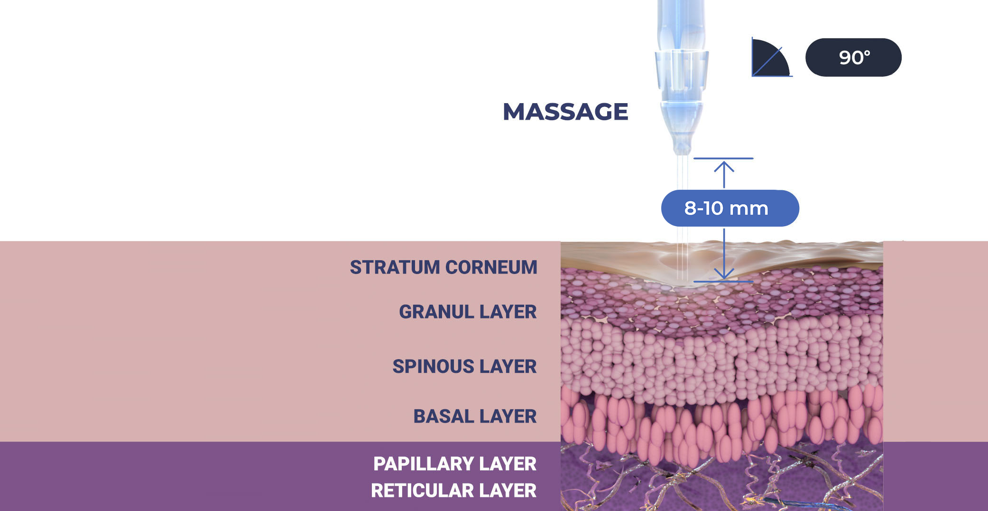

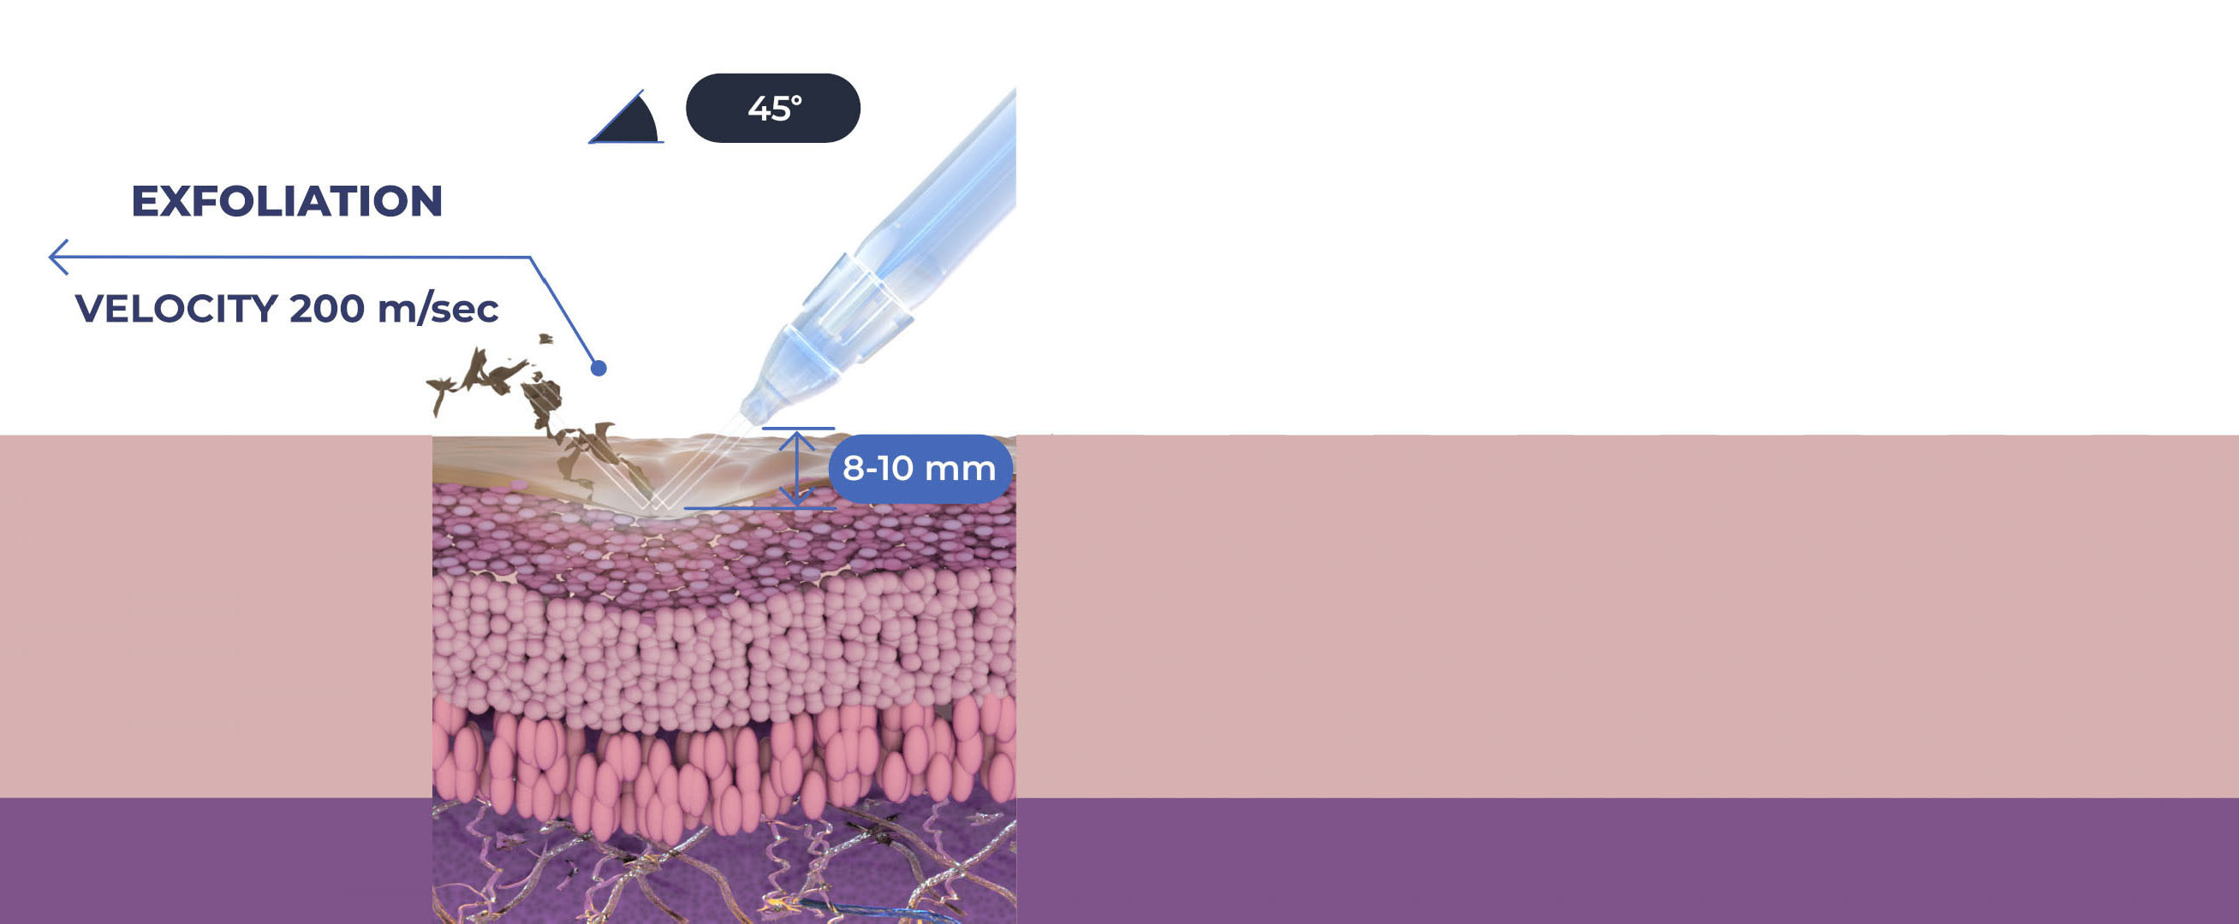
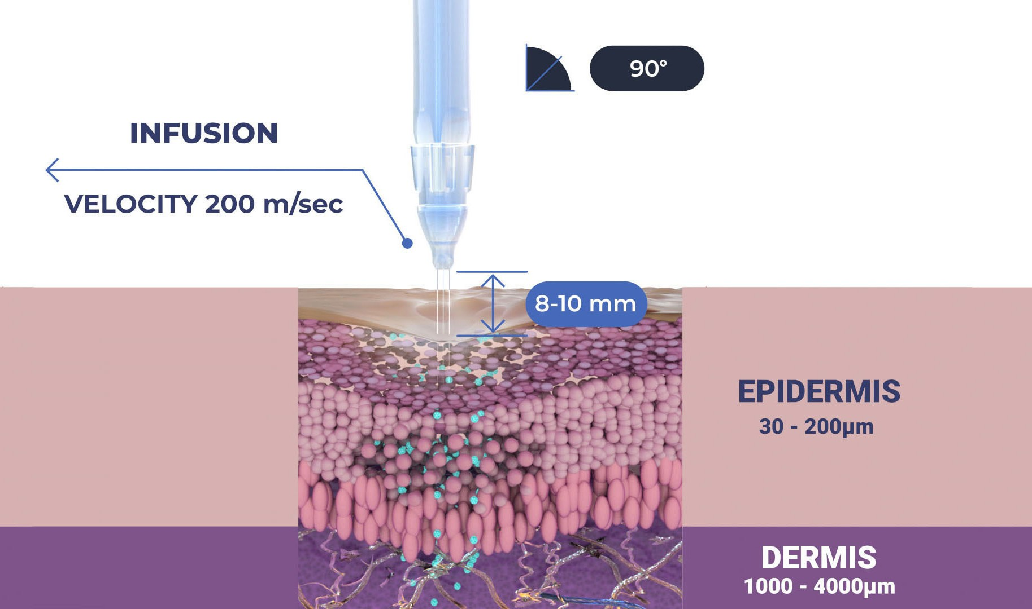

Treatment Sequence for Scalp and Hair
The versatility of JetPeel: Scalp and Hair
Unique jet pressure energy

Slide 12
The treatment sequence
STEP
1
STEP
2
STEP
3
STEP
4
LYMPHATIC
MASSAGE
GENTLE
EXFOLIATION
EFFECTIVE
INFUSION
BOOSTER
INFUSION
A pleasant and relaxing massage for detoxifying the skin and stimulating micro-circulation
Removing dead skin cells prepares the skin to receive the nourishment from the following Infusion Step
This step provides effective and deep delivery of active ingredients into the skin
Post-infusion step to amplify treatment result

Slide 13
The treatment sequence
STEP
1
STEP
2
STEP
3
STEP
4
LYMPHATIC
MASSAGE
GENTLE
EXFOLIATION
EFFECTIVE
INFUSION
BOOSTER
INFUSION
A pleasant and relaxing massage for detoxifying the skin and stimulating micro-circulation
Removing dead skin cells prepares the skin to receive the nourishment from the following Infusion Step
This step provides effective and deep delivery of active ingredients into the skin
Post-infusion step to amplify treatment result

Slide 14

Step 2 - Exfoliation with JetPeel
Exfoliation is a form of microdermabrasion using the JetPeel jet pressure energy system with JetCare solutions to hydrate the skin throughout the treatment
Exfoliation clears the dead skin cells (stratum corneum of the epidermis) revealing a smoother, more even texture of the skin and improving the skin appearance

Slide 15
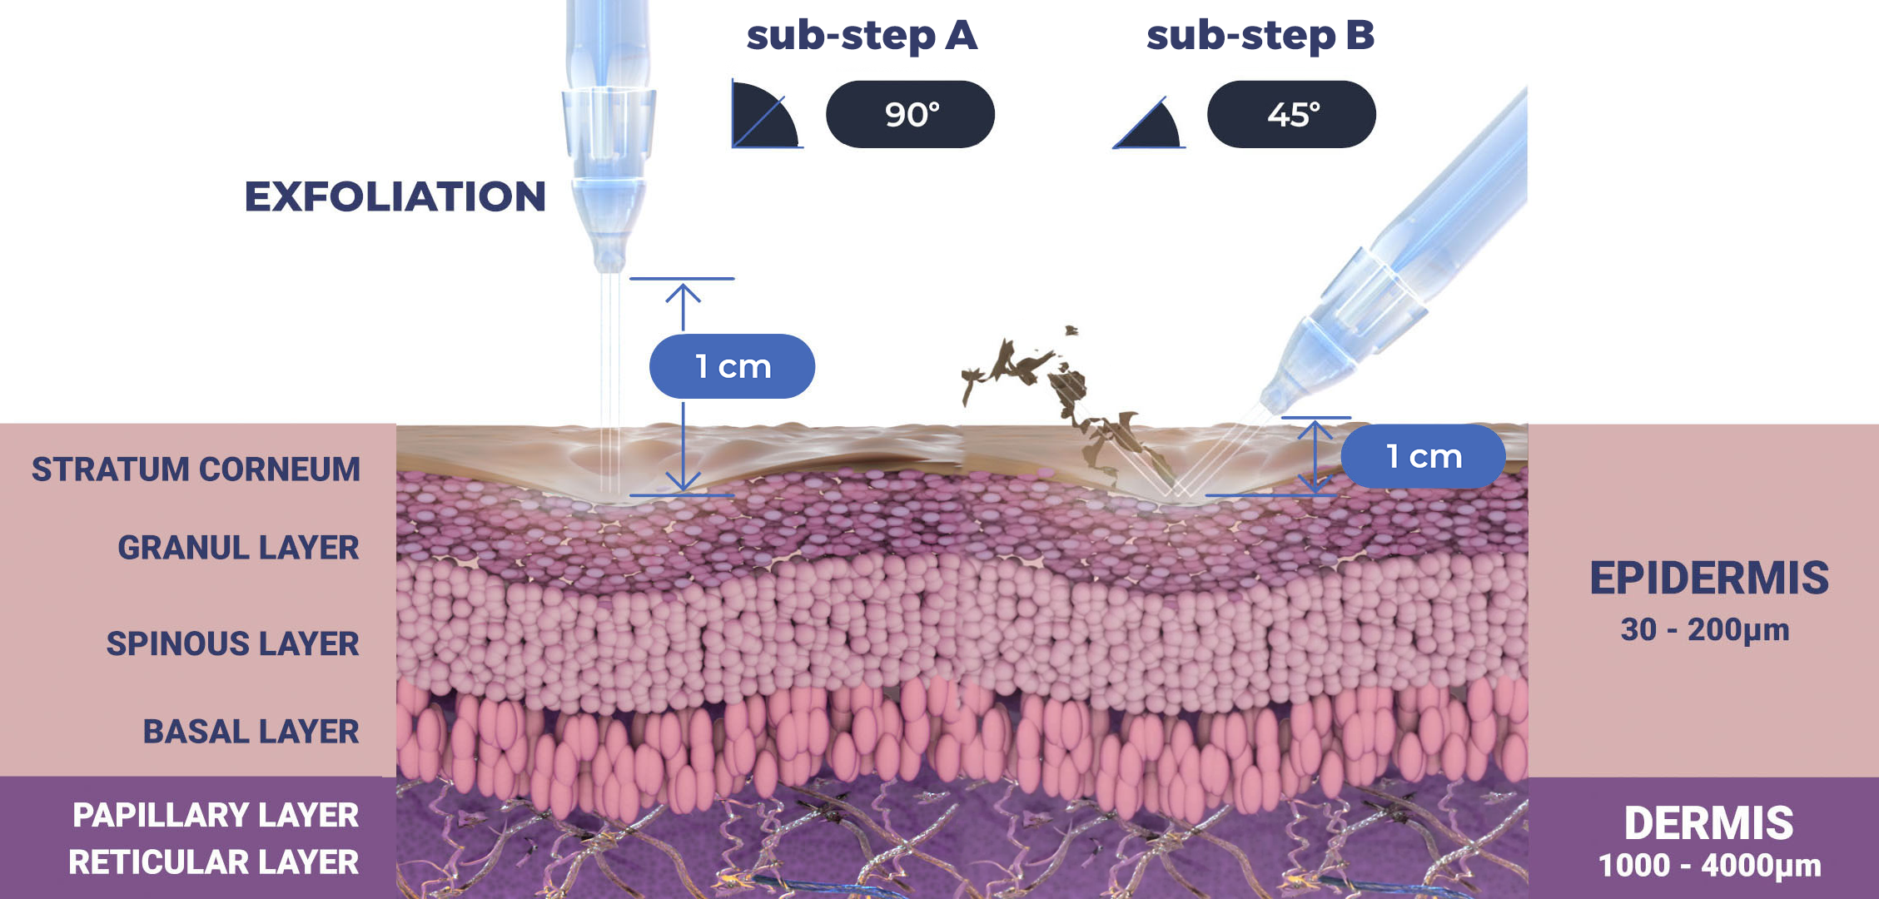
Step 2 - Exfoliation

Slide 16
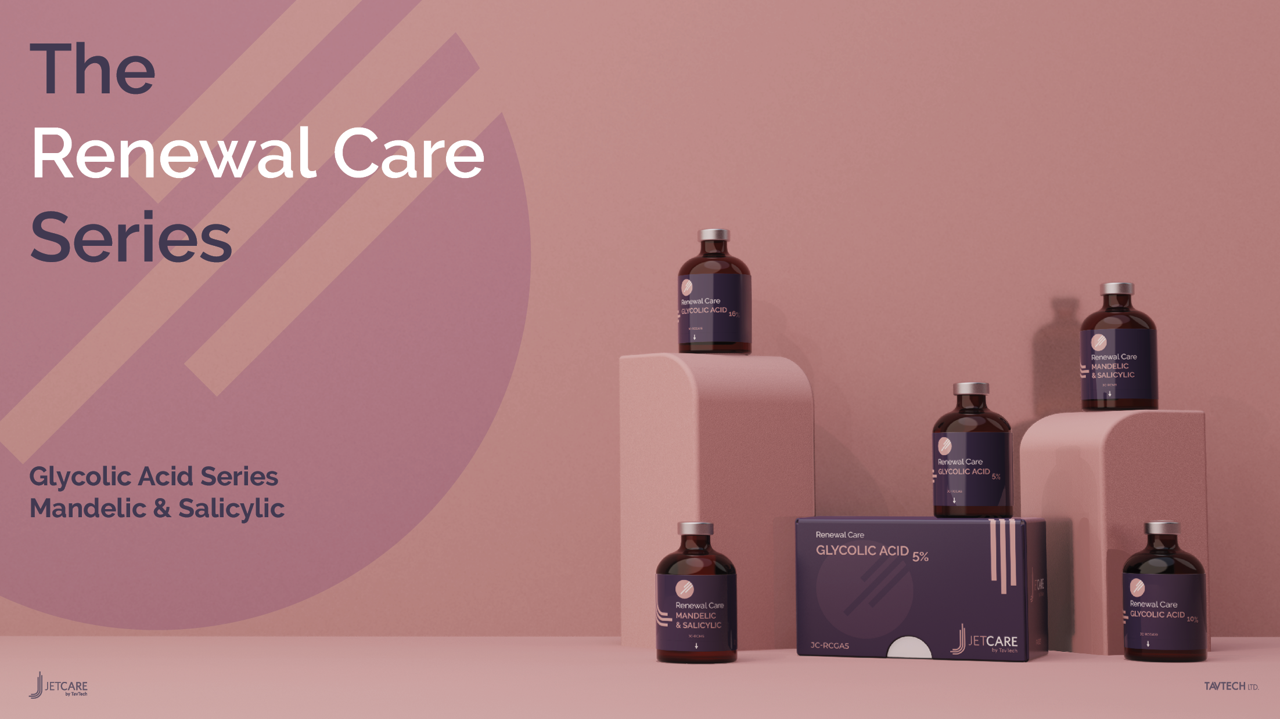

Slide 17
Technique
  According to the skin condition and desired exfoliation, use ~ 5 ml of either:
    Renewal Care Glycolic Acid 5%, or
    Renewal Care Glycolic Acid 10%, or
    Renewal Care Glycolic Acid 16%, or,
    Renewal Care Mandelic & Salicylic Acids
If exfoliating with Glycolic acid, leave on the skin for 5-8 minutes and only after that, wash with ~8ml of JetCare Hydro.
If exfoliating with Mandelic & Salicylic acids, then immediately after that, wash with ~8ml JetCare Hydro if necessary.
It is recommended to use the TripleJet handpiece.
For the exfoliation step - keep the handpiece at a 90° angle relative to the skin surface and keep 1cm from it.
For the washing step – keep the handpiece at a 45° - 60° angle relative to the skin surface 8-10mm from it.
Move in zigzag motions, covering the entire treatment area.
Duration of a complete facial exfoliation is about 5-7 minutes.

Slide 18
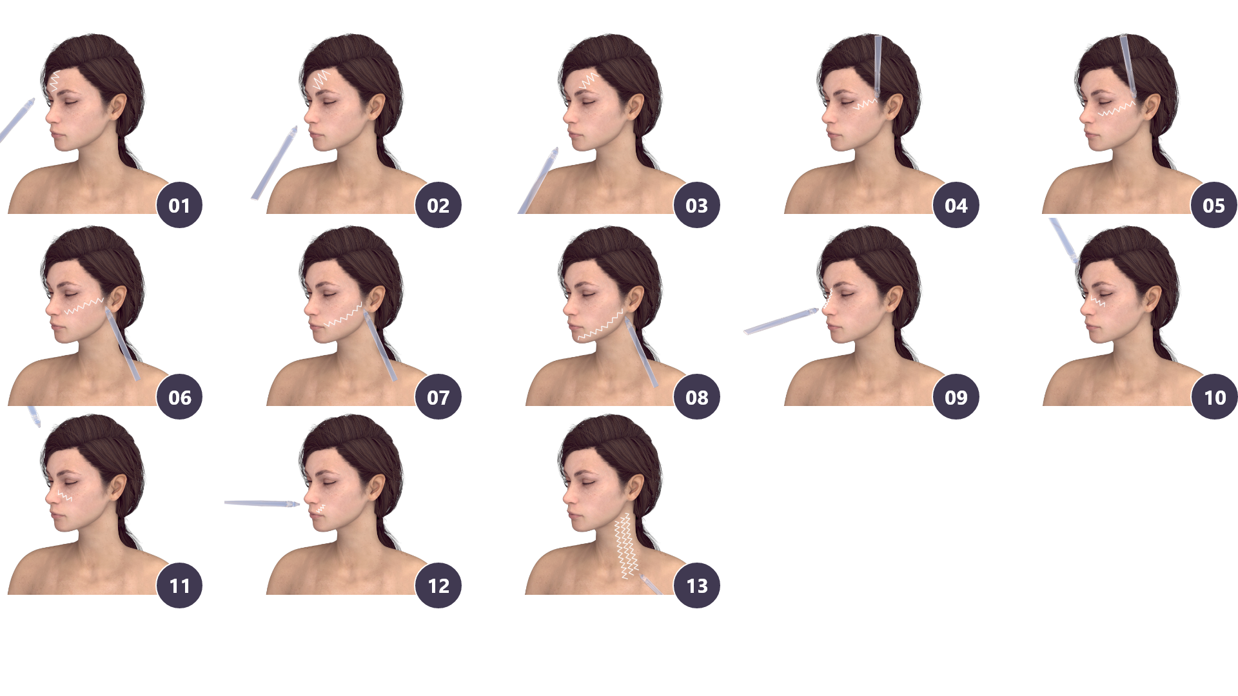
Exfoliation with JetPeel

Slide 19
Functionality
Evens out skin tone
Minimizes the size of the pores
Clears up blackheads
Improves skin texture, tone and elasticity
Better absorption of skin care products
Minimizes the appearance of stretch marks and scars
Reduces the appearance of fine lines and wrinkles
Reduces the appearance of skin spots caused by sun and age
Minimizes the appearance of acne scars and superficial scarring
Helps to boost collagen production to provide firming and toning to the complexion

Slide 20
Advantages
Exfoliation helps to diminish the appearance of superficial hyperpigmentation and photo-damage, as well as diminishing fine lines
Wrinkles, acne, large pores, and blackheads can be reduced
This procedure is gentle and very relaxing, without any discomfort
After exfoliation, the skin will appear bright and oxygenated, as well as feeling soft and hydrated
Oily skin will be less greasy, and pores may be shrunk. Puffy eyes can also be treated using exfoliation
An increase in circulation and lymph flow
Exfoliation allows the skin to better absorb skin care products, making them more effective
Exfoliation is preformed before infusing nourishments, as it prepares the skin and enhances penetration
After Exfoliation skin will be much more sensitive to sun exposure; after treatment it is best to keep out of the sun and wear sunscreen at all times

Slide 21
JetPeel Exfoliation tips
Can you do Exfoliation to sensitive skin?
1
Stretch the skin gently with the operator’s fingers to define the skin imperfections especially close to the eyes, forehead, and lips where naturally we can have more lines and wrinkles
Yes, you can!
This treatment is recommended also for those who have sensitive or very sensitive skin, unlike other exfoliation treatments.
Exfoliation with the JetPeel exfoliates the skin without peeling or breaking the skin.
Treat the wrinkles by following the horizontal and vertical direction of the wrinkle itself
2
For other imperfections such as scars, mature skin, stretch marks, spots, large pores, treat the area more than once
3

Slide 22
Contraindications
Open wounds
Severe sensitivity to cold
Skin neoplasms
Active cancer
Trigeminal nerve inflammation
Active sinusitis or laryngitis
Active herpes
Active bronchial asthma
Thrombosis
The system has not been tested or evaluated on pregnant or lactating women, nor on children and infants, therefore is not intended for use on these groups of users

Slide 23
JetPeel by TavTech
The perfect trio combining:
The enduring JetPro device
The original patented JetPeel handpieces
The premium JetCare solutions
Designed exclusively for use together to deliver outstanding results

Slide 24
For more information on Exfoliation Techniques with JetPeel check out the following presentations:
Exfoliation with JetPeel – Face & Neck

Slide 25
JetPeel by TavTech Training Program
1. JetPeel Technology and Solutions: Training Introduction
2. Lymphatic Massage with JetPeel
2.1. Lymphatic Massage with JetPeel – Face & Neck
2.2. Lymphatic Massage with JetPeel – Body
3. Exfoliation with JetPeel
3.1. Exfoliation with JetPeel – Face & Neck
4. Infusion with JetPeel
4.1. Infusion with JetPeel – Face & Neck
5. Scalp & Hair with JetPeel
6. JetPeel Handpieces

Slide 26
THANK YOU!

Slide 27
JetPeel by TavTech Academy

