Slide 1


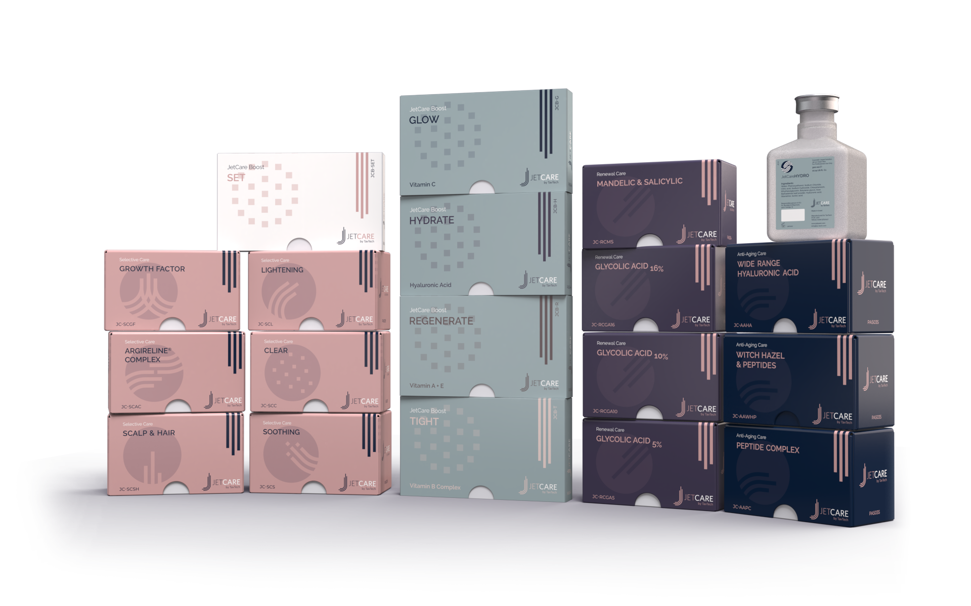
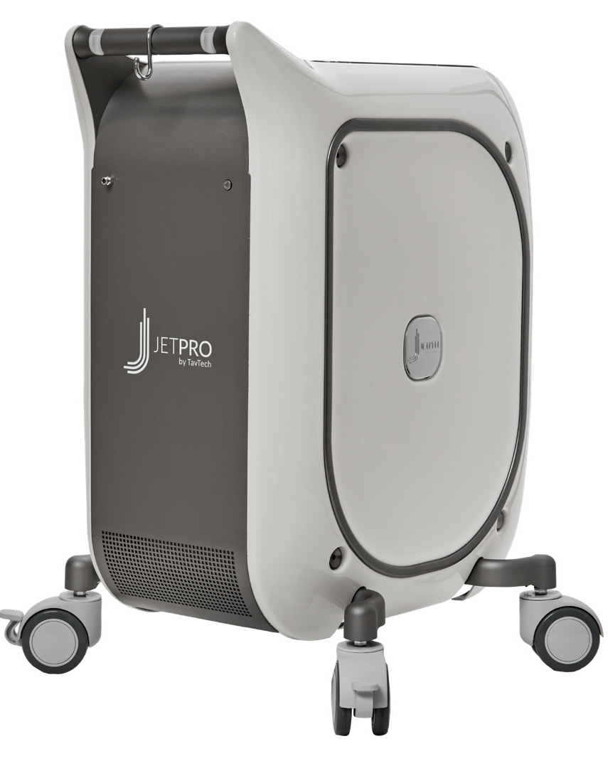
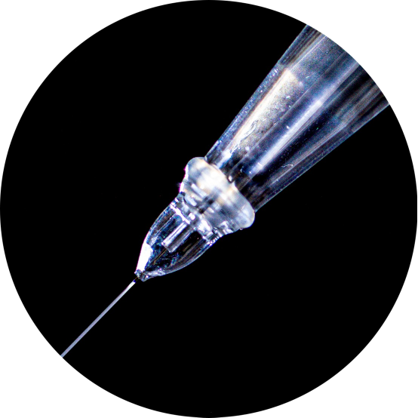
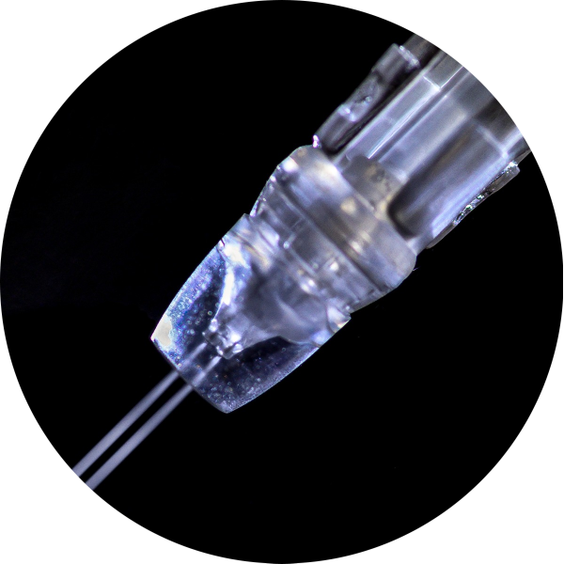
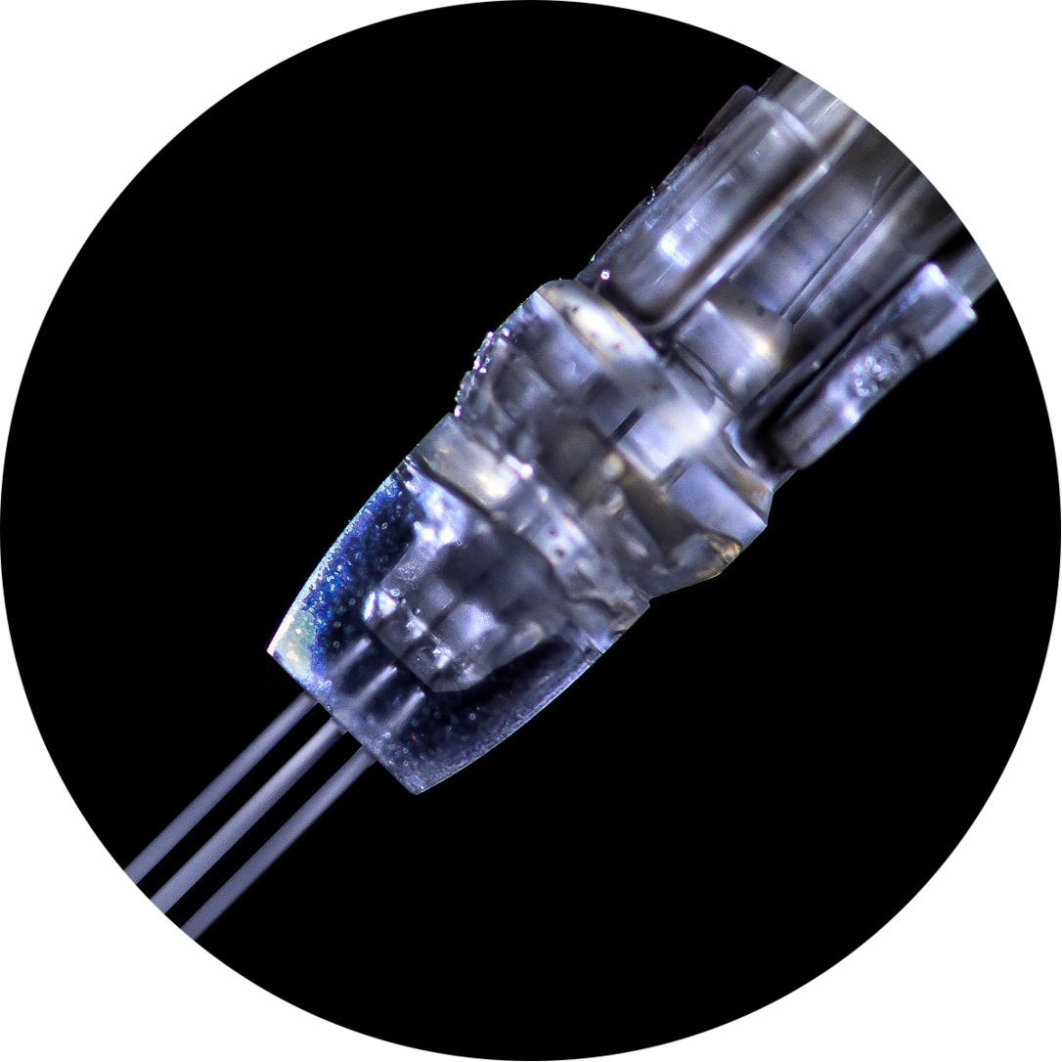
JetPeel by TavTech Academy

Slide 2



We provide people with an opportunity to become the best version of themselves
We believe in making people feel good …

Slide 3
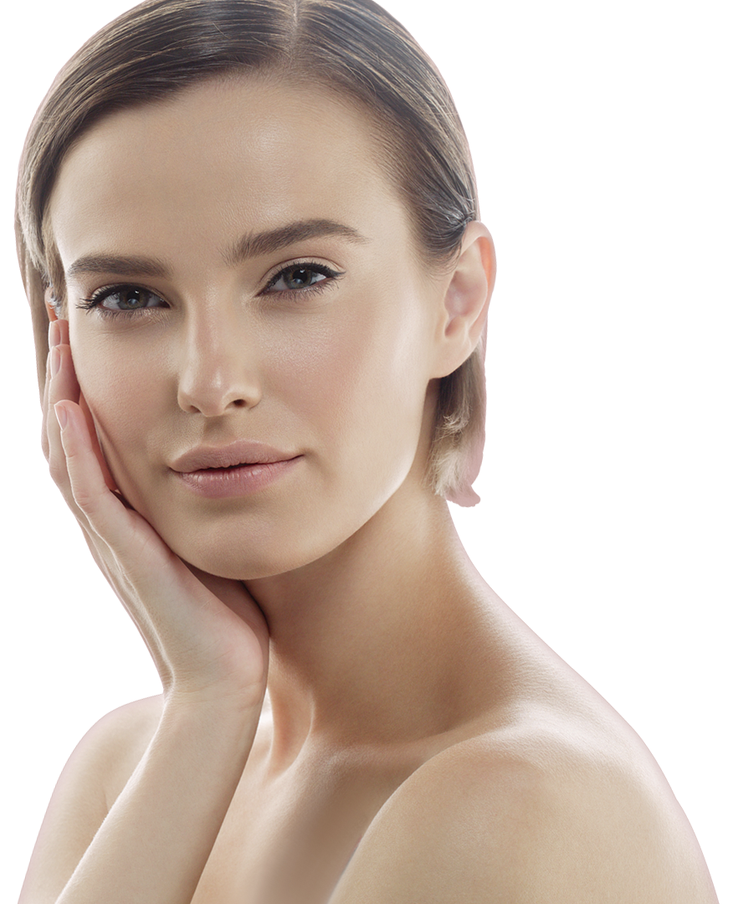
… by delivering
a powerful, instant-result treatment
Suitable for all skin types and all year-round

Slide 4
JetPeel by TavTech Training Program
1. JetPeel Technology and Solutions: Training Introduction
2. Lymphatic Massage with JetPeel
2.1. Lymphatic Massage with JetPeel – Face & Neck
2.2. Lymphatic Massage with JetPeel – Body
3. Exfoliation with JetPeel
3.1. Exfoliation with JetPeel – Face & Neck
4. Infusion with JetPeel
4.1. Infusion with JetPeel – Face & Neck
5. Scalp & Hair with JetPeel
6. JetPeel Handpieces

Slide 5
2.2. Lymphatic Massage with JetPeel
Body

Slide 6
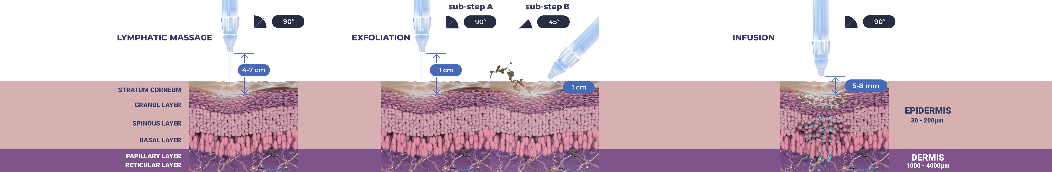
Treatment Sequence for Face and Body
The versatility of JetPeel: Face and Body
Unique jet pressure energy

Slide 7
The treatment sequence
STEP
1
STEP
2
STEP
3
STEP
4
LYMPHATIC
MASSAGE
GENTLE
EXFOLIATION
EFFECTIVE
INFUSION
BOOSTER
INFUSION
A pleasant and relaxing massage for detoxifying the skin and stimulating micro-circulation
Removing dead skin cells prepares the skin to receive the nourishment from the following Infusion Step
This step provides effective and deep delivery of active ingredients into the skin
Post-infusion step to amplify treatment result

Slide 8
The treatment sequence
STEP
1
STEP
2
STEP
3
STEP
4
LYMPHATIC
MASSAGE
GENTLE
EXFOLIATION
EFFECTIVE
INFUSION
BOOSTER
INFUSION
A pleasant and relaxing massage for detoxifying the skin and stimulating micro-circulation
Removing dead skin cells prepares the skin to receive the nourishment from the following Infusion Step
This step provides effective and deep delivery of active ingredients into the skin
Post-infusion step to amplify treatment result

Slide 9

Lymphatic massage with JetPeel
Lymphatic massage can be easily performed to improve circulation, soothing and hydration.
The energy-pressure derived jet stream of microdroplets applied by the non-contact handpiece delivers nutrients to the skin.
The special solution used for the lymphatic massage, JetCare Hydro contains: organic Aloe Vera, low molecular Hyaluronic Acid and Saline.
Lymphatic massage is a therapeutic jet massage treatment. The massage uses gentle pressure and long, gentle, rhythmic strokes to increase the flow of lymph and reduce toxins in your body. The lymph system is part of your body's immune system and helps fight infection.
Lymphatic massage can improve the skin texture by reducing swelling, puffiness and blotches providing clean, healthy pores.

Slide 10


Benefits of the cooling effect of the JetPeel lymphatic massage
The cooling jet sensation causes the lymph vessels to contract, forcing the lymphatic system to pump lymph fluids throughout the body, flushing the waste out of the area. It also activates the body’s natural healing powers that can relieve the symptoms of many medical conditions and promotes a sense of health and well-being, even providing long-lasting changes to your body’s immune, lymphatic, circulatory and digestive systems that enhance the overall quality of your life.

Slide 11
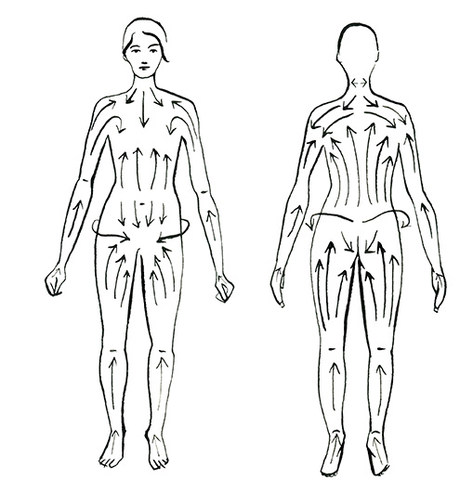
Lymph flow
Unlike blood, which flows throughout the body in a continuous loop, lymph flows in only one direction.
There is no pump pushing into lymphatic system, instead only the squeezing of skeletal muscles creating external pressure, to help lymphatic fluids move.
Image Source: Regency Clinic

Slide 12
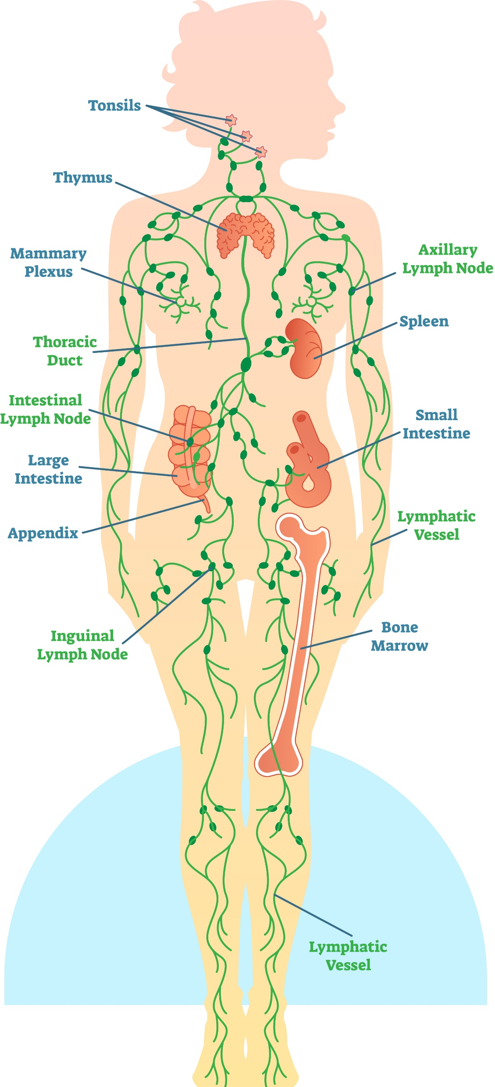
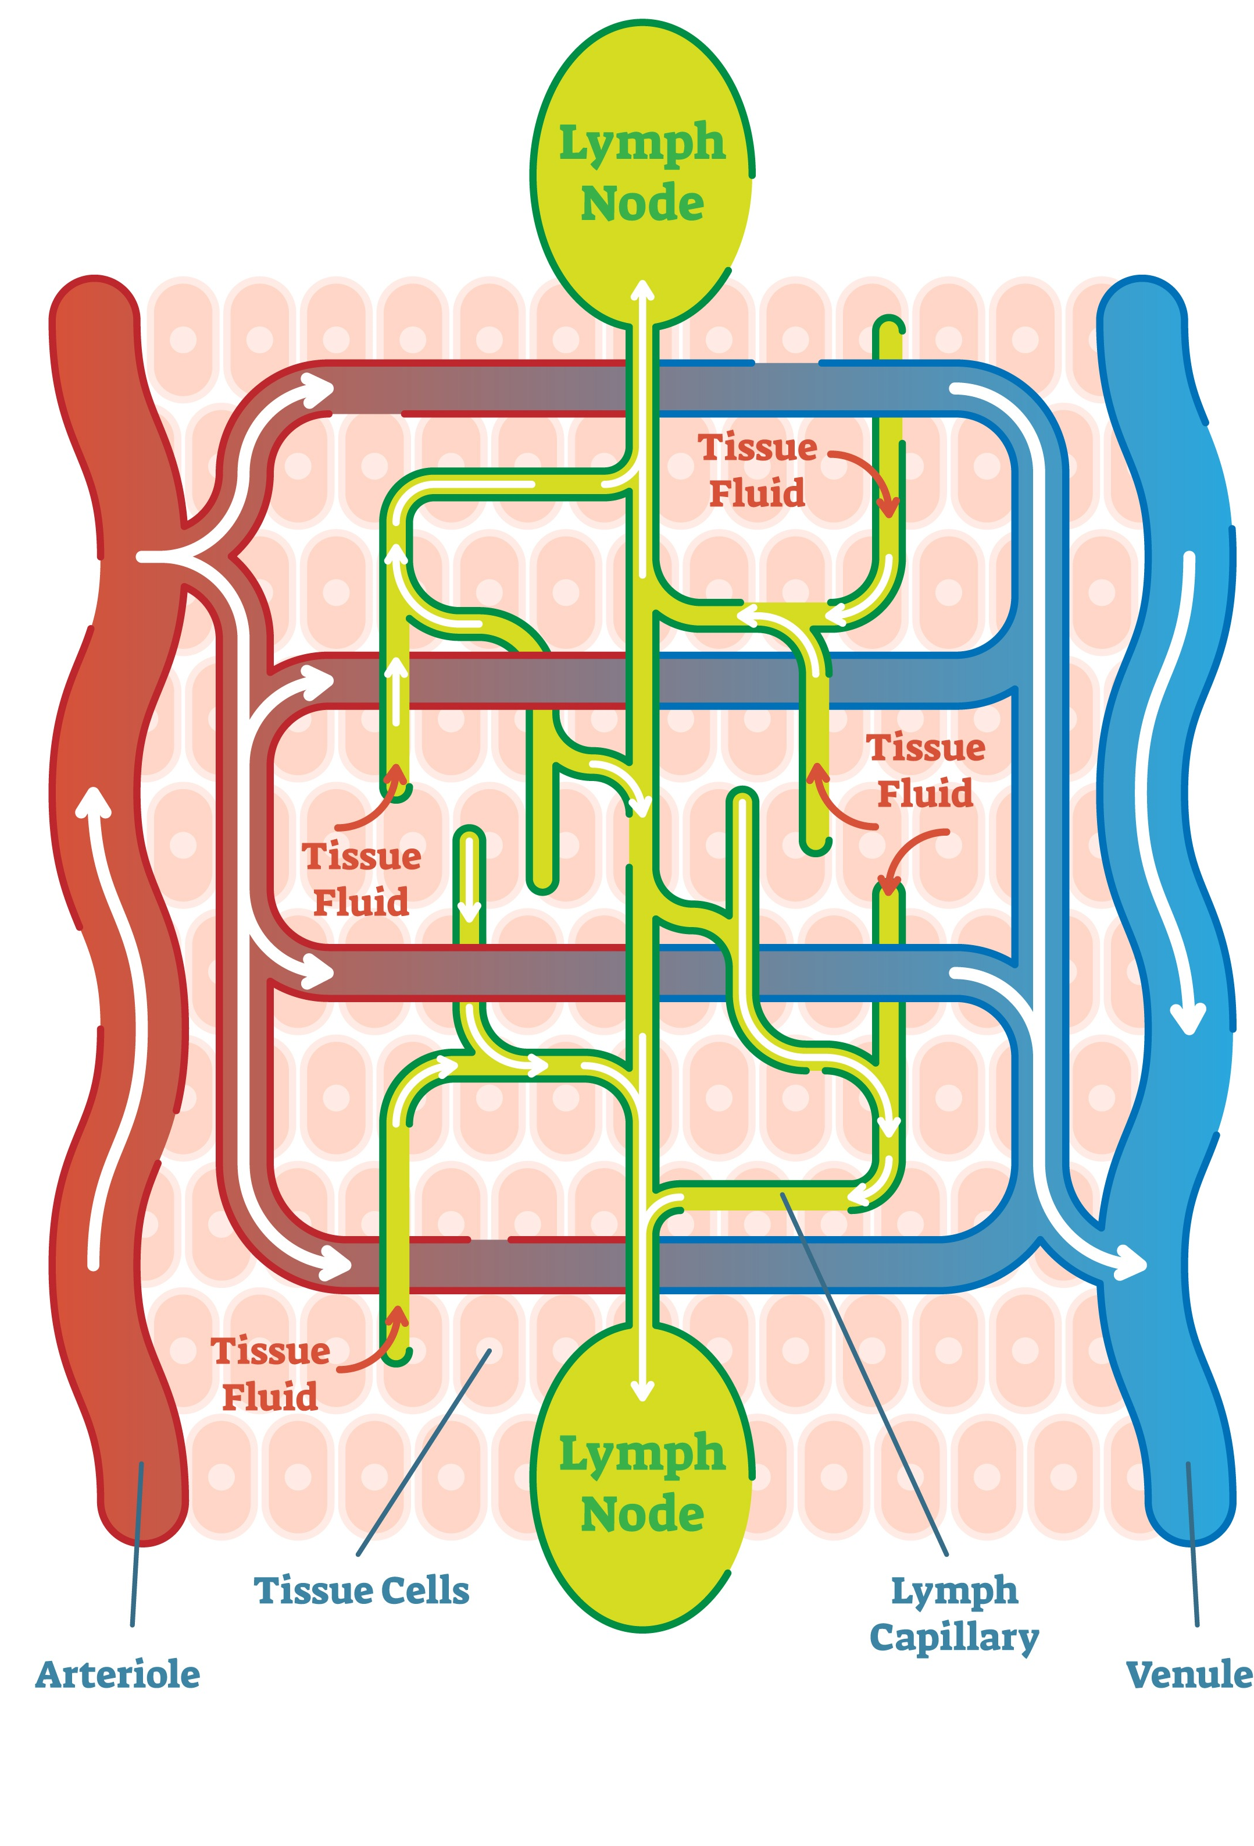
Body lymph nodes

Slide 13
Body
lymphatic massage
Technique & Sequence

Slide 14
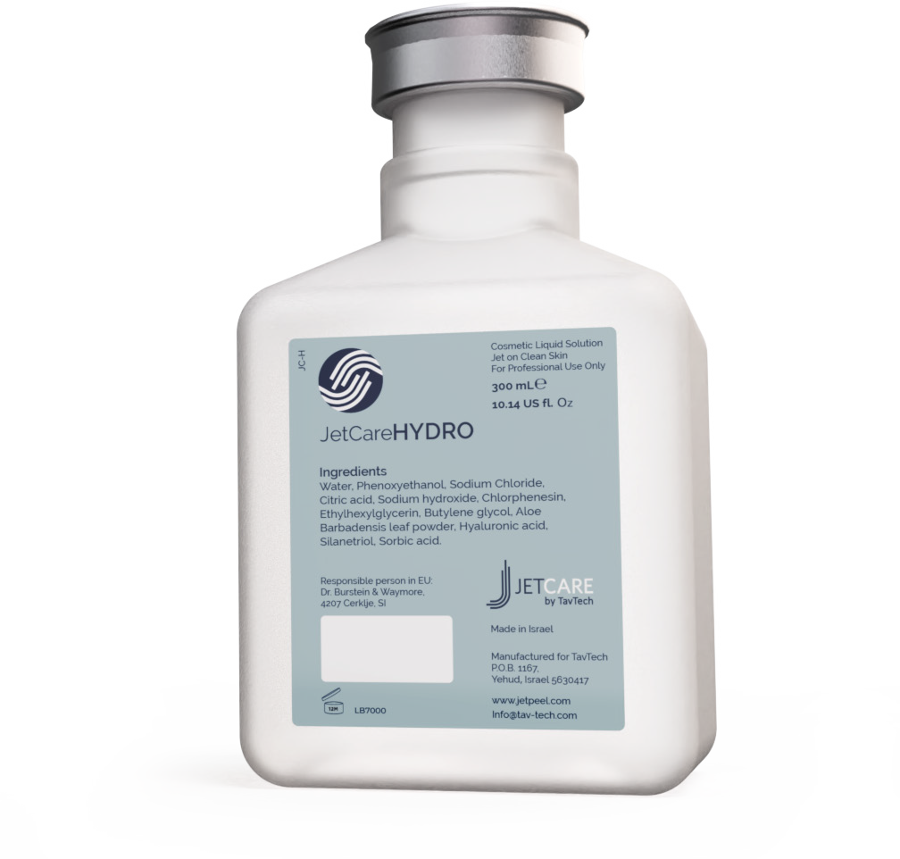
JetCareHYDRO
All JetPeel sessions begin with JetCare Hydro
Gentle solution formulated for the initial lymphatic massage, and to prep the skin for the deeper JetCare treatments
Hyaluronic Acid concentration reformulated, significantly higher than in former version
Enriched with higher concentrations of organic concentrated Aloe Vera
Solid plastic bottle, won’t puncture during transportation
300 ml - 20% more than in former version

Slide 15
Body
lymphatic massage
Technique & Sequence
The body treatment starts with massage of the collar bone area & the neck

Slide 16
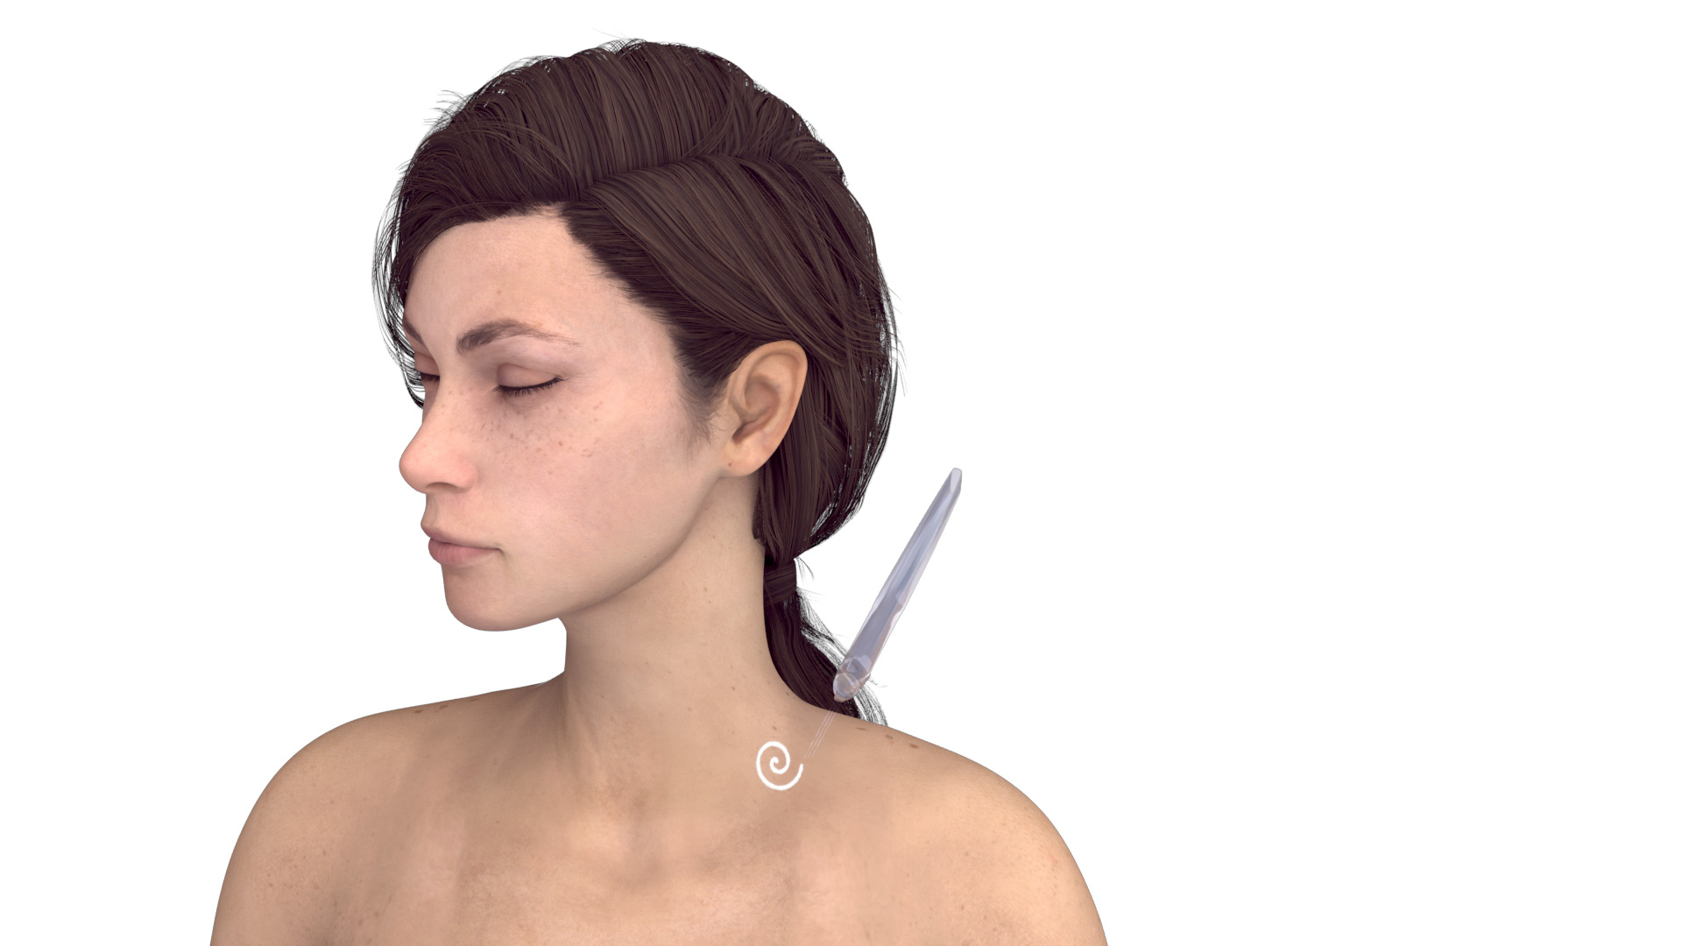
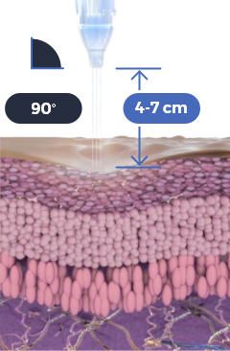

Use the TripleJet handpiece held at 90° to the skin and at 4-7 cm from the skin
Use JetCare Hydro
Repeat 3 times
Start and complete treatment on the left side, only then proceed to treat the right side
Try to keep a consistent pace during the massage

Slide 17




Use the TripleJet handpiece held at 90° to the skin and at 4-7 cm from the skin
Use JetCare Hydro
Repeat 3 times
Start and complete treatment on the left side, only then proceed to treat the right side
Try to keep a consistent pace during the massage

Slide 18
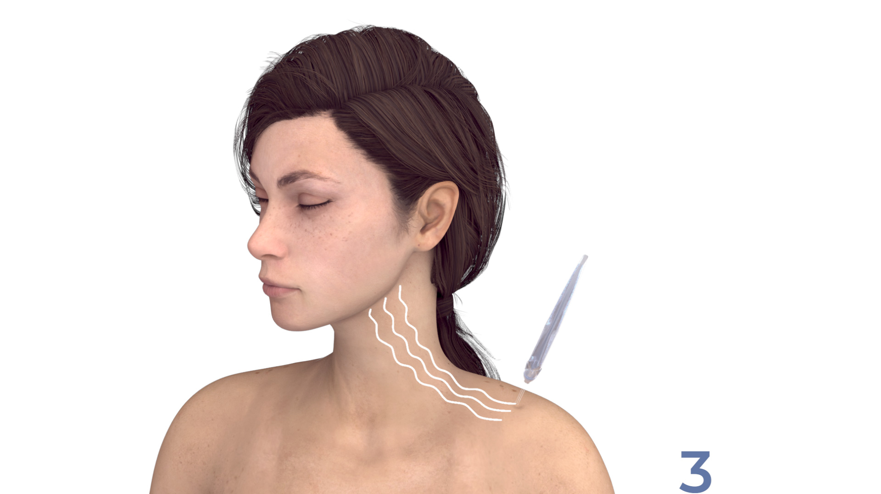



Use the TripleJet handpiece held at 90° to the skin and at 4-7 cm from the skin
Use JetCare Hydro
Repeat 3 times
Start and complete treatment on the left side, only then proceed to treat the right side
Try to keep a consistent pace during the massage

Slide 19


Use the TripleJet handpiece held at 90° to the skin and at 4-7 cm from the skin
Use JetCare Hydro
Repeat 3 times
Start and complete treatment on the left side, only then proceed to treat the right side
Try to keep a consistent pace during the massage

Slide 20
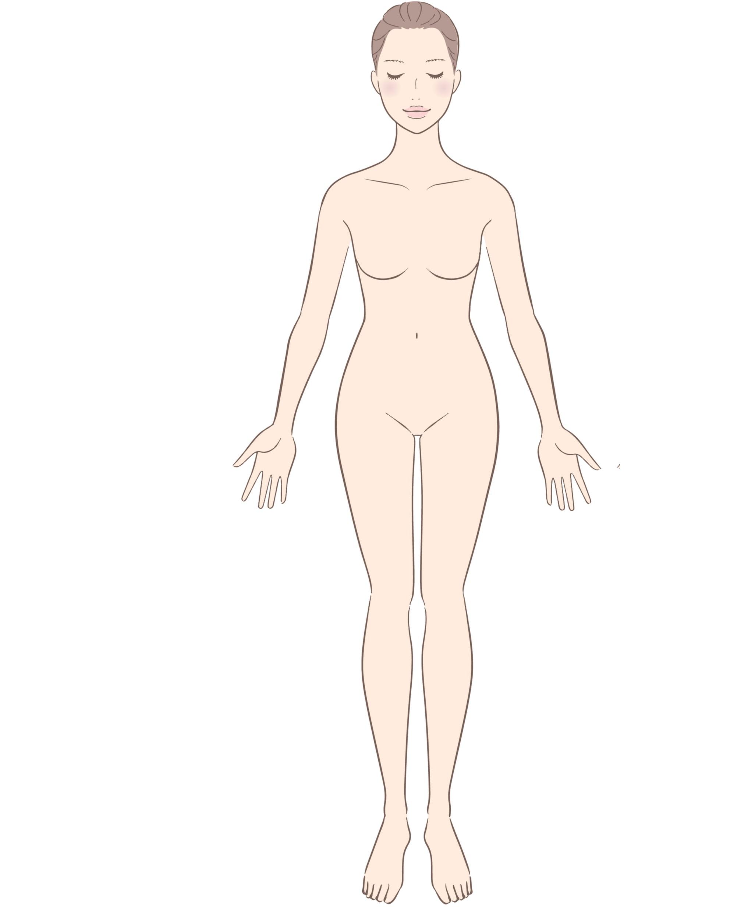
TREATMENT OF ARM
Treatment of the arms
Start from the left side – The patient is supine
Perform each movement 3 times, then repeat on the right arm
Armpit gland pump
Upper arm
Arm lymph nodes pumps
Forearm
Hand close to the wrist
Hand
Full Arm

Slide 21

Use the TripleJet handpiece held at 90° to the skin and at 4-7 cm from the skin
Use JetCare Hydro
TREATMENT OF ARM
Armpit Gland Pump
Repeat 3 times
The patient is supine
Start and complete treatment on the left side, only then proceed to treat the right side
Try to keep a consistent pace during the massage

Slide 22

Use the TripleJet handpiece held at 90° to the skin and at 4-7 cm from the skin
Use JetCare Hydro
TREATMENT OF THE ARM
Upper Arm
Repeat 3 times
The patient is supine
Start and complete treatment on the left side, only then proceed to treat the right side
Try to keep a consistent pace during the massage

Slide 23

Use the TripleJet handpiece held at 90° to the skin and at 4-7 cm from the skin
Use JetCare Hydro
TREATMENT OF THE ARM
Upper Arm
Repeat 3 times
The patient is supine
Start and complete treatment on the left side, only then proceed to treat the right side
Try to keep a consistent pace during the massage

Slide 24
Use the TripleJet handpiece held at 90° to the skin and at 4-7 cm from the skin
Use JetCare Hydro
TREATMENT OF THE ARM
Arm Lymph Nodes Pumps
Repeat 3 times
The patient is supine
Start and complete treatment on the left side, only then proceed to treat the right side
Try to keep a consistent pace during the massage

Slide 25

Use the TripleJet handpiece held at 90° to the skin and at 4-7 cm from the skin
Use JetCare Hydro
TREATMENT OF THE ARM
Forearm
Repeat 3 times
The patient is supine
Start and complete treatment on the left side, only then proceed to treat the right side
Try to keep a consistent pace during the massage

Slide 26

Use the TripleJet handpiece held at 90° to the skin and at 4-7 cm from the skin
Use JetCare Hydro
TREATMENT OF THE ARM
Forearm
Repeat 3 times
The patient is supine
Start and complete treatment on the left side, only then proceed to treat the right side
Try to keep a consistent pace during the massage

Slide 27

Use the TripleJet handpiece held at 90° to the skin and at 4-7 cm from the skin
Use JetCare Hydro
TREATMENT OF THE ARM
Hand Close to the Wrist
Repeat 3 times
The patient is supine
Start and complete treatment on the left side, only then proceed to treat the right side
Try to keep a consistent pace during the massage

Slide 28
Use the TripleJet handpiece held at 90° to the skin and at 4-7 cm from the skin
Use JetCare Hydro
TREATMENT OF THE ARM
Hand
Repeat 3 times
The patient is supine
Start and complete treatment on the left side, only then proceed to treat the right side
Try to keep a consistent pace during the massage

Slide 29

Use the TripleJet handpiece held at 90° to the skin and at 4-7 cm from the skin
Use JetCare Hydro
TREATMENT OF THE ARM
Full Arm
Start from the hand all the way up to the armpit
Repeat 3 times
The patient is supine
Start and complete treatment on the left side, only then proceed to treat the right side
Try to keep a consistent pace during the massage

Slide 30
TREATMENT OF THE ARM
Treatment of the arms
Repeat on the right arm
Perform each movement 3 times
Armpit gland pump
Upper arm
Arm lymph nodes pumps
Forearm
Hand close to the wrist
Hand
Full Arm

Slide 31

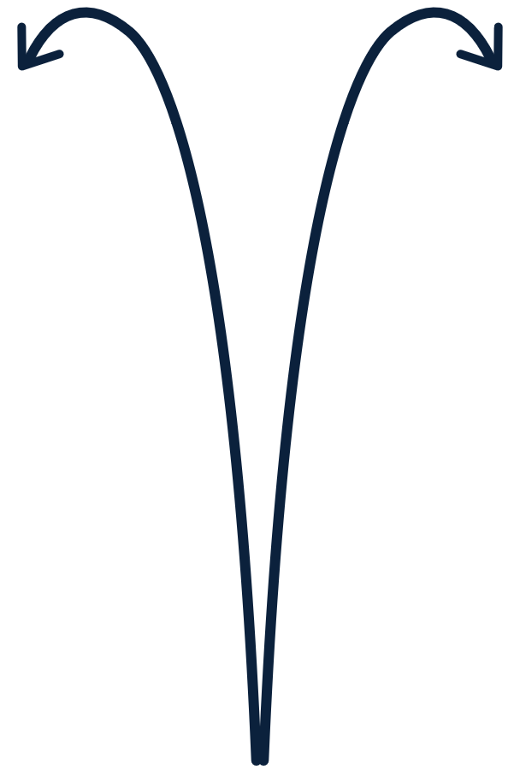
TREATMENT OF THE ABDOMEN
All movements are by hands, no jet in this area.
Along the Abdomen & Trunk – Long Effleurage
Use butterfly paired hands
Start from the hand all the way up to the armpit
Repeat at least 3 times
The patient is supine
Try to keep a consistent pace during the massage

Slide 32

TREATMENT OF THE ABDOMEN
All movements are by hands, no jet in this area.
Along the Abdomen & Trunk – Long Effleurage
Use butterfly paired hands
Repeat at least 3 times
The patient is supine
Try to keep a consistent pace during the massage

Slide 33
TREATMENT OF THE LEG
Treatment of the legs
Start from the left side
Perform each movement 3 times, then repeat on the right leg
Pump technique groin
Upper part of the leg
Knees
Lower part of the leg
Foot
Full Leg

Slide 34

Use the TripleJet handpiece held at 90° to the skin and at 4-7 cm from the skin
Use JetCare Hydro
TREATMENT OF THE LEG
Groin
Repeat 3 times
The patient is supine
Start and complete treatment on the left side, only then proceed to treat the right side
Try to keep a consistent pace during the massage

Slide 35
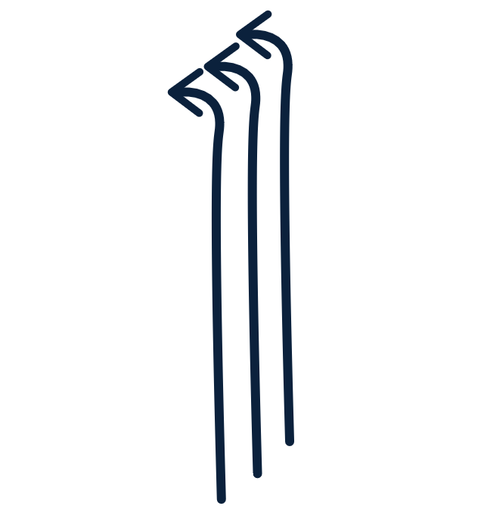
Use the TripleJet handpiece held at 90° to the skin and at 4-7 cm from the skin
Use JetCare Hydro
TREATMENT OF THE LEG
Upper Leg
Repeat 3 times
The patient is supine
Start and complete treatment on the left side, only then proceed to treat the right side
Try to keep a consistent pace during the massage

Slide 36

Use the TripleJet handpiece held at 90° to the skin and at 4-7 cm from the skin
Use JetCare Hydro
TREATMENT OF THE LEG
Upper Leg
Repeat 3 times
The patient is supine
Start and complete treatment on the left side, only then proceed to treat the right side
Try to keep a consistent pace during the massage

Slide 37
Use the TripleJet handpiece held at 90° to the skin and at 4-7 cm from the skin
Use JetCare Hydro
TREATMENT OF THE LEG
Lower Leg
Repeat 3 times
The patient is supine
Start and complete treatment on the left side, only then proceed to treat the right side
Try to keep a consistent pace during the massage

Slide 38

Use the TripleJet handpiece held at 90° to the skin and at 4-7 cm from the skin
Use JetCare Hydro
TREATMENT OF THE LEG
Lower Leg
Repeat 3 times
The patient is supine
Start and complete treatment on the left side, only then proceed to treat the right side
Try to keep a consistent pace during the massage

Slide 39

Use the TripleJet handpiece held at 90° to the skin and at 4-7 cm from the skin
Use JetCare Hydro
TREATMENT OF THE LEG
Foot
Repeat 3 times
The patient is supine
Start and complete treatment on the left side, only then proceed to treat the right side
Try to keep a consistent pace during the massage

Slide 40
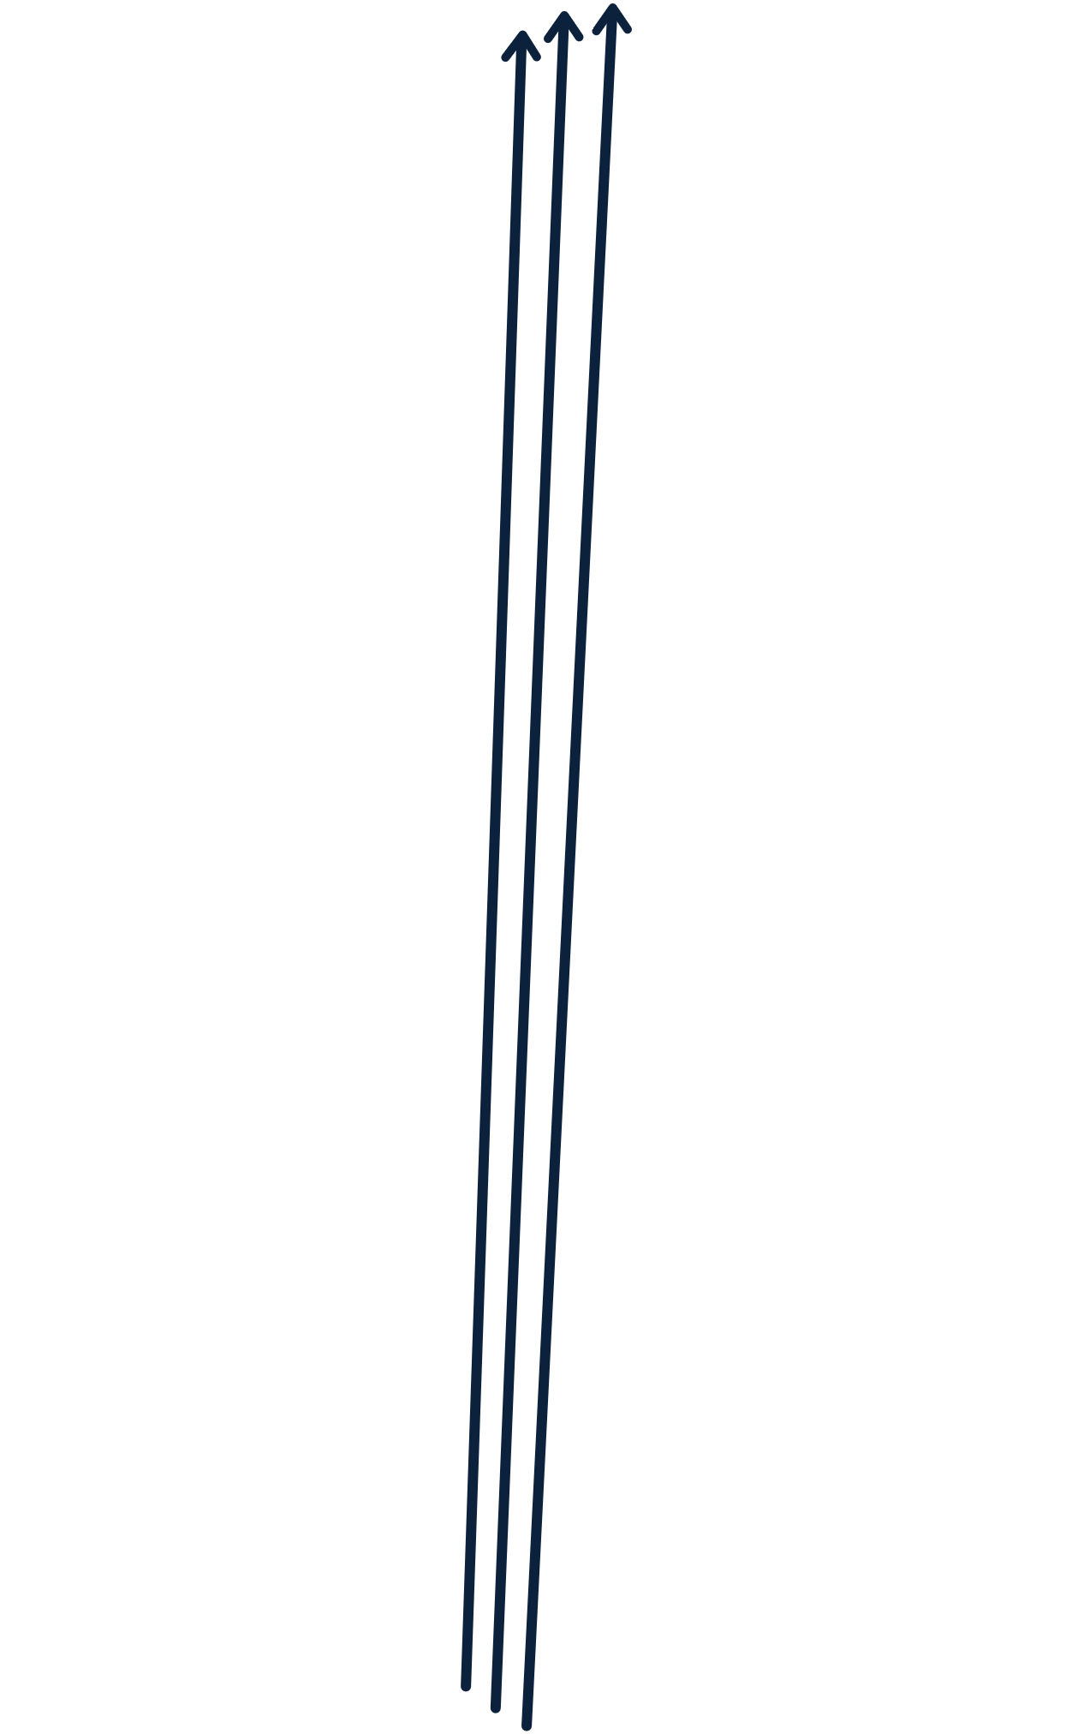
Use the TripleJet handpiece held at 90° to the skin and at 4-7 cm from the skin
Use JetCare Hydro
TREATMENT OF THE LEG
Full Leg
Start from the foot
Repeat 3 times
The patient is supine
Start and complete treatment on the left side, only then proceed to treat the right side
Try to keep a consistent pace during the massage

Slide 41
TREATMENT OF THE LEG
Treatment of the legs
Repeat on the right leg
Perform each movement 3 times
Pump technique groin
Upper part of the leg
Knees
Lower part of the leg
Foot
Full Leg

Slide 42
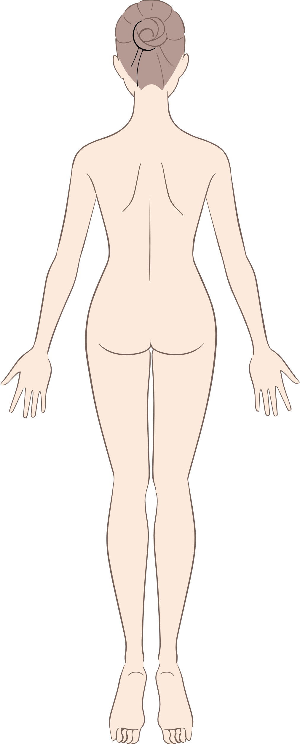
TREATMENT OF THE BACK
Treatment of the back
Patient is prone
Perform each movement 3 times
Back of the head
Shoulders
Left intercostal spaces with paired hands
Right intercostal spaces with paired hands

Slide 43

Use the TripleJet handpiece held at 90° to the skin and at 4-7 cm from the skin
Use JetCare Hydro
TREATMENT OF THE BACK
Back of the Head
Fingers follow the jet
Repeat 3 times
The patient is supine
Try to keep a consistent pace during the massage

Slide 44
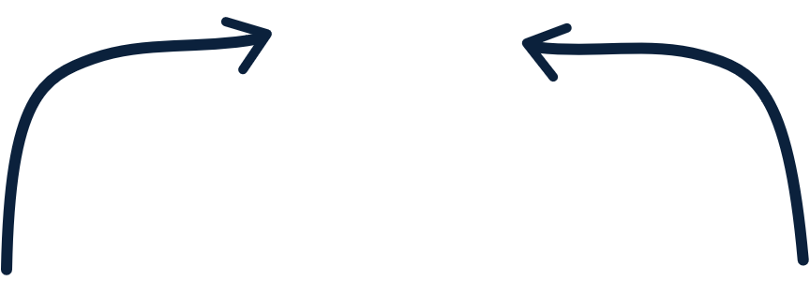
Use the TripleJet handpiece held at 90° to the skin and at 4-7 cm from the skin
Use JetCare Hydro
TREATMENT OF THE BACK
Shoulders
Fingers follow the jet
Repeat 3 times
The patient is supine
Try to keep a consistent pace during the massage

Slide 45
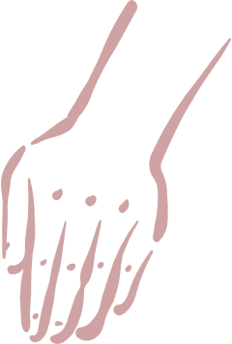

TREATMENT OF THE BACK
All movements are by hands, no jet in this area.
Left Intercostal Spaces
Repeat 3 times
Use butterfly paired hands
The patient is supine
3
2
1
Try to keep a consistent pace during the massage

Slide 46

TREATMENT OF THE BACK
All movements are by hands, no jet in this area.
Right Intercostal Spaces
Repeat 3 times
Use butterfly paired hands
The patient is supine
3
2
1
Try to keep a consistent pace during the massage

Slide 47
TREATMENT OF THE LEGS
Treatment of the back of the legs
Start from the right side - Patient is prone
Perform each movement 3 times
Upper part of the leg
Popliteal fossa
Lower part of the leg
Foot
Full Leg

Slide 48
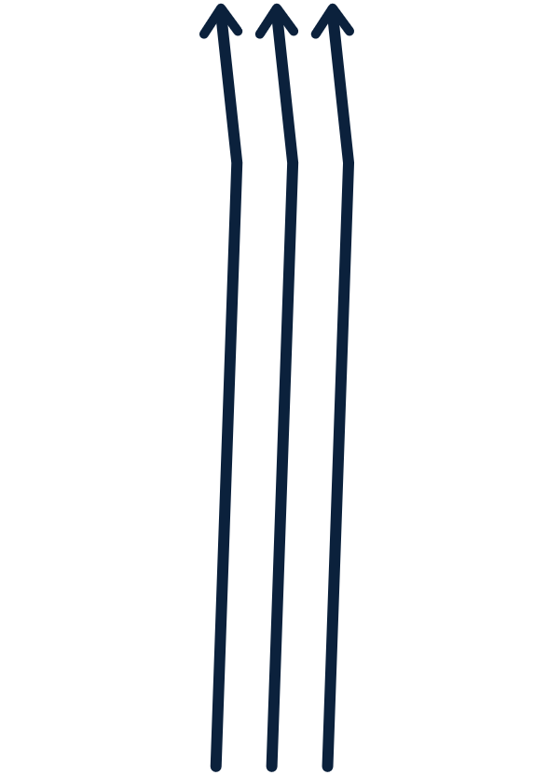
Use the TripleJet handpiece held at 90° to the skin and at 4-7 cm from the skin
Use JetCare Hydro
TREATMENT OF THE LEGS
Upper Leg
Repeat 3 times
The patient is supine
Start and complete treatment on the left side, only then proceed to treat the right side
Try to keep a consistent pace during the massage

Slide 49
Use the TripleJet handpiece held at 90° to the skin and at 4-7 cm from the skin
Use JetCare Hydro
TREATMENT OF THE LEGS
Upper Leg
Repeat 3 times
The patient is supine
Start and complete treatment on the left side, only then proceed to treat the right side
Try to keep a consistent pace during the massage

Slide 50
Use the TripleJet handpiece held at 90° to the skin and at 4-7 cm from the skin
Use JetCare Hydro
TREATMENT OF THE LEGS
Popliteal Fossa
Repeat 3 times
The patient is supine
Start and complete treatment on the left side, only then proceed to treat the right side
Try to keep a consistent pace during the massage

Slide 51
Use the TripleJet handpiece held at 90° to the skin and at 4-7 cm from the skin
Use JetCare Hydro
TREATMENT OF THE LEGS
Lower Leg
Repeat 3 times
The patient is supine
Start and complete treatment on the left side, only then proceed to treat the right side
Try to keep a consistent pace during the massage

Slide 52
Use the TripleJet handpiece held at 90° to the skin and at 4-7 cm from the skin
Use JetCare Hydro
TREATMENT OF THE LEGS
Lower Leg
Repeat 3 times
The patient is supine
Start and complete treatment on the left side, only then proceed to treat the right side
Try to keep a consistent pace during the massage

Slide 53
Use the TripleJet handpiece held at 90° to the skin and at 4-7 cm from the skin
Use JetCare Hydro
TREATMENT OF THE LEGS
Foot
Repeat 3 times
The patient is supine
Start and complete treatment on the left side, only then proceed to treat the right side
Try to keep a consistent pace during the massage

Slide 54
Use the TripleJet handpiece held at 90° to the skin and at 4-7 cm from the skin
Use JetCare Hydro
TREATMENT OF THE LEGS
Full Leg
Start from the foot
Repeat 3 times
The patient is supine
Start and complete treatment on the left side, only then proceed to treat the right side
Try to keep a consistent pace during the massage

Slide 55
TREATMENT OF THE LEGS
Treatment of the back of the legs
Repeat on the left leg
Perform each movement 3 times
Upper part of the leg
Popliteal fossa
Lower part of the leg
Foot
Full Leg

Slide 56
Contraindications
Open wounds
Severe sensitivity to cold
Skin neoplasms
Active cancer
Trigeminal nerve inflammation
Active sinusitis or laryngitis
Active herpes
Active bronchial asthma
Thrombosis
The system has not been tested or evaluated on pregnant or lactating women, nor on children and infants, therefore is not intended for use on these groups of users

Slide 57
JetPeel by TavTech
The perfect trio combining:
The enduring JetPro device
The original patented JetPeel handpieces
The premium JetCare solutions
Designed exclusively for use together to deliver outstanding results

Slide 58
For more information on Lymphatic Massage Techniques with JetPeel check out the following presentations:
Lymphatic Massage with
JetPeel – Face & Neck

Slide 59
JetPeel by TavTech Training Program
1. JetPeel Technology and Solutions: Training Introduction
2. Lymphatic Massage with JetPeel
2.1. Lymphatic Massage with JetPeel – Face & Neck
2.2. Lymphatic Massage with JetPeel – Body
3. Exfoliation with JetPeel
3.1. Exfoliation with JetPeel – Face & Neck
4. Infusion with JetPeel
4.1. Infusion with JetPeel – Face & Neck
5. Scalp & Hair with JetPeel
6. JetPeel Handpieces

Slide 60
THANK YOU!

Slide 61
JetPeel by TavTech Academy

