Slide 1


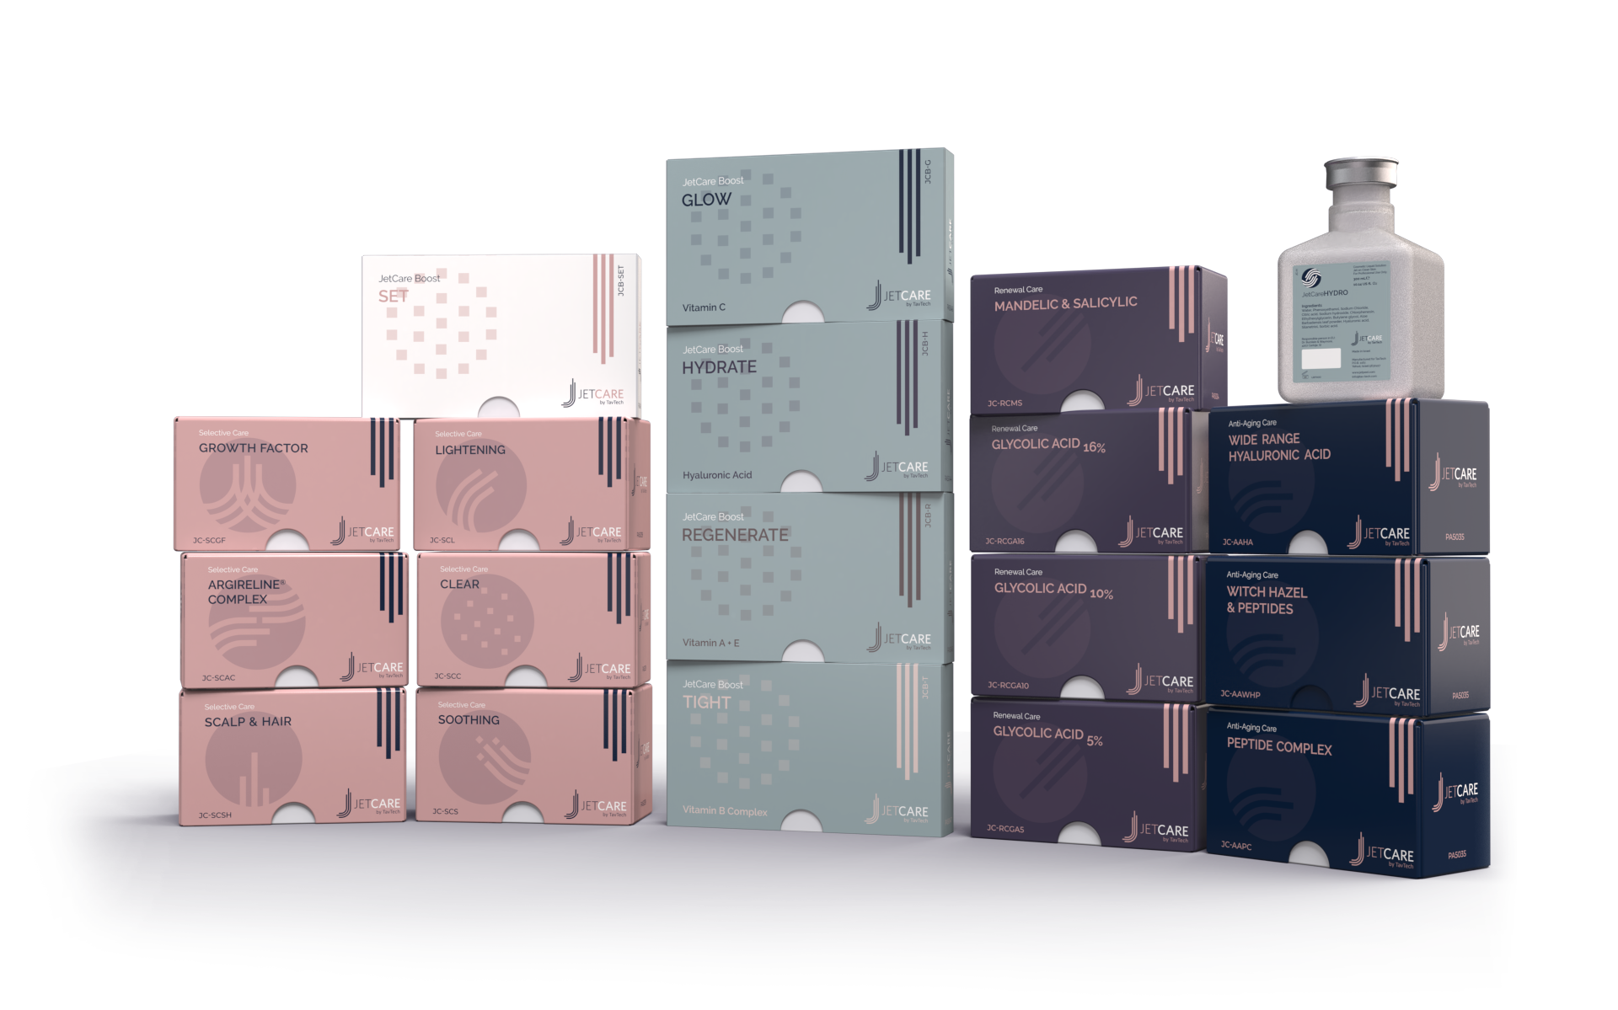
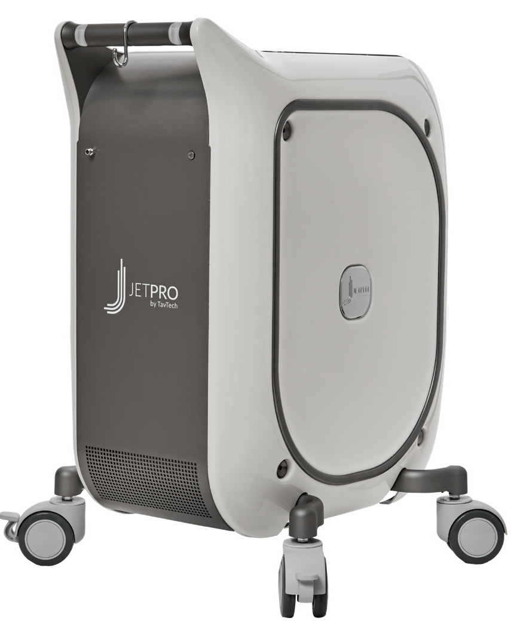
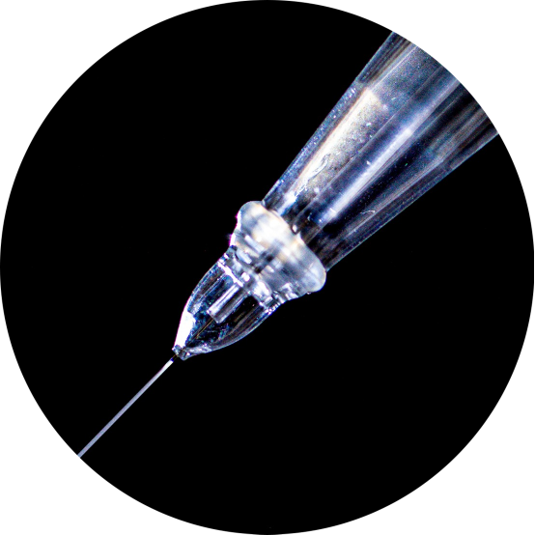
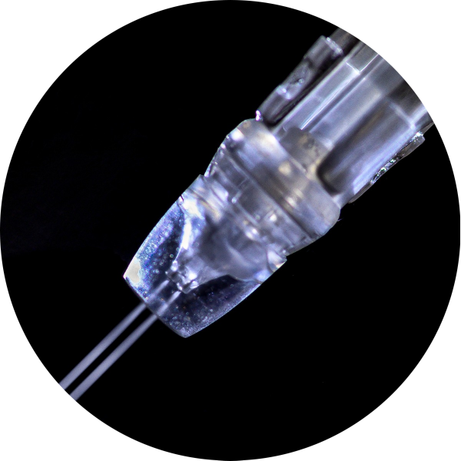
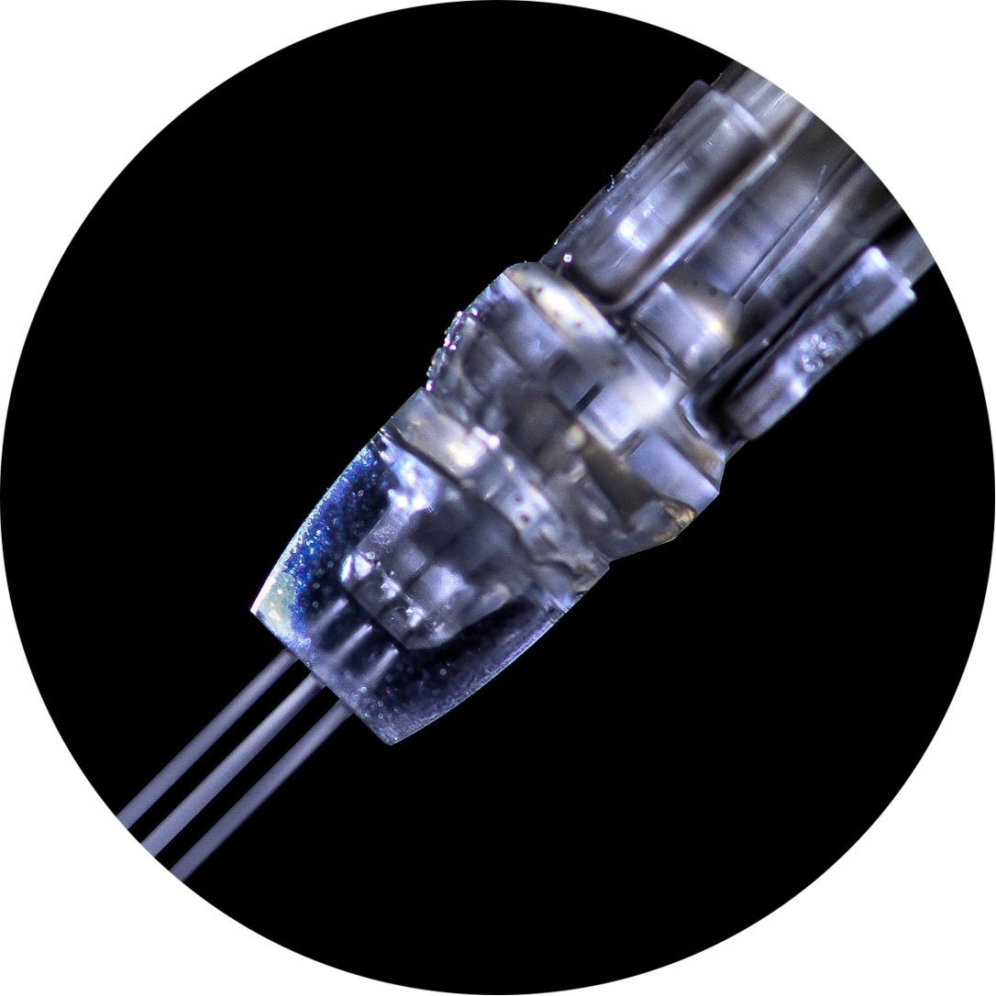
JetPeel by TavTech Academy

Slide 2



We provide people with an opportunity to become the best version of themselves
We believe in making people feel good …

Slide 3
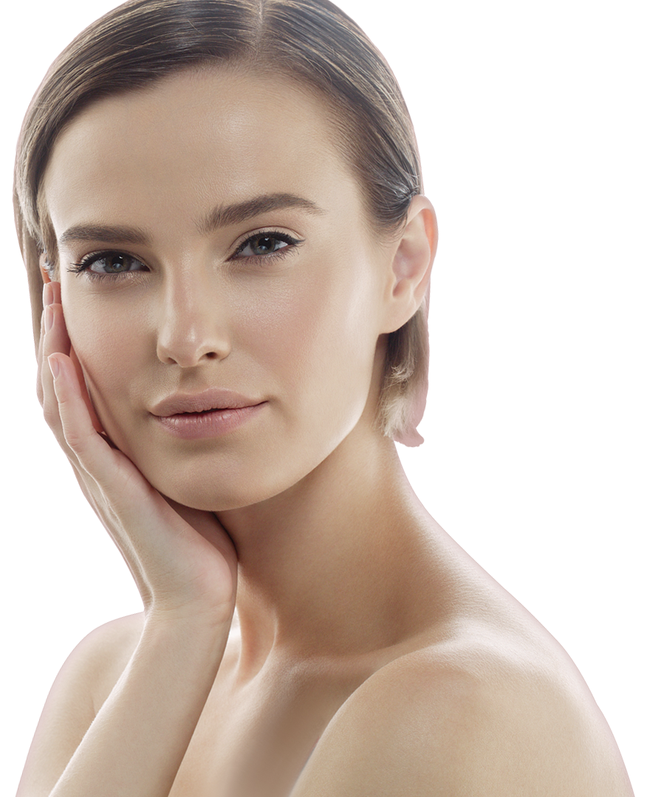
… by delivering
a powerful, instant-result treatment
Suitable for all skin types and all year-round

Slide 4
JetPeel by TavTech Training Program
1. JetPeel Technology and Solutions: Training Introduction
2. Lymphatic Massage with JetPeel
2.1. Lymphatic Massage with JetPeel – Face & Neck
2.2. Lymphatic Massage with JetPeel – Body
3. Exfoliation with JetPeel
3.1. Exfoliation with JetPeel – Face & Neck
4. Infusion with JetPeel
4.1. Infusion with JetPeel – Face & Neck
5. Scalp & Hair with JetPeel
6. JetPeel Handpieces

Slide 5
2.1. Lymphatic Massage with JetPeel
Face & Neck

Slide 6
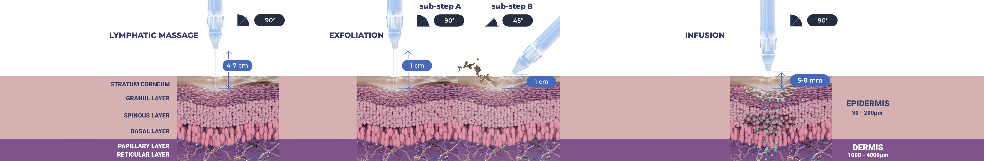
Treatment Sequence for Face and Body
The versatility of JetPeel: Face and Body
Unique jet pressure energy

Slide 7
The treatment sequence
STEP
1
STEP
2
STEP
3
STEP
4
LYMPHATIC
MASSAGE
GENTLE
EXFOLIATION
EFFECTIVE
INFUSION
BOOSTER
INFUSION
A pleasant and relaxing massage for detoxifying the skin and stimulating micro-circulation
Removing dead skin cells prepares the skin to receive the nourishment from the following Infusion Step
This step provides effective and deep delivery of active ingredients into the skin
Post-infusion step to amplify treatment result

Slide 8
The treatment sequence
STEP
1
STEP
2
STEP
3
STEP
4
LYMPHATIC
MASSAGE
GENTLE
EXFOLIATION
EFFECTIVE
INFUSION
BOOSTER
INFUSION
A pleasant and relaxing massage for detoxifying the skin and stimulating micro-circulation
Removing dead skin cells prepares the skin to receive the nourishment from the following Infusion Step
This step provides effective and deep delivery of active ingredients into the skin
Post-infusion step to amplify treatment result

Slide 9

Lymphatic massage with JetPeel
Lymphatic massage can be easily performed to improve circulation, soothing and hydration.
The energy-pressure derived jet stream of microdroplets applied by the non-contact handpiece delivers nutrients to the skin.
The special solution used for the lymphatic massage, JetCare Hydro contains: organic Aloe Vera, low molecular Hyaluronic Acid and Saline.
Lymphatic massage is a therapeutic jet massage treatment. The massage uses gentle pressure and long, gentle, rhythmic strokes to increase the flow of lymph and reduce toxins in your body. The lymph system is part of your body's immune system and helps fight infection.
Lymphatic massage can improve the skin texture by reducing swelling, puffiness and blotches providing clean, healthy pores.

Slide 10


Benefits of the cooling effect of the JetPeel lymphatic massage
The cooling jet sensation causes the lymph vessels to contract, forcing the lymphatic system to pump lymph fluids throughout the body, flushing the waste out of the area. It also activates the body’s natural healing powers that can relieve the symptoms of many medical conditions and promotes a sense of health and well-being, even providing long-lasting changes to your body’s immune, lymphatic, circulatory and digestive systems that enhance the overall quality of your life.

Slide 11
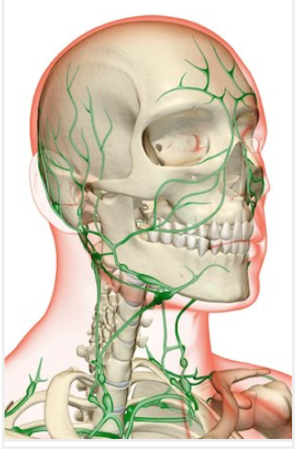
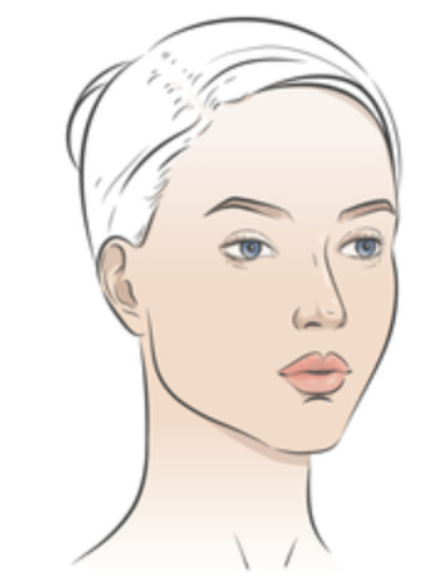
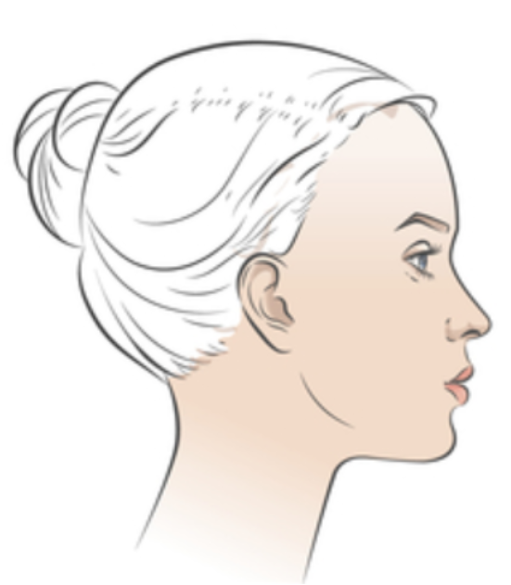
Facial lymph nodes

Slide 12
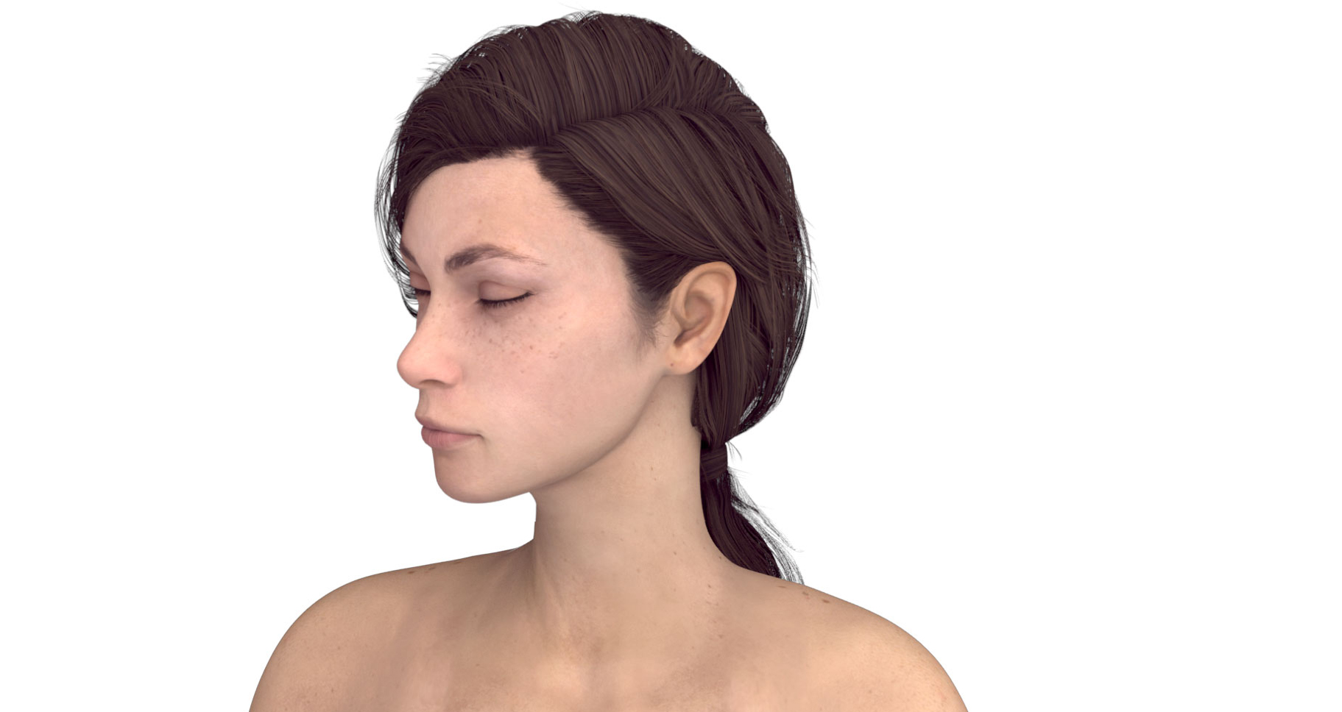
Facial lymph nodes
Preauricular
Posterior auricular
Jugulodigastric
Superficial cervical
Submandibular
Submental
Posterior cervical
Deep cervical chain
Supraclavicular
Supraclavicular

Slide 13
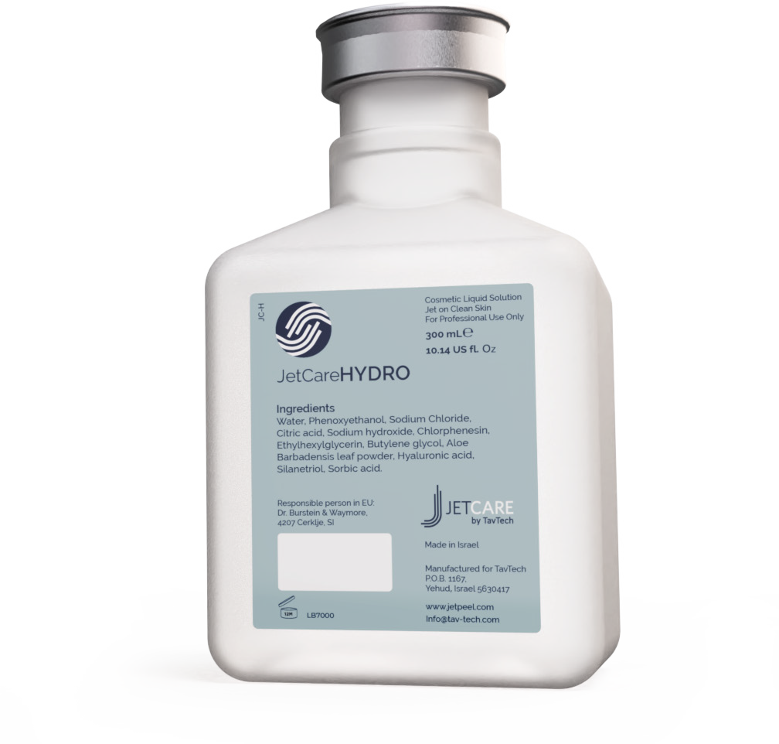
JetCareHYDRO
All JetPeel sessions begin with JetCare Hydro
Gentle solution formulated for the initial lymphatic massage, and to prep the skin for the deeper JetCare treatments
Hyaluronic Acid concentration reformulated, significantly higher than in former version
Enriched with higher concentrations of organic concentrated Aloe Vera
Solid plastic bottle, won’t puncture during transportation
300 ml - 20% more than in former version

Slide 14
Face & neck lymphatic massage
Technique & Sequence

Slide 15
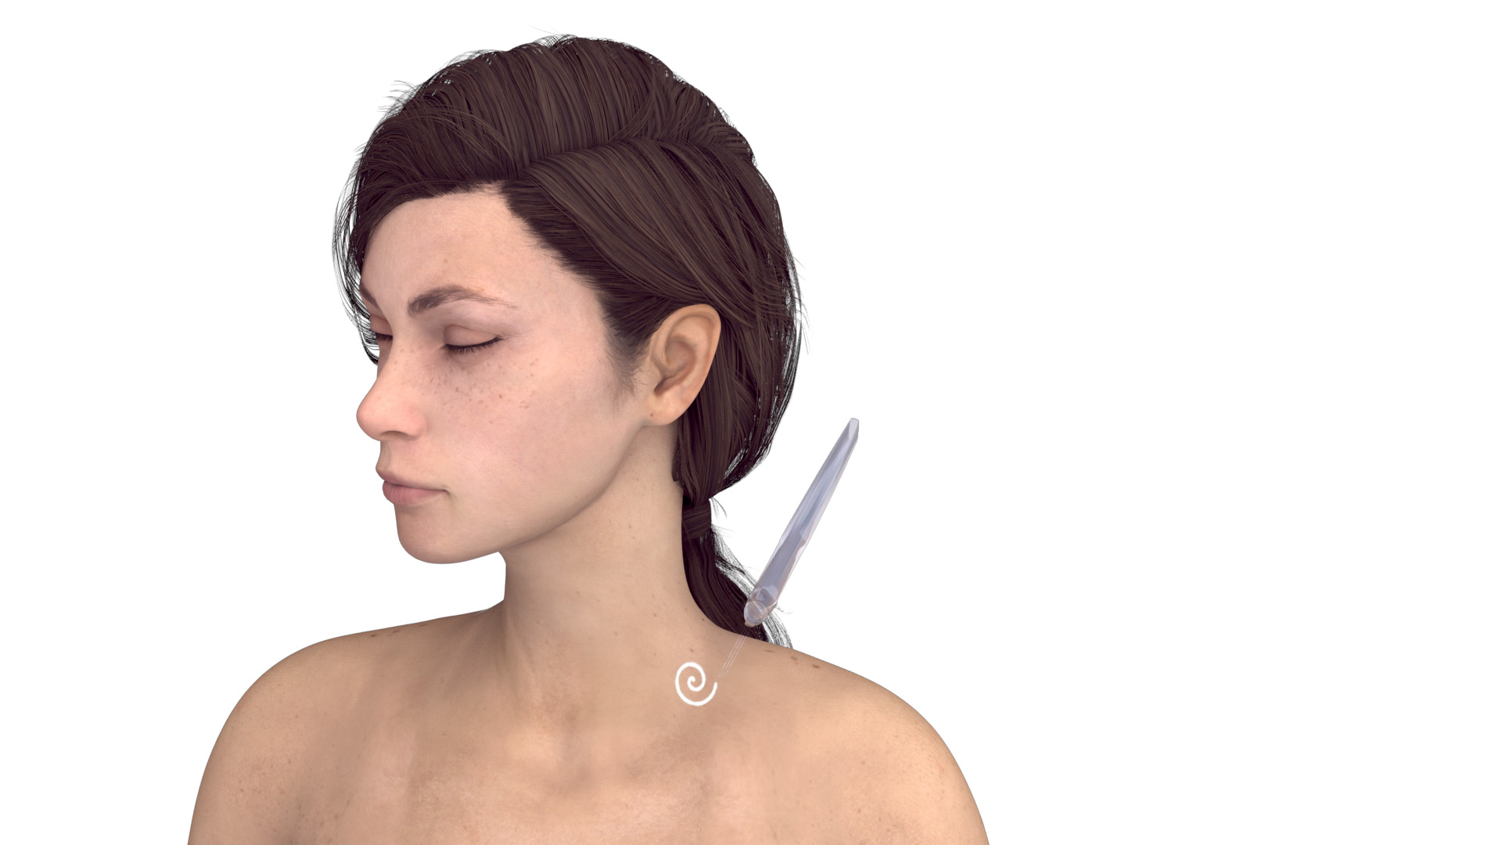
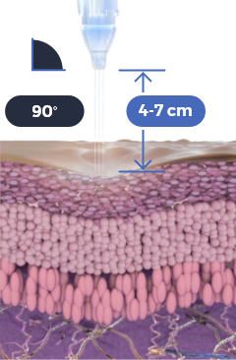

Use the TripleJet handpiece held at 90° to the skin and at 4-7 cm from the skin
Use JetCare Hydro
Repeat 3 times
Start and complete treatment on the left side, only then proceed to treat the right side
Try to keep a consistent pace during the massage

Slide 16




Use the TripleJet handpiece held at 90° to the skin and at 4-7 cm from the skin
Use JetCare Hydro
Repeat 3 times
Start and complete treatment on the left side, only then proceed to treat the right side
Try to keep a consistent pace during the massage

Slide 17
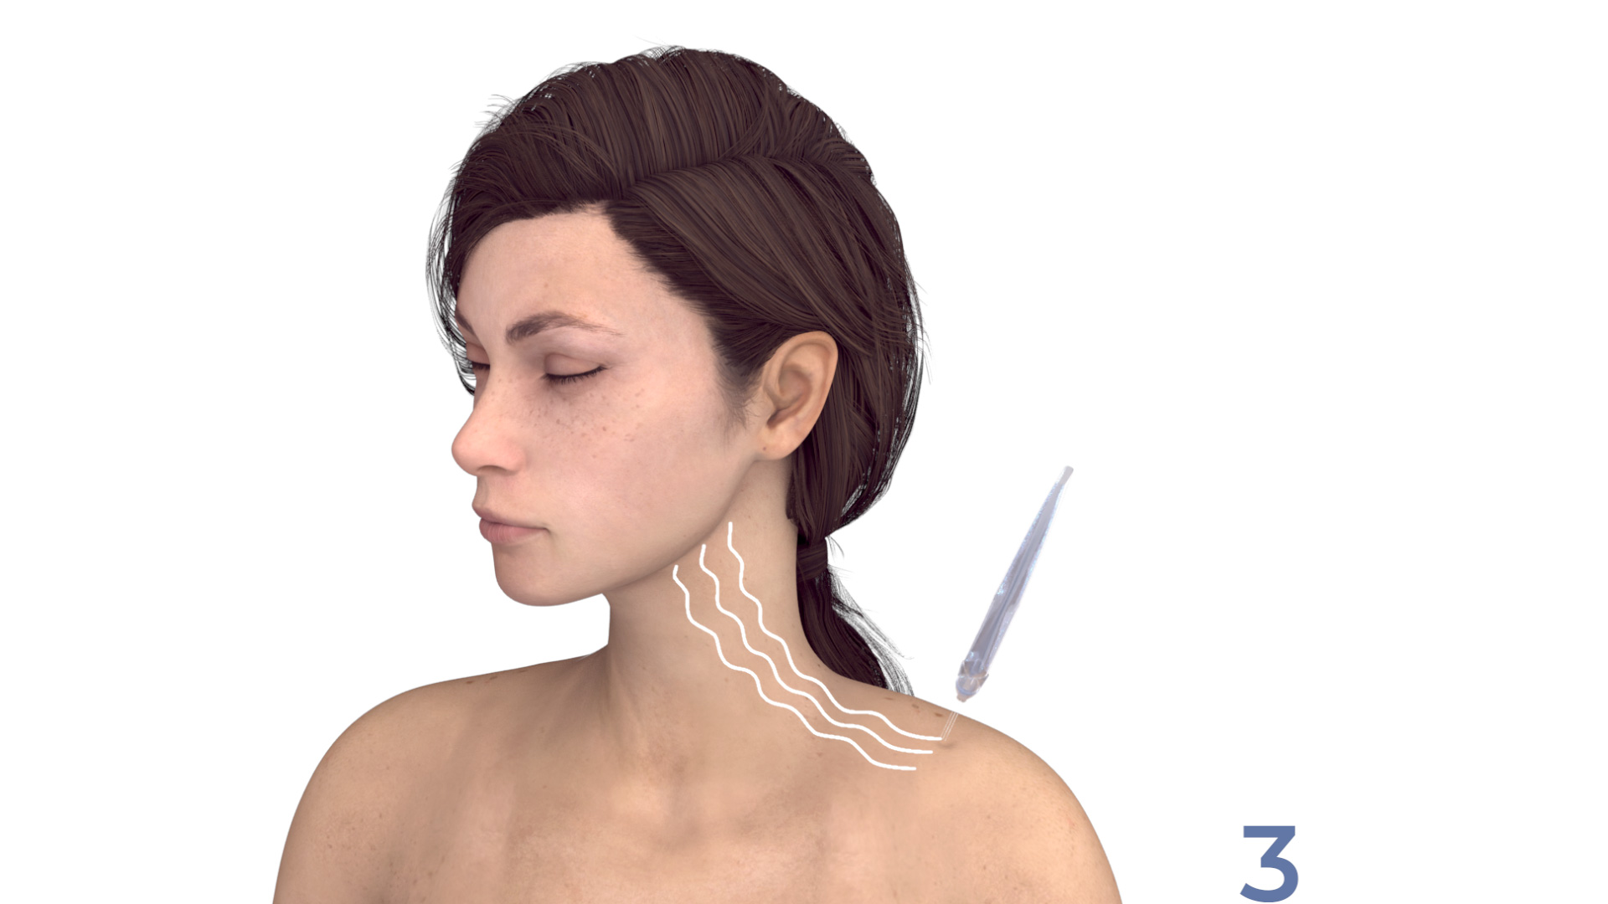



Use the TripleJet handpiece held at 90° to the skin and at 4-7 cm from the skin
Use JetCare Hydro
Repeat 3 times
Start and complete treatment on the left side, only then proceed to treat the right side
Try to keep a consistent pace during the massage

Slide 18


Use the TripleJet handpiece held at 90° to the skin and at 4-7 cm from the skin
Use JetCare Hydro
Repeat 3 times
Start and complete treatment on the left side, only then proceed to treat the right side
Try to keep a consistent pace during the massage

Slide 19


Use the TripleJet handpiece held at 90° to the skin and at 4-7 cm from the skin
Use JetCare Hydro
Repeat 3 times
Start and complete treatment on the left side, only then proceed to treat the right side
Try to keep a consistent pace during the massage

Slide 20


Use the TripleJet handpiece held at 90° to the skin and at 4-7 cm from the skin
Use JetCare Hydro
Repeat 3 times
Start and complete treatment on the left side, only then proceed to treat the right side
Try to keep a consistent pace during the massage

Slide 21


Use the TripleJet handpiece held at 90° to the skin and at 4-7 cm from the skin
Use JetCare Hydro
Repeat 3 times
Start and complete treatment on the left side, only then proceed to treat the right side
Try to keep a consistent pace during the massage

Slide 22


Use the TripleJet handpiece held at 90° to the skin and at 4-7 cm from the skin
Use JetCare Hydro
Repeat 3 times
Start and complete treatment on the left side, only then proceed to treat the right side
Try to keep a consistent pace during the massage

Slide 23


Use the TripleJet handpiece held at 90° to the skin and at 4-7 cm from the skin
Use JetCare Hydro
Repeat 3 times
Start and complete treatment on the left side, only then proceed to treat the right side
Try to keep a consistent pace during the massage

Slide 24


Use the TripleJet handpiece held at 90° to the skin and at 4-7 cm from the skin
Use JetCare Hydro
Repeat 3 times
Start and complete treatment on the left side, only then proceed to treat the right side
Try to keep a consistent pace during the massage

Slide 25


Use the TripleJet handpiece held at 90° to the skin and at 4-7 cm from the skin
Use JetCare Hydro
Repeat 3 times
Start and complete treatment on the left side, only then proceed to treat the right side
Try to keep a consistent pace during the massage

Slide 26


Use the TripleJet handpiece held at 90° to the skin and at 4-7 cm from the skin
Use JetCare Hydro
Repeat 3 times
Start and complete treatment on the left side, only then proceed to treat the right side
Try to keep a consistent pace during the massage

Slide 27


Use the TripleJet handpiece held at 90° to the skin and at 4-7 cm from the skin
Use JetCare Hydro
Repeat 3 times
Start and complete treatment on the left side, only then proceed to treat the right side
Try to keep a consistent pace during the massage

Slide 28


Use the TripleJet handpiece held at 90° to the skin and at 4-7 cm from the skin
Use JetCare Hydro
Repeat 3 times
Start and complete treatment on the left side, only then proceed to treat the right side
Try to keep a consistent pace during the massage

Slide 29
Contraindications
Open wounds
Severe sensitivity to cold
Skin neoplasms
Active cancer
Trigeminal nerve inflammation
Active sinusitis or laryngitis
Active herpes
Active bronchial asthma
Thrombosis
The system has not been tested or evaluated on pregnant or lactating women, nor on children and infants, therefore is not intended for use on these groups of users

Slide 30
JetPeel by TavTech
The perfect trio combining:
The enduring JetPro device
The original patented JetPeel handpieces
The premium JetCare solutions
Designed exclusively for use together to deliver outstanding results

Slide 31
For more information on Lymphatic Massage Techniques with JetPeel check out the following presentations:
Lymphatic Massage with
JetPeel – Body

Slide 32
JetPeel by TavTech Training Program
1. JetPeel Technology and Solutions: Training Introduction
2. Lymphatic Massage with JetPeel
2.1. Lymphatic Massage with JetPeel – Face & Neck
2.2. Lymphatic Massage with JetPeel – Body
3. Exfoliation with JetPeel
3.1. Exfoliation with JetPeel – Face & Neck
4. Infusion with JetPeel
4.1. Infusion with JetPeel – Face & Neck
5. Scalp & Hair with JetPeel
6. JetPeel Handpieces

Slide 33
THANK YOU!

Slide 34
JetPeel by TavTech Academy

