Slide 1


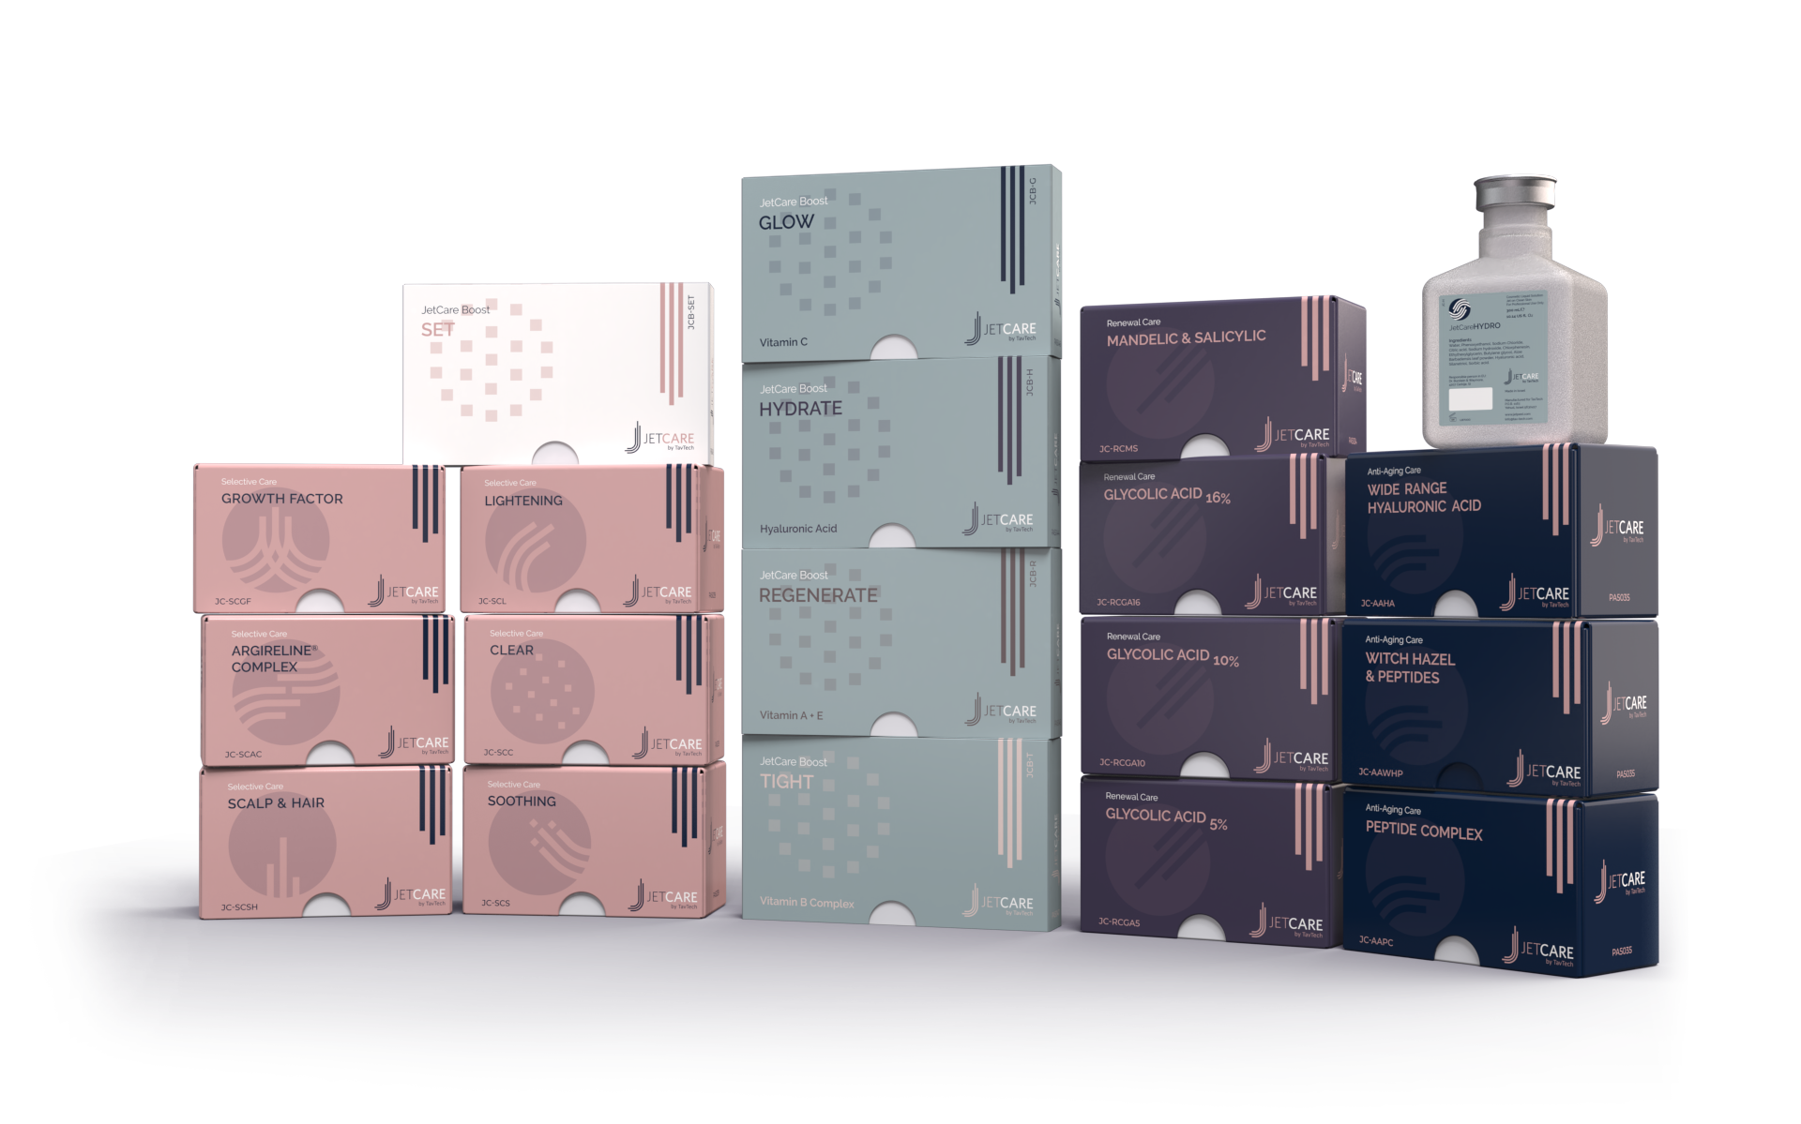
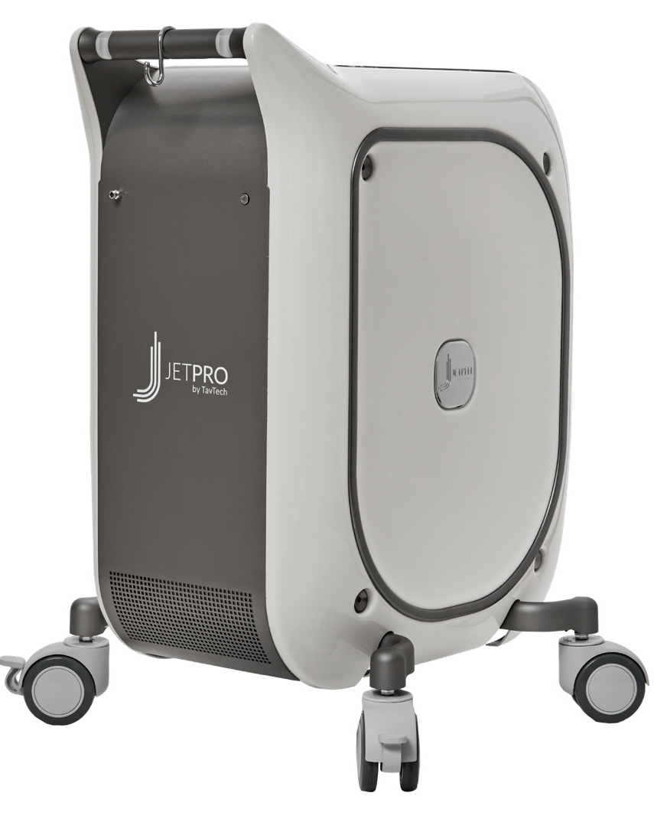
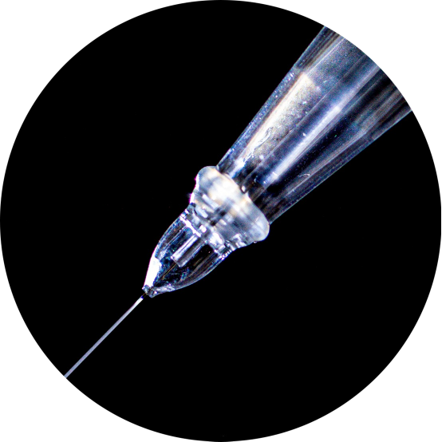
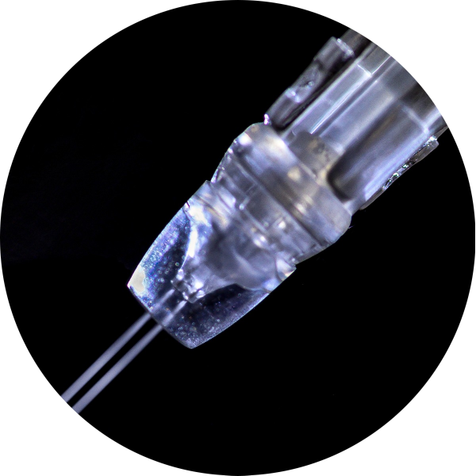
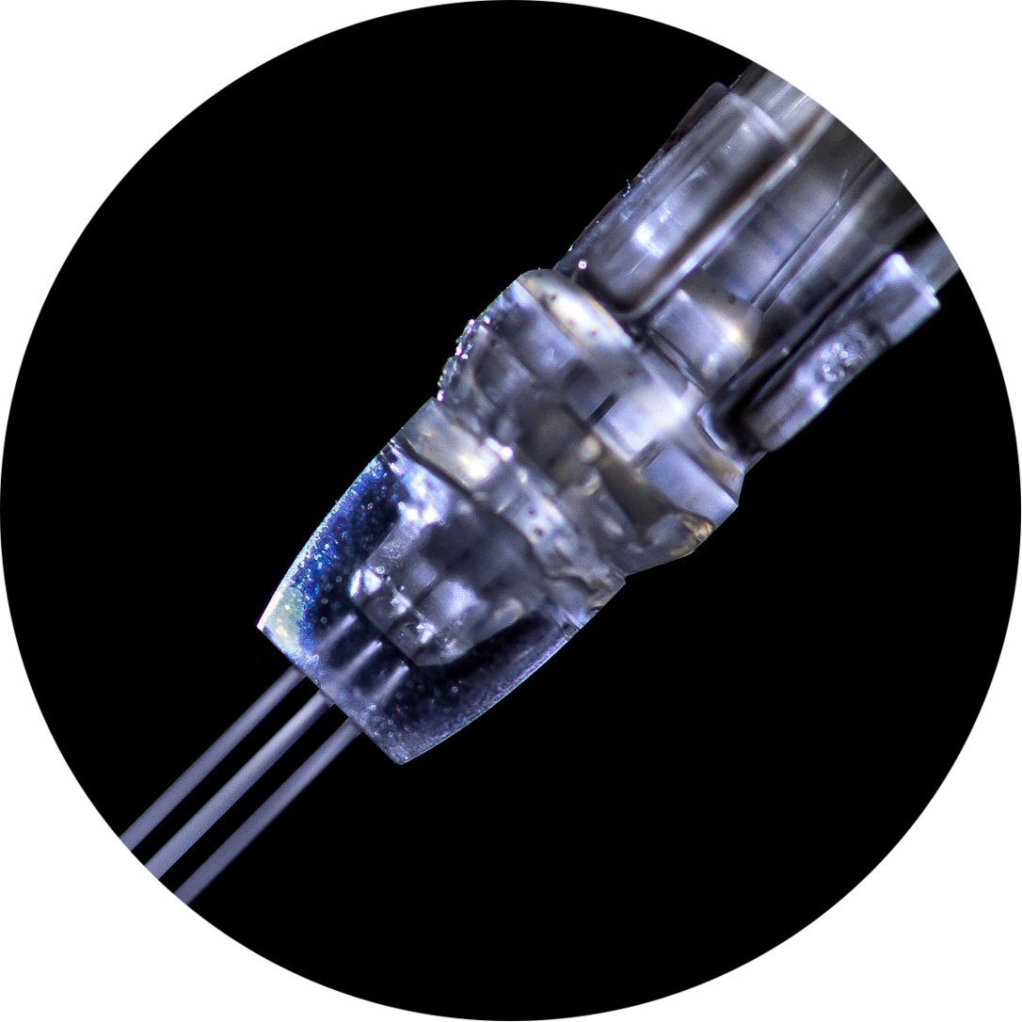
JetPeel by TavTech Academy

Slide 2



We provide people with an opportunity to become the best version of themselves
We believe in making people feel good …

Slide 3
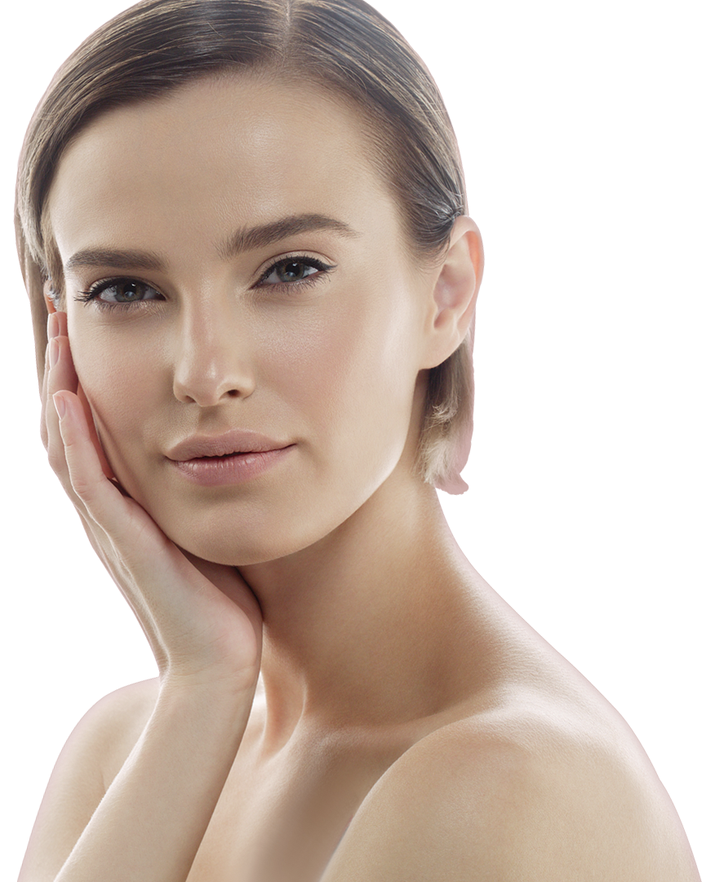
… by delivering
a powerful, instant-result treatment
Suitable for all skin types and all year-round

Slide 4
JetPeel by TavTech Training Program
1. JetPeel Technology and Solutions: Training Introduction
2. Lymphatic Massage with JetPeel
2.1. Lymphatic Massage with JetPeel – Face & Neck
2.2. Lymphatic Massage with JetPeel – Body
3. Exfoliation with JetPeel
3.1. Exfoliation with JetPeel – Face & Neck
4. Infusion with JetPeel
4.1. Infusion with JetPeel – Face & Neck
5. Scalp & Hair with JetPeel
6. JetPeel Handpieces

Slide 5
2. Lymphatic Massage
with JetPeel

Slide 6
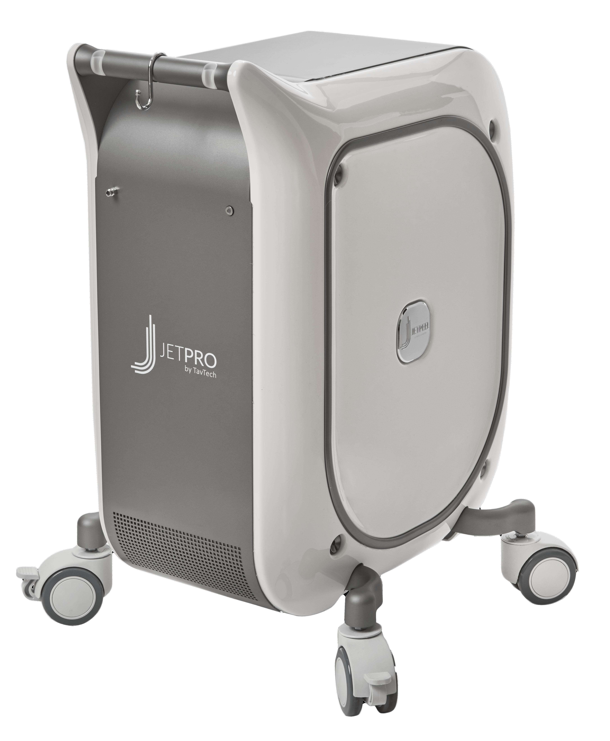






The JetPeel jet pressure energy system provides trans-epidermal infusion of a rich variety of nutrients and solutions
JetPeel System
For the treatment of an array of skincare and aesthetics conditions
Anti-Aging Care
Scalp & Hair
Lightening
Clear
Soothing
Growth Factor
Renewal Care

Slide 7
Handpieces range
Trans-epidermal infusion
delivery system
TripleJet
3 fine nozzles
Utilizing jet propulsion technology for needle-less, pain-free, non-invasive, non-ablative, trans-epidermal delivery
DoubleJet
2 fine nozzles
SingleJet Narrow (Magic)
1 fine nozzle

Slide 8
JetCare -
A variety of solutions, vitamins, minerals and acids
and an array of treatment guidelines

Slide 9
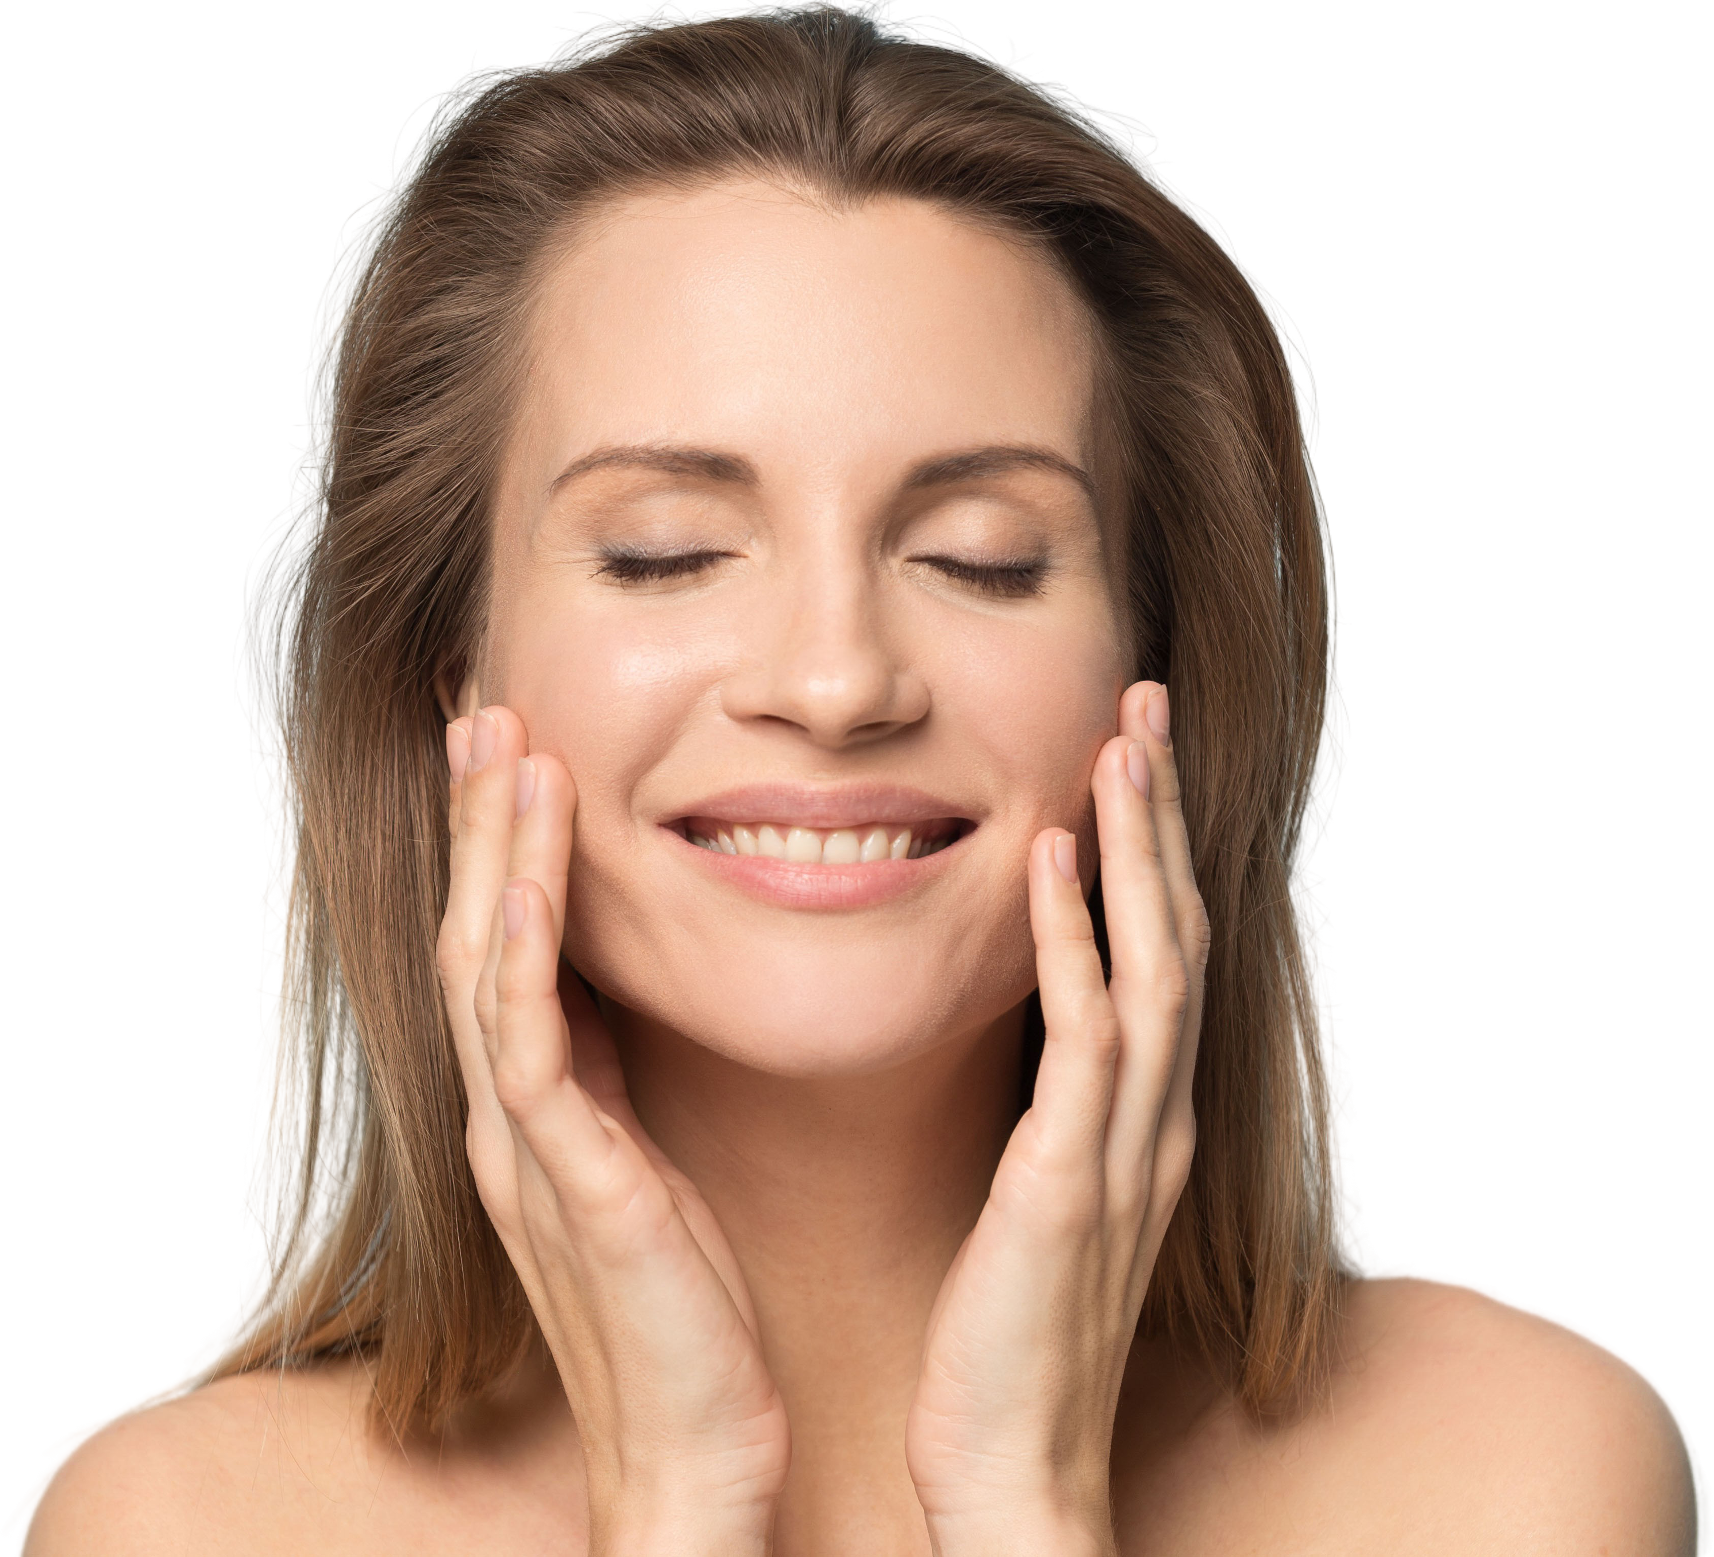
The enduring way to:
JetPeel way
Perform a Lymphatic Massage
Exfoliate
Infuse Skin Nutrients without Needles
Stimulate Collagen and Elastin Fibers
Tighten
Brighten
Eliminate Blemishes
Smooth Skin Imperfections

Slide 10
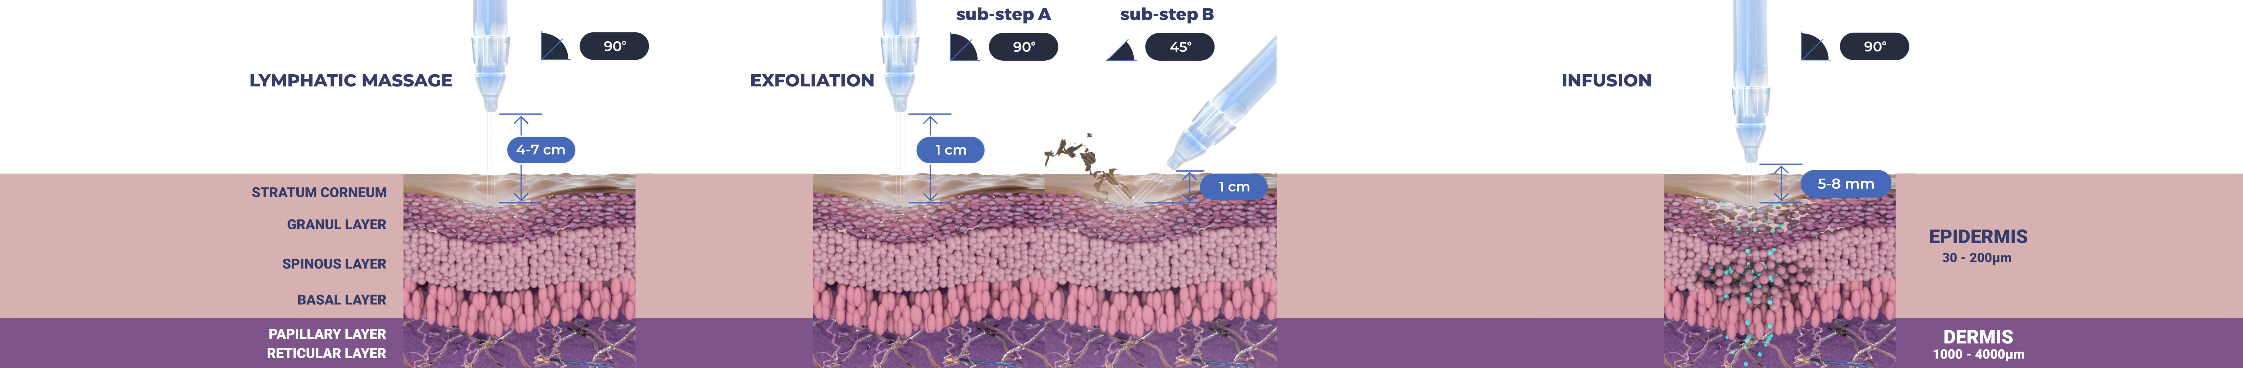
Treatment Sequence for Face and Body
The versatility of JetPeel: Face and Body
Unique jet pressure energy

Slide 11
The treatment sequence
STEP
1
STEP
2
STEP
3
STEP
4
LYMPHATIC
MASSAGE
GENTLE
EXFOLIATION
EFFECTIVE
INFUSION
BOOSTER
INFUSION
A pleasant and relaxing massage for detoxifying the skin and stimulating micro-circulation
Removing dead skin cells prepares the skin to receive the nourishment from the following Infusion Step
This step provides effective and deep delivery of active ingredients into the skin
Post-infusion step to amplify treatment result

Slide 12
The treatment sequence
STEP
1
STEP
2
STEP
3
STEP
4
LYMPHATIC
MASSAGE
GENTLE
EXFOLIATION
EFFECTIVE
INFUSION
BOOSTER
INFUSION
A pleasant and relaxing massage for detoxifying the skin and stimulating micro-circulation
Removing dead skin cells prepares the skin to receive the nourishment from the following Infusion Step
This step provides effective and deep delivery of active ingredients into the skin
Post-infusion step to amplify treatment result

Slide 13
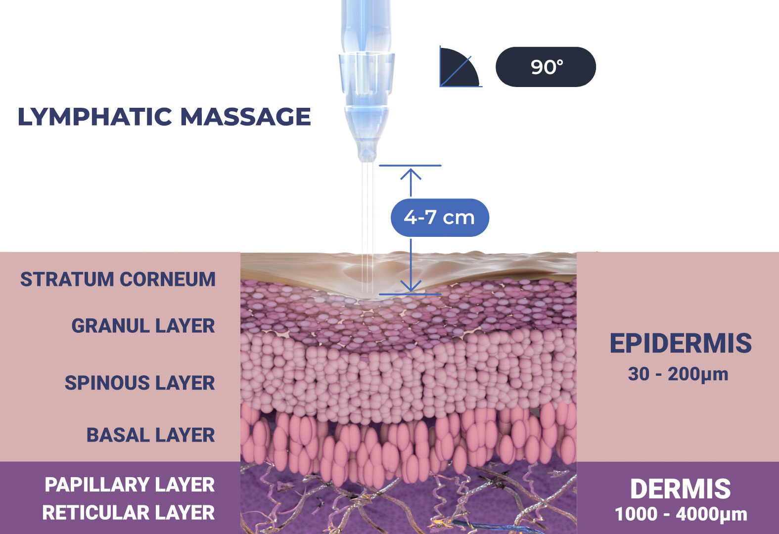
Lymphatic massage

Slide 14

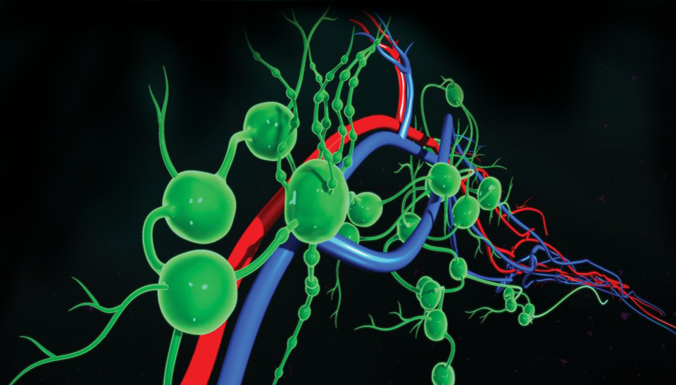

Lymphatic System
The body has two circulatory systems (cardiovascular and lymphatic)
The lymphatic system is a network of vessels and tissues that carry a clear lymph fluid
Lymph means clear water in Latin
The lymphatic system is spread all around the body, it filters and cleans the body from any foreign and dangerous substances.
The lymphatic system works with the cardiovascular system to return body fluids to the blood
Notes:
This therapy can also be beneficial post-surgary

Slide 15
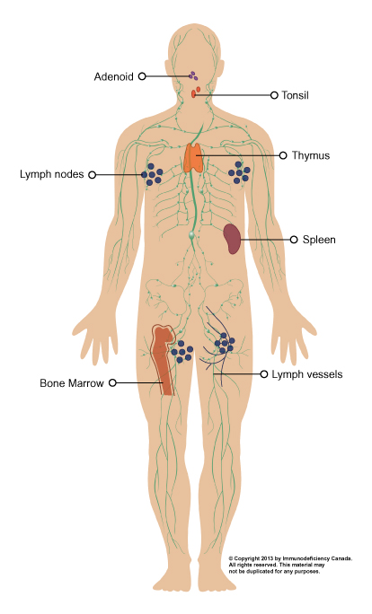
Lymphatic system
The lymphatic system consists of lymphatic vessels, which are similar to the veins and capillaries of the circulatory system.
The vessels are connected to lymph nodes, where the lymph fluid is filtered. The tonsils, adenoids, spleen and thymus are all part of the lymphatic system.

Slide 16
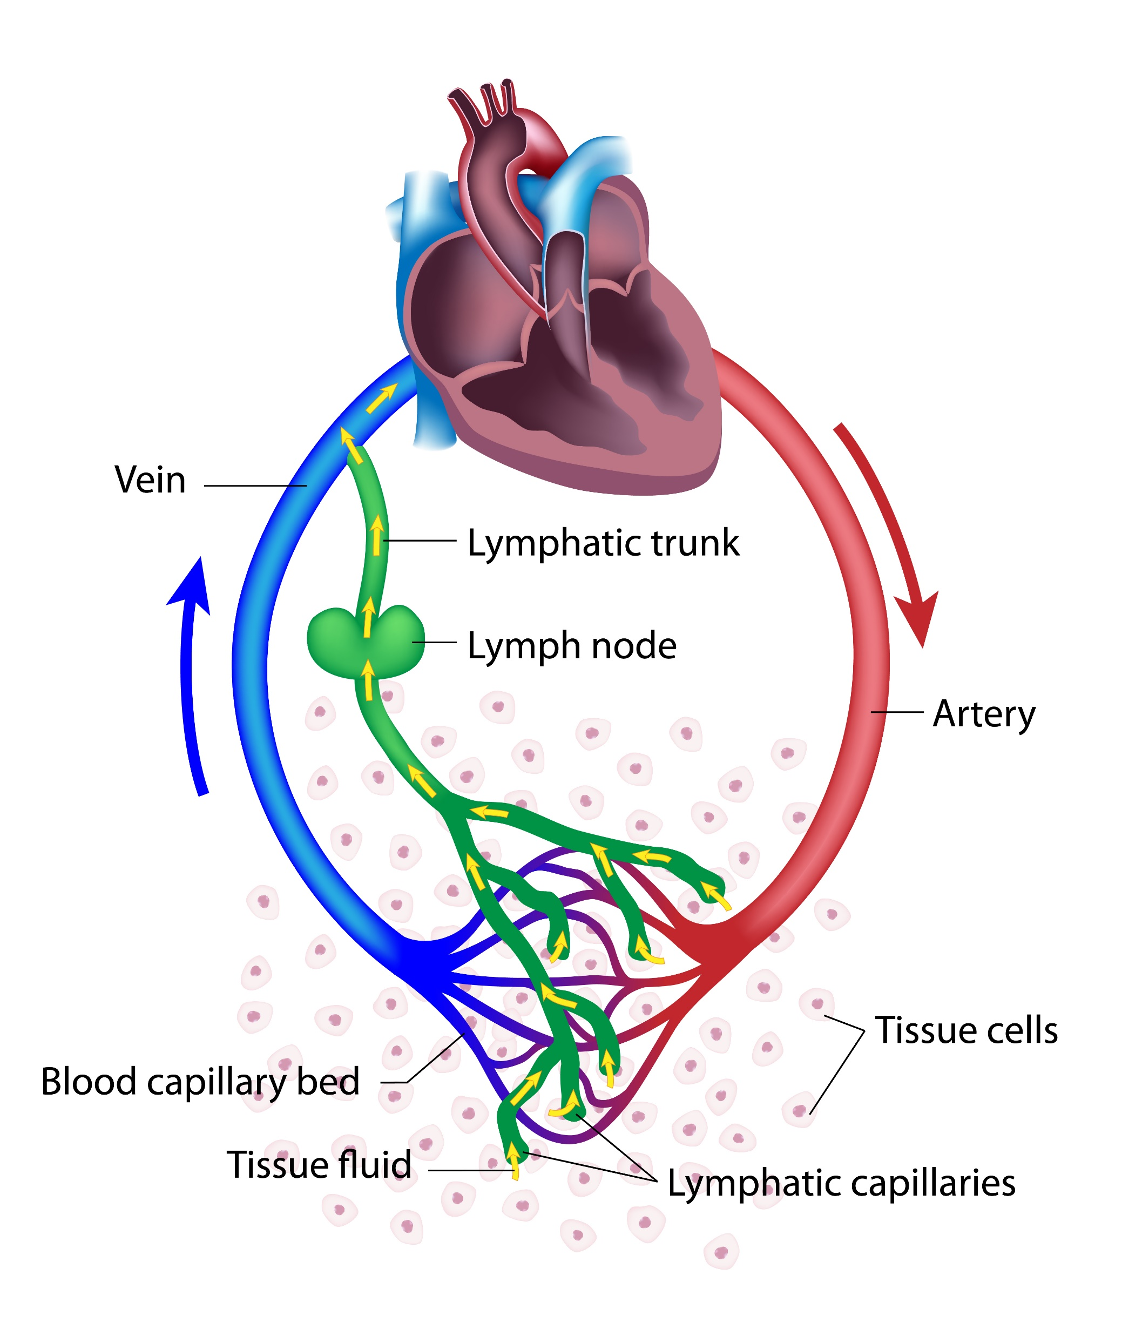
What are the skin lymphatics?
The lymph fluid comes from the blood circulation that goes through the main arteries via high pressure (heart) to arteries branching into the narrow ones until reaching the smallest capillaries.
Every day 20 litres of fluid and proteins seep out from the capillaries in the interstitial fluids between cells.
About 17 litres will be quickly reabsorbed by the capillaries but 3 litres are left behind in the tissues each day. These 3 litres need to find a way back into the blood, so that the interstitial fluid volume and the blood volume stay constant over time.
This is where the lymphatic vessels come to collect interstitial fluids and return them to the blood. Once the interstitial fluid is in the vessels it is called lymph fluid.
The lymph system collects products of tissue metabolism and catabolism, proteins, salts, glucose, fats, water and white blood cells as well as circulating immune cells and transports them to the regional lymph nodes.

Slide 17
Lymphatic system function
The lymphatic system collects excess fluid from the tissues, purifies it and returns it to the blood stream.
This role is important because many substances are continuously leaking out of the blood capillaries into the surrounding tissues.
When the lymphatic system fails to sweep up these excess fluids, they can accumulate, cause swelling and potentially increase the risk of infection.
An efficient lymphatic system helps to defend the body against germs such as bacteria, viruses & fungi that may cause illness.
The lymphatic system drains the fluid into specific regions of the body such as the armpits and groin where there is a concentration of lymph nodes.
The lymph nodes contain lymphocytes (a type of white blood cell) and some of these lymphocytes contain antibodies that fight off germs (including cancer cells) and stop infection from spreading throughout the body.

Slide 18
The lymphatic system has 3 main functions:
1
Returning fluids back to the heart
and maintaining the balance of fluid between the blood and tissues
2
Immune system protector
keeping infection away
Help large molecules like hormones and lipids enter to the blood
3
Notes:
This therapy can also be beneficial post-surgary

Slide 19
What does the lymphatic system do?
Helps the body rid itself of toxins (detoxification) and wastes
Fights infection
Speeds up healing and recovery from illness
Regenerates tissues while normalizing organ function
Enhances metabolism and immune system
Reduces edema (swelling)
Notes:
This therapy can also be beneficial post-surgary

Slide 20
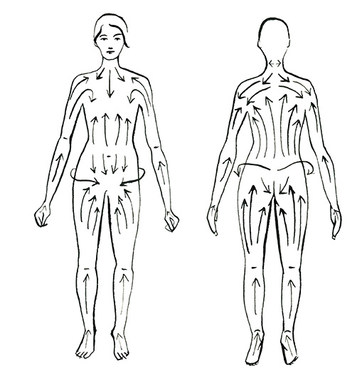
Lymph flow
Unlike blood, which flows throughout the body in a continuous loop, lymph flows in only one direction.
There is no pump pushing into lymphatic system, instead only the squeezing of skeletal muscles creating external pressure, to help lymphatic fluids move.
Image Source: Regency Clinic

Slide 21
Lymph nodes
Lymphatic system
How does the lymphatic system fights infection?
  The lymphatic system produces white blood cells, known as lymphocytes. There are two types of lymphocyte, T cells and B cells. They both travel through the lymphatic system.
  As they reach the lymph nodes, they are filtered and become activated through contact with viruses, bacteria, foreign particles, and so on in the lymph fluid. From this stage, the pathogens, or invaders, are known as antigens.
  Clusters of lymph nodes are concentrated in the neck, armpits, and groin.
  Lymph nodes are filtering stations located along the lymph collectors' paths.
  There are about 600-700 lymph nodes in the human body, about 160 of them are in the neck region alone.
  Every region of the body has its own group of regional lymph nodes.
  They may be described as biological filters, filtering out everything harmful to the body and rendering it harmless of viruses, bacteria, fungi, and so on.

Slide 22
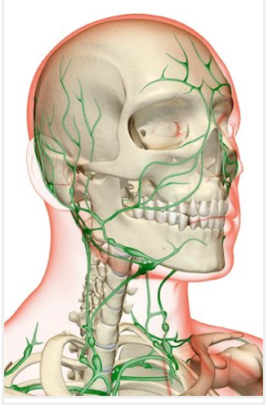
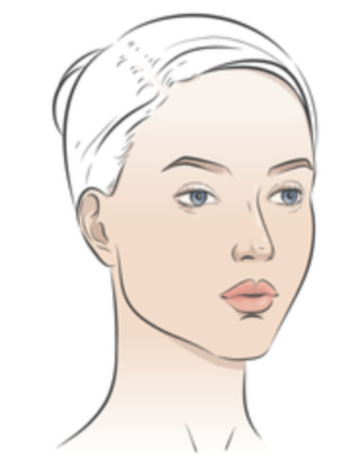
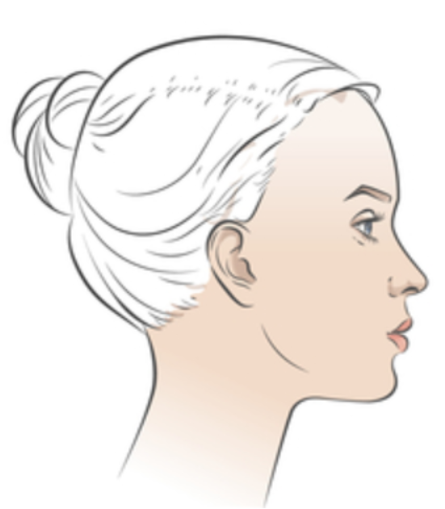
Facial lymph nodes

Slide 23
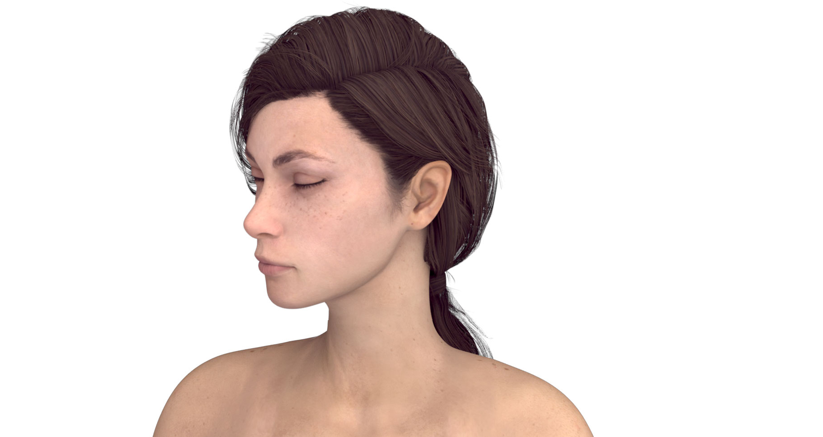
Facial lymph nodes
Preauricular
Posterior auricular
Jugulodigastric
Superficial cervical
Submandibular
Submental
Posterior cervical
Deep cervical chain
Supraclavicular
Supraclavicular

Slide 24
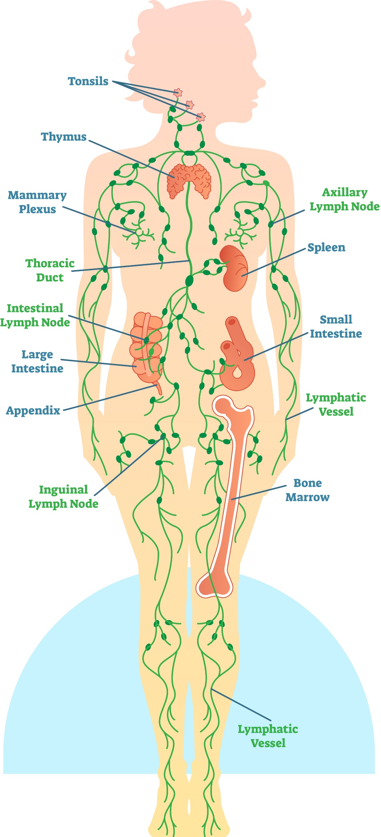
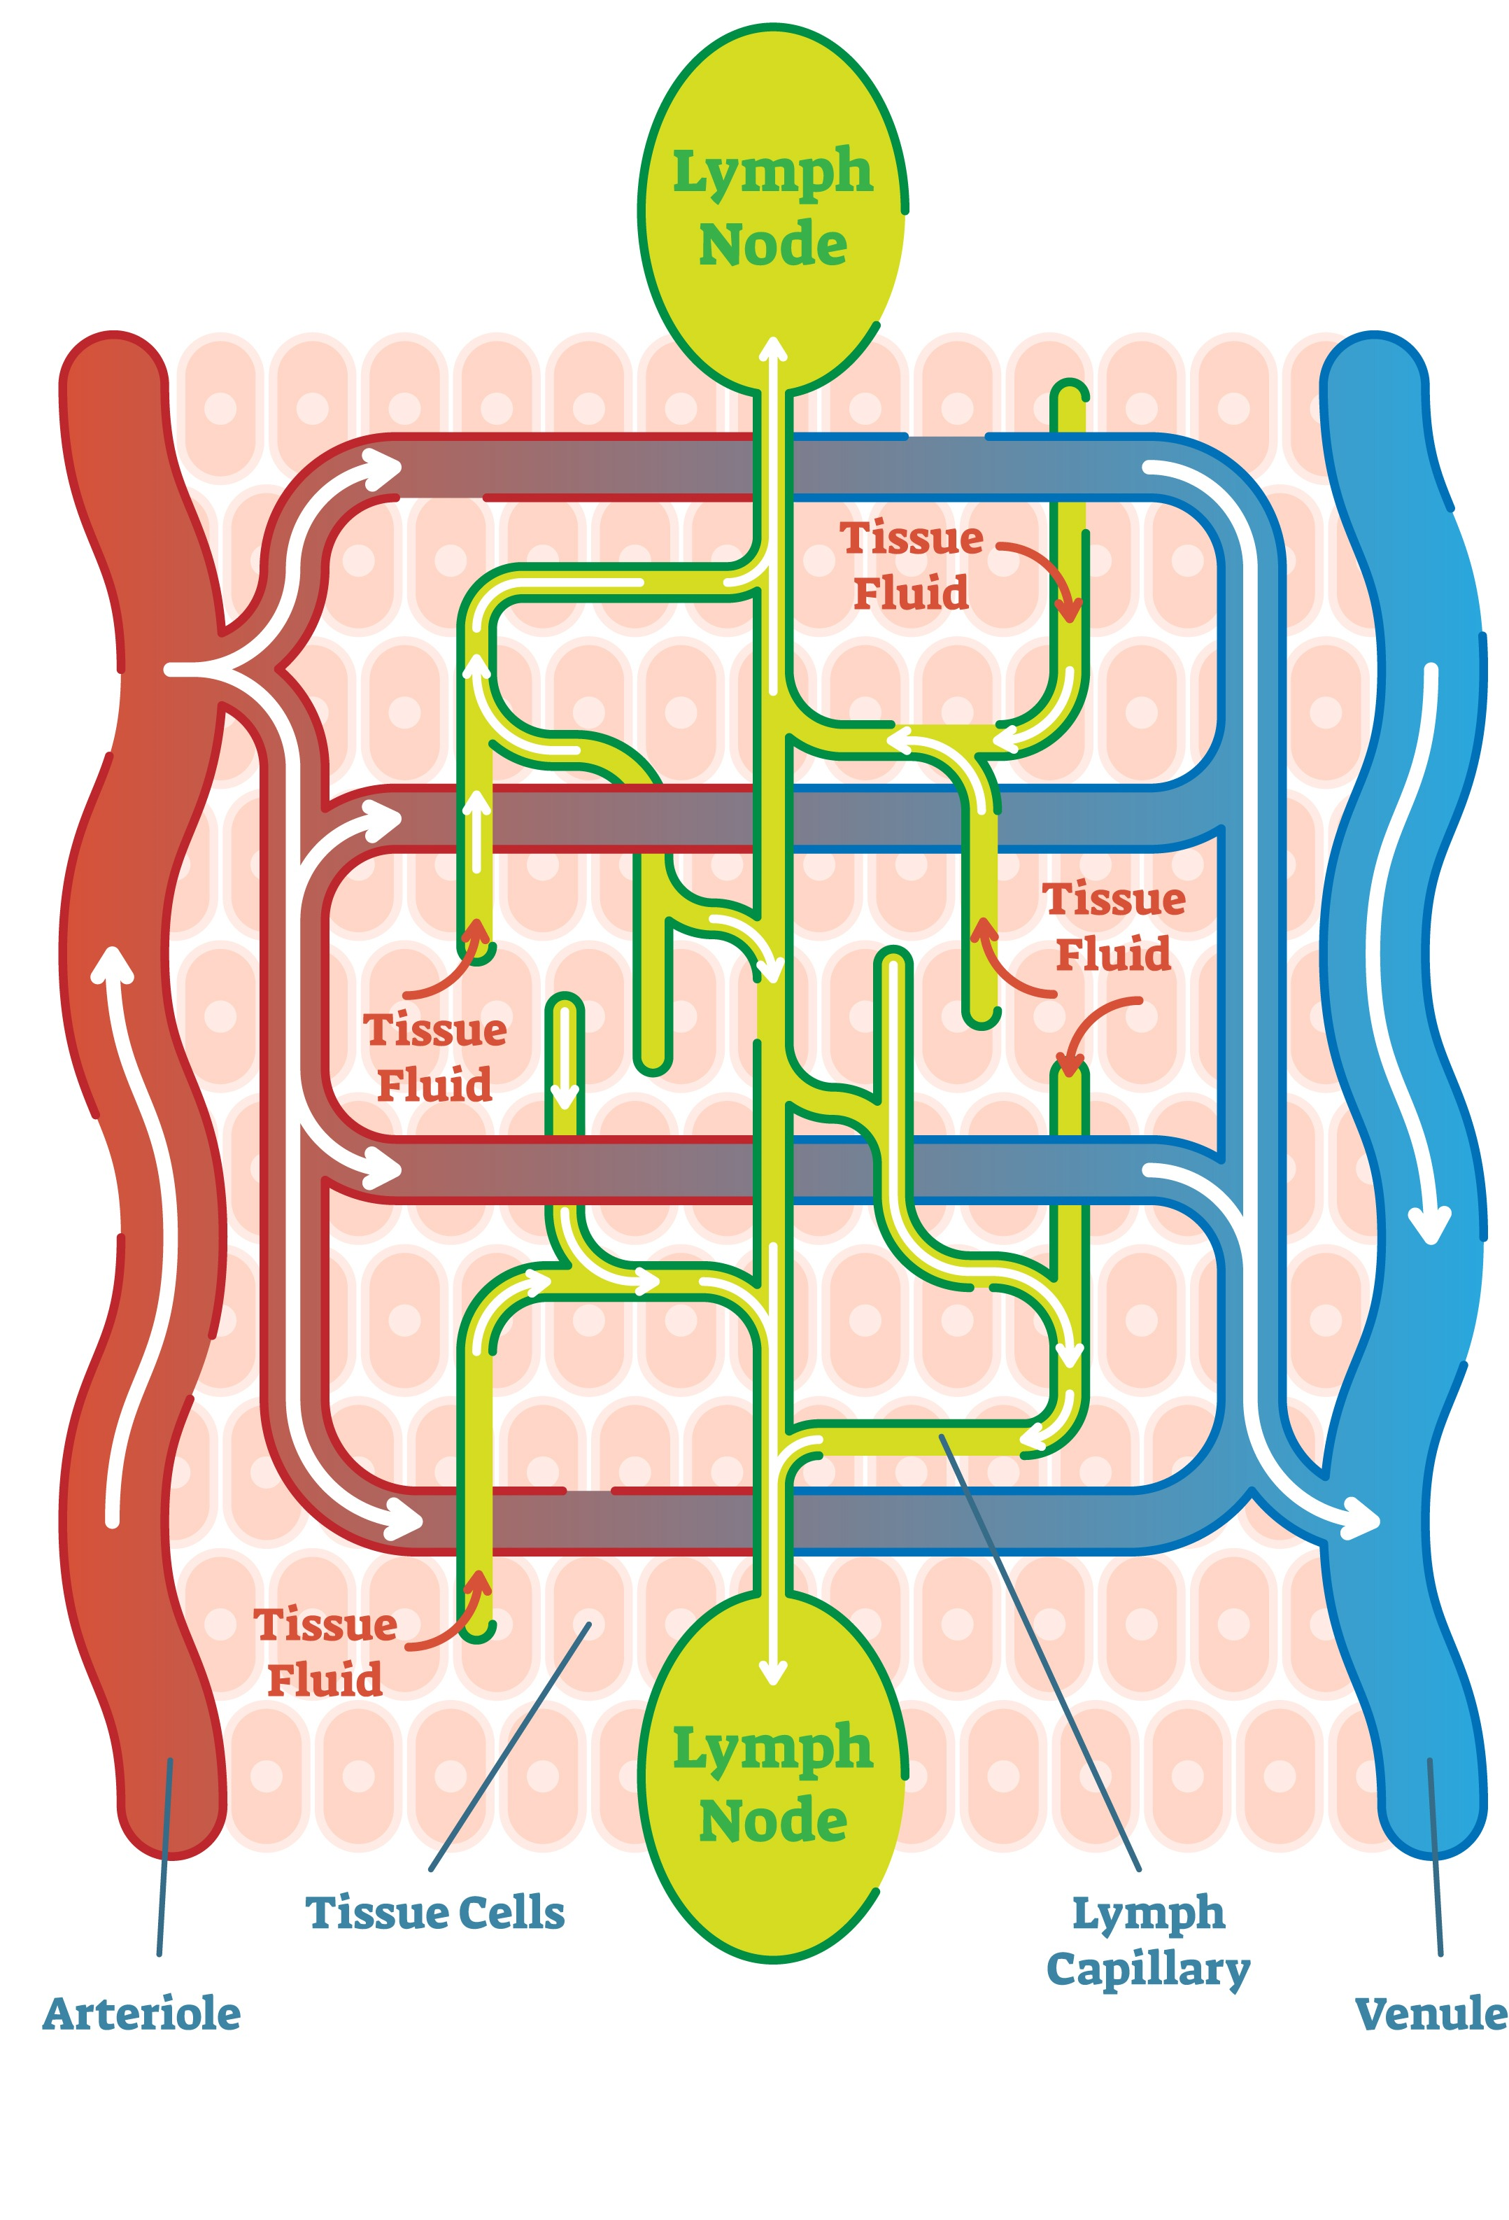
Body lymph nodes

Slide 25
Lymphatic system diseases
The lymphatic system stops working properly if nodes, ducts, vessels, or lymph tissues become blocked, infected, inflamed, or cancerous.
Lymphoma
Cancer that starts in the lymphatic system is known as lymphoma. It is the most serious lymphatic disease. Hodgkin lymphoma affects a specific type of white blood cells known as Reed-Sternberg cells. Non-Hodgkin lymphoma refers to types that do not involve these cells. Cancer that affects the lymphatic system is usually a secondary cancer. This means it has spread from a primary tumor, such as the breast, to nearby or regional lymph nodes.
Lymphadenitis
Sometimes, a lymph node swells because it becomes infected. The nodes may fill with pus, creating an abscess. The skin over the nodes may be red or streaky. Localized lymphadenitis affects the nodes near the infection, for example, as a result of tonsillitis. Generalized lymphadenitis can happen when a disease spreads through the bloodstream and affects the whole body. Causes a range from sepsis to an upper respiratory tract infection.
Lymphedema
If the lymphatic system does not work properly, for example, if there is an obstruction, fluid may not drain effectively. As the fluid builds up, this can lead to swelling, for example in an arm or leg. This is lymphedema. The skin may feel tight and hard, and skin problems may occur. In some cases, fluid may leak through the skin. Obstruction can result from surgery, radiation therapy, injury, a condition known as lymphatic filariasis, or rarely a congenital disorder.

Slide 26
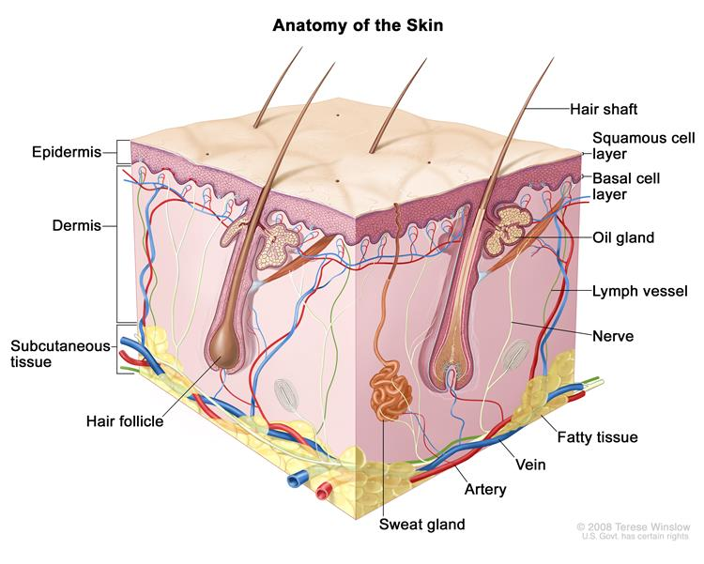
What are the skin lymphatics?
The lymphatic vessels of skin are composed of two twisted parts, one superficial which extends into the dermal papillae near the subpapillary arterial network, which drains vertically into the deep lymphatic plexus below the second arterial network.
To achieve a natural, healthy glow, it is important to nurture our bodies from the inside out, combining skin care with nutritious food, hydration and movement.

Slide 27
Who are lymphatic massage therapy practitioners?

Slide 28
Where can the JetPeel lymphatic massage be used?
The treatment can be easily performed on the entire body to improve circulation, soothing and hydration.
The high velocity, high pressure jet stream of JetCare Hydro microdroplets generated by the JetPeel TripleJet handpiece deliver non-contact organic Aloe Vera, Hyaluronic Acid and Saline to the skin.
The JetPeel lymphatic massage treatment is a real skin fitness workout thanks to the pressurized jet pressure energy stream that awakens and stimulates the skin to rejuvenate cells (fibroblasts) for the production of collagen (firmness), elastin (suppleness), and hyaluronic acid (volume and hydration), naturally present in our skin.

Slide 29
Benefits of lymph massage therapy with JetPeel:
JetPeel way
Lymphatic massage therapy is commonly used for:
  Fighting off infection
  Swollen legs or arms due to fluid retention
  Lymphoedema
  Improving cellulite & fat accumulation
  Speeding up healing and recovery from a cold or flu
  Reducing water retention
  Boosting weight loss
  Reducing scar tissue or stretch marks
  Reducing stress and fatigue
  Helping with post exercise recovery
  Post-mastectomy or breast cancer treatment
Reducing swelling
Detoxification of the body
Relieving inflammation related symptoms
Reducing fatigue
Anti-aging effects
Pain relief
Deep relaxation to aid insomnia, depression, stress

Slide 30
How often does a JetPeel lymphatic massage need to be done ?
1
Frequency:
The number of sessions depend on the skin and blemishes but mostly
4 - 6 treatments once - twice a week are required for maximum benefit.
2
Maintenance:
Once a month
Duration of the complete lymphatic massage:
Face - 10-15 minutes
Body - 30 minutes
3

Slide 31
Lymphatic massage with JetPeel
Lymphatic massage can be easily performed and improves circulation, sooths and hydrates.
The Jet Stream of microdroplets generated by the non-contact JetPeel TripleJet handpiece delivers nutrients to the skin. The JetCare Hydro contains: organic Aloe Vera, Hyaluronic Acid and Saline solution.
Lymphatic massage is a therapeutic jet massage treatment. The massage uses a combination of pleasant pressure and long, gentle, rhythmic strokes to increase the flow of lymph and reduce toxins in your body. The lymph system is part of your body's immune system and helps fight infection.
The JetPeel Lymphatic Massage Therapy Treatment is a real skin fitness workout thanks to pressurized jet stream that awakens and stimulates the skin to rejuvenate cells (fibroblasts) for their production of collagen (firmness), elastin (suppleness), and hyaluronic acid (volume and hydration), naturally present in our skin.
Lymphatic massage can improve the skin texture by reducing swelling, puffiness and blotches providing clean, healthy pores speeding up healing of scar tissue.

Slide 32
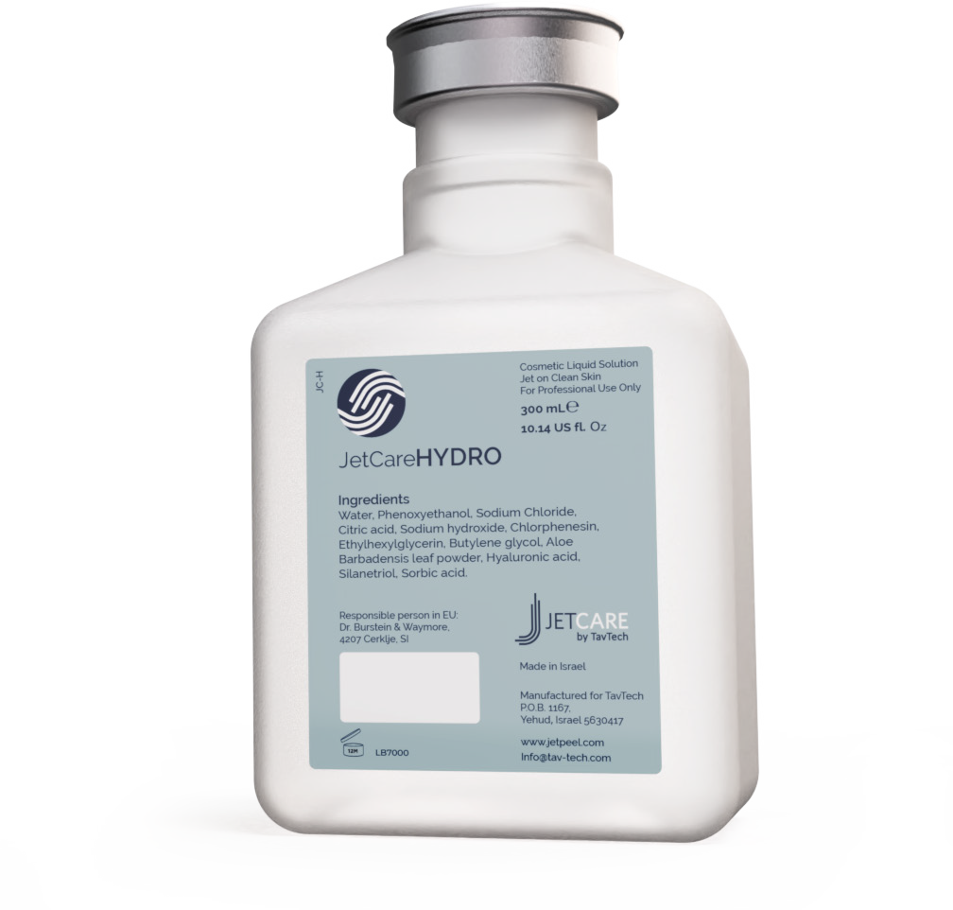
JetCareHYDRO
All JetPeel sessions begin with JetCare Hydro
Gentle solution formulated for the initial lymphatic massage, and to prep the skin for the deeper JetCare treatments
Hyaluronic Acid concentration reformulated, significantly higher than in former version
Enriched with higher concentrations of organic concentrated Aloe Vera
Solid plastic bottle, won’t puncture during transportation
300 ml - 20% more than in former version

Slide 33
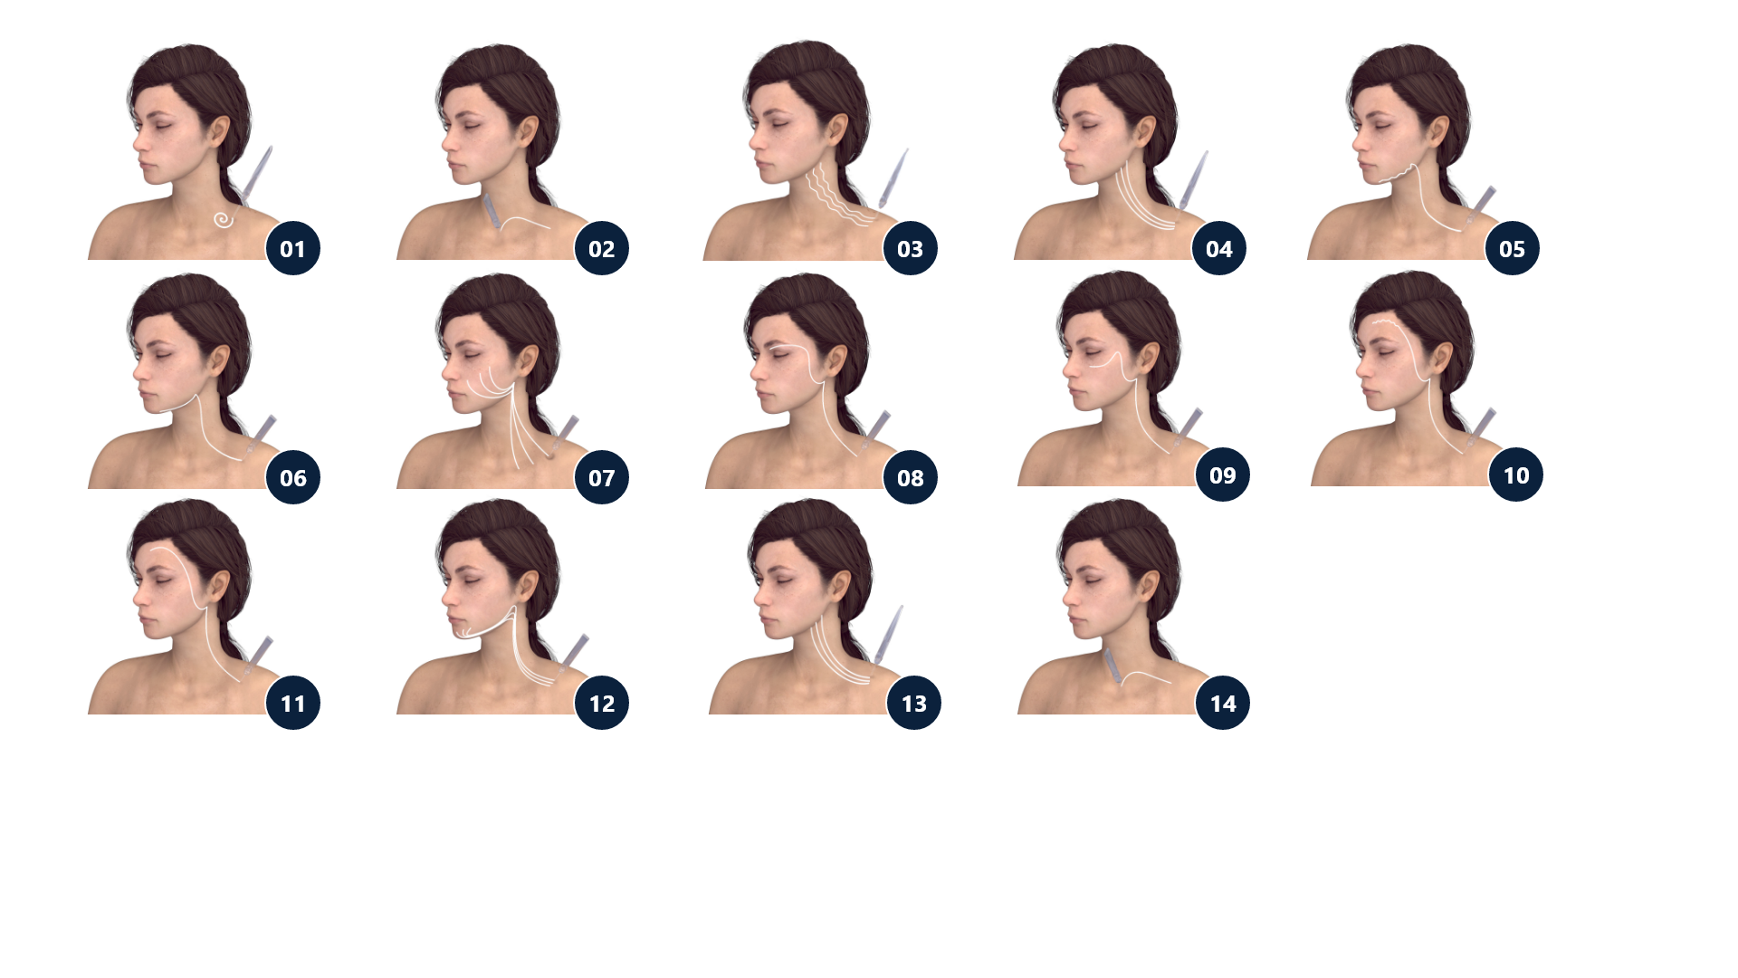
Lymphatic massage technique with JetPeel
Use ~18ml of JetCare Hydro solution.
Use the TripleJet handpiece and keep distance from skin 4-7cm.
Massage the skin 10-15 minutes as shown.

Slide 34


Benefits of the cooling effect of the JetPeel lymphatic massage
The cooling jet sensation causes the lymph vessels to contract, forcing the lymphatic system to pump lymph fluids throughout the body, flushing the waste out of the area. It also activates the body’s natural healing powers that can relieve the symptoms of many medical conditions and promotes a sense of health and well-being, even providing long-lasting changes to your body’s immune, lymphatic, circulatory and digestive systems that enhance the overall quality of your life.

Slide 35
Lymphatic massage for:
Detoxing, Rejuvenating, Anti-inflamming, De-stressing
Reduce the chance of suffering from minor colds and viruses; it helps the body fight off infection and speeds up healing and recovery from illness. It helps reduce water retention; for instance, because the lymph system has no pump, when sitting for a long time without moving, the lymph can't flow easily — this may lead to swollen feet or fingers.
Boost weight loss. Improving the lymphatic system improves the metabolic rate, which helps burn calories more efficiently.
Lymphatic massage can improve the skin texture by: reducing swelling, puffiness and blotches providing clean, healthy pores, speeding up healing of scar tissue, and so it may, for example, improve the appearance of stretch marks.
Helps to reduce cellulite: increases blood flow and circulation to the affected areas, which helps the body break down the toxins which cause dimply skin.

Slide 36
Contraindications
Open wounds
Severe sensitivity to cold
Skin neoplasms
Active cancer
Trigeminal nerve inflammation
Active sinusitis or laryngitis
Active herpes
Active bronchial asthma
Thrombosis
The system has not been tested or evaluated on pregnant or lactating women, nor on children and infants, therefore is not intended for use on these groups of users

Slide 37
JetPeel by TavTech
The perfect trio combining:
The enduring JetPro device
The original patented JetPeel handpieces
The premium JetCare solutions
Designed exclusively for use together to deliver outstanding results

Slide 38
For more information on Lymphatic Massage Techniques with JetPeel check out the following presentations:
Lymphatic Massage with
JetPeel – Face & Neck
Lymphatic Massage with
JetPeel – Body

Slide 39
JetPeel by TavTech Training Program
1. JetPeel Technology and Solutions: Training Introduction
2. Lymphatic Massage with JetPeel
2.1. Lymphatic Massage with JetPeel – Face & Neck
2.2. Lymphatic Massage with JetPeel – Body
3. Exfoliation with JetPeel
3.1. Exfoliation with JetPeel – Face & Neck
4. Infusion with JetPeel
4.1. Infusion with JetPeel – Face & Neck
5. Scalp & Hair with JetPeel
6. JetPeel Handpieces

Slide 40
THANK YOU!

Slide 41
JetPeel by TavTech Academy

